Slide 1
Losses at PS Injection
S. Aumon, W. Bartmann, H. Bartosik, J. Borburgh, S. Gilardoni, B. Goddard, O. Hans, F. Peters, R. Steerenberg

Slide 2
Contents
Motivations
Losses due to the incoming beam
Possible cures
Turn by turn losses
Aperture Scan

Slide 3
Motivations
Understand losses from the high intensity beams at injection
Radiation protection issue
Important also for the 2 GeV PS upgrade

Slide 5
Losses due to the incoming beam
Injection Septum 42

Slide 6
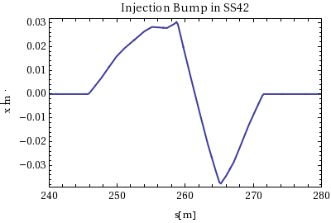
Injection in the PS
4 bumpers in SS-41-42-43-44
Kicker at pi/2 in SS45
Bump shape chosen in the past to save a bit of kicker strength
since the angle of the injection line with respect to the closed orbit is important.

Slide 7
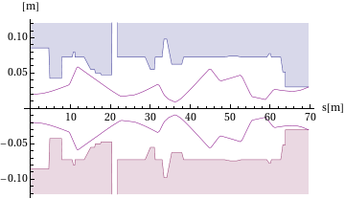
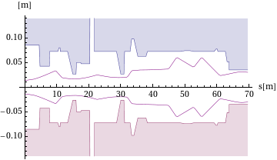
Aperture available
eHor(RMS)= 12mm.mmrad
eVer=10mm.mrad
normalised
3sigma

Slide 8
Losses due to the incoming beam
3%
1%
ToF beam full intensity
800e10
eHor(RMS)=12mm.mrad
MD beam
100e10
eHor(RMS)=5mm.mmrad

Slide 9
Losses due to the incoming beam
Injection tuned with respect to the minimization of the losses, injection beam oscillation.
Rende: the beam is put very close to the septum blade to minimize the kicker strength (limitation)

Slide 10
Possible cures
Minimize the beam size at least in the horizontal plane (possibly both)
From existing : QKE quadrupoles+collimation in the line
From existing : triplets of gammajump quadrupoles+collimation in the line
New insertion based on the QKE scheme
One of this solution+2GeV upgrade (2 injection kickers)

Slide 11
Upgrade of the BTP line (Wolfgang Bartmann)
Two new quadrupoles in the BT-BTP line and use of the BTPQNO10 (quad in the wall) allow to gain more flexibility in optics matching to provide small horizontal beam size
Betax=5m and Dx=1.84 m (11% betatron mismatch)

Slide 12
BT line: recombination of the 4 rings from the Booster extraction
BTP: Booster to PS, after BT line
Courtesy S. De Man

Slide 13
Existing QKE scheme

Slide 14
Existing QKE scheme
Θ~ x/Sqrt(betax42*betax45)
To be checked with W. Bartmann
Vertical Collimator in the BTBTP line

Slide 15
Existing gamma jump scheme
From M. Martini

Slide 16
Existing triplets gamma jump quadrupoles
Would not reduce the losses in SS43

Slide 17
Other scenario
Same scheme as the QKE but in the injection region
New insertion with new quads etc..
Upgrade @ 2 GeV: natural gain the beam size
For the moment no data about what would be the emittances coming from the Booster (the computations are done with the same emittances as now)

Slide 18
Existing QKE scheme

Slide 19
Injection in the PS
4 bumpers in SS-41-42-43-44
Kicker at pi/2 in SS45
Bump shape chosen in the past to save a bit of kicker strength
since the angle of the injection line with respect to the closed orbit is important.

Slide 20
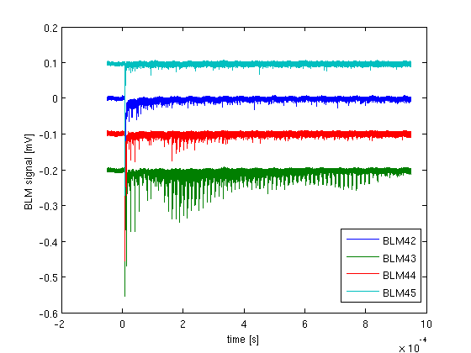
Turn by turn losses after injection: CNGS beam

Slide 21
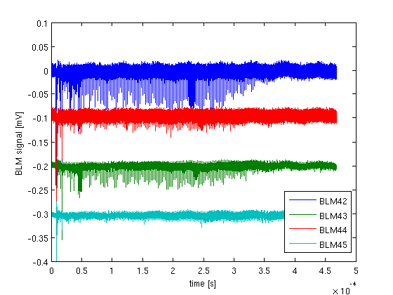
Turn by turn losses after injection: TOF beam

Slide 22
Aperture Scan
Flat bottom magnetic cycle
Small single bunch beam
1.84mm.mrad Hor emittance normalised
Intensity: 70e10 protons
Second injection bump
Variation of the Radial position during the bump

Slide 23
Injection in the PS

Slide 24
BLM42 signal
8mm
BLM signal (V)
Rpos=15mm
Rpos=20mm
38mm/sigmaRMS=12
time

Slide 25
Space Charge (First try with PTC-Orbit)
ToF beam
After 20 turns
PTC-Orbit simulation
(Thanks a lot to Hannes !!!!!)
- Confirm what Elias said in the past

Slide 26
Turn by turn losses
Studying process which repopulates the tail of the beam
The main candidate is the space charge which might repopulated the tail turn after turn+ due to synchrotron motion and high chromaticity (xih=-1)
Some particles might also cross resonances
Working point scan on going this week

Slide 27
Thank you for your attention !!

Slide 28
Estimation of the coherent tune shift due to the space charge at injection in the vertical plane
26 GeV/c
1.4 GeV/c
Estimated tune shift due to Space charge with analytical formulas
Total vertical tune shift
Estimation!
ΔQ-Space charge ~ ¼ Total measured ΔQ at injection

