Slide 1
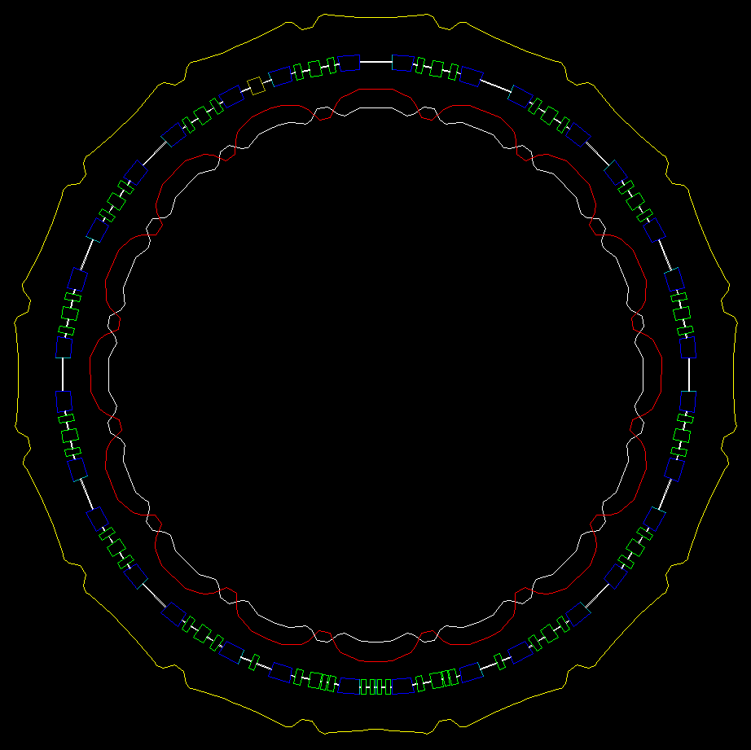
Status of space charge studies and simulations in the PS Booster
LIS meeting, 22-10-2012
Vincenzo Forte
Acknowledgements: E. Benedetto, C. Carli, S. Hancock, A. Molodozhentsev

Slide 2
Presentation outline
Evolution of space charge studies (MD) compared with PTC-Orbit simulations
Behavior for shorter bending magnets at injection (PTC-Orbit simulations)
New useful tools for simulations
Last MDs measurements and studies
Next goals
Status of space charge studies and simulations in the PS Booster – Vincenzo Forte

Slide 3
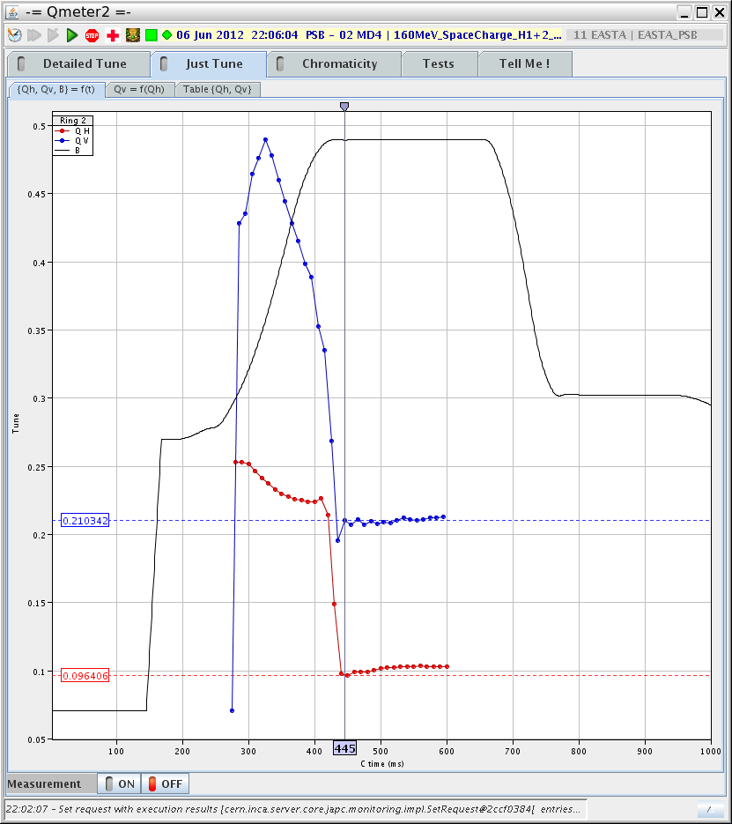
Machine cycle
The measurements were done
on a flat plateau at 160 MeV (to emulate the injection energy from the Linac4) in a time window between 440 ms and 600 ms
Intensity required -> 1.65 e12 p.p.bunch for LHC 25ns type beam
Status of space charge studies and simulations in the PS Booster – Vincenzo Forte

Slide 4
Simulations - Beam characteristics – transverse
 | αx | βx | αy | βy | Dx
Lattice (PTC) | -0.1889E-14 | 5.8138 | -0.22351e-3 | 4.2509 | -1.5215
500e3 (Matlab post p.) | -5.7985e-4 | 5.805 | -7.7873e-4 | 4.2485 | -1.5238
εx ( 1 sigma – normalized) ~ 4.7235 mm-mrad
εy (1 sigma – geometrical) ~ 2.3392 mm-mrad
BetaGamma = 0.61
2D gaussian distribution
Status of space charge studies and simulations in the PS Booster – Vincenzo Forte

Slide 5
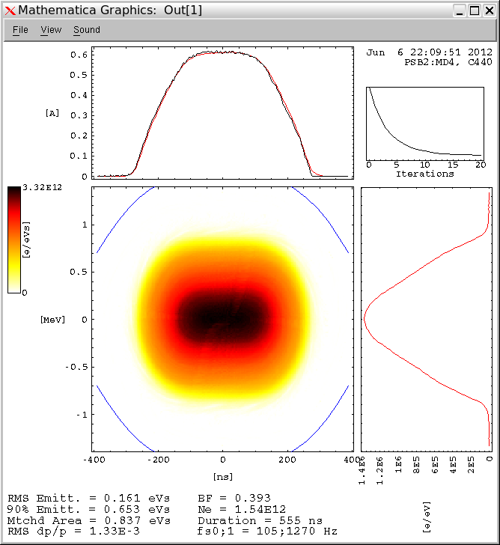
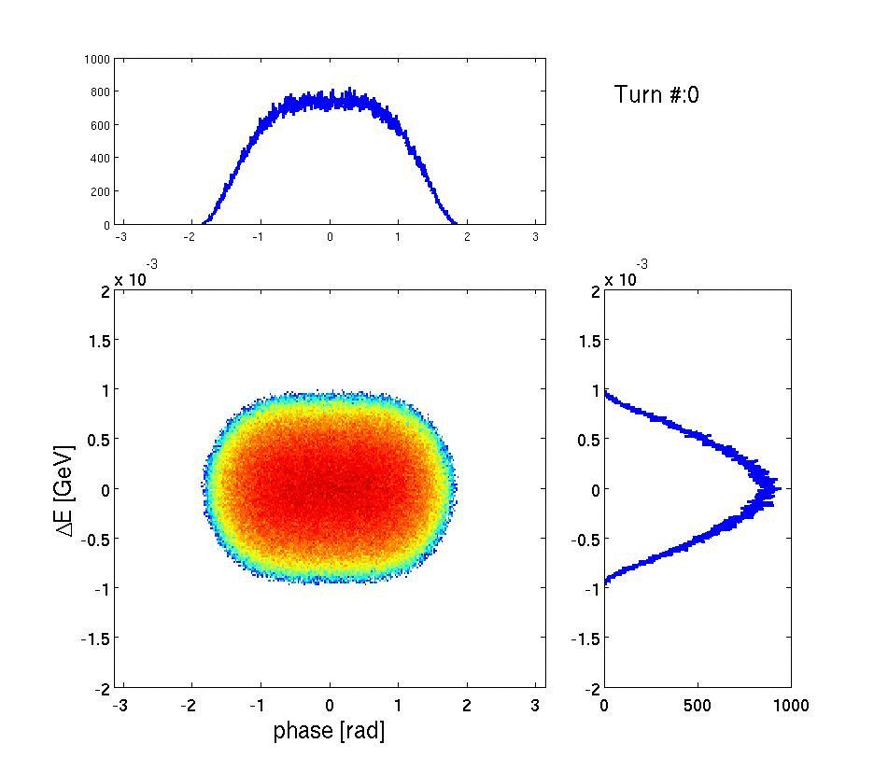
Beam characteristics – longitudinal
Reproduction through ESME…
500e3 m.particles
Long bunch – B.f. 0.397 (± 0.0024)*
RMS emittance ~ 0.16 eVs
RMS Δp/p ~ 1.33e-3
* Along 35 ms tracking
h=1 - double harmonic RF +8kV & +4kV in antiphase
Long bunch – B.f. ~0.39
RMS emittance = 0.161 eVs
RMS Δp/p = 1.33e-3
Status of space charge studies and simulations in the PS Booster – Vincenzo Forte

Slide 6
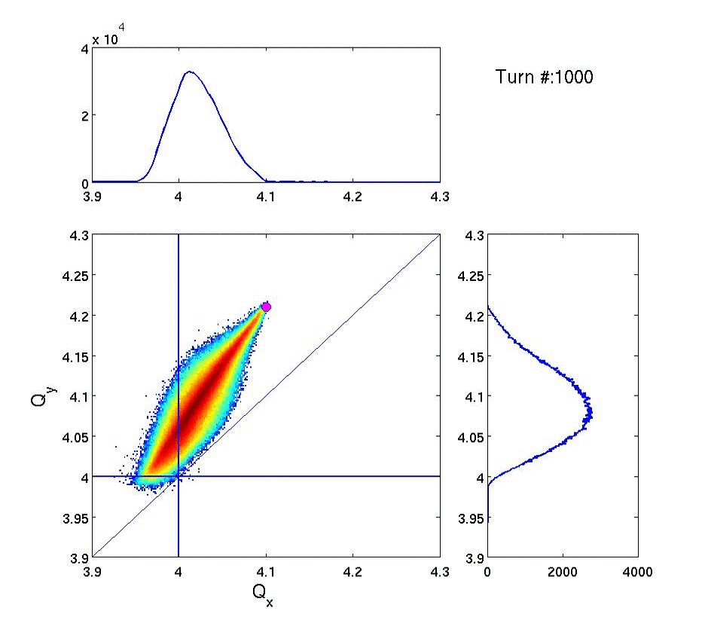
Tunes footprint evolution…
Status of space charge studies and simulations in the PS Booster – Vincenzo Forte

Slide 7
Moving the tune to Qx = 4.06… the tunes footprint…
Status of space charge studies and simulations in the PS Booster – Vincenzo Forte

Slide 8
…x RMS emittances…for different horiz. tune
~ +27.94% over 5000 turns
Status of space charge studies and simulations in the PS Booster – Vincenzo Forte

Slide 9
…y RMS emittances…for different horiz. tune
~ +0.66% over 5000 turns
Status of space charge studies and simulations in the PS Booster – Vincenzo Forte

Slide 10
The shorter bending magnets at injection …
Thanks to Elena Benedetto for her studies and lattice setup
Status of space charge studies and simulations in the PS Booster – Vincenzo Forte

Slide 11
Integer resonance (Qx=4) effect
PS The random quad. field errors are used while waiting for a detailed estimation in the PSB.
Status of space charge studies and simulations in the PS Booster – Vincenzo Forte

Slide 12
Qx=4.10 Qy= 4.21
Status of space charge studies and simulations in the PS Booster – Vincenzo Forte

Slide 13
Status of space charge studies and simulations in the PS Booster – Vincenzo Forte

Slide 14
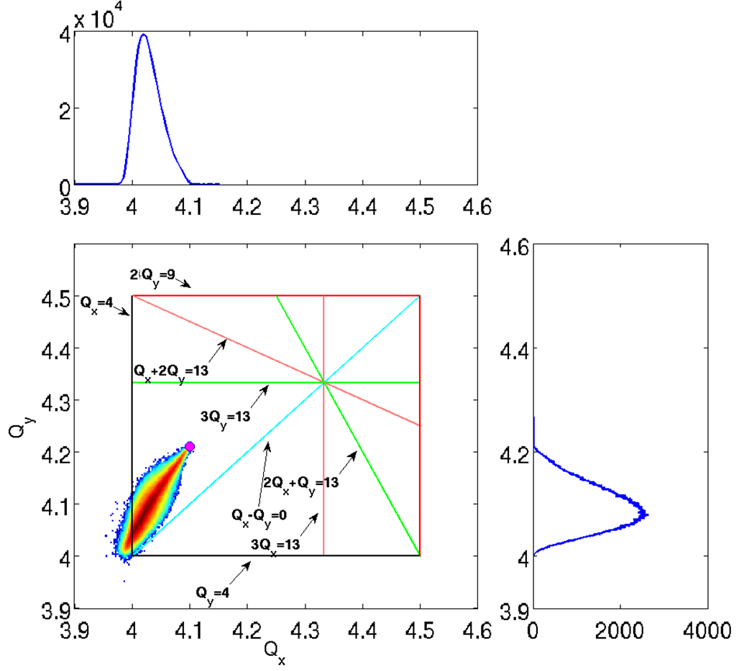
The footprint for the shorter bending magnets case
Turn #: 115000
Status of space charge studies and simulations in the PS Booster – Vincenzo Forte

Slide 15
Qx=4.10 Qy= 4.21
Status of space charge studies and simulations in the PS Booster – Vincenzo Forte

Slide 16
Qx=4.10 Qy= 4.21
Status of space charge studies and simulations in the PS Booster – Vincenzo Forte

Slide 17
-- simple lattice
-- -- simple lattice with misalignments random errors
(1σ = 2.17e-5 and 4.28e-5 rad)
Measured and simulated effect of the 4th order coupling resonance [2,-2,0] for the lattice working point Qx = 4.18, Qy = 4.23
Status of space charge studies and simulations in the PS Booster – Vincenzo Forte

Slide 18
New tools for simulations…
The space charge transverse matching
A new way to match the longitudinal distribution (thanks to S. Hancock)
Status of space charge studies and simulations in the PS Booster – Vincenzo Forte

Slide 19
The matching procedure… results with linear lattice matching
Then, matching with the beam properties after 20 turns…
Status of space charge studies and simulations in the PS Booster – Vincenzo Forte

Slide 20
Matching with the space charge dominated beam … after 20 turns…
The Twiss parameters evolution is smoother at the beginning (first 10 turns), before settling up to the steady state values…
Status of space charge studies and simulations in the PS Booster – Vincenzo Forte

Slide 21
The RMS emittances behavior differences…
Status of space charge studies and simulations in the PS Booster – Vincenzo Forte

Slide 22
The RMS emittances behavior differences…
Status of space charge studies and simulations in the PS Booster – Vincenzo Forte

Slide 23
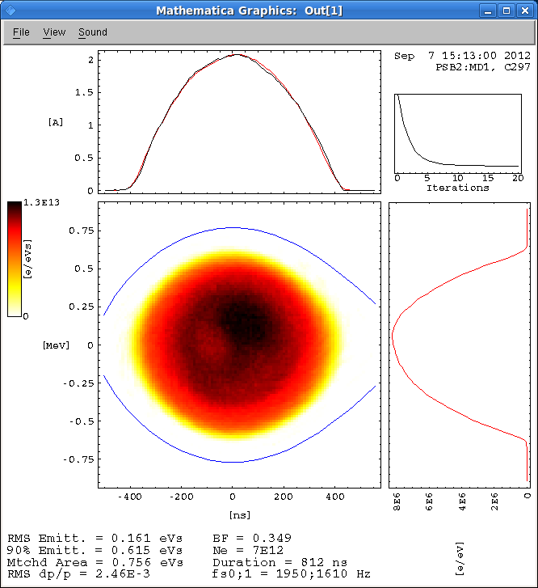
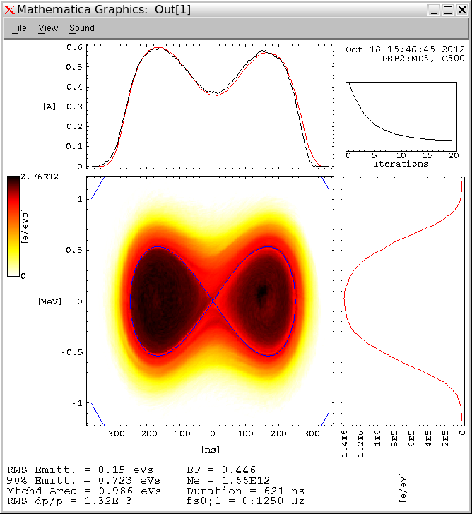
A new way to match the longitudinal distribution
(thanks to S. Hancock)
Steven’s Mathematica
script
Very useful in case of “particular” longitudinal shapes (filamentation, acceleration,…)
Status of space charge studies and simulations in the PS Booster – Vincenzo Forte

Slide 24
Last MDs studies and measurements
MD sessions between 22nd Aug. and 18th Oct.
Study of linear coupling in the PSB
Dynamic tune scans to evaluate losses and resonances (and relative correctors)
Status of space charge studies and simulations in the PS Booster – Vincenzo Forte

Slide 25
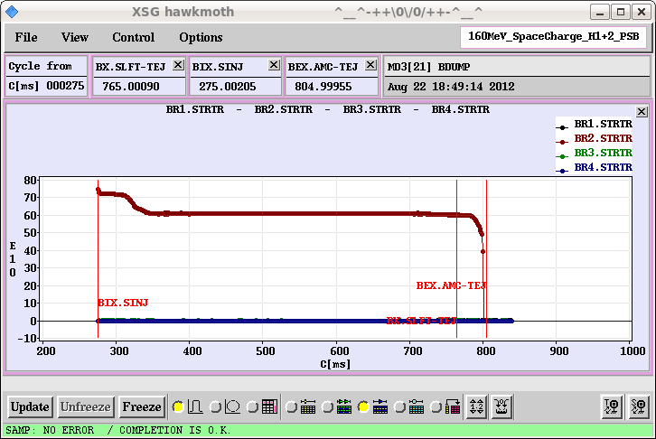
Last MDs studies and measurements
Linear coupling in the PSB
Minimum tune approach applied
PSB linear coupling is very weak
The relative corrector QSKH0 has
not important effect
Status of space charge studies and simulations in the PS Booster – Vincenzo Forte

Slide 26
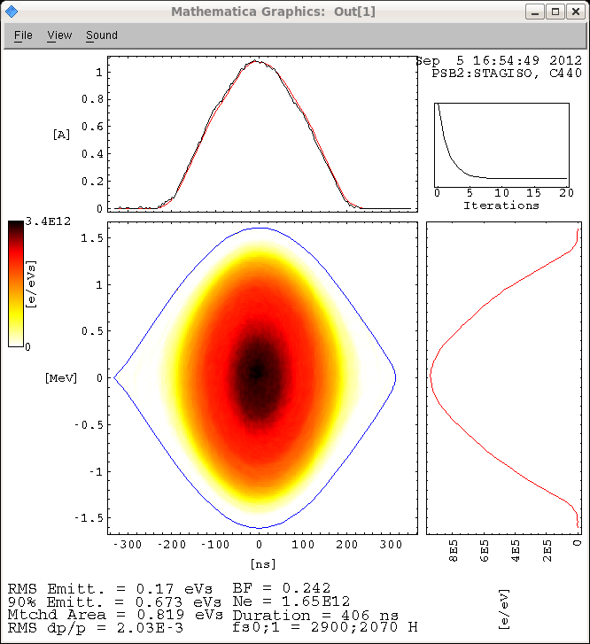
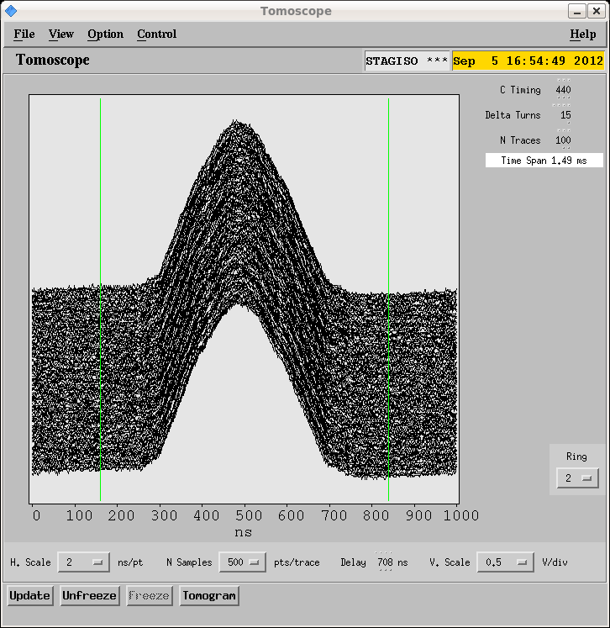
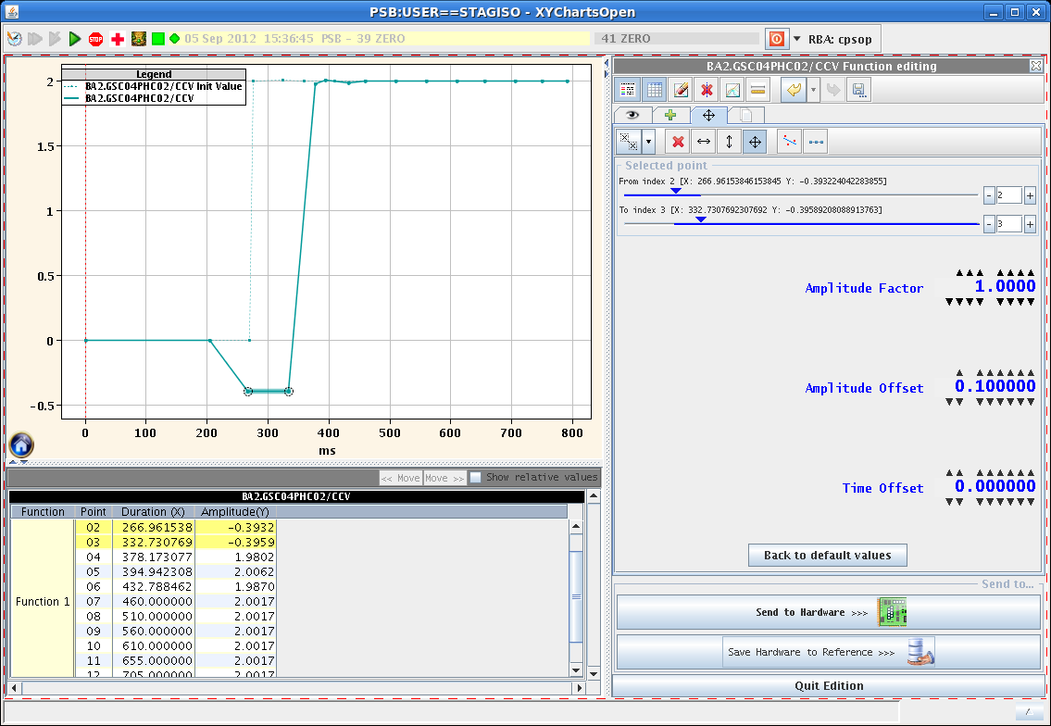
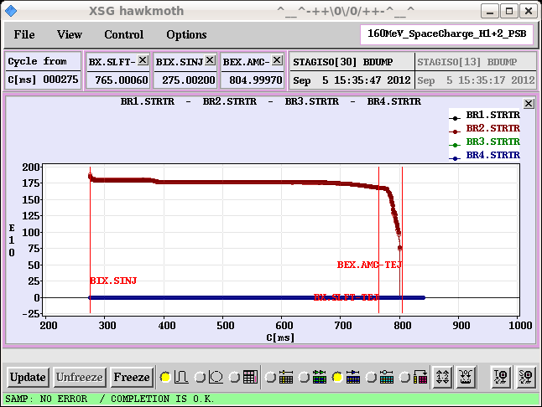
Last MDs studies and measurements
Tune scans for resonances for resonances and losses evaluation
Longitudinal beam analysis (8kV + 8kV in phase)
RF gymnastics to keep the flattest possible intensity along the machine cycle
Intensity ~ 1.75 p.p.bunch – expected ΔQy ~ -0.4
Measurements always in the flat plateau at ~160 MeV
Status of space charge studies and simulations in the PS Booster – Vincenzo Forte

Slide 27
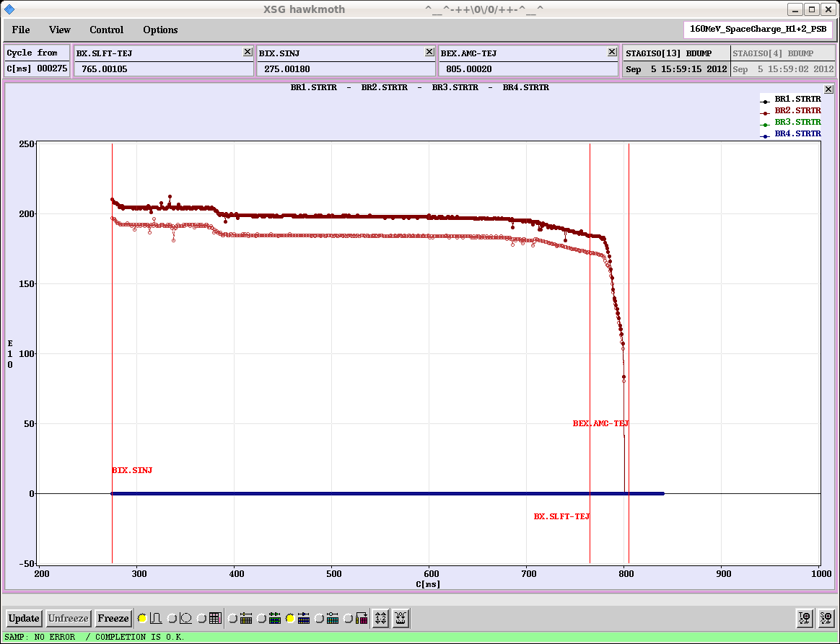
Last MDs studies and measurements
STATIC TUNE: a first set of emittances measurement has been done with a static working point (Qx ~ 4.23, Qy ~ 4.32), observing no losses and no important effect by the correctors in emittance behavior
The correctors in the PSB ring 2
Name | Resonance | GFA
XSK2L4 | 2Qx+Qy=13 3Qy=13 | GSQX08
XSK6L4
QNO412L3 | 2Qy=9 | GSQX05
QNO816L3
QSKHO | Qx-Qy=0 | GSPOOL9
XNO4L1 | Qx+2Qy=13 3Qy=13 | GSPOOL10
XNO12L1
Status of space charge studies and simulations in the PS Booster – Vincenzo Forte

Slide 28
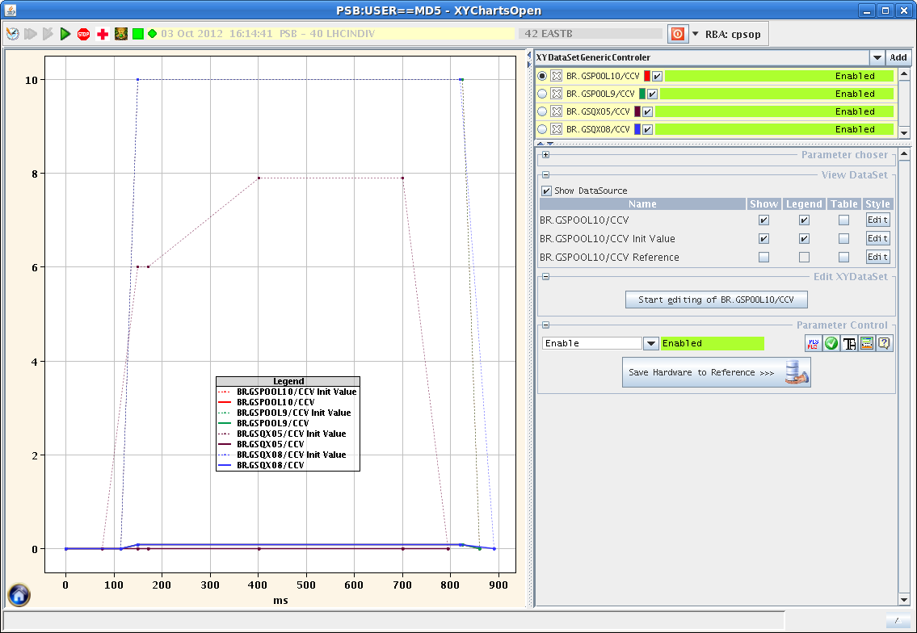
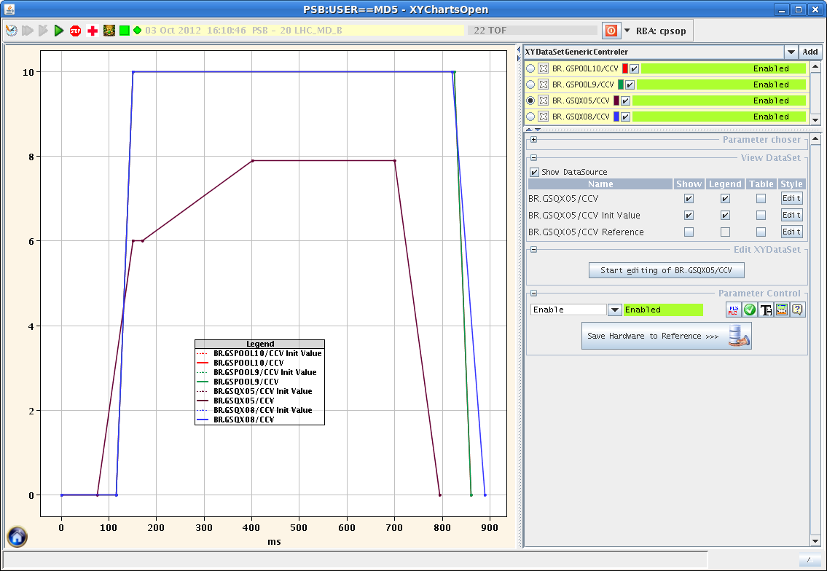
Last MDs studies and measurements
GFAs ON
GFAs OFF
Status of space charge studies and simulations in the PS Booster – Vincenzo Forte

Slide 29
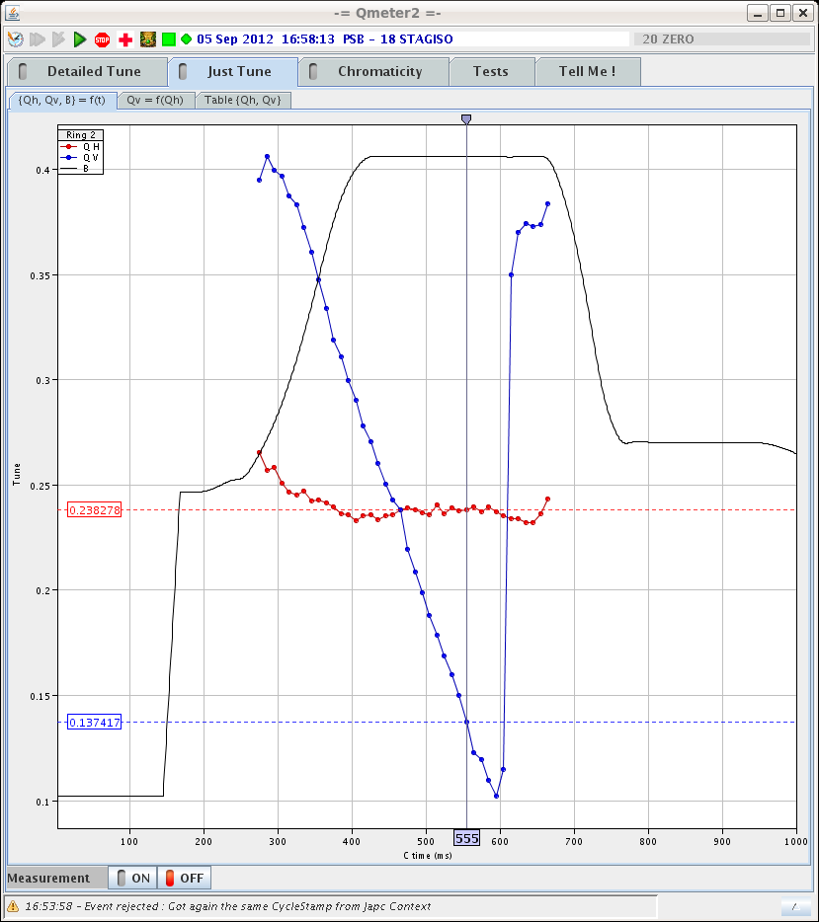
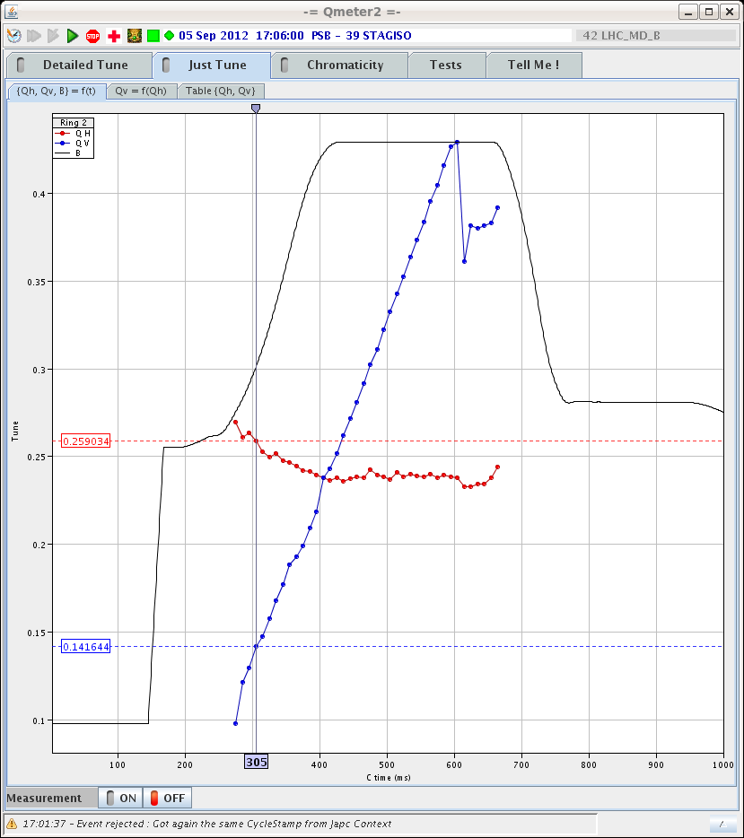
Last MDs studies and measurements
Starting the tune scans (keeping constant the horizontal tune)…
Qx=4.23 Qy=4.26 -> 4.10
Qx=4.23 Qy=4.26 -> 4.44
Status of space charge studies and simulations in the PS Booster – Vincenzo Forte

Slide 30
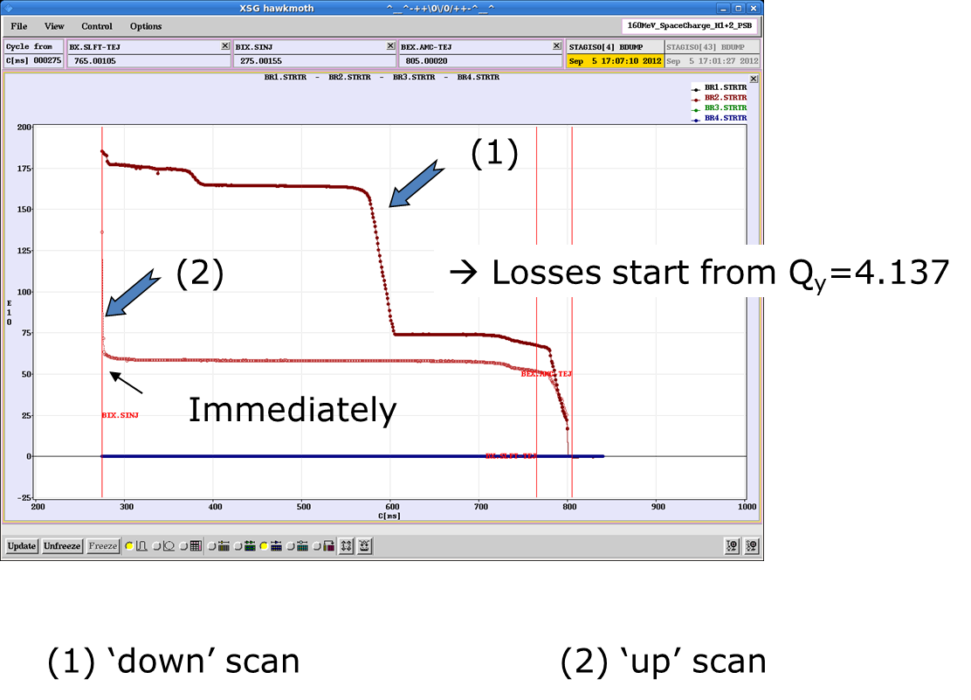
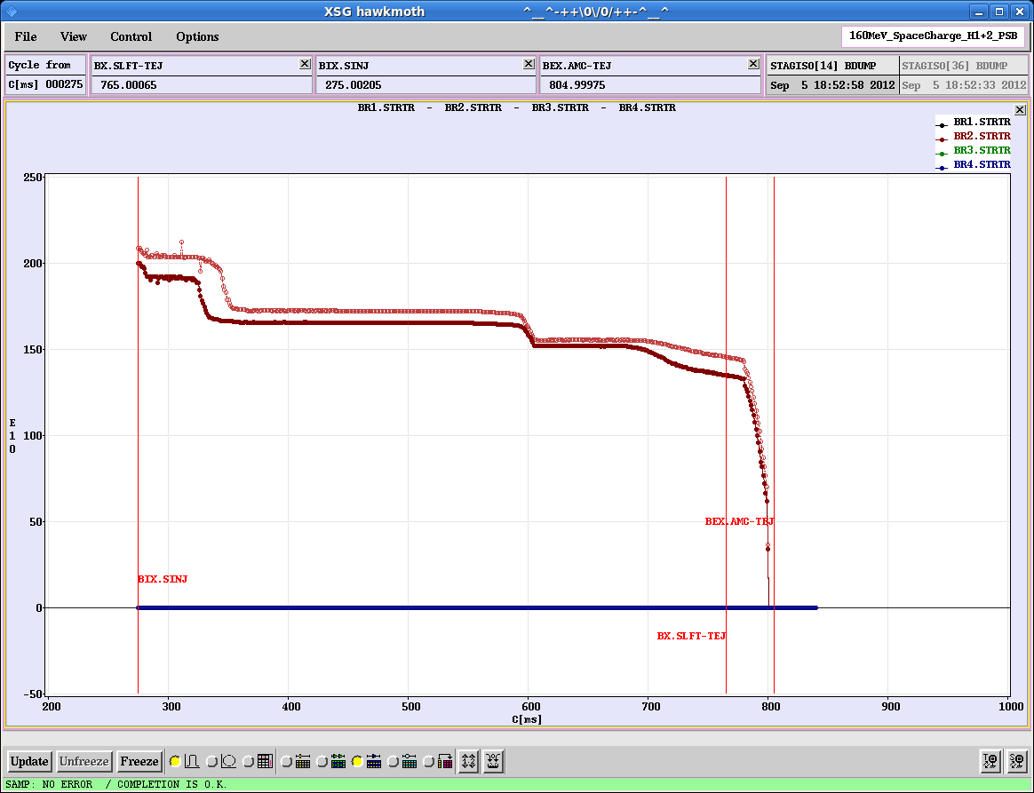
Last MDs studies and measurements
Losses during the tune scans can be useful for Apertures benchmarking in PTC-Orbit
Bf = 0.24
Bf = 0.4 (‘down’ scanning)
Status of space charge studies and simulations in the PS Booster – Vincenzo Forte

Slide 31
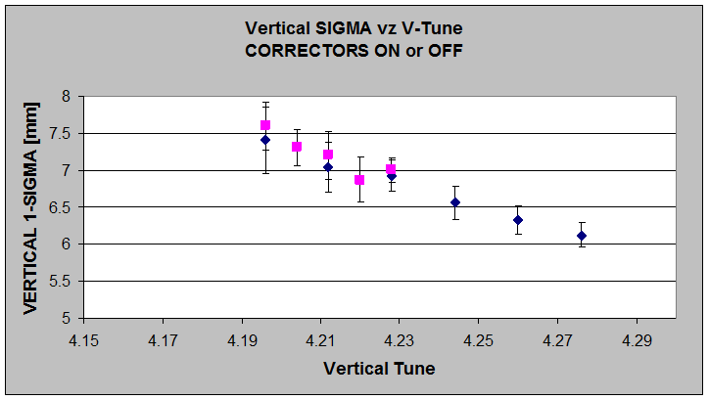
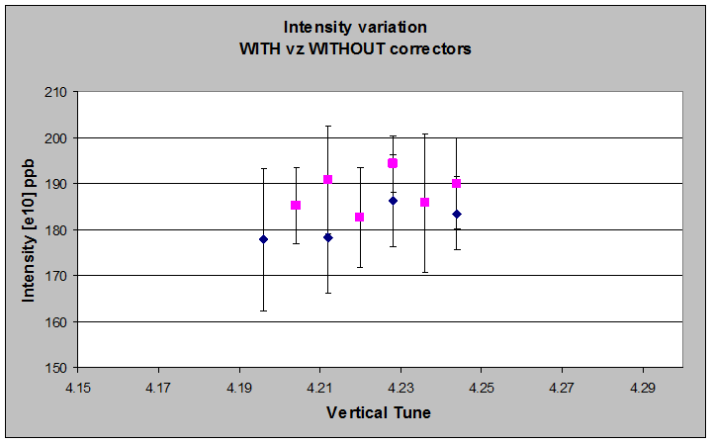
Last MDs studies and measurements
WireScanner
Saturation
limit
Short bunch – going down with the tune
Status of space charge studies and simulations in the PS Booster – Vincenzo Forte

Slide 32
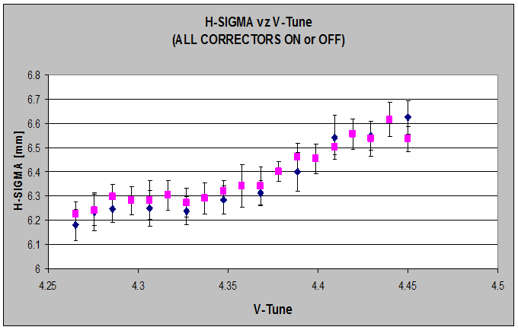
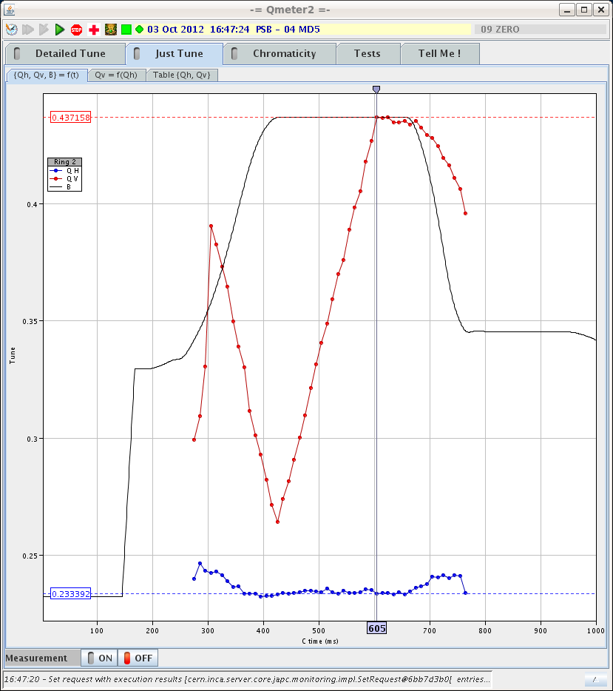
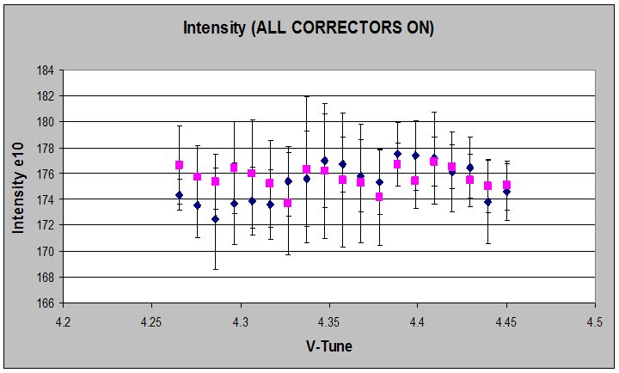
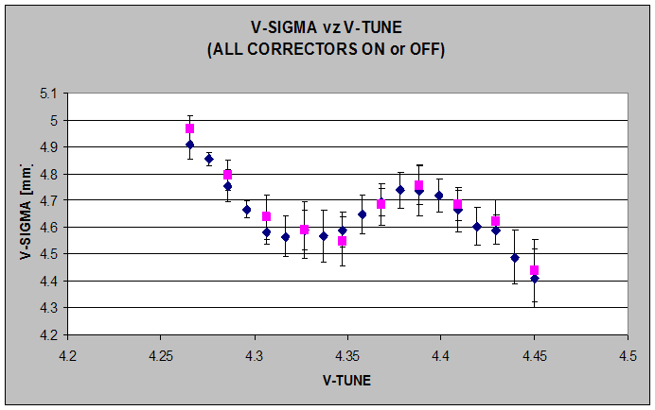
Last MDs studies and measurements
In the successive MD (MD7) we went up: Qy=4.26 -> 4.44
Long term tracking simulations are currently running for this case
Status of space charge studies and simulations in the PS Booster – Vincenzo Forte

Slide 33
Why evaluate sigma instead of RMS emittance?
Δβy = 7% !!!
The beta function, used to compute the RMS emittance, is constant in the wirescanner settings.
To be independent from beta variations during the tune scan, we decided to use the sigmas (not the emittances values) from the wirescanner measurements
The wirescanner measurements’ precision has been improved with new settings (PM voltage > 600 V)
Status of space charge studies and simulations in the PS Booster – Vincenzo Forte

Slide 34
The footprint for the short bunch (bf ~0.24) – 8 + 8 kV in phase
W. Point
Qx = 4.24
Qy = 4.32
Estimated Laslett (theoretical):
ΔQx ~ - 0.29
ΔQy ~ - 0.37
Status of space charge studies and simulations in the PS Booster – Vincenzo Forte

Slide 35
Long term tracking simulations are running now for this case
Status of space charge studies and simulations in the PS Booster – Vincenzo Forte

Slide 36
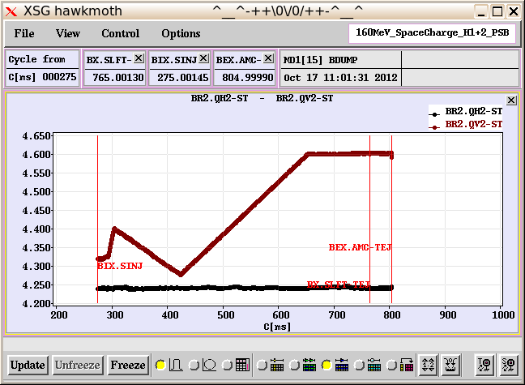
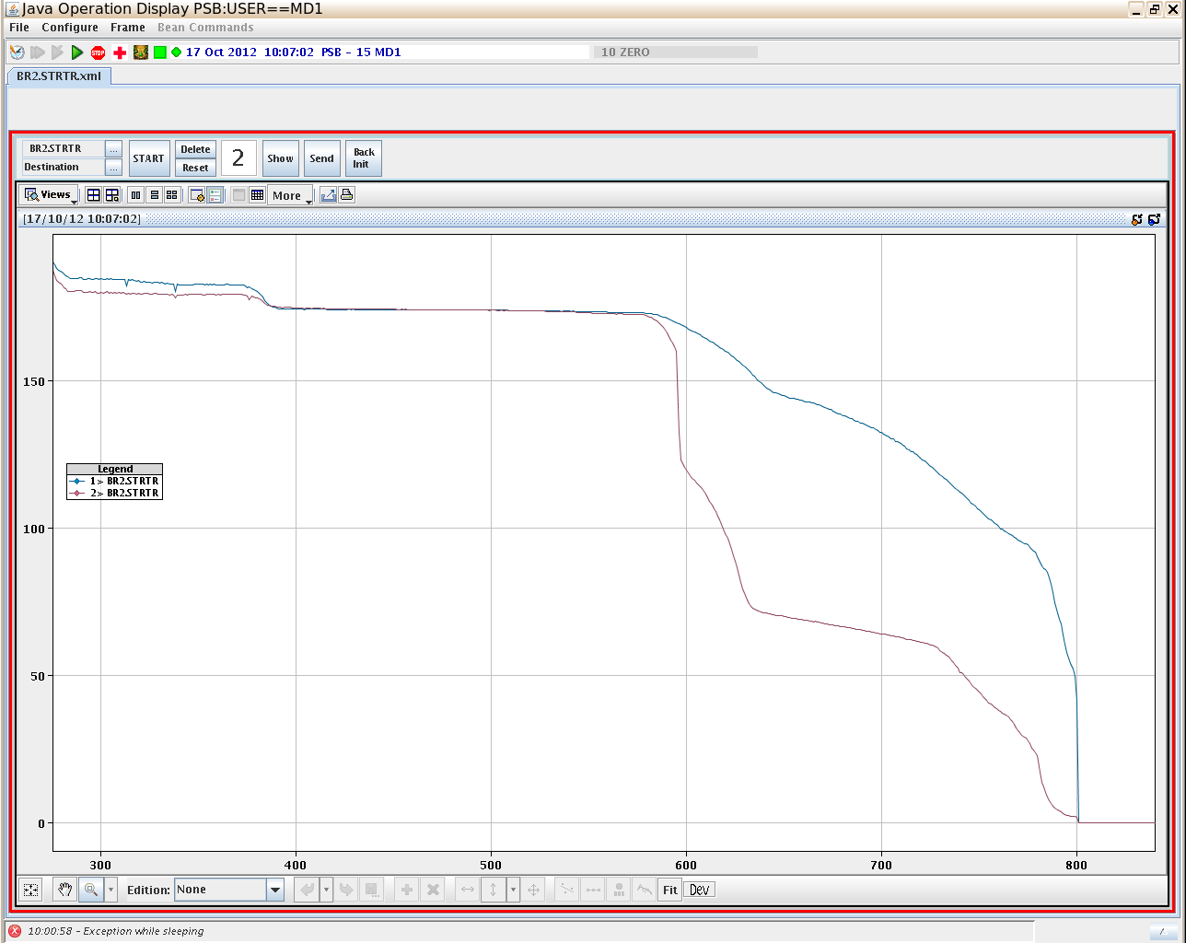
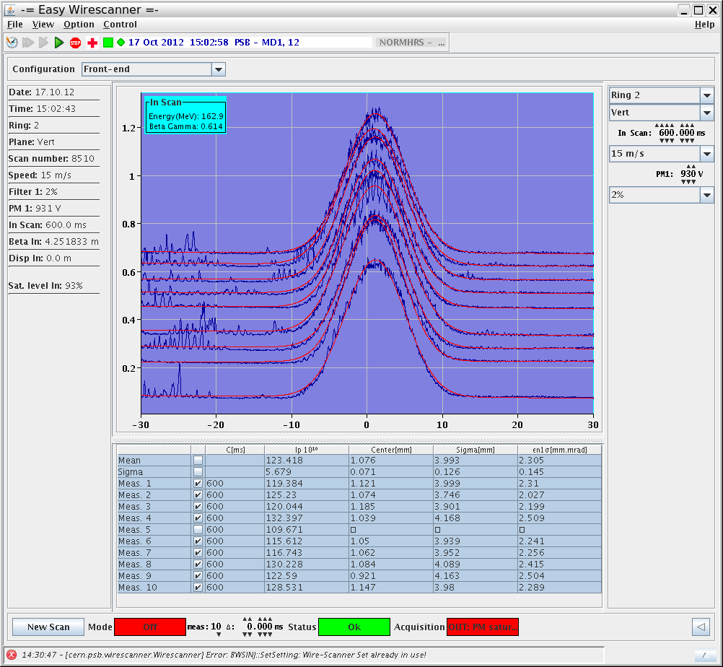
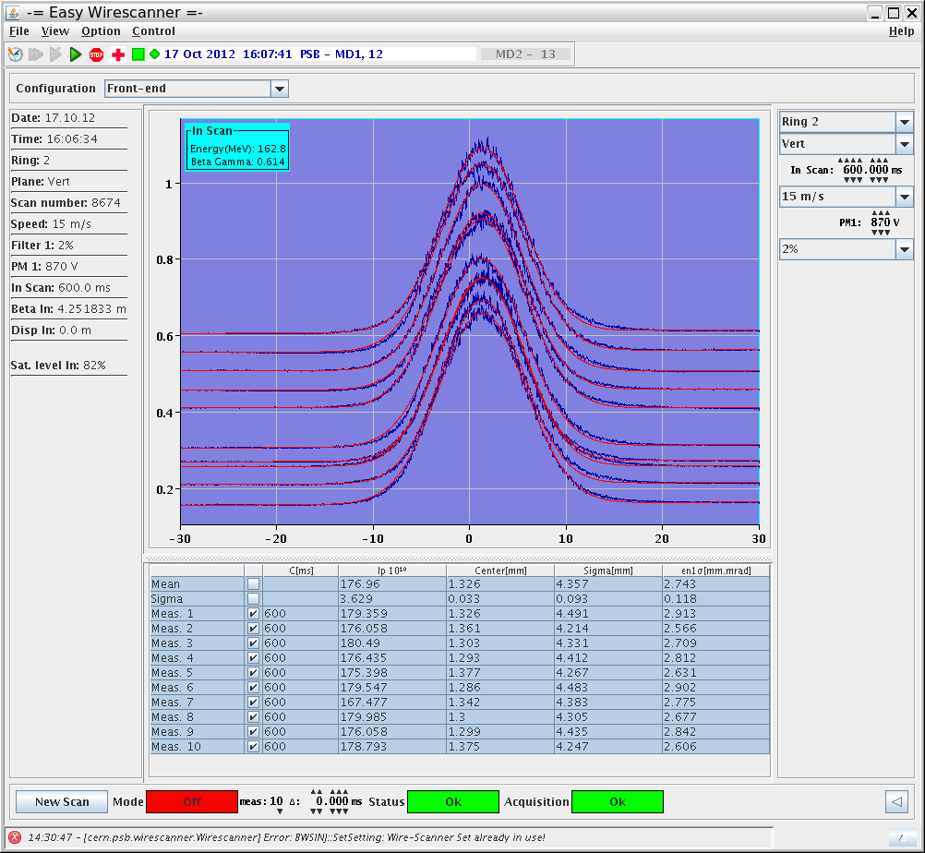
Last MDs studies and measurements
Going above the half-integer (2Qy=9)…
CORRECTORS ON
CORRECTORS OFF
CORRECTORS OFF
CORRECTORS ON
Status of space charge studies and simulations in the PS Booster – Vincenzo Forte

Slide 37
NEXT GOALS
Keep on collecting measurements from the real machine to investigate its properties and “stress” PTC-Orbit (i.e. tune scans above Qy=4 and below 2Qy=9)
Discussions are started with authors of the paper
TUNE SPREAD STUDIES AT INJECTION ENERGIES FOR THE CERN PROTON SYNCHROTRON BOOSTER (B. Mikulec, A. Findlay, V. Raginel, G. Rumolo, G. Sterbini)
for developing simulations through PTC-Orbit even at different energies (60 – 100 – 160 MeV)
Discussions are started with A. Lombardi (Linac4) to obtain realistic distributions from the Linac4 (to the foil) and fix the beam parameters that PSB will need from Linac4 during the multi-turn injection
Discussions are started with the magnets group about non-uniformity of the field as effect of Eddy currents in the bump magnets with Inconel chambers, taken into account the variation of the magnetic field components during the ramp-down of the bump magnets
Adding “foil” setting to PTC-Orbit
Status of space charge studies and simulations in the PS Booster – Vincenzo Forte

