Slide 1
PSB H- chicane magnets: Inconel vacuum chamber option & consequences on beam dynamics
E. Benedetto, V. Forte, M. Martini
Thanks: C. Carli, B. Balhan, J. Borburgh, G. Arduini, R. De Maria, L. Deniau, A. Molodozhentsev

Slide 2
Outline
Introduction & ~order of magnitudes
Simulations
New correction settings
Caveats
Conclusions

Slide 3
Introduction
ϕ
ϕ
BSW1
-ϕ
-ϕ
BSW2
BSW3
BSW4
Chicane magnets for H- injection
  46mm (ϕ=66mrad), falls linearly to 0mm in 5ms
Proposed corrugated Inconel vac. chamber new baseline
Influence on beam dynamics of induced Eddy currents:
  Delay of ~50us (hp: it is compensated by power supplies)
  Higher order field components (sextupolar)
    Quadrupolar feed-down
    Excitation 3rd order resonance

Slide 4
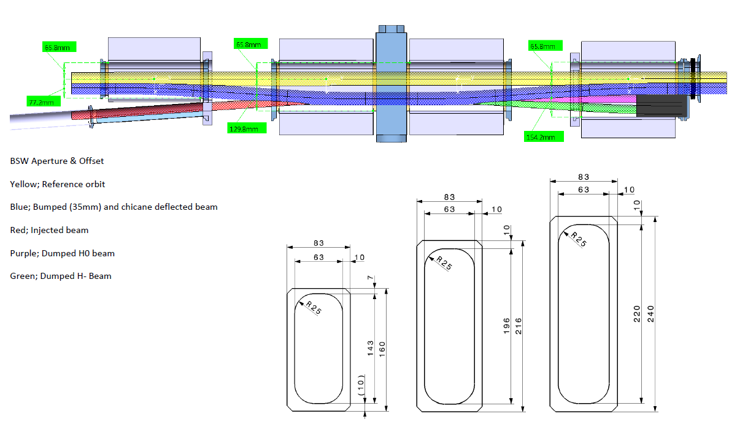
Drawings
from W.Weterings, 09/01/13

Slide 5
Drawings
from W.Weterings, 09/01/13
5.5 mm
32 mm
44 mm
66 mm
Bump height = 46 mm MAX

Slide 6
Order of magnitude of perturbation
Edge effect (rectangular magnet):
  k1L~ ϕ²/2L~6e-3
Feed-down from sextupole:
  Int(Bdl)~c0+c1 x+c2 x² +…
  x0=-50mm
  → k1L~3.4e-3
Cfr. presentatin by C. Carli 19/11/09 at PSB beam dynamics w. L4 WG

Slide 7
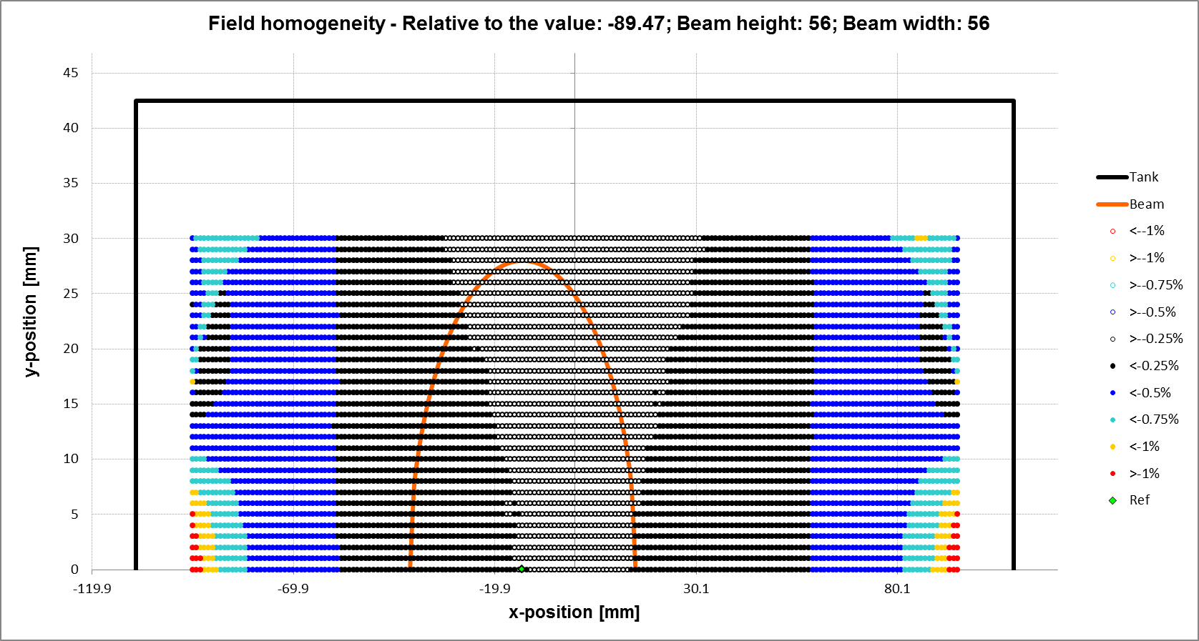
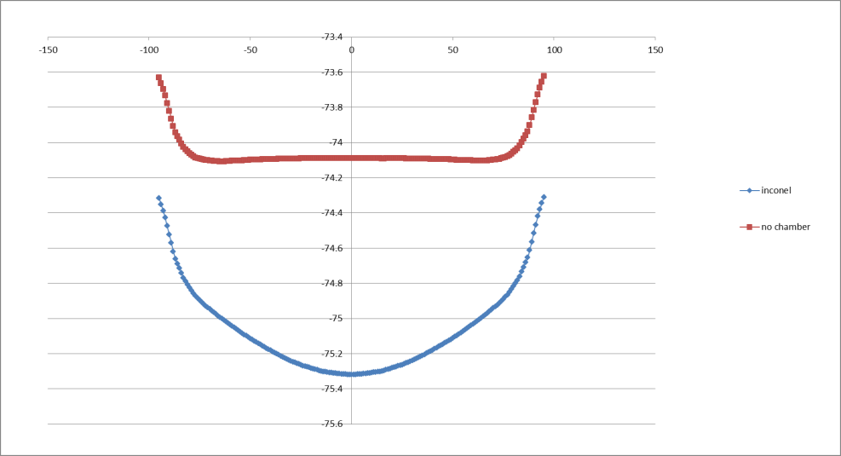
Extraction BSW multipoles
from B. Balhan
Sextupolar component from eddy currents
Took k2L=0.084
  assumed constant for 5ms
  the same for the 4 BSW
Quadrupolar component at BSW1 (similar for both chambers) not considered
BSW2-3 @ 2.5ms

Slide 8
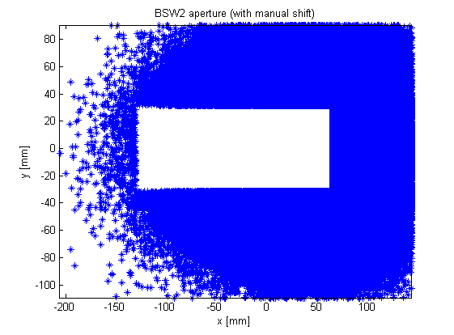
Implementation MADX-PTC/PTC-Orbit:
Understand edge effects in PTC
Time-varying fields w. Multipolar components (thanks A. Molodozhentsev)
Misalignments
BSW apertures (they are shifted!)

Slide 9
The beam
Nb=35e11 (~twice)
Ex,Ey=2, 2.3 um (...normalized are E*=1.20, 1.38um!!!)
Bf=0.56, V1=8kV, V2=6kV, Brhodot=10 Tm/s
Painting horiz and longitud (20 turns)
Cut @ 95% bucket acceptance after 20t-injection to remove uncapured particles (~0.4%) & avoid artifacts

Slide 10
The beam: tune footprint
Huge!!!! ..to be an LIU or HL-LHC beam!!!
→ more reasonable param under consideration
ΔQ~0.5
ΔQ~0.4

Slide 11
RMS emittance evolution vs.Turn
Qv=4.45 (Qh=4.28)
Qv=4.55 (Qh=4.28)
Vertical
Vertical
Horizontal
Horizontal
RED: ceramic chamber
GREEN: inconel, only dipole edge compensation
BLUE: inconel, new compensation settings
Large growth in horizontal…due to (too) large ΔQ & integer x-ing
  Does it “hide” effect of multipoles? → Check ongoing
  For ISOLDE, Qh needs optimization

Slide 12
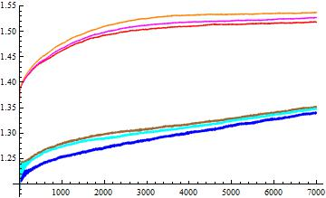
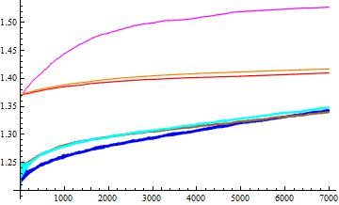
RMS normalized emittances
Qv=4.45 (Qh=4.28)
Qv=4.55 (Qh=4.28)
Vertical
Vertical
Horizontal
Horizontal

Slide 13
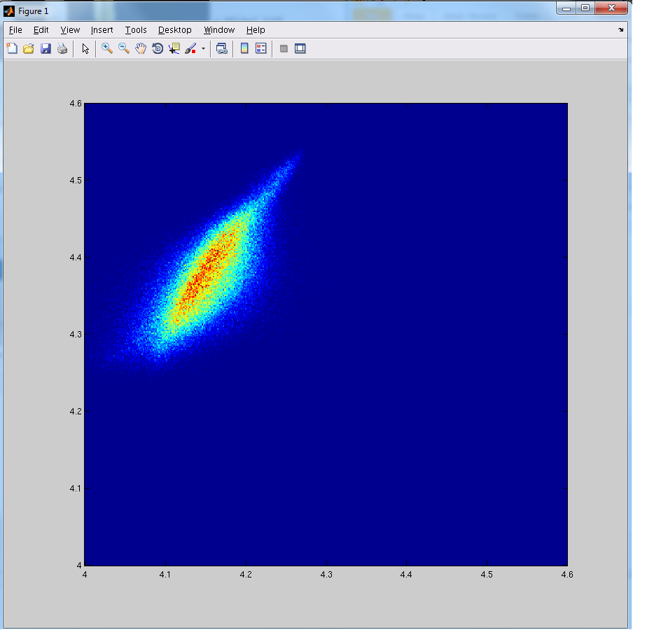
Actual intensity (Nb=17.5e11)

Slide 14
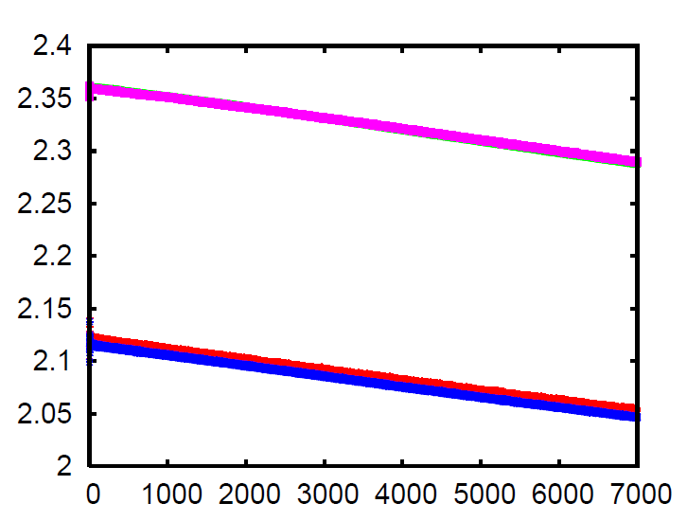
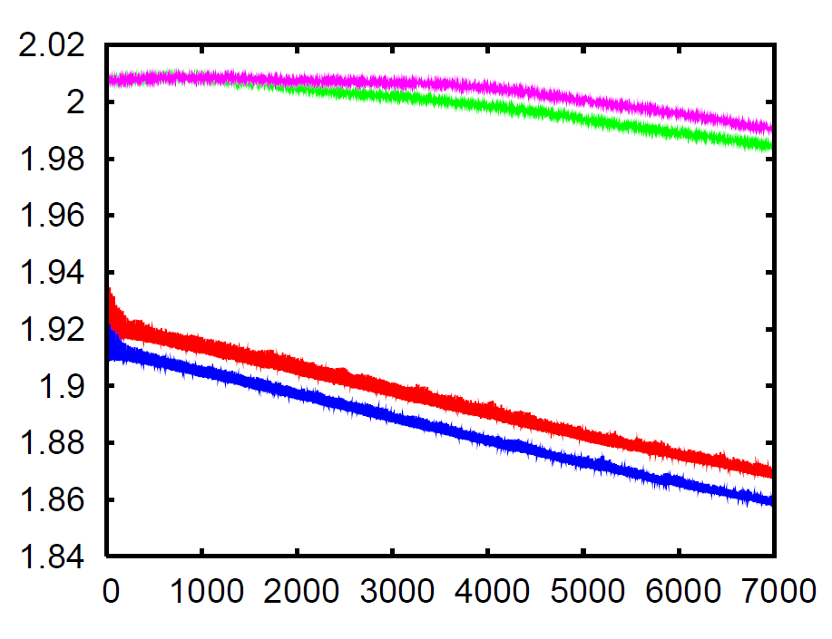
Actual intensity (Nb=17.5e11)
Qv=4.45 (Qh=4.28)
Qv=4.55 (Qh=4.28)
Vertical
Vertical
Horizontal
Horizontal

Slide 15
Compensation settings
Extra trims on QDE3, QDE14
Selected for active compensation of Vertical BetaBeating from edge effects (quad. error)
  Cfr many presentation by C.Carli et al. 2009-2011
Used also for perturbation (feed-down from sextupolar errors) in Inconel vac. Chamber
What is left uncorrected:
  Almost no correction for the horizontal plane (what if Qx moves close to 0.5?)
  Feed-down from sextupoles induces also small dipole error → COD of <1mm (not corrected, but could it be adjusted with delays?)

Slide 16
New settings QDE3,14 and QFO, QDE (w. Q-strips)

Slide 17
Not taken into account
Transient for the multipoles rise/fall (discontinuities in Bdot) → foresee smooth transition?
Delay (i.e. individual powering would compensate for it), i.e. bump is closed
Quad. component at BS1 (septum), similar for both chambers → could it be reduced with poles shaping?
Case if not perfect compensation ~10% off (→ what could be achieved?)
Operation/future beams:
  High intensity (ISOLDE) beams → losses!!!
  A more realistic LIU beam (w. no painting?) with ΔQ=-(0.2,0.3)

Slide 18
Summary
Eddy current induced multipoles have an effect and need proper compensation, but do not seems to be a show-stopper
TODO or ongoing:
  Effects of a not perfect compensation should be evaluated (Question: what are the limits of power supplies? What about transients?)
  Simulations for an ISOLDE beam (losses!!!) and for an LHC beam generated with no painting and lower intensity.

Slide 19
Back-up slides

Slide 20
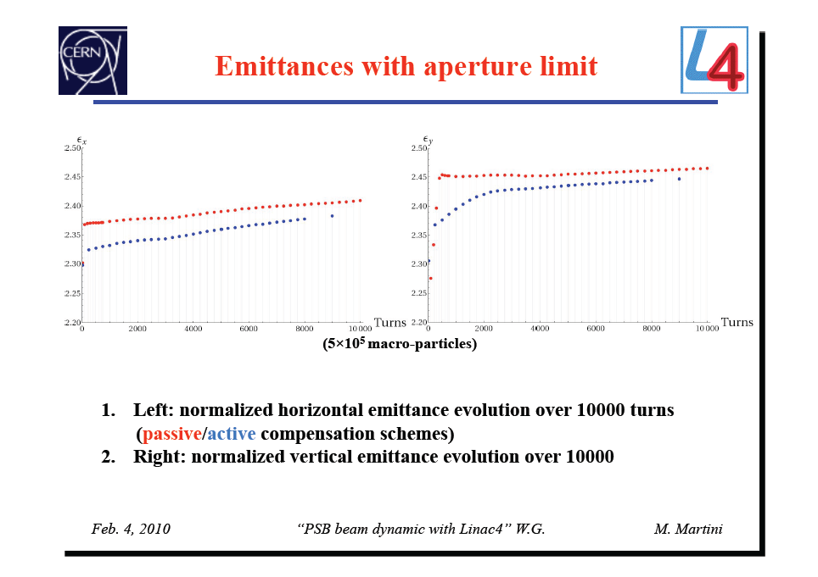
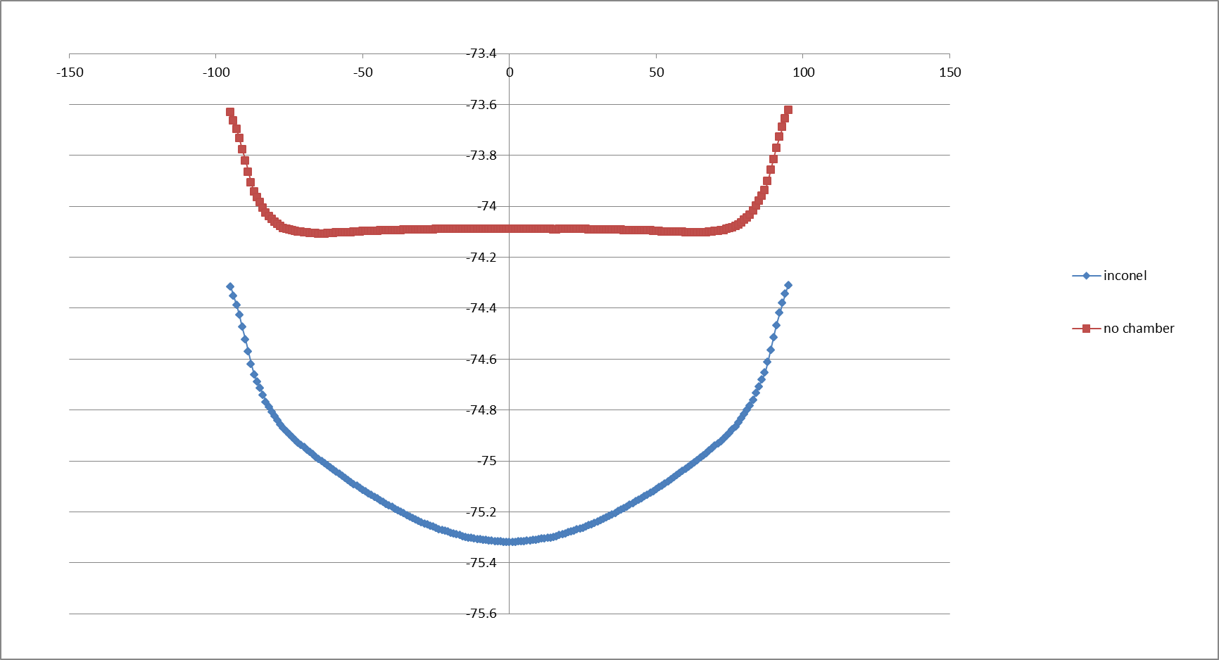

Slide 21
“Static” simulations
Ramp @ 2ms (out of 5ms)
Assumed:
  trajectory bump
  edge effects
  multipoles
Correction for the vertical BetaBeating with QDE3, QDE14

Slide 22
Horiz emittance vs. time

Slide 23
Vertical emittance vs time

