Slide 1
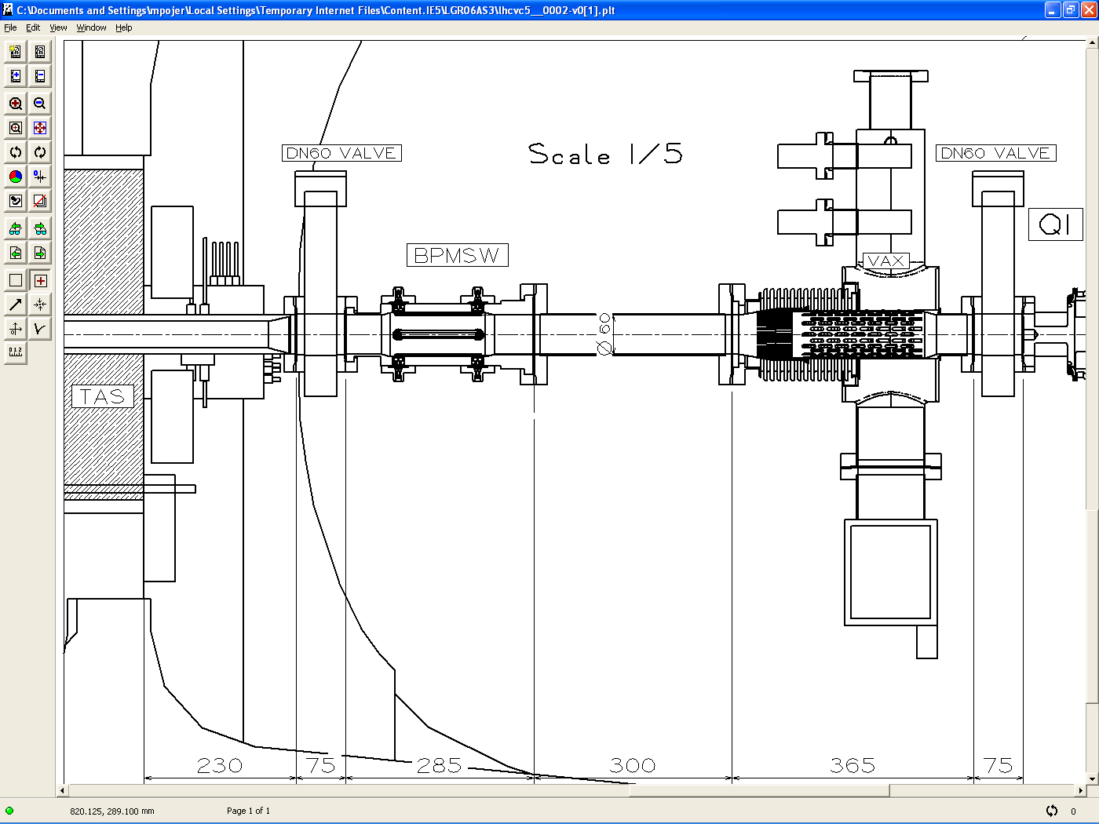
x
z
y
x= -4
y= 2
z= 27
x= -4
y= 2
z= 26
x= -5
y= 1
z= 26
x= 0
y= 3
z= 11
x= -6
y= 1
z= 21
x= -2
y= 0
z= 14
x= -4
y= -7
z= 20
x= -2
y= 5
z= 10
x= -3
y= 2
z= 9
x= 0
y= 0
z= 11
x= -2
y= 0
z= 16
x= 3
y= 1
z= 7
x= 3
y= -4
z= 15
x= 2
y= 2
z= 11
x= 2
y= 0
z= 12

