Slide 1
... The sign of the LHC octupoles S. Fartoukh for the LHC team
Observations
Facts & basic rules
A few simulation cases
Conclusion & Recommendations

Slide 2
Observations
Far too much octupole strength needed since the LHC start
→ 450 A in operation compared to 100A expected with the present settings and clearly demonstrated in MD but with only one beam (N. Mounet, E. Metral et al.)
→ 450 A presently would imply 1.2 KA after LS1 (7TeV, nominal TCS settings)!
→ 450 A presently would imply 1.8 KA for the HL-LHC beam brilliance!
→ ... to be compared to a nominal of 550A!
Beam dumps due to unexplained heavy losses
→ Several unexplained beam dumps when putting the two beams into collision (during physics or adjust BP).
→ Sudden beam dumps during coast triggered by losses of so-called IP8 bunches
... no longer there ... new private bunches with much less LR in IR1 and IR5 ...
→ Some activities on some bunches towards the end of the squeeze

Slide 3
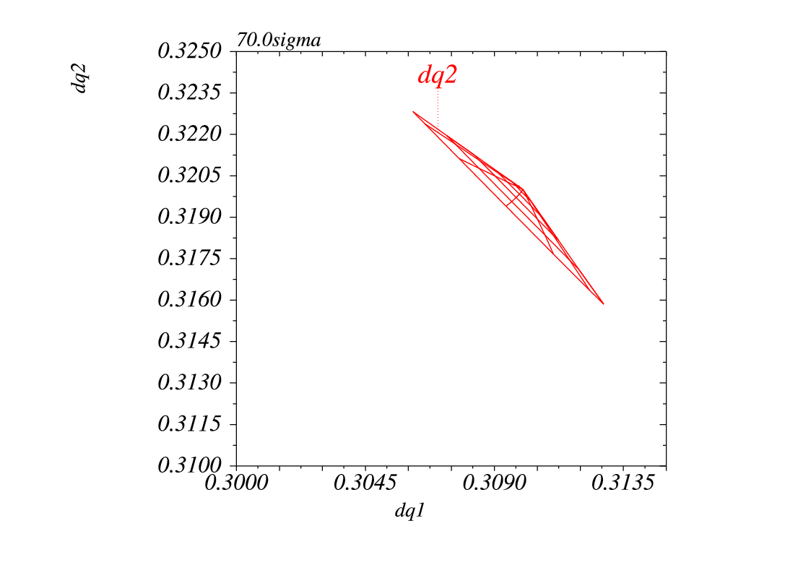
Facts & Rules (1/5) (different sources of tune spread at 4 TeV, occurring at different time)
→ Octupoles at 450 A with present polarity at 4 TeV
$${\left(\begin{matrix}∆Q_{x}\left[{10}^{−3}\right] \\ ∆Q_{y}\left[{10}^{−3}\right]\end{matrix}\right)}_{@6σ,γε=2.5 μm}=\left[\begin{matrix}−5.0 & +3.6 \\ +3.6 & −5.0\end{matrix}\right]\left[\begin{matrix}J_{x} \\ J_{y}\end{matrix}\right]$$
5.0 10⁻³
Jx=1, Jy=0
3.6 10⁻³
Jx=0,Jy=1

Slide 4
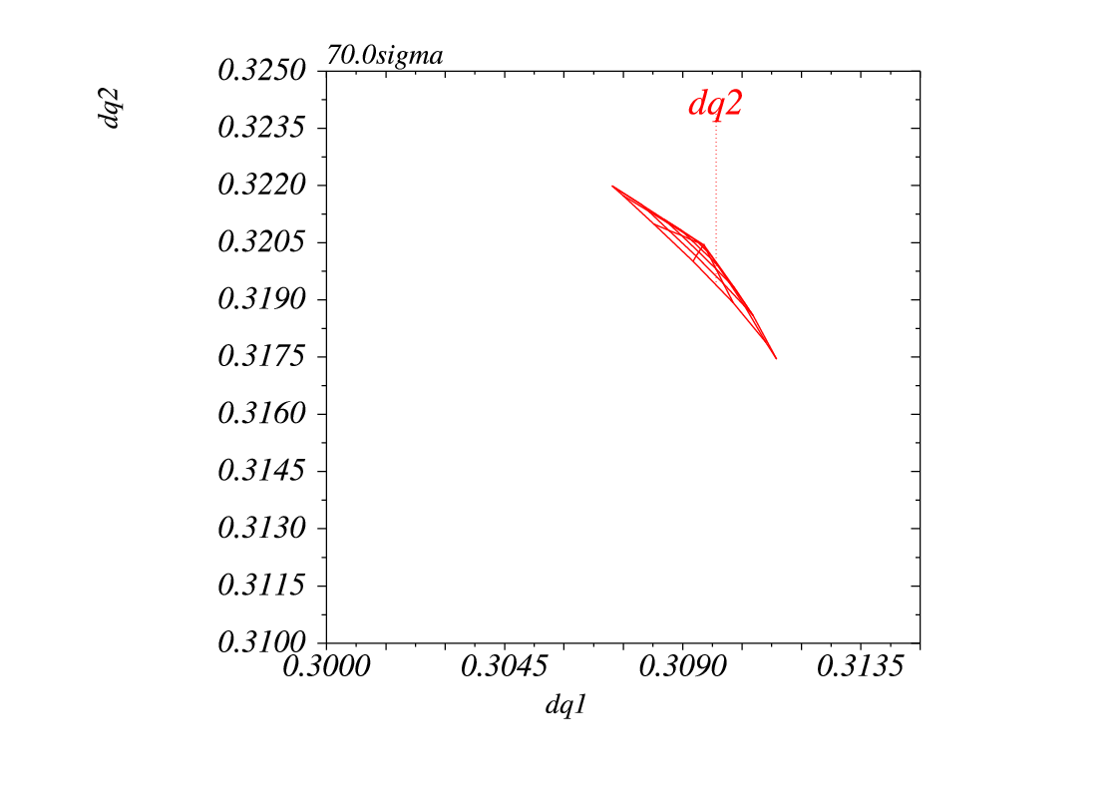
Facts & Rules (2/5)
→ Long-range with full separation (70σ in IR1&IR5)
${\left(\begin{matrix}∆Q_{x}\left[{10}^{−3}\right] \\ ∆Q_{y}\left[{10}^{−3}\right]\end{matrix}\right)}_{@6σ,γε=2.5 μm,1.5E11}≈\left[\begin{matrix}+2.5 & −2.5 \\ −2.5 & +2.5\end{matrix}\right]\left[\begin{matrix}J_{x} \\ J_{y}\end{matrix}\right]$ + higher order
Jx=0,Jy=1
Jx=1,Jy=0
Not negligible (~50% of MO) but also and mainly with the wings inverted !

Slide 5
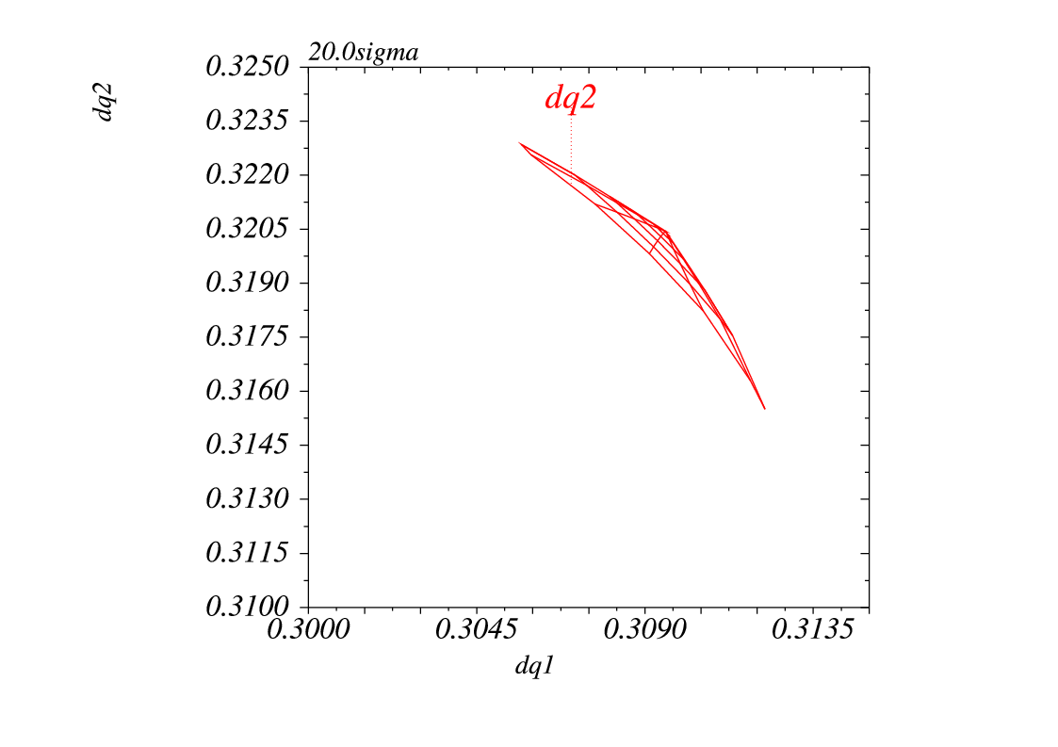
Facts & Rules (3/5)
→ LR doubled with ~15-20 σ sep. in IR1&IR5
${\left(\begin{matrix}∆Q_{x}\left[{10}^{−3}\right] \\ ∆Q_{y}\left[{10}^{−3}\right]\end{matrix}\right)}_{@6σ,γε=2.5 μm,1.5E11}≈\left[\begin{matrix}+5.0 & −5.0 \\ −5.0 & +5.0\end{matrix}\right]\left[\begin{matrix}J_{x} \\ J_{y}\end{matrix}\right]$ + higher order
Jx=0,Jy=1
Jx=1,Jy=0
Reach the size of the MO tune spread, still with the wings inverted,
... mainly due to an enhancement of the LR tune spread in IR1 and IR5 at lower parallel sep.

Slide 6
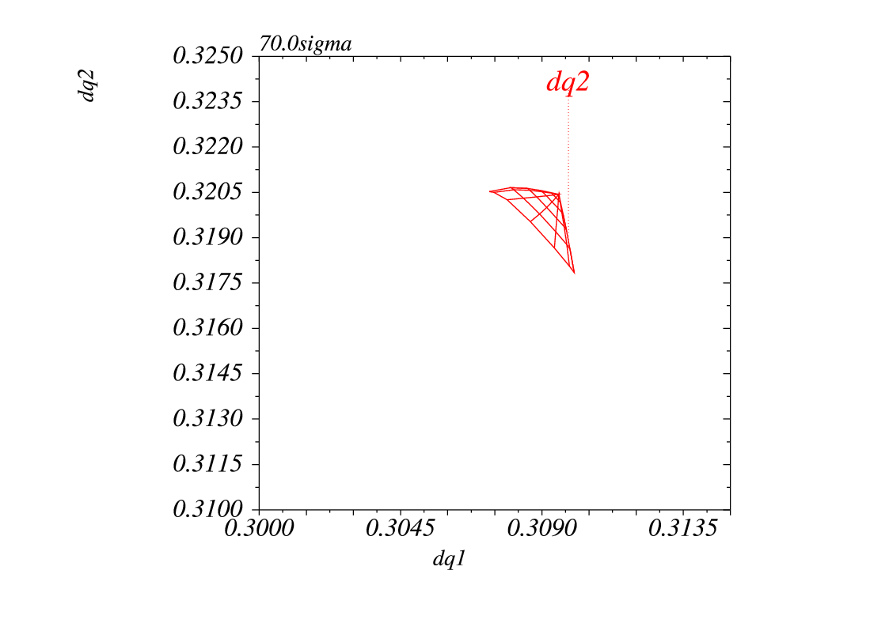
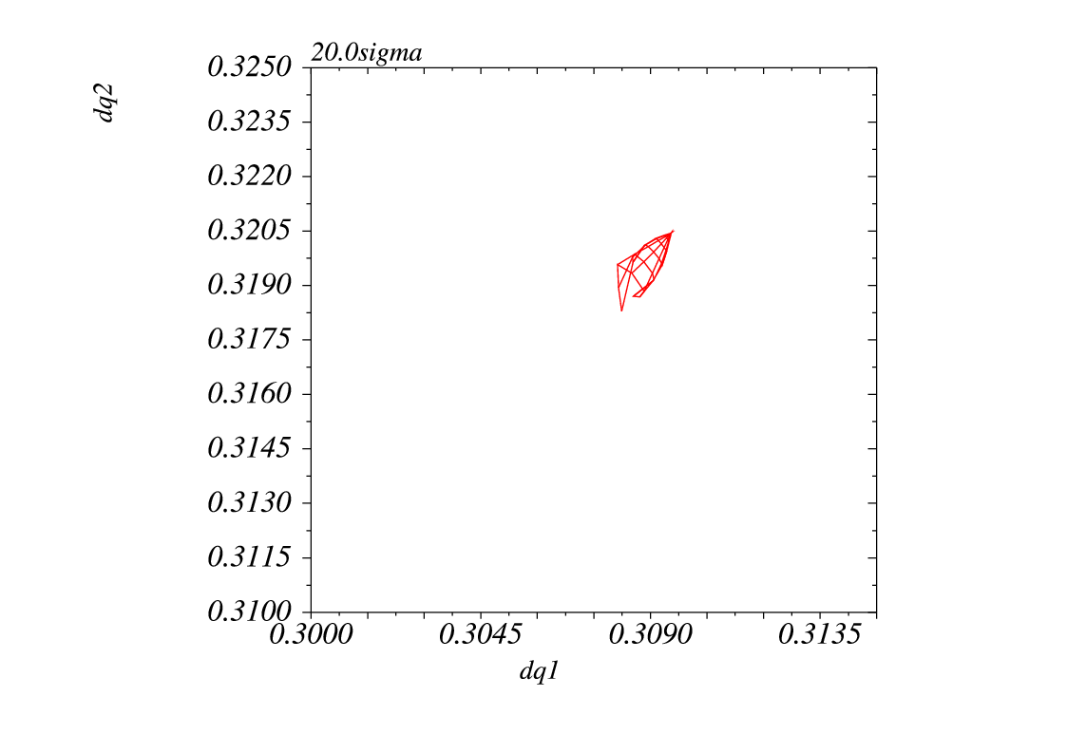
Facts & Basic Rules (4/5)
→ Rule 1:
The LR compensate the octupole tune spread both in terms of direct and cross-anharmonicity, more and more during the squeeze and even more when bringing the beam into collision
End of ramp
(only MO plays a role)
End of squeeze
(MO+LR plays a role)
During bump collapsing in
IR1 and IR5 (at 15-20σ)
Typical tune spread ΔQ=5×10⁻³
→ dominated by 450 A in MO
Typical tune spread ΔQ =2.5×10⁻³
→equivalent to 220 A for MO w/o LR
(.. but not exactly the same nature)
Typical tune spread ΔQ =1.5×10⁻³
→equivalent to 130 A for MO w/o LR
(.. but not at all the same nature)

Slide 7
Facts & Rules (5/5)
→ Rule 2:
Octupoles (with present polarity) and h.-o. tune spread are opposite along the diagonal even if of course the h.-o. tune spread completely dominates at 0 parallel separation
→ Zero tune spread both on the diagonal and anti-diagonal are expected
1) in general during adjust mode for most of the bunches (with close to full number of LRs)
2) when leveling some private IP8 bunches (in some
previous filling scheme)

Slide 8
Putting the beam into collision (case of bunches colliding only in IR1/5 with full number of LR, including 10 beyond D1)
W/o octupole
With octupole
→ No longer tune spread around the anti-diagonal around 15-20σ during the Physics BP
→ No longer tune spread at all around 1.8σ during the ADJUST BP.

Slide 9
Pac-man effect at 20σ sep. in IR1 and IR5 (footprints vs. bunches from the first 6 IP8 private bunches to the end of the 3rd train)
W/o octupole
With octupole
→ Bunches will less LRs in IR1 and IR5 should escape at low parallel sep. in IR1&IR5

Slide 10
Leveling the private bunches in IP8 (octupole ON)
50ns_1374_1368_0_1262_144
Bunch #1, Beam1
50ns_1380b_1331_0_1320_144
Bunch #835, Beam1
Private IP8 Bunch for the latest filling scheme
→ Never lost with only 3 to 6 LRs in IR1/5 ...
→ Still some spread for any sep.
Private IP8 Bunches in the previous scheme
→ Very frequently lost with up to 13 LRs in IR1/5!
→ H tune spread is gone at a sep. of 1.0-1.1 σ
→ Again the number of LRs in IR1 and IR5 plays a big role at low or zero sep. at IP1&5

Slide 11
Conclusion & Recommendation (1/2)
→ With the present octupole polarity, the killers are the long-range encounters in IR1 and IR5 for parallel separation less than 15-20 σ
◊ Pending an EoF MD (see next slide), an immediate action is to rethink the Physics and Adjust beam process
dealing sequentially with IP1 and IP5, i.e. not in parallel as presently, to always preserve a minimum tune spread for any bunches (at least 50% of the MO tune spread)

Slide 12
Conclusion & Recommendation (2/2)
→ Organize asap an EoF MD to change the MO polarity
1) Decrease the octupole when the beam are still colliding (and readjust the collision if necessary).
2) Cross zero if this works with full head-on?.. This should work!!
3) Change sign and increase to +450A
4) If losses before +450 A, stop at this current and reduce a bit (LR+ MO adds up, and HO still big)
5) Fully re-separate in IR1 and IR5
6) If losses in this process re-increase the MO current
7) At full parallel separation, decrease the octupole current till the beam starts to be unstable → I_flat_top (hopefully not than 220-230 A in view of the HL-LHC! )
8) Re-collapse IR1 and IR5 to 15 sigma or so at cst MO
9) Decrease the octupole current till the beam starts to be unstable
→ I_physics (a priori half of I_flat_top if theory is correct)
10) Re-establish the collision at cst MO to check that everything is fine (i.e. MO spread not too high since now adding up with long-range and head-on)

