Slide 1
Multiturn extraction for PS2
First results
Antoine LACHAIZE LIS meeting 6/09/2010

Slide 2
Multi-Turn extraction, principle
Crossing an excited resonance modify the stable area of the phase space : some
stable islands appear around a remaining core.
The number of desired beamlets after capture gives us the order of the resonance
to be crossed.
In this way the beam is splitted into N beamlets without any mechanical action.
For PS2 the beam is splitted into 5 beamlets so we cross a 4th order resonance
(4 stable islands and the core) excited by an octupole.
Antoine LACHAIZE LIS meeting 6/09/2010

Slide 3
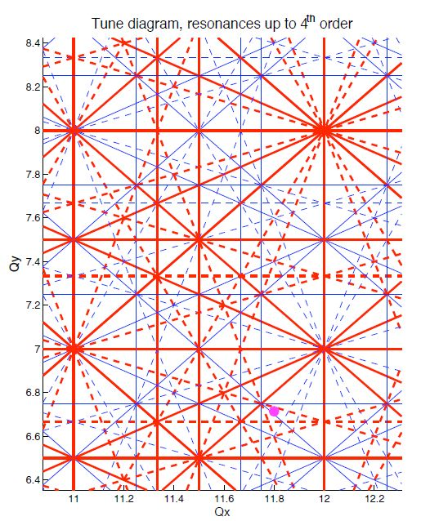
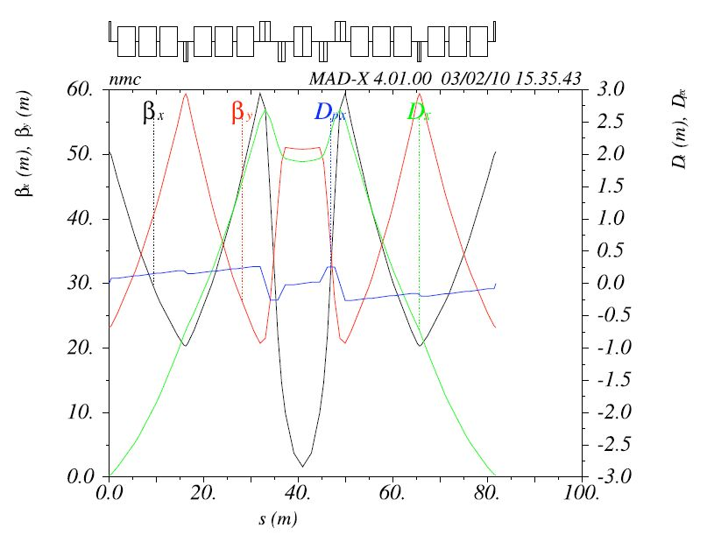
Which resonance ?
Current working point for PS2 : (11.8, 6.71)
4th Order resonance ν_{z}= 11.75
The ring is tuned from 11.8 to 11.752 with classical
matching process.
The final tune ramp is achieved by varying central
quads of each NMC cell.
(PS2.MQB.MOD.3 & PS2.MQC.MOD.4).
Antoine LACHAIZE LIS meeting 6/09/2010

Slide 4
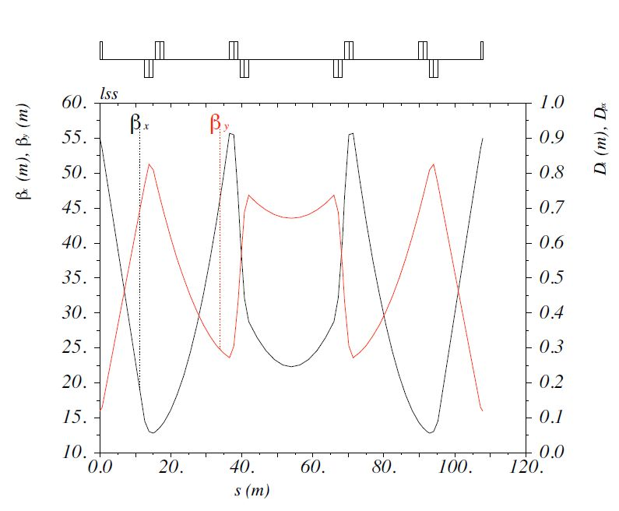
Octupoles
2 octupoles for the MTE :
- One excitation octupole, located at maximum of Horizontal Beta function.
- One correction octupole, to cancel the vertical coupling.
Antoine LACHAIZE LIS meeting 6/09/2010

Slide 5
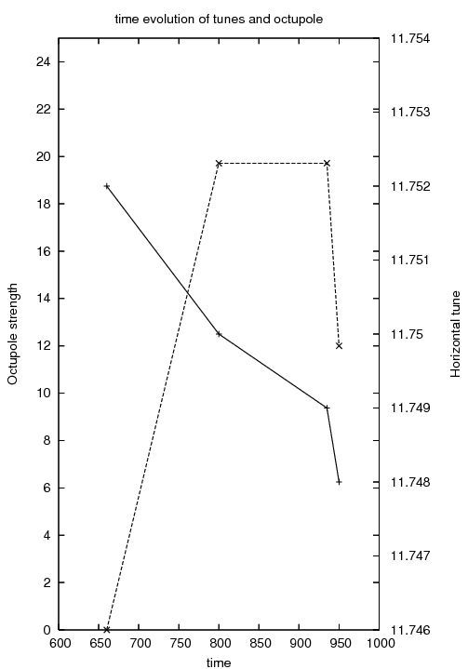
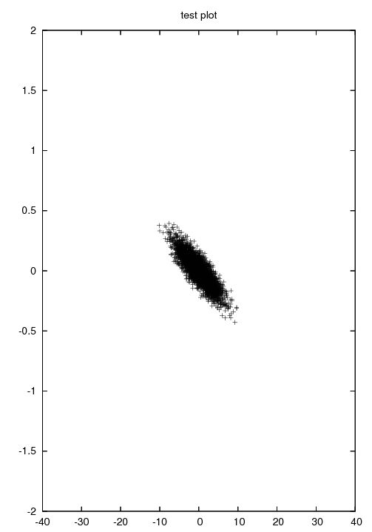
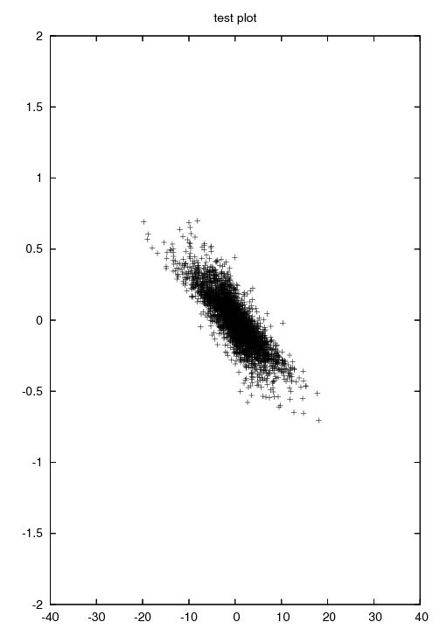
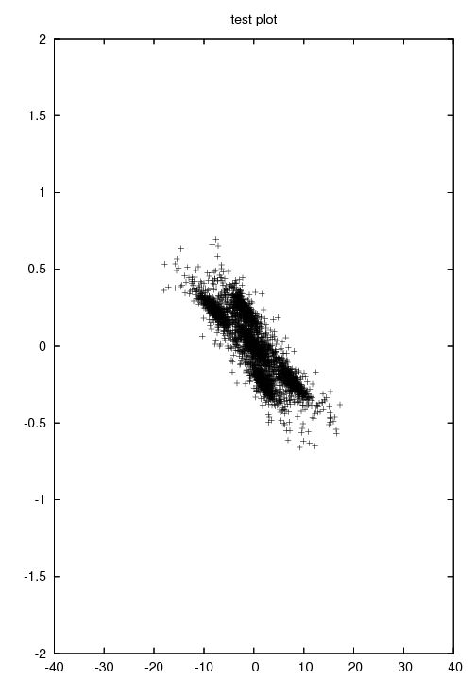
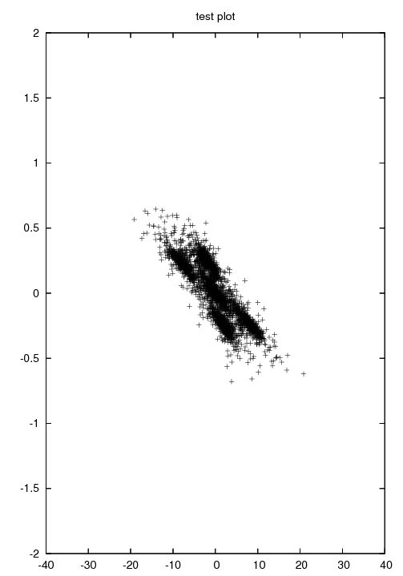
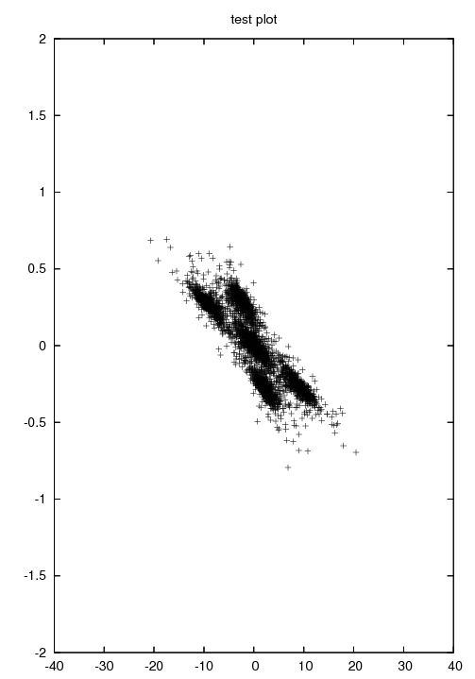
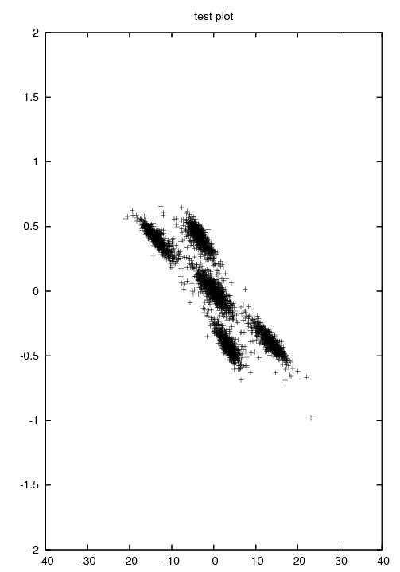
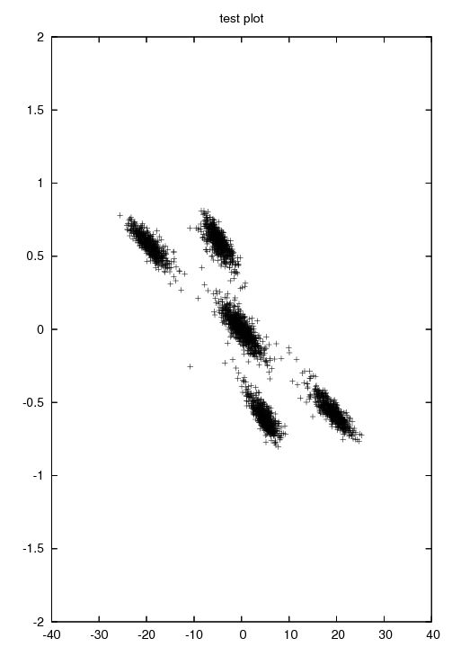
Capture process
Antoine LACHAIZE LIS meeting 6/09/2010

Slide 6
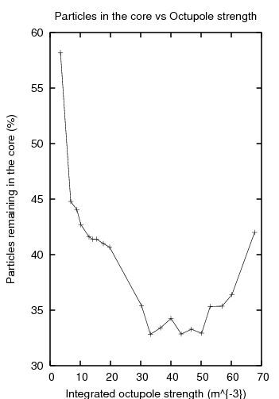
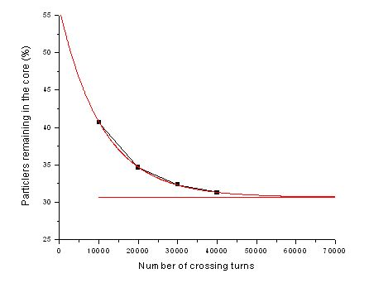
MTE : First optimisation
First step : to find an optimum for the octupole strength and the number of crossing turns
Antoine LACHAIZE LIS meeting 6/09/2010

Slide 7
Work to be Done
20% of remaining particles in the core
More complete control of the beam during capture
Design of extraction bumps (W.Bartmann and al.)
Acknowledgments : Massimo G., Simone G., Myriam N, Andrea F.
Antoine LACHAIZE LIS meeting 6/09/2010

