Slide 1
Preliminary MD results for a low transition energy in the SPS
H. Bartosik, Y. Papaphilippou, B. Salvant, T. Argyropoulos

Slide 2
MD participants
G. Arduini, T. Argyropoulos, H. Bartosik, T. Bohl, S. Cettour Cave, E. Shaposhnikova, K. Cornelis, F. Follin, W. Hofle, D. Jacquet, Y. Papaphilippou, A. Rey, G. Rumolo, B. Salvant, R. Tomas, G. Vanbavinckhove, J. Wenninger
Thanks to all members of the OP group!

Slide 3
Outline
Motivation for changing transition energy
How to change transition energy in SPS
General properties
Comparison of optics
Present status of the new SPS cycles
Measurements done so far
Measurement of synchrotron tunes
Confirmation of optics
Nonlinear chromaticity
Studies with high intensity in the flat bottom cycle
Injection losses
Bunch length and bunch profile
Transverse emittances
Preliminary studies with acceleration
Open questions – possible future MD activities

Slide 4
Why is it interesting to change transition energy in SPS?
Intensities of single bunch proton beams in SPS limited in the transverse plane by TMCI (Transverse Mode Coupling Instability)
Nominal SPS optics (transition energy γ_{t}~23) for LHC type of beams, threshold for TMCI is about 1.6E11 p/b (with low vertical chromaticity)
Transverse instability thresholds usually scale linearly with slippage factor η
Higher slippage factor (smaller transition energy) translates to higher synchrotron frequency Ω_{s}, i.e. faster longitudinal motion and damping of instabilities
Increasing slippage factor means lowering transition energy γ_{t}
However, required RF-voltage for obtaining the same longitudinal parameters scales with η – possible limitation

Slide 5
How to change transition energy in SPS?
How can transition energy be changed?
Transition energy γ_{t} defined by dispersion function in the bending magnets
In FODO lattice (like the SPS), transition energy scales roughly with the horizontal tune
Changing betatron tunes by a few units for lowering γ_{t} recently suggested by Y. Papaphilippou
Changing transition energy in SPS not new!
Already in 1978, Lyn Evans et al. changed transition energy
Lowering γ_{t} by reducing Q_{x}!

Slide 6
Change of tunes – change of transition energy
Boussard et al.,
SPS report 147,
1978
G. Arduini et al.,
CERN/SL-Note 98-001
(MD), 1998
2010
D. Boussard et al., SPS improvement report No 147, Nov. 1978

Slide 7
Comparison of optics
! Big change in η @ injection (factor 2.8) by reducing γ_{t} a few units !
Q26: Qx=26.13, Qy=26.18
Maximal β-functions: 108m
Mininam β-functions: 20m
Maximal dispersion: 4.8m
γt: 22.8
η @ 26GeV: 0.63E-3
η @ 450GeV: 1.9E-3
Q20: Qx=20.13, Qy=20.18
Maximal β-functions: 108m
Minimal β-functions: 30m
Maximal dispersion: 8m
γt: 18
η @ 26GeV: 1.8E-3
η @ 450GeV: 3.1E-3

Slide 8
Setup of 2 SPS cycles with new tunes
Prepared 2 cycles with integer tunes of 20
MD1 with a long flat bottom of about 3.7s, then beam is dumped
LHCfast3 with short flat bottom of 60 ms and acceleration up to 450GeV
Present status
Machine model with Q_{x,y}~20 entered into the SPS database
New zero-chromaticity values and knob parameters defined
RF program slightly adapted from Q26 cycle
Most of the machine controls can be used (some parameters are still based on the nominal Q26 lattices, e.g. for RF radial steering)
Tunes and chromaticity are corrected along the ramp of the new LHCfast3 Q20 cycle
Transferline TT2/TT10 not yet matched to new optics
Many thanks to the operators for preparing the cycles and helping us with the setup

Slide 9
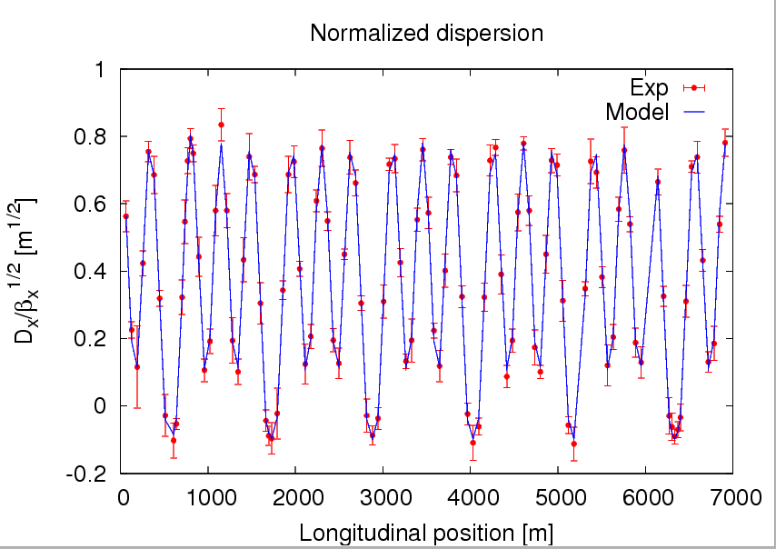
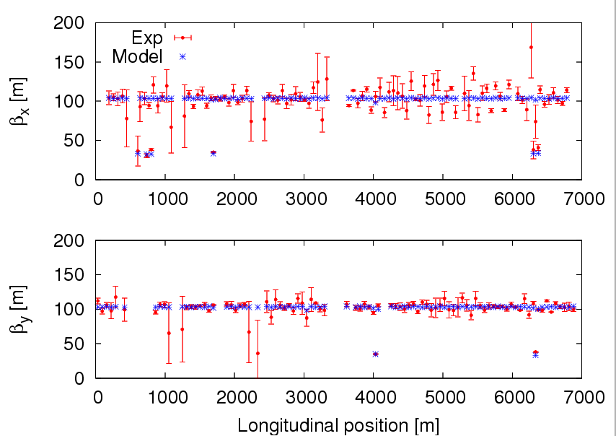
Experimental confirmation of the new optics*
* measured by R. Tomas and G. Vanbavinckhove
Optics functions of the new lattice
Beta beating around 20% in horizontal and 10% in vertical plane
Normalized dispersion in striking agreement with the model

Slide 10
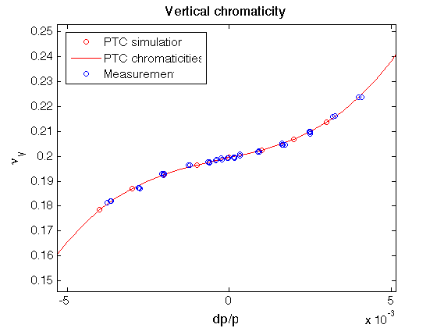
Nonlinear chromaticity in the new lattice
Sextupole strengths set with new chromaticity knobs
MADX-PTC nonlinear model of SPS adapted/fitted to the measurements with the new optics
Further studies will include measurements on tune-shift with amplitude and recalibration of dp/p with RF-frequency variation
Combined with measurements on the Q26 lattice a global approach to the nonlinear model may allow for a better understanding of the machine nonlinearities

Slide 11
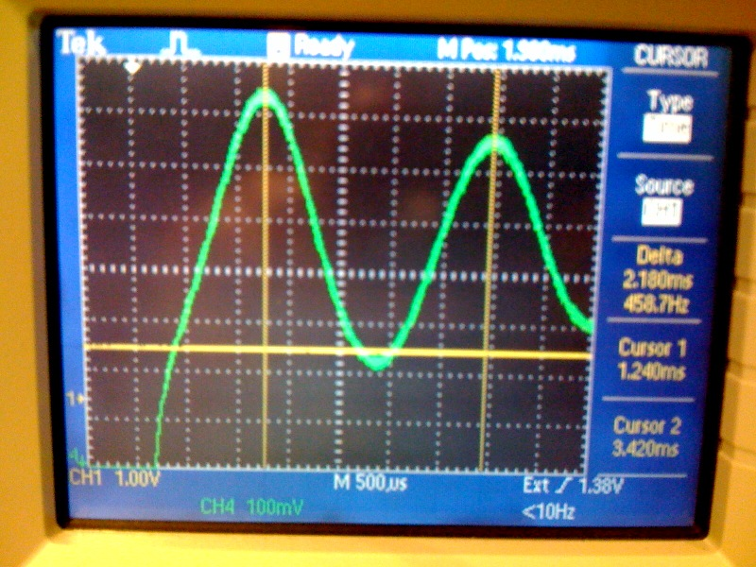
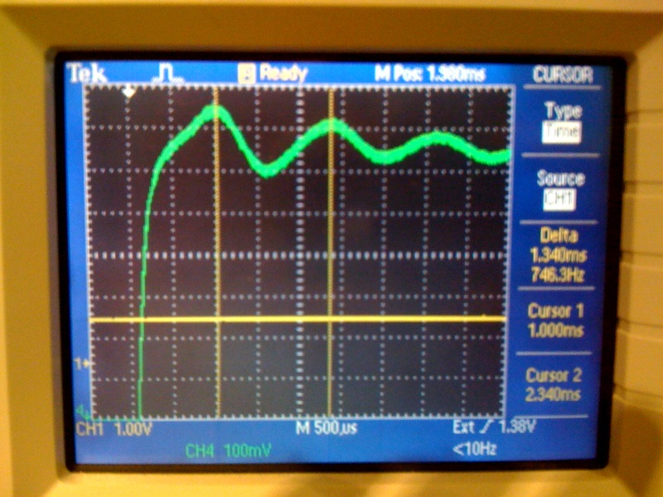
Higher synchrotron frequency
Measured synchrotron frequency from quadrupolar oscillations at injection
Set RF-voltage to 2.2 MV for both optics in the MD1 cycle
“Over-focusing” RF-bucket in both cases
Ratio of Synchrotron frequencies ~ 1.63 corresponds to an increase in slippage factor η by factor 2.65 (MADX prediction: 2.86)
Q26: Q20:
Fs=458/2=229 Hz Fs=746/2=373 Hz
Qs=0.0106/2=0.0053 Qs=0.0172/2=0.0086

Slide 12
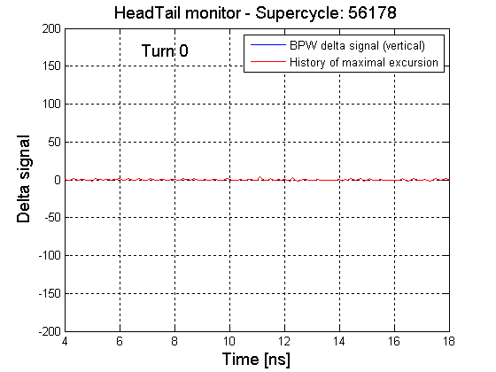
Observations at injection – MD1 – 10.Nov
Machine settings
Tunes close to Q_{x}=20.13 and Q_{y}=20.16 (a bit low, nominal 20.18)
Chromaticities ξ_{x}~0.2, ξ_{y}~0.03 (settings used in Q26 for instability studies)
RF voltage 1.8MV, second harmonic off
Octupoles switched off
Intensity from PS between 2.7E11-3.3E11 p/b
Systematic losses within the first 30ms after injection
No signature of Transverse Mode Coupling instabilities

Slide 13
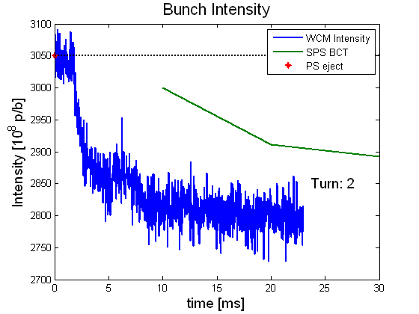
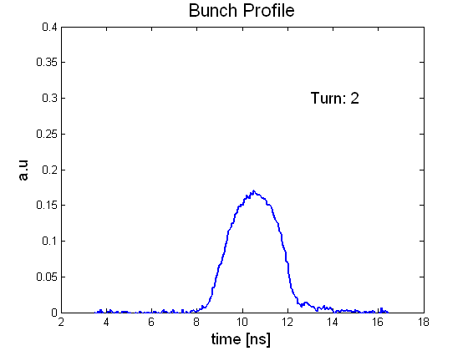
Bunch profile and bunch intensity – MD1 – 10.Nov
Intensity obtained from integrated bunch profile
Signal of WCM normalized to intensity delivered by PS
Even bigger losses (~10%) out of the bunch within first 5ms
Maybe the RF-voltage was too low for this intensity
First measurement of SPS BCT at 10ms!
Problem of normalization of integrated bunch intensity…

Slide 14
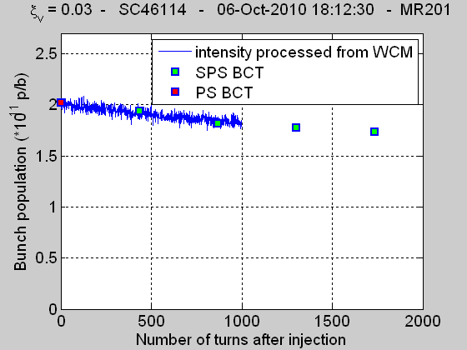
Previous results with the Q26 cycle
Previous results with Q26
Recent results with Q20
Calibration between PS BCT, SPS BCT and integrated WCM seems to work
Is the discrepancy caused by the calibration between PS BCT, SPS BCT and integrated WCM?
If the calibration is ok, it seems like we lose out of the bucket!

Slide 15
Bunch length – MD1 – 10.Nov
Bunch intensity integrated from WCM shows continuous loss along the flat bottom
Possible reasons: working point (slightly too low in vertical), space charge effects, RF-voltage
Bunch length calculated from bunch profile
Quadrupolar synchrotron oscillations observed right after injection
Slight reduction of bunch length with time due to losses

Slide 16
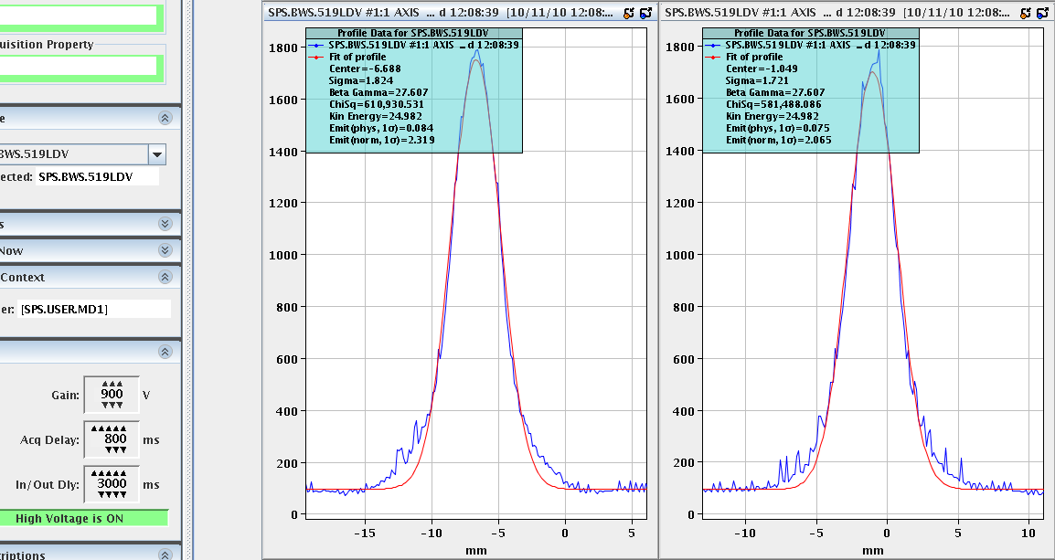
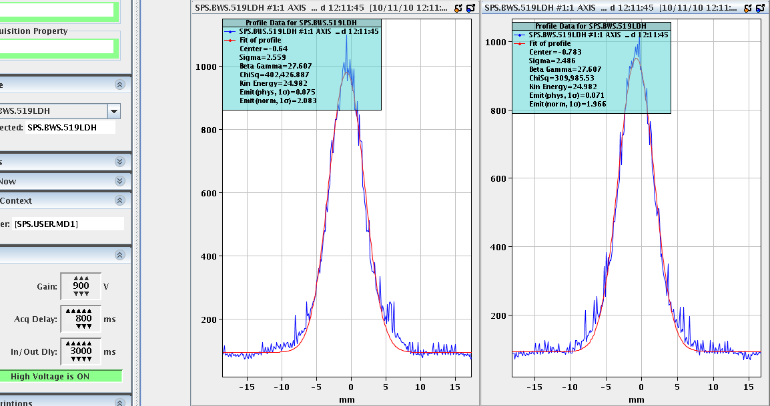
Transverse emittances - MD1 – 10.Nov
Machine parameters
Tunes close to Q_{x}=20.13 and Q_{y}=20.16 (a bit low, nominal 20.18)
Chromaticities ξ_{x}~0.2, ξ_{y}~0.03
RF voltage 1.8MV, second harmonic off
Octupoles switched off
Emittances at beginning of flat bottom (measured with in-scan)
Ε_{h}~1.9-2.1 mm.mrad, Ε_{v}~2.2-2.4 mm.mrad @ 2.6E11 p/b
Ε_{h}~2.4-2.6 mm.mrad, Ε_{v}~2.6-2.7 mm.mrad @ 3.3E11 p/b
No significant blow-up at the end of flat bottom (measured with out-scan)
Emittances at the end of FB always gave smaller values than at the beginning of FB
Systematic error of out wire scan (gives about 0.2 mm.mrad smaller values)

Slide 17
Preliminary comparison of the cycles: Q26 – Q20
Q26
Q20
Well studied and optimized cycles
TMC instability threshold about 1.6E11 p/b with low vertical chromaticity
Immediate beam loss for positive vertical chromaticity due to headtail instability
Difficult to avoid significant transverse emittance blow-up for high intensities
Acceptable longitudinal parameters for LHC
TMC instability threshold seems to be higher than 3E11 p/b
Even the headtail instability for negative chromaticity seems to be damped for significant intensities
Without much optimization, transverse emittance blow-up seems very small
Still many parameters left to optimize and to explore
Acceptable longitudinal parameters for LHC ?

Slide 18
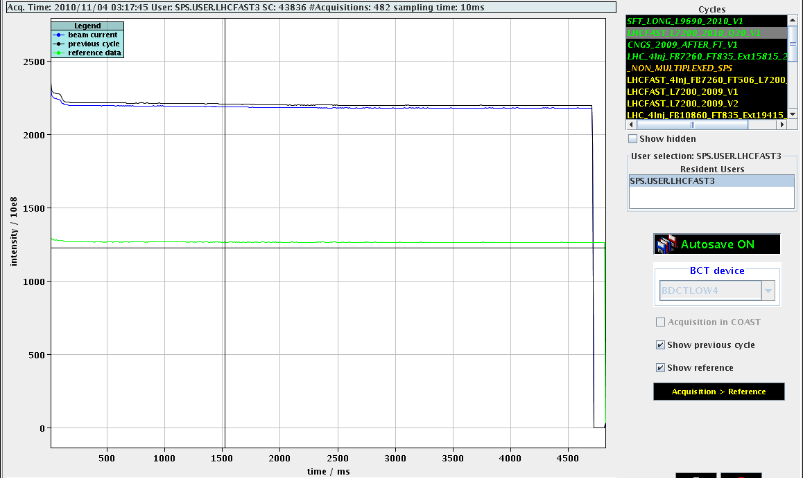
Achievements with the LHCfast3 cycle
Corrected tunes all along the cycle
Accelerated single bunches with intensities up to 2.5E11 p/b up to flat top without major losses (only small losses <5% right after injection and at beginning of acceleration)
Transverse emittances (norm, 1σ) Ε_{h}~2.4 mm.mrad, Ε_{v}~2.9 mm.mrad @ 2.4E11 p/b
Bunch length measured at extraction about 1.5 ns
RMS-Orbit within usual limits
Chromaticity knobs at that point still based on the nominal Q26 lattice

Slide 19
MD on MD1 cycle, 20.Nov
Scan of RF-voltage for different intensities
Qx=20.13, Qy=20.18, ξ_{x}~0.2, ξ_{y}~0.03 (chromaticities not measured)
Improving losses after injection with increasing RF-voltage
Small effect for intensity around 1E11 p/b: 2-4% losses
Losses around 4% for RF-voltage above 2.5 MV for 2E11, but increased loses for lower voltages
No clear dependence on RF-voltage in both cases – maybe due to longitudinal phase space distribution coming from the PS (optimization for high intensities may be needed)

Slide 20
MD1, 20.Nov: 2E11 p/b from PS
RF-voltage: 1.8 MV
RF-voltage: 3.2 MV
RF-voltage: 3.8 MV
Immediate losses with 1.8 MV (~10%)
Reduced losses within first 20 ms after injection for RF-voltage above 2.5 MV (~4%)
Slow losses within 1.5 s
Total losses seem to increase again with higher voltage
Why?

Slide 21
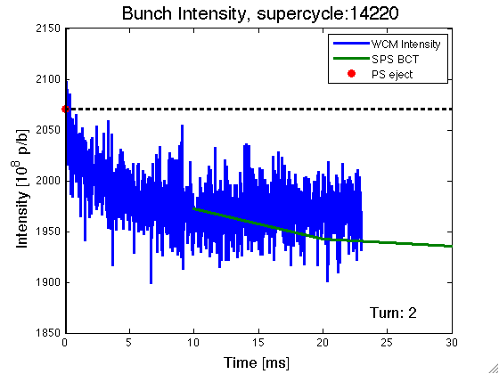
MD1, 20.Nov: 2E11 p/b from PS, RF-voltage: 3.8 MV
Strong quadrupolar synchrotron oscillation due to high RF-voltage
clearly above matched voltage
What is the optimum RF-voltage?
Comparison with MD1 cycle with nominal tunes and further studies needed

Slide 22
MD on LHCfast3 acceleration cycle, 20.Nov
Attempt to correct chromaticity along the ramp with the new knobs
Manual adjustment of constant chromaticity is not easy: Beam losses for negative chromaticity; many measurements along the ramp needed
Correction curves from nominal cycle cannot be used since the chromaticity knobs are completely different
Auto Q’ function in this stage not usable since it relies on the correct response of the momentum offset on the RF radial steering knob
For next year, RF radial steering knob should be updated for the new optics
Not so trivial since this knob is hard coded

Slide 23
Open questions – Possible future MD activities
MD1 flat bottom studies
Instability thresholds for the new Q20 cycles are higher than for the nominal Q26… but where?
Can we improve losses at injection by changing the RF-voltage or are there other effects to be considered?
What isthe optimal RF-voltage as a function of intensity?
How big is the impact of the optics mismatch at injection?
LHCfast3 acceleration cycle
How about emittances at flat top for very high intensities?
Can acceptable beam parameters be reached with the current maximal RF-voltage available?
Is there any other limitation?
Possible future MD activities
Try to answer questions from above
Inject LHC bunch trains with high intensity for studying electron cloud and other multi-bunch instabilities
Investigate the possibility of injecting high intensity (CNGS) beams above transition (Q15)
New cycles could be very useful to study the localization of the impedance sources of the machine
Further studies on the nonlinear machine model
Match transferline TT2/TT10

