Slide 1
PS2 – single particle dynamics
H. Bartosik, Y. Papaphilippou

Slide 2
Machine parameters – main characteristics
PS2 meant as potential replacement of existing PS
PS2 main characteristics given by LHC requirements
  Circumference defined by optimized filling pattern of subsequent SPS: C=1346.4m (=15/77 of SPS)
  Negative Momentum Compaction (NMC) lattice (imaginary γt) for avoiding crossing of transition energy
  Basic requirement is very high intensity
    LHC: 4E11 p/b, ε_{x,norm}=3π.mm.mrad, ε_{y,norm}=3π.mm.mrad
    fixed target: 6E11 p/b, ε_{x,norm}=9π.mm.mrad, ε_{y,norm}=6π.mm.mrad
  Injection energy 4GeV kinetic (to compensate increased space charge tuneshift compared to PS)
  Extraction energy 50GeV
Injection/extraction located in the same long straight section
Zero dispersion in straight sections to ease beam transfer
Nominal lattice has superperiodicity of 2 (alternative option has 3)

Slide 3
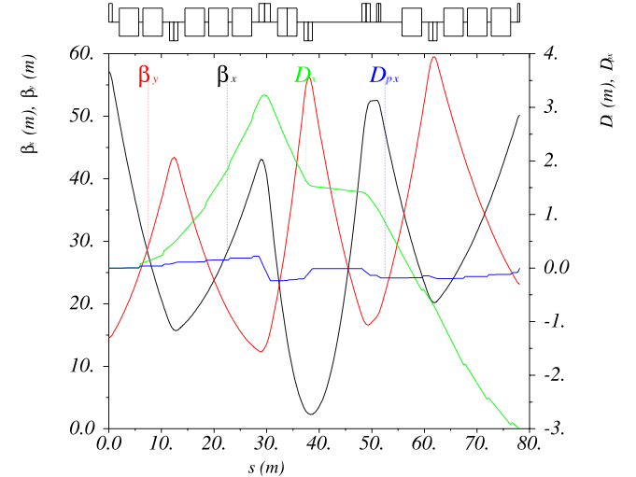
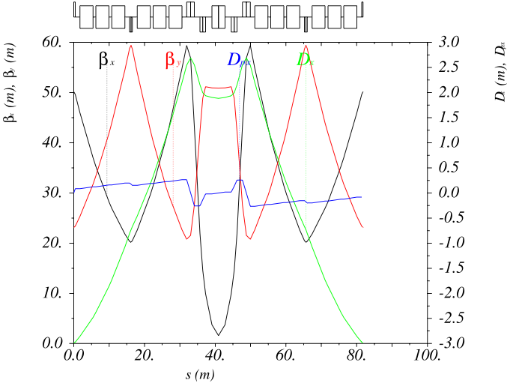
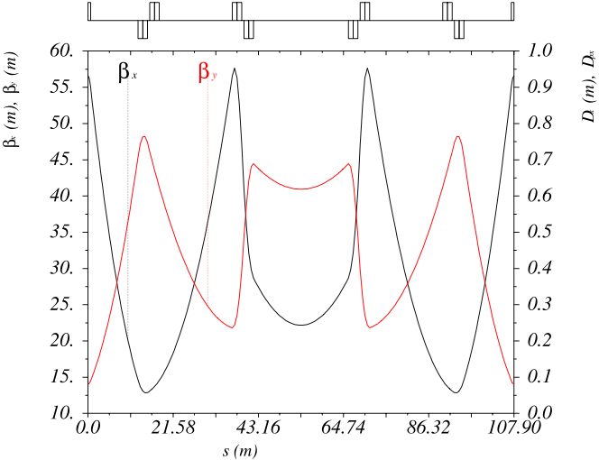
Linear lattice
Long straight section (LSS)
4 independ quadrupole families
Wider aperture magnets due to beam transfer constraints
Zero dispersion
Optics optimized for injection with charge exchange by stripping foil
Dispersion suppressor
First and last quad shared with LSS and NMC cell
6 independent quadrupoles (same 3 types as in the NMC cells) needed for achieving matching constraints
Fexibility to match to a wide range of phase advances of the NMC cell
NMC cell
FODO-Doublet-Doublet-FODO structure with high filling factor
4 independent quadrupoles (3 types) for high flexibility
Imposing negative dispersion at entrance of cell leads to negative momentum compaction

Slide 4
Summary of Lattice parameters
Parameter | Value
Circumference | 1346.4m
Bending radius | 99.9m
Injection energy | 4GeV
Extraction energy | 50GeV
Transition energy | imaginary
Number of dipoles | 170
Minimum drift space between dipoles | 0.8m
Number of quadrupoles | 116
Minimum drift space around quadrupoles | 1.3m
Types of quadrupoles | 3
Number of sextupoles | 84
Full aperture, focusing quadrupoles and dipoles | 12.6x6.5cm
Full aperture, defocusing quadrupoles | 11x7.5cm
Nominal working point (Q_{x}, Q_{y}) | 11.8, 6.7

Slide 5
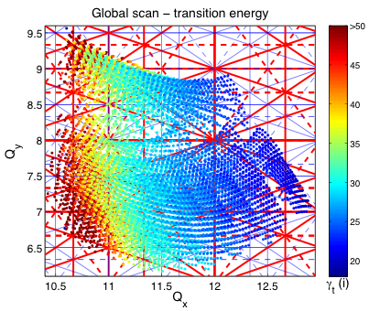
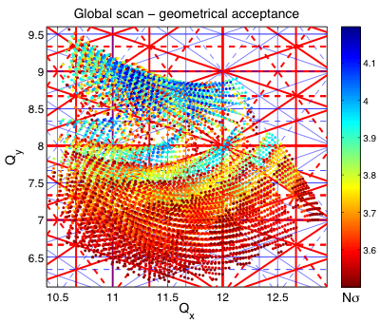
Tuning flexibility
GLASS (Global Scan of All Stable Solutions) for studying tuning flexibility
  Optics in LSS kept constant
  4 quadrupole families in the NMC cells scanned systematically
  For each stable set, dispersion suppressor is matched
  Stable solutions are filtered: max gradients within limits (<16T/m), geometrical acceptance Nσ>3.5 for fixed target beam (ε_{x,norm}=9πmm.mrad, ε_{y,norm}=6πmm.mrad, total δp/p=7e-3)
Tuning range > 2 units in horizontal and > 3 units in vertical plane
  Transition energy depends clearly on horizontal phase advance (18i<γt<80i)
Geometrical acceptance up to Nσ=4.2 for fixed target beam

Slide 6
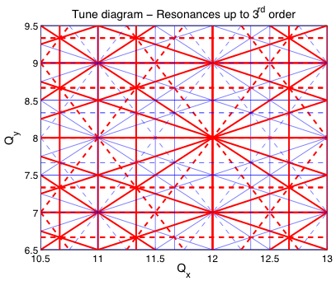
Tune diagram – superperiod 2
Interesting tune region restricted by
  space charge tune shift ΔQ~0.2-0.25
  Structural resonance at Q_{x}=12
  3rd order structural resonances in horizontal plane at Q_{x}=11.33 and Q_{x}=12.66
  Increasing imaginary transition energy for lower horizontal tunes
  Physical aperture considerations

Slide 7
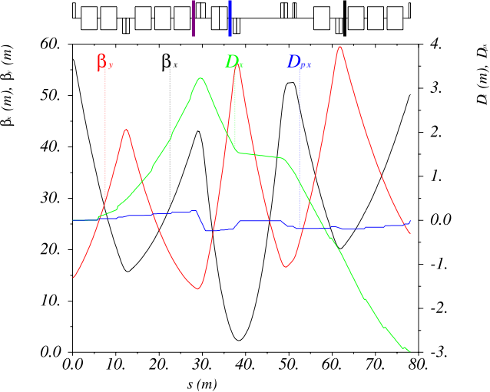
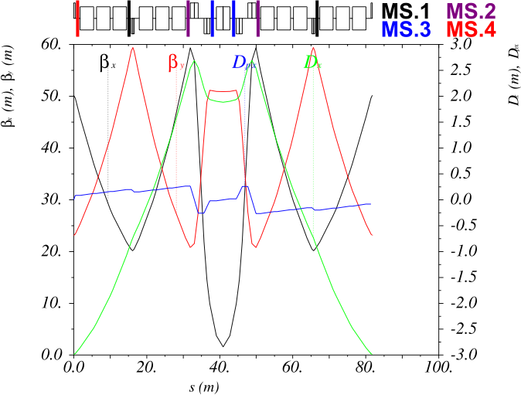
Chromaticity correction
4 families of sextupoles (88 sextupoles in total)
  MS.1: 24 members, in center of FODO part of NMC cell and dispersion suppressor
  MS.2: 24 members, around doublet insertion in NMC cell and dispersion suppressor
  MS.3: 24 members, around central dipole in NMC cell and dispersion suppressor
  MS.4: 12 members, at beginning/end of NMC cell
Main chromaticity correction families MS.2 and MS.3
MS.1 and MS.4 can be used for adjusting nonlinear chromaticity or tune-footprint

Slide 8
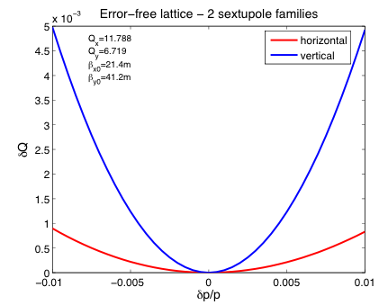
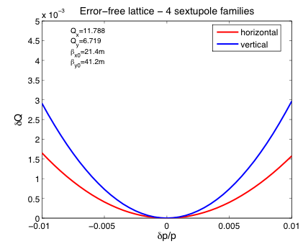
Nonlinear chromaticity – error-free lattice
Nonlinear chromaticity dominated by second order
  The 2 additional families in 4 family scheme can be used to slightly reduce second order chromaticity and optimize off-momentum β-beat
  In both cases, the induced tune-shift is smaller than 5E-3 for momentum deviations up to 1%

Slide 9
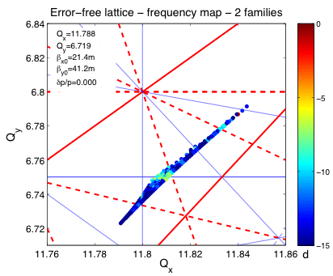
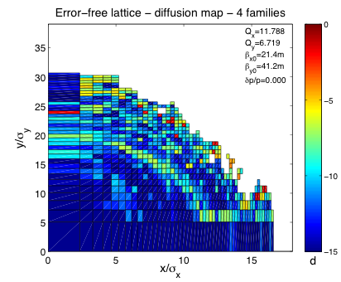

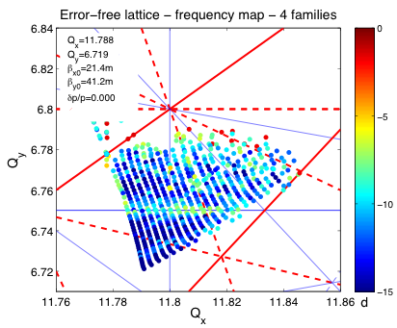
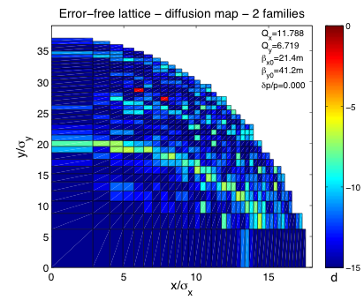
Frequency maps – error-free lattice
Tracking particles with PTC in 5D with initial conditions in configuration space evenly spaced in action
For each particle, the tune diffusion rate d is plotted in lograthmic scale as function of initial condition (Diffusion map) and as function of betatron-tune (Frequency map)
Resonances up to 5th order shown in tune diagram
4 family sextupole scheme is reshaping of the tune-footprint (tune-shift with amplitude) leading to a smaller dynamic aperture in this case

Slide 10
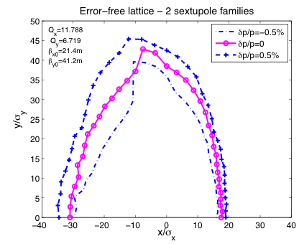
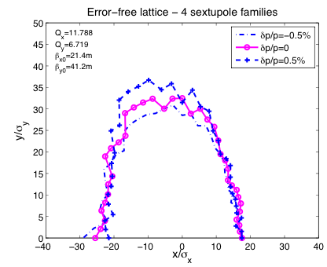
Dynamic aperture – error-free lattice
MADX-PTC tracking in 5D (fixed momentum offset, no synchrotron oscillations) - tracking starts in the center of LSS where a-functions and dispersion is zero = location of the scraper
Nonlinearities of fringe fields and chromaticity sextupoles included (linear chromaticity corrected to zero in all studies)
Units are given by the beam sizes of the high intensity fixed target beam (ε_{x,norm}=9π.mm.mrad, ε_{y,norm}=6π.mm.mrad)
Dynamic apertures for the error free lattice is huge compared to geometrical acceptance of the machine (Nσ_{geom}~3.6)

Slide 11
Impact of closed orbit distortion
Orbit correction system of the PS2
  108 biplanar BPMs
  60 correctors for vertical and 48 for horizontal plane
  Installed around quadrupole magnets
Machine imperfections assumed to follow Gaussian distributions
  Field errors with a cut at 2σ
  Misalignments with a cut at 3σ
MICADO algorithm in MADX in 2 iterations used to correct orbit
Type | Dipoles | Quadrupoles | Sextupoles
Relative field error | 5E-4 | 5E-4 | 0
Tranverse shift | 0.3mm | 0.2mm | 0.2mm
Longitudinal shift | 1mm | 1mm | 1mm
Tilt | 0.3mrad | 0.3mrad | 0.3mrad

Slide 12
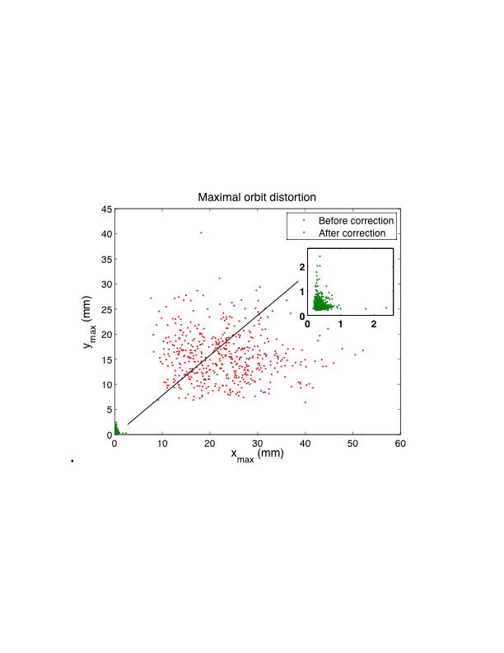
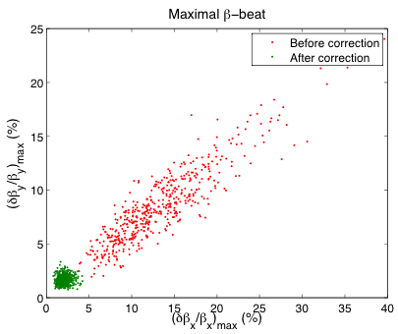
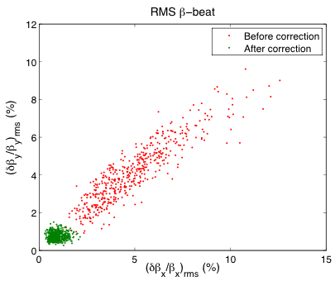
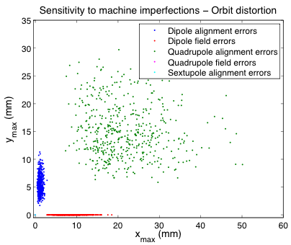
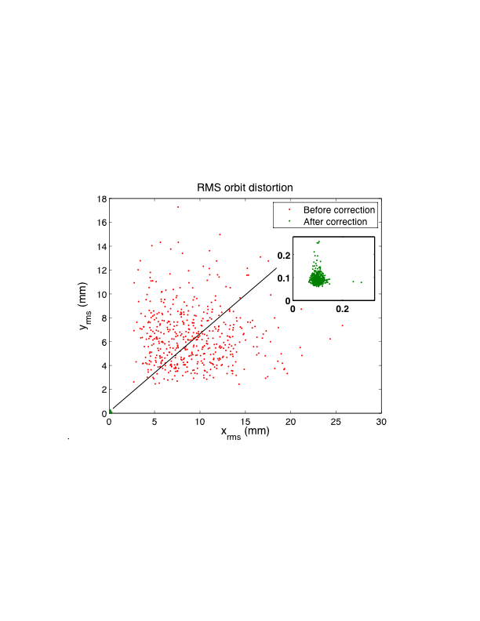
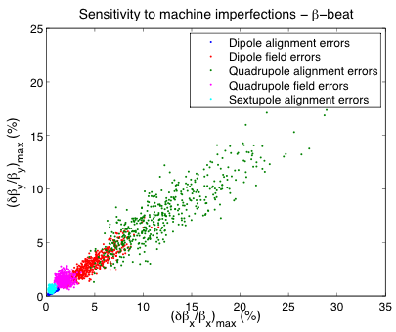
Impact of closed orbit distortion
→ Correction of closed orbit distortion sufficiently reduces β-beat

Slide 13
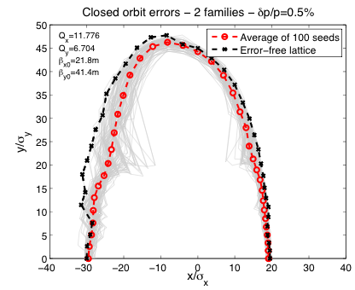
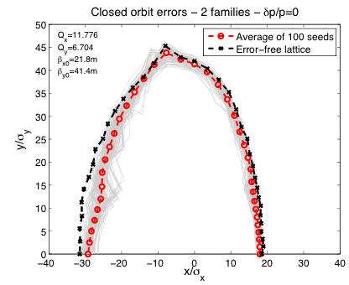
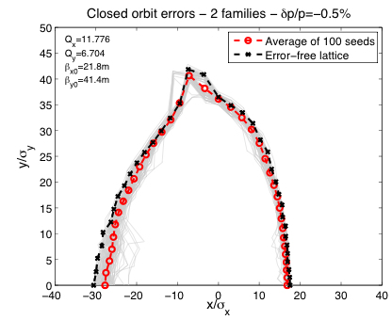
Impact of closed orbit distortion – dynamic aperture
Tracking particles for 1000 turns in 5D (no synchrotron motion) in lattice with 2 sextupole families after closed orbit correction in MAD
For 100 error seeds only minor degradation in dynamic aperture for negative momentum offset and on-momentum particles - slightly bigger effect for positive momentum offset

Slide 14
Impact of multipole errors – error table*
Order | Dipoles(R=5.95cm) |  | Quadrupoles(R=5.95cm) |  | Sextupoles(R=5.95cm)
 | mean | random | mean | random | mean | random
n | B_{n}/b₁ (1E-4) | b_{n}/b₁ (1E-4) | b_{n}/b₂ (1E-4) | b_{n}/b₂ (1E-4) | b_{n}/b₃ (1E-4) | b_{n}/b₃ (1E-4)
1 | 1E4 | 5 | 0 | 1 | 0 | 3
2 | 0.3 | 0.2 | 1E4 | 5 | 0 | 10
3 | 4 | 2 | -2 | 1 | 1E4 | 5
4 | 0.1 | 0.5 | 1 | 1 | -0.5 | 1.5
5 | -1.5 | 1 | 1 | 1.5 | 0.5 | 1.5
6 | -0.1 | 0.1 | 3 | 1 | -1 | 0.5
7 | -1.5 | 0.3 | 0.5 | 1 | 1 | 0.5
8 | 0.1 | 0.1 | 0.5 | 0.5 | 0.5 | 0.5
9 | -1 | 0.3 | 0.1 | 0.3 | -4 | 0.3
10 | - | - | 0.5 | 0.3 | 0.1 | 0.5
11 | - | - | 0.1 | 0.3 | 0.1 | 0.5
*based on field distribution and measurements of JPARC Main Ring magnets (similar characteristics), K.Nikietal.,WEPCH028,EPAC2006 and JPARC technical design report

Slide 15
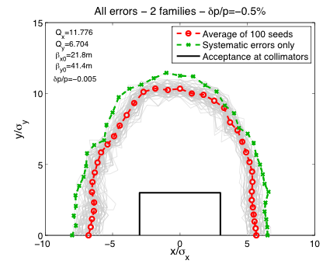
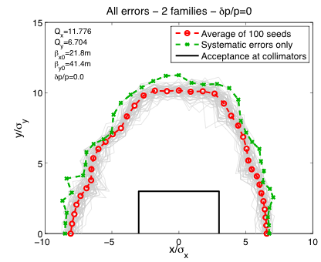
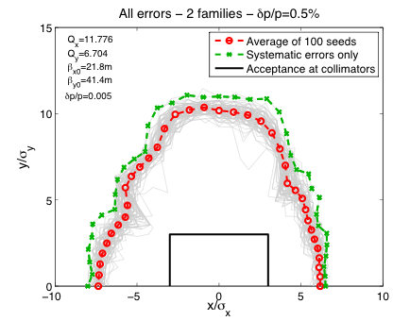
Impact of multipole errors – dynamic aperture
1000 turn dynamic aperture plots for the lattice with all multipole field errors and magnet misalignments as described before
Black rectangle shows the acceptance defined by the collimation scraper located in the center of the LSS (where the tracking starts) – set to 3σ
Green line indicates dynamic aperture for the symmetric lattice (no misalignments, only systematic multipole errors)
Drastic degradation of the stable area in configuration space compared to the error-free case – biggest impact due to dipole errors (B5, B7, …)

Slide 16
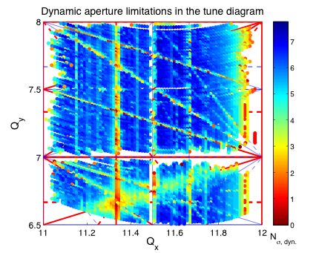
Impact of multipole errors – tune scan
1000 turn dynamic aperture in tune diagram for one particular error seed (2 sextupole families) - resonance plotted up to 3rd order
Possible locations for the working point indicated by circles:
  (Q_{x}, Q_{y})≈(11.8, 6.7): nominal working point
  (Q_{x}, Q_{y})≈(11.8, 7.7): alternative working point with similar transition energy (γ_{t}≈26i)
  (Q_{x}, Q_{y})≈(11.25, 7.2): alternative working point, higher transition energy (γ_{t}≈32i), systematic 3rd order resonance at 3Q_{x}=34 not nice for resonant slow extraction

Slide 17
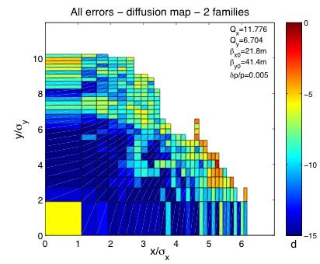
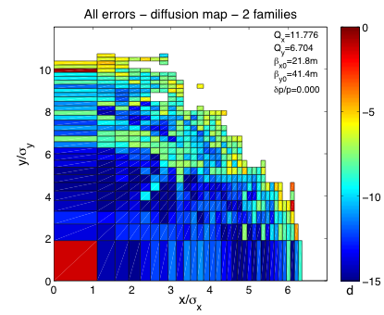
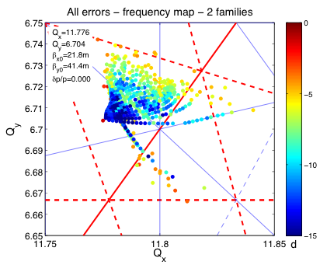
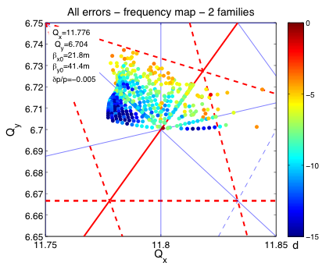
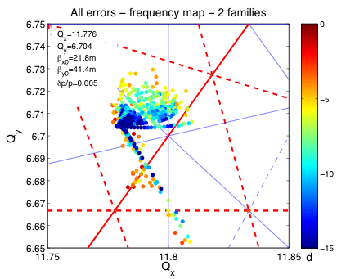
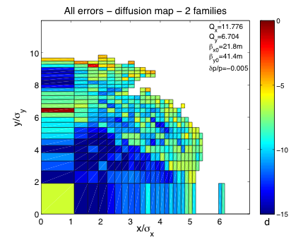
Impact of multipole errors – frequency maps
Tune footprint shapes are determined to large extend by higher order multipole errors – note also the dependence on the momentum due to feed-down effects

Slide 18
Impact of multipole errors – beam survival
Dynamic aperture bigger than physical acceptance is not sufficient for small particle losses
  Particles may cross resonances causing transverse emittance blow-up
  Particle survival in the presence of aperture limitations is important
PTC-tracking simulation
  Particles with initial conditions within the aperture limitation defined by the scraper at 3 σ of the fixed target beam
  Particle survival is defined by amplitude of betatron oscillation at the location of the scraper

Slide 19
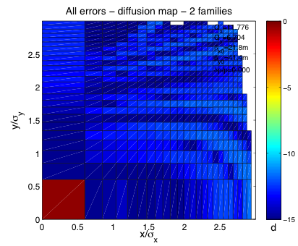
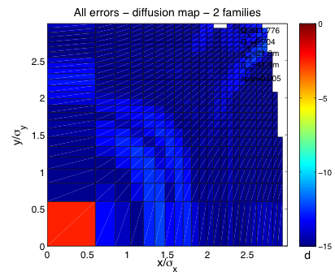
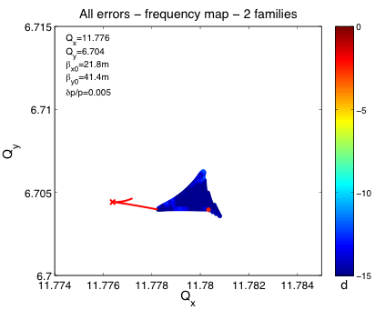
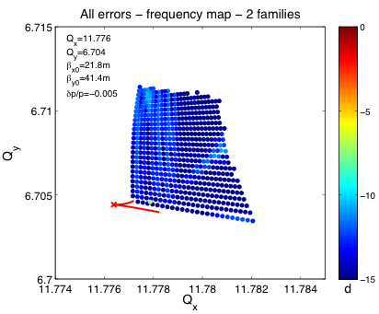
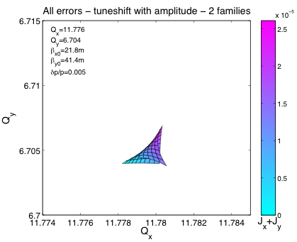
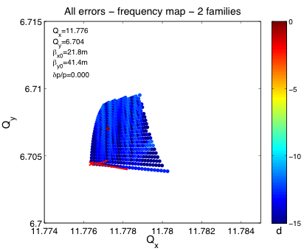
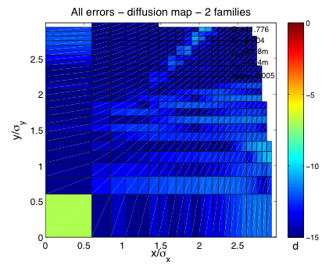
Impact of multipole errors – beam survival – 2 families
Already for small actions nonlinear dependence of the detuning due to higher order multipoles
Strong variation of tune-footprint with momentum offset
Reconstruction with anharmonicities given by PTC shows folding for positive momentum offset

Slide 20
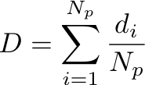
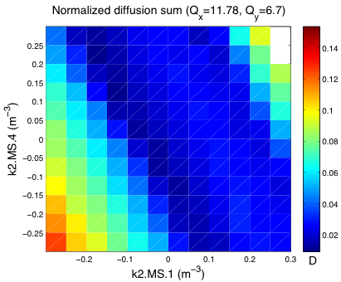
Impact of multipole errors – scan of sextupole strengths
Scanning strength of sextupole families MS.1 and MS.4 while resetting linear chromaticity to zero with reaming two families
Total diffusion rate D is used for optimizing beam survival
  Summing tune diffusion rates d_{i} over all tracked particles N_{p}
  Lost particles are assigned with an artificially high diffusion rate

Slide 21
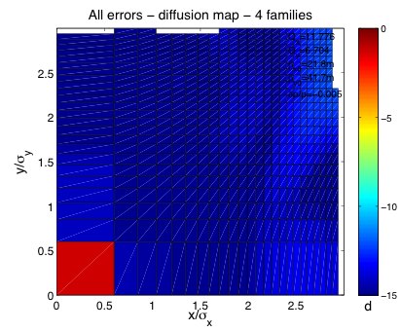
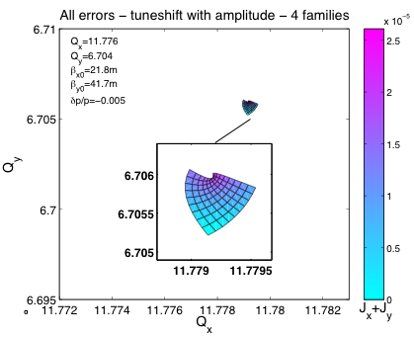
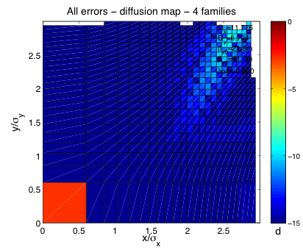
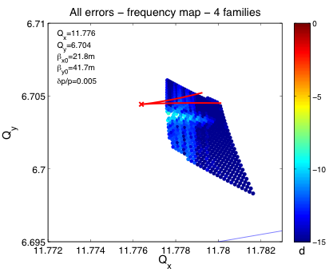
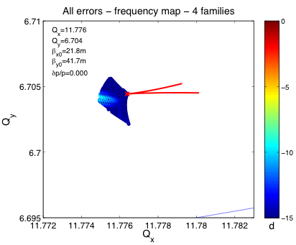
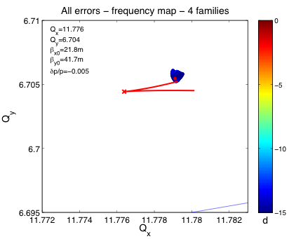

Impact of multipole errors – beam survival – 4 families
Tune footprint completely reshaped
Slightly smaller amplitude detuning than in the 2 family case but increased nonlinear chromaticity
Reconstruction with anharmonicities given by PTC shows nonlinear dependence of the detuning

Slide 22


Impact of multipole errors – 6D dynamic aperture
10000 turn 6D (with synchrotron motion) dynamic aperture
  RF parameters according to stationary bucket: h=180, V_{RF}=0.65MV, φ_{s}=0
  Black rectangle shows aperture limitation defined by scrapers
  Slightly bigger stable area and smaller variation for different error seeds in this specific example of 4 sextupole families

Slide 23


Impact of multipole errors – nonlinear chromaticity
Higher order chromaticity induced by multipole field errors
Slightly increased second order chromaticity in the case of the 4 family sextupole scheme with the settings used above compared to 2 families

Slide 24
Summary - Conclusions
Linear lattice of PS2 provides good tuning flexibility without changing optics in the straight sections
Dynamic aperture and nonlinear dynamics of the racetrack PS2 lattice studied with two chromaticity correction schemes
  Dynamic aperture in the error-free lattice huge compared to the physical acceptance of the machine for both schemes – comparably small betatron amplitude detuning
  Adding misalignments and errors in the strength of the main magnets have minor effect on dynamic aperture
  Multipole errors lead to drastic degradation of dynamic aperture – stable area more or less given by good field region of the main magnets, amplitude detuning determined to large extend by high order multipoles
4 family sextupole scheme provides some flexibility for adjusting detuning effects and slightly increasing dynamic aperture

