Slide 1
Multiturn extraction for PS2
M.Giovannozzi, A.Lachaize
LIS meeting 17/01/2011

Slide 2
Multi-Turn extraction, principle
Method developed to fill the SPS with beam from the PS with minimized losses and
filling time and without mechanical action.
Splitting is performed by creating stables islands in phase space with non-linear elements
which excite non-linear resonances.
Then, by varying the horizontal tune, particles are trapped into islands by adiabatic
Capture.
Finally the beamlets are moving far away from the remaining core around the origin.
For PS2 the beam is splitted into 5 beamlets so we cross a 4th order resonance
(4 stable islands and the core) excited by an octupole.
LIS meeting 17/01/2011

Slide 3
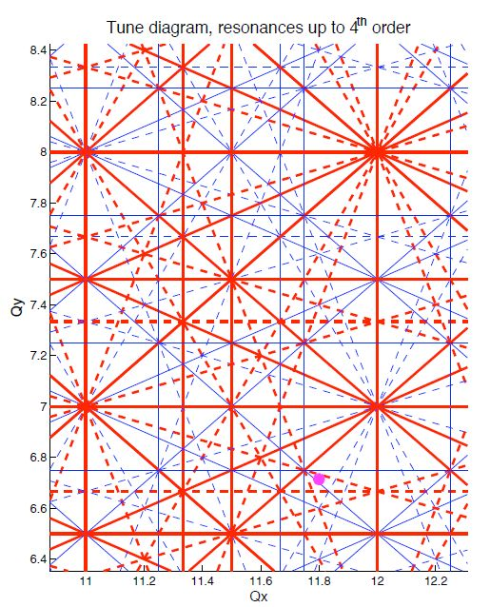
Which resonance ?
Current working point for PS2 : (11.788, 6.71)
4th Order resonance Qx= 11.75
First the ring is matched to move the horizontal tune from 11.788 to 11.75
Then the resonance is crossed using a power law :
Finally a linear decrease is performed up to 11.746 to move island towards higher amplitudes
LIS meeting 17/01/2011

Slide 4
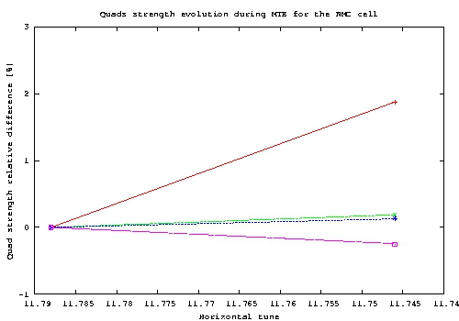
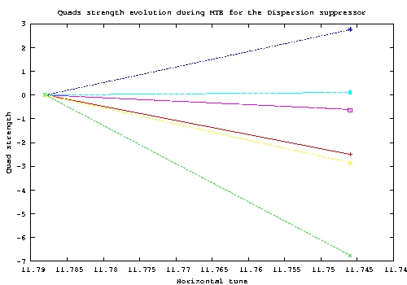
Quadrupole strength variation
Relative quad strength difference from nominal working point to the end of capture for NMC cell (left) and dispersion suppressor
(right).
LIS meeting 17/01/2011

Slide 5
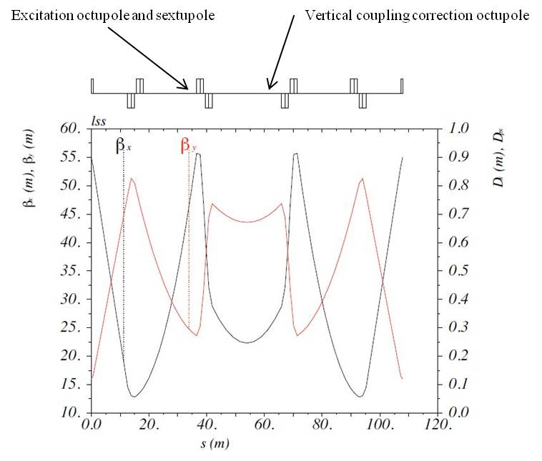
Magnetic elements location
2 octupoles and one sextupole for the MTE :
- One excitation octupole, coupled to one excitation sextupole located at
maximum of horizontal beta function.
- One correction octupole, to cancel the vertical coupling, located at
maximum of vertical beta function
LIS meeting 17/01/2011

Slide 6
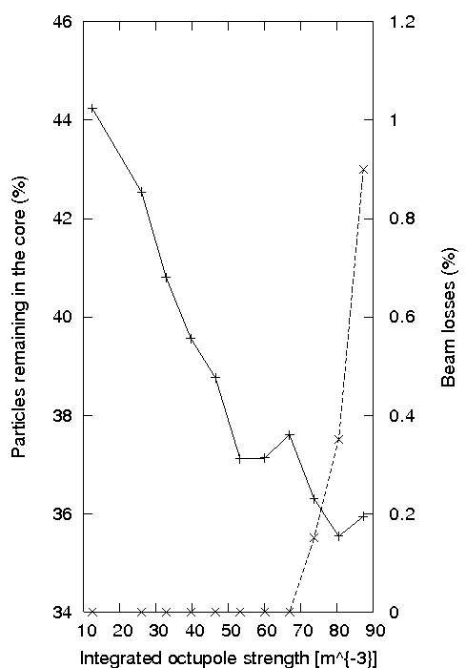
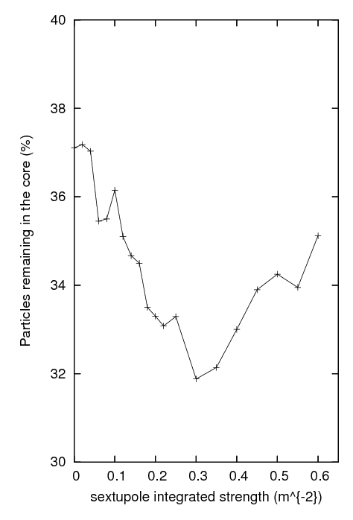
Magnetic elements optimisation
Optimum value : K₃l = 53 m⁻³
Optimum value : K₂l = 0.3 m⁻²
Optimum set of magnetic strength : K₃l^{ext} = 60.53 m⁻³
(10000 crossing turns) K₃l^{cor} = -59.33 m⁻³
K₂l^{ext} = 0.3 m⁻²
LIS meeting 17/01/2011

Slide 7
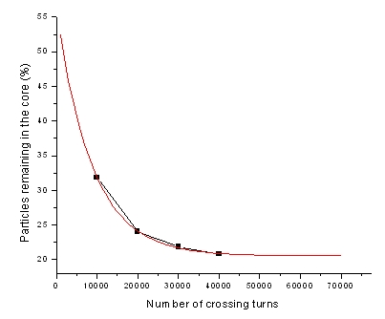
Number of crossing turns optimisation
A higher number of crossing turns provides a more adiabatic capture and a better efficiency.
Final choice of number of crossing turns will depend on extraction flat-top length
LIS meeting 17/01/2011

Slide 8
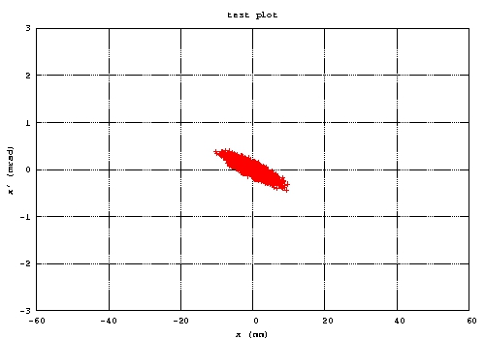
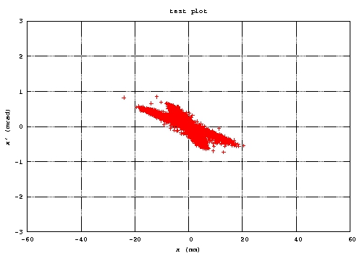
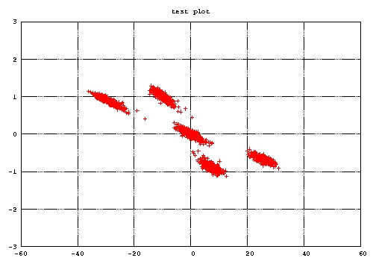
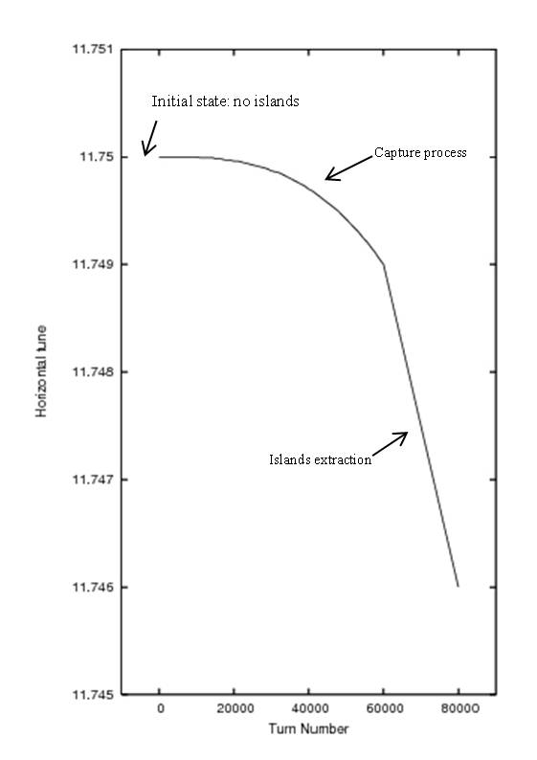
Beam distribution in transverse phase space
LIS meeting 17/01/2011

Slide 9
Capture process main parameters
Resonance | Q_{x} = 11.75
Order of resonance | 4
Capture time (ms/turns) | 180 / 40000
Extraction time (ms/turns) | 90 / 20000
Excitation octupole integrated strength (m⁻³) | 60.5394
Correction octupole integrated strength (m⁻³) | -59.3303
Sextupole integrated strength (m⁻²) | 0.3
Horizontal tune at the beginning/end of capture | 11.75/11.749
Horizontal tune at the end of the process | 11.746
Number of remaining particles in the core after capture | 20.5
Beamlets and core emittances at the end of capture (mm.mrad, 1σ)
Core | Island1 | Island2 | Island3 | Island4
2.4 | 2.15 | 2.03 | 2.11 | 2.04
LIS meeting 17/01/2011

Slide 10
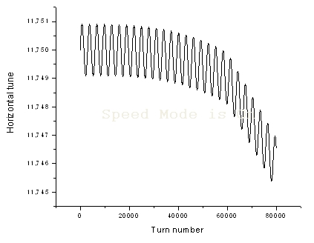
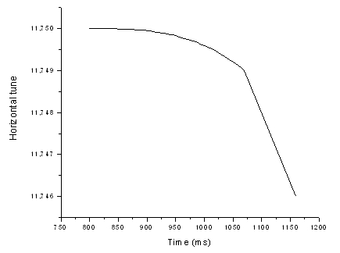
Longitudinal aspects
Longitudinal dynamics affects the capture process mainly with chromatic effects.
The main effect is a tune ripple which will periodically displace the islands, and the capture process might suffer from that tune ripple during the essential phase of adiabatic capture.
Indeed, one part of the beam is not trapped and remains in the regions between islands.
LIS meeting 17/01/2011

Slide 11
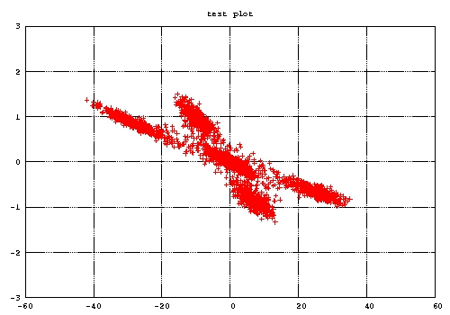
Longitudinal aspects
Final plot, simulation without dp/p
Final plot, simulation with full dp/p= 3.1E-03
LIS meeting 17/01/2011

Slide 12
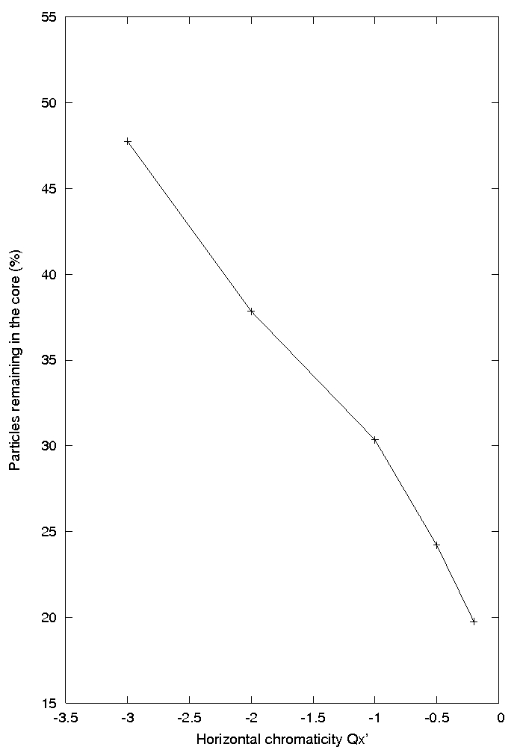
Longitudinal aspects : chromaticity influence
Chromatic sextupoles installed in dispersion regions to adjust the linear chromaticity.
In this case the momentum spread has been fixed to 1.88.10⁻⁰³ and the synchrotron tune to 3.3.10⁻⁰⁴, which
correspond to a voltage of 100kV in cavities.
Good compromise between performance and operation
LIS meeting 17/01/2011

Slide 13
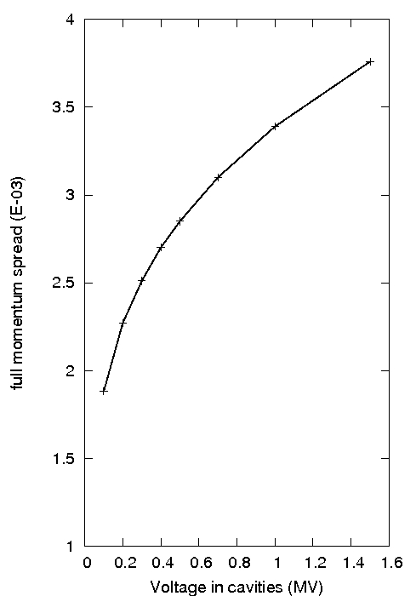
Longitudinal aspects : Momentum spread influence
Momentum spread at extraction. (S.Hancock)
If we take the basic PS2 optics (transition gamma of 25.75i) the available 1.5MV at 40MHz in accelerating
cavities makes 0.6eV.s bunches 4.0ns long on the flat-top before extraction. In this way the transfer to the SPS can be matched.
The corresponding full Dp/p is 3.76.10⁻⁰³ and the synchrotron tune is 3.3.10⁻⁰⁴ .
LIS meeting 17/01/2011

Slide 14
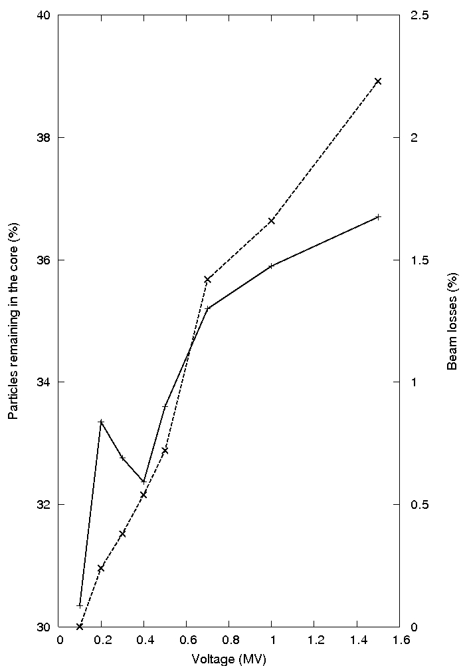
Longitudinal aspects : Momentum spread influence
Best results for low momentum spread, but it could be a
problem in terms of instabilities.
One possibility could be to increase the voltage up to 0.4MV.
LIS meeting 17/01/2011

Slide 15
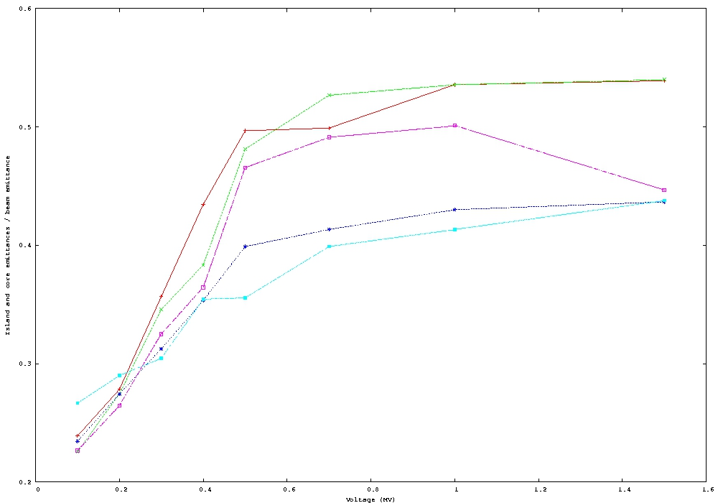
Longitudinal aspects : Momentum spread influence
LIS meeting 17/01/2011

Slide 16
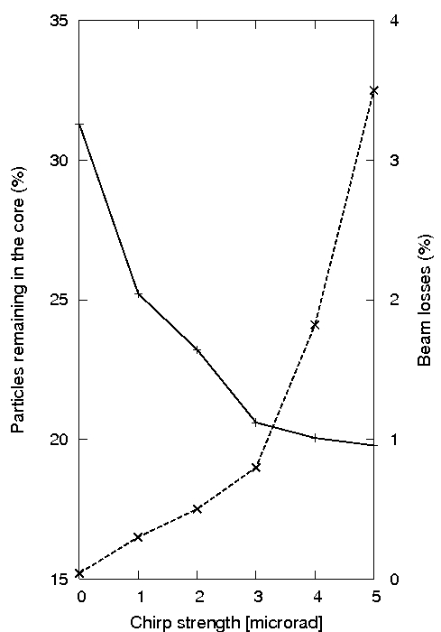
Chirp influence
The beam receives turn after turn a horizontal kick which is modulated by a sinusoidal function.
Beneficial effect on particles sharing between core and islands.
The beam is excited during 10000 turns at the beginning of capture. The frequency has been fixed according to the horizontal tune.
Dp/p = 1.88.10⁻⁰³
Q_{s}=3.3. 10⁻⁰⁴
LIS meeting 17/01/2011

Slide 17
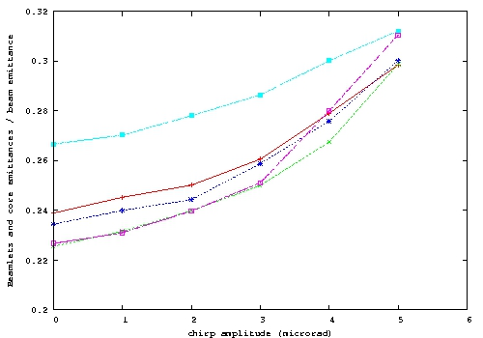
Chirp influence
LIS meeting 17/01/2011

Slide 18
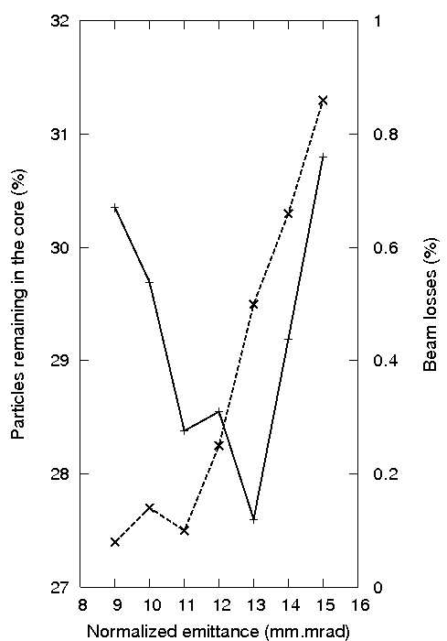
Emittance influence
The influence of the normalized beam emittance before capture start has been simulated.
Dp/p = 1.88.10⁻⁰³
Q_{s}=3.3. 10⁻⁰⁴
LIS meeting 17/01/2011

Slide 19
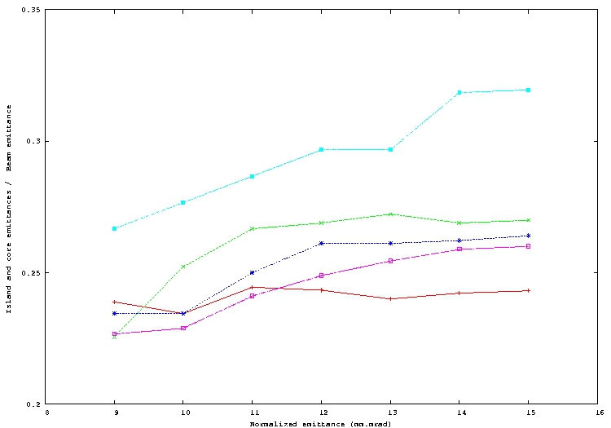
Emittance influence
LIS meeting 17/01/2011

Slide 20
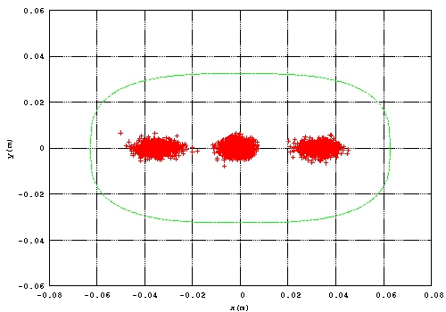
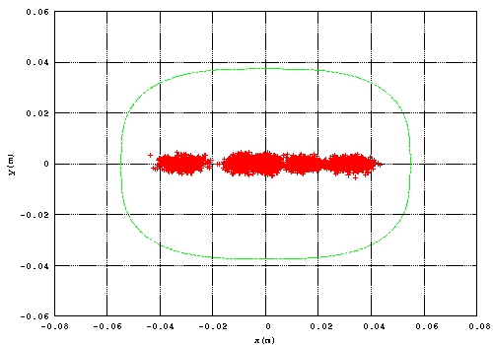
Beam envelope
The compatibility between beam size after capture and ring aperture has been verified to prepare the extraction bump design.
LIS meeting 17/01/2011

Slide 21
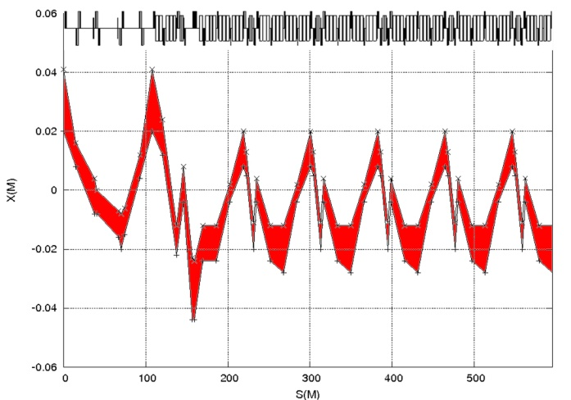
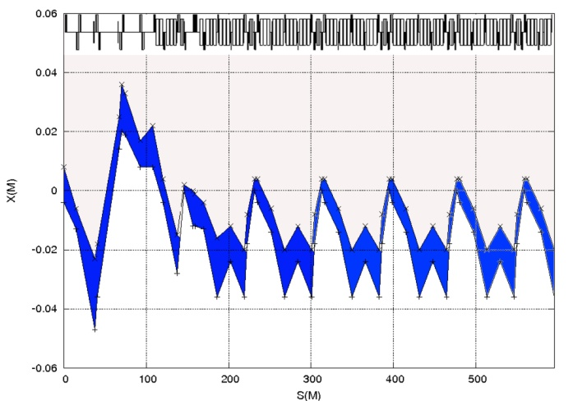
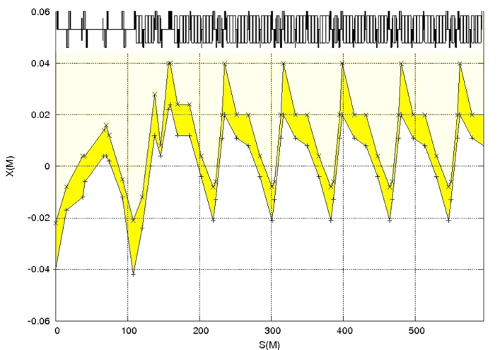
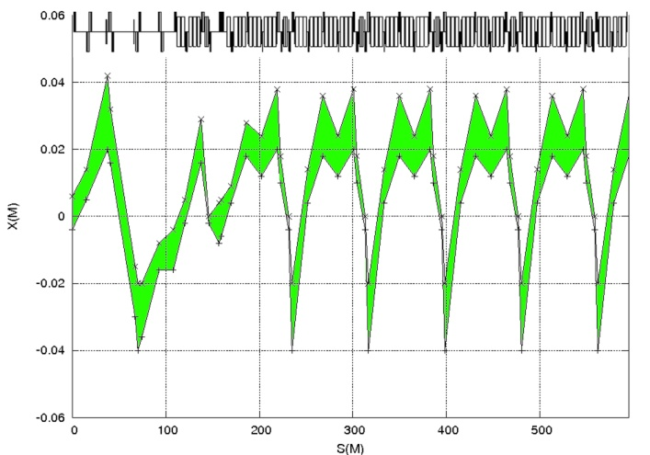
Beam envelope
Envelopes of each beamlet for one half of the ring.
LIS meeting 17/01/2011

Slide 22
Conclusion
The capture process has been simulated and main characteristics (magnetic elements location and strength,
number of crossing turns) have been optimized.
The capture process without longitudinal motion offers good simulation results in terms of emittance and beamlets
intensity.
Different ways of optimization have been proposed to reach the 20% intensity for each beamlet and core with
longitudinal motion :
- Voltage in cavities
- Chirp
- Beam emittance before variation before capture
A new scheme is under study to potentially cancel the chromo-geometric terms in order to obtain the same results
than capture without longitudinal motion.
LIS meeting 17/01/2011

