Slide 1
Recent MD results for nominal SPS and low γ_{t} optics: Tune scans and Transverse emittances for single bunches
H. Bartosik, K. Cornelis, A. Guerrero, B. Mikulek, G. Rumolo, Y. Papaphilippou, B. Salvant, E. Shaposhnikova
June 16th, 2011

Slide 2
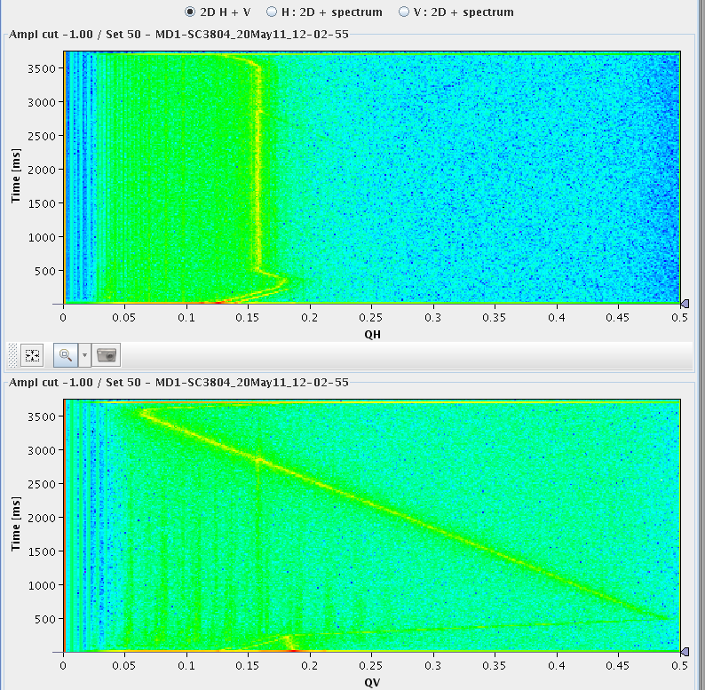
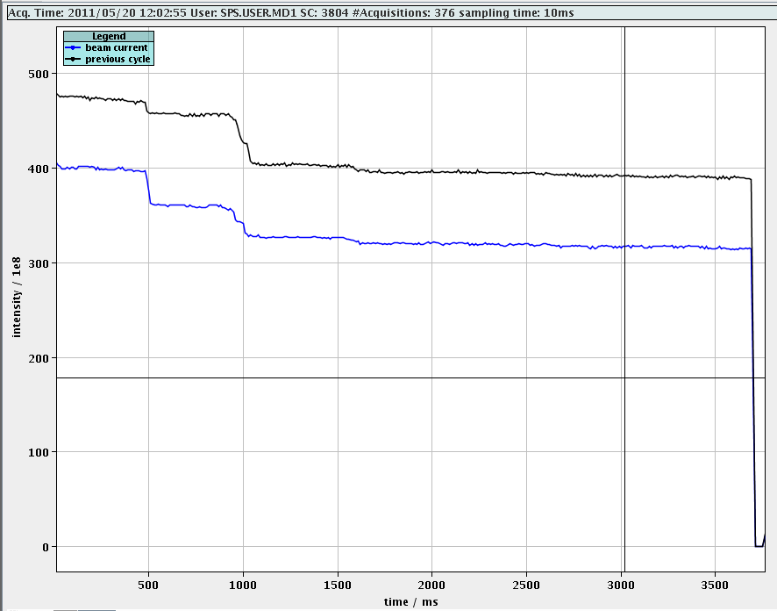
Tune scans – Method*
Goal: study the resonance behaviour around the nominal the working points of the nominal SPS (Q26) and the low γ_{t} (Q20) optics on the injection plateau
Strength of individual resonance lines can be identified from the beam loss rate, i.e. the derivative of the beam intensity at the moment of crossing the resonance
Vertical tune is scanned from about 0.45 down to 0.05 during a period of 3s along the flat bottom
Low intensity 4-5e10 p/b single bunches with ε~1.2 μm (“single particle behaviour”) injected at nominal tunes
Horizontal tune is constant during the same period within a supercycle (scanned from cycle to cycle)
Tunes are continuously monitored using the BBQ and the beam intensity is recorded with the DC-BCT
* similar method (with beams filling the vacuum pipe) previously applied by G. Franchetti et al. in the PS
Notes:
TMCI threshold can be increased by increasing chromaticity or longitudinal emittance

Slide 3
Tune Scans - Results
Identified resonances in the low γ_{t} optics
normal sextupole resonance Qx+2Qy is the strongest
skew sextupole resonance 2Qx+Qy quite strong !!??
normal sextupole Qx-2Qy, skew sextupole resonance at 3Qy and 2Qx+2Qy fourth order resonances visible
Identified resonances in the nominal optics
normal sextupole resonance Qx+2Qy is the strongest
Coupling resonance (diagonal, either Qx-Qy or some higher order of this), Qx-2Qy normal sextupole
skew sextupole resonance 2Qx+Qy weak compared to Q20 case
It seems that the stop-band width of the vertical integer is stronger than in Q20 optics
Notes:
TMCI threshold can be increased by increasing chromaticity or longitudinal emittance

Slide 4
Recap - measurements from May 10th
Measurement of single bunch emittances
In scan with “reference” wire scanner BWS.519 at flat top
Long cycle (~10s injection plateau, ~10s acceleration)
Losses along the cycle extracted from DC-BCT measurement
Bunch length at flat bottom increasing with intensity
Τ=2.9ns @ 1.5e11 p/b, Τ=3.5ns @ 3e11 p/b
Emittances in PSB: ~ 1μm < 1.5e11p / ~ 1.1μm @ 2e11p / ~ 1.3μm @ 3e11p
Well adjusted beam parameters in the PSB!

Slide 5
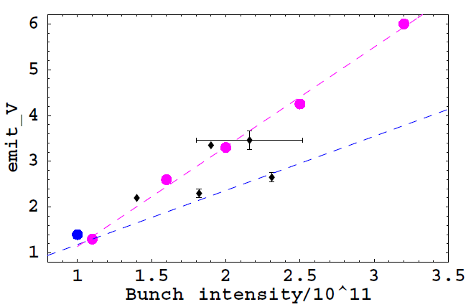
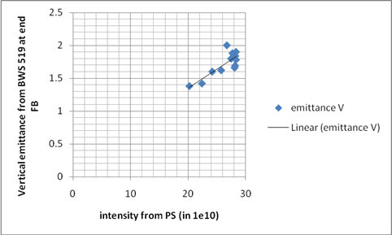
Difference compared to 2010 for nominal optics?
No dedicated measurements of emittance as function of intensity in 2010
In 2010, emittance blow-up in PS was necessary in order to reduce blow-up in the SPS nominal optics
In low γ_{t} optics, no blow-up in PS was necessary
Dedicated measurements in 2011
2010 results for low γ_{t} optics confirmed (or outreached)
No additional blow-up in PS needed for nominal optics – in general beam is more stable
First measurement of emittance for high intensity in nominal optics shows promising results - What is different in 2011? Why beam is so much more stable this year?
Emittances measured 2010,
intensity corrected for losses
Nominal SPS optics, end of flat bottom (26 GeV/c)
B. Salvant, 26.5.2011
E. Shaposhnikova, Chamonix 2011
450 GeV/c
low γ_{t}

Slide 6
Latest transverse emittance studies
Previous results interesting, but question remains where the blow-up occurs
In particular the injected beam parameters were no well known
What is the situation in the nominal optics?
In the last weeks, big effort by BI and OP groups to qualify emittance measurements and cross calibrate wire scanners
PS wire scanner application was corrected (wrong value of β-function for emittance calculations) and calibrated with local orbit bumps
emittance measurements in PS can be used now to study blow-up in SPS
Present studies on short cycle with 3.5s flat bottom, no acceleration
Stable beam conditions by adequate adjustment of chromaticity (for Q26)
Measurements of emittance and intensity at the end of flat bottom
Biggest effect of emittance blow-up due to space charge expected at flat bottom (biggest space charge tune spread)
Since there is no acceleration in this cycle, losses due to uncaptured beam not taken into account
Nominal SPS fractional tunes (20.13, 20.18)/(26.13, 26.18)
Only “In-Scans” are considered; most measurements done in vertical plane (horizontal gave similar results for a few test samples)

Slide 7
Results – Vertical emittance
MD4 beam in PSB with 2 turns injected (slightly bigger transverse emittances)
Transverse emittances between 1.1-1.5 μm, depending on intensity
Not exaclty the same conditions for beam prepation as in the MD on 10th of May
RF-voltage settings were varied with no sizeable influence on emittance
Here Q20: 3.9 MV
Q26: 2 MV
Notes:
TMCI threshold can be increased by increasing chromaticity or longitudinal emittance

Slide 8
Results Q20 – Vertical emittance in PS and SPS
MD4 beam in PSB with 1.1 turns injected (slightly smaller transverse emittances)
Simultaneous measurements of vertical emittance in PS and SPS
At extraction (just before bunch rotation) in PS using PS-65.V
At end of flat bottom using SPS-BWS.519
Here RF-voltage of 5.75 MV in SPS
If calibration of wirescanners between machine is believed → emittance blow-up for intensities above 1.5e11 p/b with peak values of 25% at 3e11 p/b
Notes:
TMCI threshold can be increased by increasing chromaticity or longitudinal emittance

Slide 9
Losses from the SPS DC-BCT
Low γ_{t} optics
Low losses (up to 4% for 3e11 p/b) from injection to end of flat bottom
Fat intensity profiles even for high intensity but losses at injection increase
Analysis of losses consistent with small emittance blow-up observation
Nominal optics
Significantly increasing losses for intensities above 2.5e11 p/b up to 10%
Losses at injection and along the flat bottom for high intensities

Slide 10
High intensity tune scan for nominal optics
Tune scan with high intensity small emittance single bunches
“Space charge” tune scan with an intensity of about 2.5-3e11 p/b and injected emittances of about ε_{n}~1.3-1.5μm
Measuring the emittance at the end of flat bottom as function of injected emittance and the total losses
First scan of vertical tune with a fixed horizontal tune of Q_{x}~26.18 (to be continued …)
Further scans for different horizontal tune settings will follow …

