Slide 1
Summary and present status of studies on SPS Q20 optics
H. Bartosik, Y. Papaphilippou
LIS meeting, 5.12.2012

Slide 2
Outline
Motivation for lower transition energy in SPS (a small recap)
Implications of lower transition energy
Impact of injection dogleg
Single bunch studies and threshold for transverse mode coupling
Recent MD results for 25ns beam
Recent MD results for 50ns beam
First impressions of lower transition energy for ions
Summary

Slide 3
Motivation for Q20 optics
Known intensity limitations in SPS are due to
Instabilities leading to emittance blow up and/or beam loss
Transverse mode coupling instability (TMCI) at injection - single bunch instability in vertical plane for intensities above threshold of 1.6x10¹¹p/b (ε_{L}=0.35eVs, τ=3.8ns) and low ξ_{y}: N_{th}~ηε_{L}/β_{y} (for matched voltage)
Longitudinal instability due to loss of Landau damping, N_{th} ~ ηε²τ (stationary bucket)
Electron cloud instability
Other limitations like beam loading, beam loss, heating of machine elements
Instability thresholds can be raised by increasing slip factor η
Damping of instabilities due to faster synchrotron motion
Changing integer part of tunes down to 20 (“Q20”)
Transition energy reduced from γ_{t}=22.8 (nominal optics) to γ_{t}=18
Factor of about 3 higher η at injection (1.6 at top energy) compared to nominal optics
N_{th} … Instability threshold
ε … longitudinal emittance
τ … bunch length
η … slip factor
Slip factor relative to nominal optics

Slide 4
Implications of using Q20 optics
Available RF voltage and beam transfer to LHC
Higher RF-voltage in Q20 needed (V~η) for same bucket area → better for beam loading
RF-voltage limited to 7.5MV (already used in Q26 at flat top) → bunch length at extraction?
For given longitudinal emittance → longer bunches at extraction (due to limited RF voltage, RF upgrade should help)
For given bunch length at extraction → smaller longitudinal emittance but similar longitudinal stability in SPS since N_{th}~ε²ητ and τ~(ε²η/V)^{1/4} → ε→η^{-1/2} (however potentially unstable in LHC, to be seen …)
Also higher voltage of 800MHz Landau cavity needed!
Injection dogleg and beam dump
Quads in injection region (LSS1) are misaligned to gain aperture for beam dump
This creates non-closed orbit bump in Q20 optics which presently cannot be corrected at high energy → realign quadrupoles or install high energy orbit correctors
Potential complication for extraction if not corrected (dispersion beating)
Trajectory for high energy beam dump going off-center through main quadrupole → less kick downwards in Q20 optics (smaller quadrupole gradient) – but still within foreseen region!
Calculated voltage programs
Courtesy E. Shaposhnikova

Slide 5
Injection dogleg – beam dump apertures
Quads in LSS1 are displaced (“dogleg”) to gain aperture for the beam dump trajectory
QDA.117, QFA.118 and QDA.119 are displaced in negative direction in both planes such that a closed bump is created in nominal optics (see following slides) - Due to the different phase advance (change of quadrupole gradient) in Q20 optics → this bump is not closed
Due to the reduced gradient in QFA.118, slightly smaller kick downwards in case of Q20
Worst case in terms of aperture: beam dump at 115GeV
Lowest energy above “forbidden region” → largest beam size (no problem aperture-wise, plot below shows beam envelop using 6σ transverse and 2.5σ longitudinal)
QDA.117
QFA.118
QDA.119
3xMKDH
QDA.117
QFA.118
QDA.119
3xMKDH
TIDVG
TIDH
TIDH
TIDVG
2xMKDV
No aperture limitation,
beam is dumped
“underneath”
2xMKDV

Slide 6
Beam dump trajectory
MKDH and MKDV sweep the beam on high energy beam dump TIDVG
Dump trajectory is going off-center through quadrupole QFA.118
Due to weaker quadrupole gradients in Q20, slightly smaller kick downwards (beam is dumped closer to edge of dump block)
Due to intervention on MKDV on electrical feed-through only reduced kicker strength from MKDV available (39kV instead of 47kV)
Beam must be dumped at least 10mm below edge of TIDVG (≥-27 on SEM grid)
Still within the good region for both optics, even with reduced voltage
single bunch
1 batch
Q26 (39kV)
Q20 (39kV)
Good region
Good region
MADX Simulation
TIDVG

Slide 7
Impact of quadrupole displacement in LSS1
Assuming the worst case of no orbit correction
Small non-closure of orbit in Q26 (per design)
Huge non-closure for Q20 (due to reduced quad strength, i.e. 30% less gradient)
Potential consequences
Different injection trajectory (although full corrector strength available → should not be a real problem)
Could be responsible for spurious dispersion as measured at flat top (no orbit correction) due to big orbit oscillation → not nice for extraction to LHC
Q26 – nominal optics
Q20 – low γ_{t} optics

Slide 8
Dogleg correction using existing orbit correctors
Option I (no hardware change apart from adding interlocks)
Horizontal plane
MDHD.11832: hkick=-15 μrad (20A, present max)
MDH.11407: hkick= 22.8 μrad (3.5A, present max)
MDH.12207: hkick= 22.8 μrad (3.5A, present max)
Vertical plane
MDV.11705: vkick=-12.4 μrad (3.5A, present max)
MDVA.11904: vkick=-12.4 μrad (3.5A, present max)
Option II (less correctors → less chance of failure, but minor hardware changes)
Horizontal plane
MDHD.11832: hkick=-50 μrad (17A, but reconfiguration of the 4 coils on this special wide aperture corrector in series and changing power convertor, present max) – under investigation …
Vertical plane
MDV.11705: vkick=-12.4 μrad (3.5A, present max)
MDVA.11904: vkick=-12.4 μrad (3.5A, present max)
Q20 – low γ_{t} optics
Q20 – low γ_{t} optics

Slide 9
Single bunch studies – TMCI threshold
Nominal optics Q26
Sharp losses after ~70 turns for low vertical chromaticity and injected intensity higher than 1.6x10¹¹p/b
Clearly observed threshold for TMCI
Higher intensity requires larger vertical chromaticity
Hard to reach intensity above 2.5x10¹¹p/b
Q20 optics
Numerical simulations predict threshold at 3.2x10¹¹p/b (N_{th}~η/β_{y}, η is 2.85 times higher but also β_{y} is increased)
No observation of TMCI up to 3.5x10¹¹p/b for low vertical chromaticity (ξy~0.03)
Regime of higher intensity remains to be explored systematically
Further increase of threshold possible by using split tunes: Q_{x}~20 (→ low γ_{t}) and Q_{y}~26 (→ no increase of β_{y}); feasibility to be checked … (interference with LHC QPS?)

Slide 10
Nominal optics (Q26) – single bunches
Measurements during preparation for LHC high pile up single bunch MD
ξ_{y} ~0.25 as optimal value to reach around 2.5x10¹¹p/b with small emittance (total losses around 15%)
Slightly higher intensity (2.8x10¹¹p/b) can be reached with chromaticity of ξ_{y}~0.4 however with emittance blowup (data not shown)
Smaller chromaticity (ξ_{y}~0.1) leads to significant losses at injection due to TMCI (data not shown)
Hard to reach more than 2.5x10¹¹p/b at end of cycle due to losses at injection, even for high chromaticity

Slide 11
Low γ_{t} optics (Q20) – single bunches
SPS - Q20
SPS - Q20
Single bunch emittances vs. intensity
Injected up to 3.3x10¹¹p/b and accelerated to flat top using nominal LHC magnetic cycle (long FB, slow ramp) and low chromaticity (ξ_{y}~0.1)
Working point readjusted to 20.13/20.18 for each intensity
Linear increase of emittance with intensity
Losses at injection and along flat bottom increasing for intensity above 2x10¹¹p/b (space charge? (ΔQ_{y}~0.15), working point optimization for high intensity?)

Slide 12
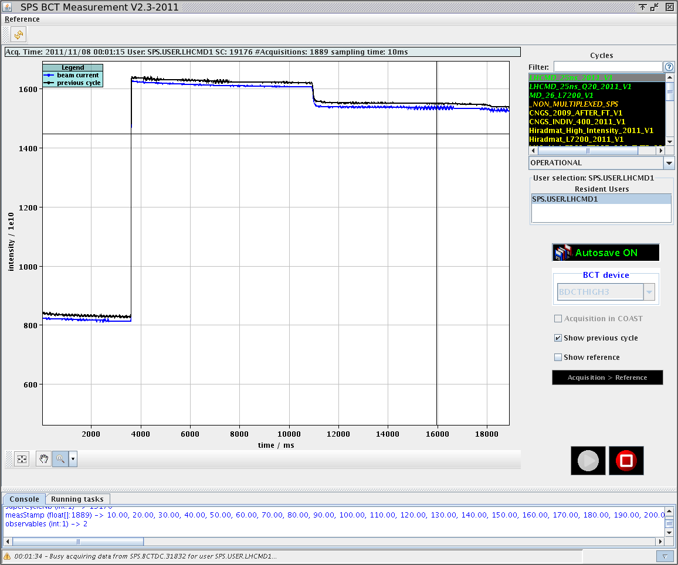
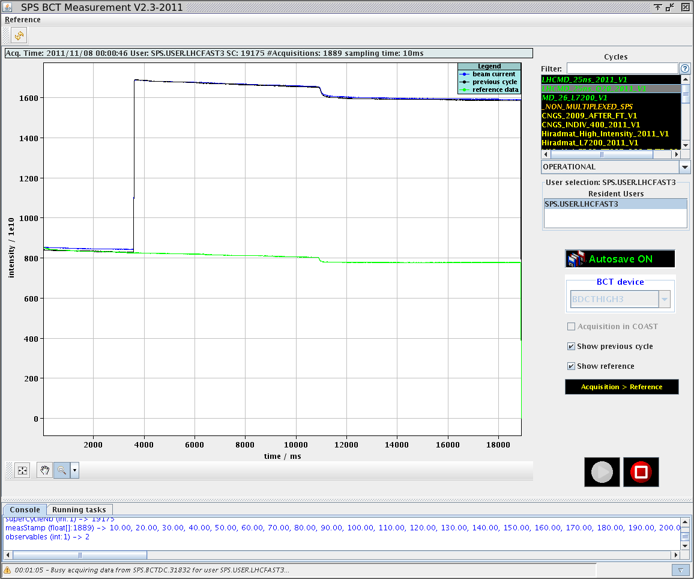
MD session with 25ns beam – November 7th
Injected Intensities around 1.2x10¹¹p/b
Setup and measurements on 25ns beam in Q20 and Q26 optics
Slightly higher intensity in Q20 at flat top (Injected intensities the same)
Higher chromaticity in Q26 may be needed for improving transmission
Went up to 2 batches at most
Other MD studies during the same session
E-clouid measurements (M. Taborelli), Studies on transmission from PS to SPS with 25ns beam in Q26 optics (T. Bohl, H. Damerau)
Q26
Q20

Slide 13
Transverse emittance - 25ns beam (1 batch)
Q20: Measurements with WS.416 → ε_{x}~2.9μm and ε_{y}~2.4μm
Q26: Measurements with WS.416 → ε_{x}~2.8μm and ε_{y}~2.6μm

Slide 14
Transverse emittance - 25ns beam (2 batches)
Q20: Measurements with WS.416 → ε_{x}~3μm and ε_{y}~2.6μ (only a few measurements …)
Q26: Measurements with WS.416 → ε_{x}~2.7μm and ε_{y}~2.7μm (only a few measurements …)

Slide 15
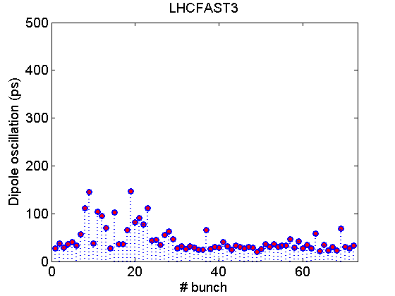
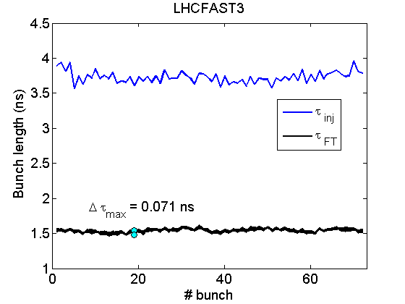
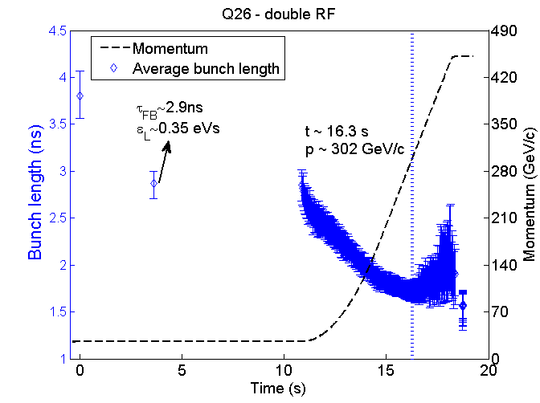
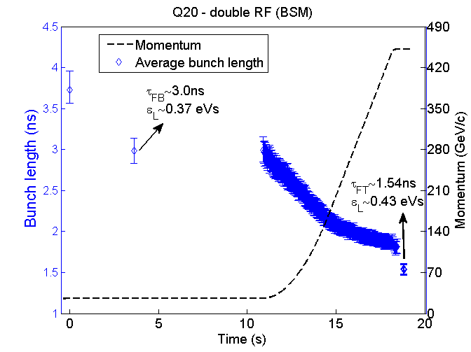
Longitudinal stability – 25ns beam (1.2x10¹¹p/b)
Comparing stability for 1 batch of 72 bunches with 1.2x10¹¹p/b injected
Voltage program for constant bucket area of 0.65eVs, 7MV on flat top and 1.8MV (5.25MV) on flat bottom for Q26 (Q20)
Beam is unstable in Q26 → controlled longitudinal emittance blow-up needed
Beam stable in Q20 (some bunches show increased dipole oscillations)
RF-settings remain to be optimized for more batches (in Q20)
Q26 – nominal optics
Q20 – low γ_{t} optics

Slide 16
MD session with 50ns beam – November 9th
Comparing longitudinal stability with around 1.5x10¹¹p/b at flat top (without longitudinal emittance blow-up)
Extracted intensity systematically higher in Q20 due to better “injection efficiency” (ratio between first intensity seen on SPS-BCT and intensity extracted from PS)
Transmission in nominal optics may be improved by optimizing chromaticity (zero chromaticity value probably different than usual due to preceding MD1 cycle)
Increased intensity to around 1.9x10¹¹p/b injected
Maximum intensity at flat top reached in Q20 optics around 1.7x10¹¹p/b (however longitudinally unstable, longitudinal emittance blow-up needed)
Q26 – nominal optics
Q20 – low γ_{t} optics

Slide 17
Comparing transmission
1 batch, 1.55x10¹¹p/b
1 batch, 1.55x10¹¹p/b
4 batches, 1.55x10¹¹p/b
Q26
1 batch, 1.95x10¹¹p/b
Q20
1 batch, 1.95x10¹¹p/b
4 batches, 1.95x10¹¹p/b
4 batchES, 1.95x10¹¹p/b
Q26
Q20
Clearly better “injection efficiency” (ratio between first intensity seen on SPS-BCT and intensity extracted from PS) in Q20 - chromaticity settings not optimal in Q26 or indication for TMCI?
Injection efficiency worse for later batches in both optics – optimization needed
Transmission calculated only from SPS-BCT overestimated (losses within first 10ms not seen)

Slide 18
Transverse emittance – 50ns 1.5x10¹¹p/b (450GeV)
Q20: WS.416
ε_{x}~1.6μm/ε_{y}~1.8μm
… on average (spread ±0.3μm)
Bigger spread in measurements (and larger average) with WS.519 due to small number of data points along the beam profile at high energy …
Q26: WS.416
ε_{x}~1.6μm/ε_{y}~1.7μm
… on average (spread ±0.2μm)
Many measurements were taken (are still being looked at together with A. Guerrero)

Slide 19
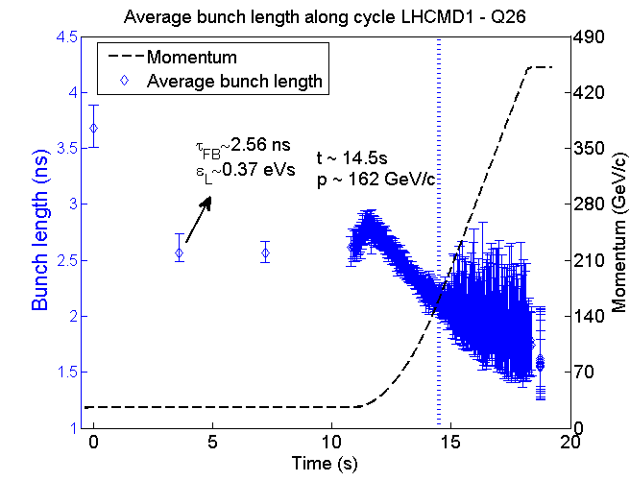
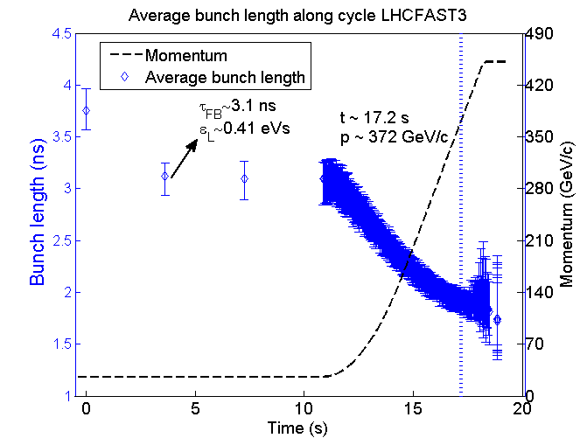
Longitudinal stability – 50ns beam (1.5x10¹¹p/b) I
Comparing longitudinal stability of 1 batch in single RF system (200MHz)
Voltage program “comparable” between the two optics – injection with 2MV (5.6MV) in Q26 (Q20) and constant bucket area of 0.6eVs in both cycles along the ramp
Longitudinal damper gain of 15db (10db) in Q26 (Q20) optics – smaller gain works better in Q20
Beam becomes unstable in Q26 optics for lower energy compared to Q20 (as expected, since threshold is decreasing with energy and proportional to slip factor η) resulting in large spread of bunch length along the batch
Usual measures: 800MHz Landau cavity + longitudinal emittance blow-up if needed

Slide 20
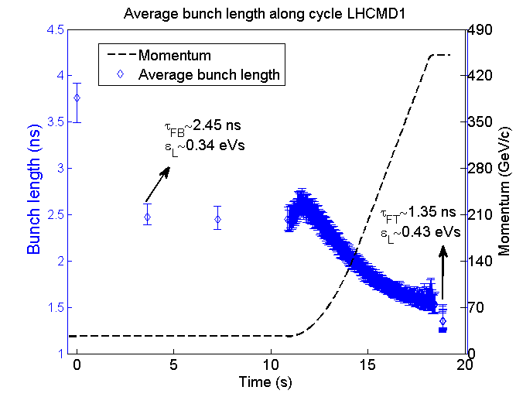
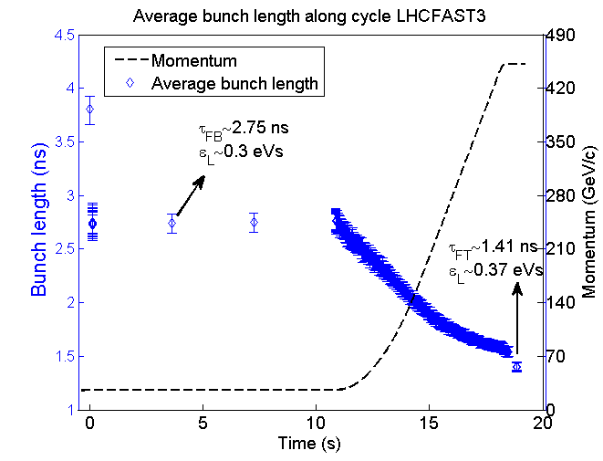
Longitudinal stability – 50ns beam (1.5x10¹¹p/b) II
Q26
Q20
Courtesy T. Argyropoulos
Comparing longitudinal stability of 1 batch in double RF system
Best settings found during the MD for Q20 optics (injection at 2.5MV and keeping 4.5MV along flat bottom, voltage of 800MHz cavity V₈₀₀=0.15V₂₀₀) – nominal setting for Q26 but with increased voltage in 800MHz (V₈₀₀=0.15V₂₀₀)
Without longitudinal emittance blow-up (used in routine operation for stabilizing beam)
Unstable during ramp in Q26 for this intensity → emittance blow-up needed
Stable in Q20 for this intensity (emittance blow-up needed for higher intensities, not presented)
Longer bunches at extraction in Q20 due to limited RF-voltage (however blow-up needed in nominal optics → bunch length with stable settings will be comparable)

Slide 21
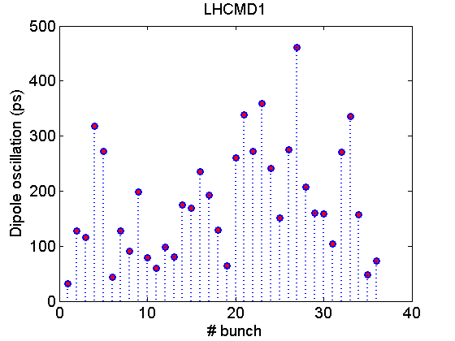
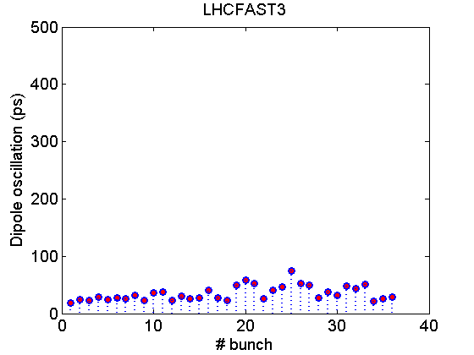
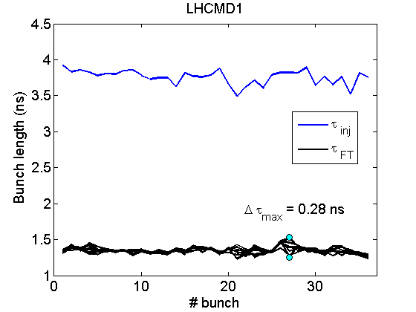
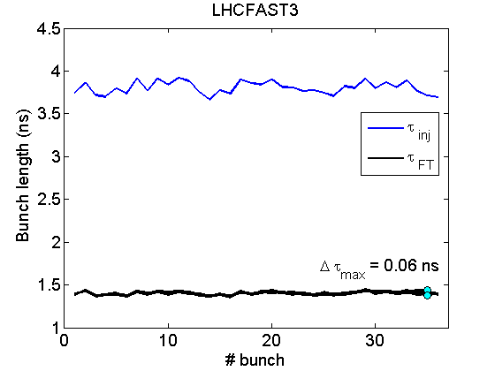
Longitudinal stability – 50ns beam (1.5x10¹¹p/b) III
50ns beam at flat top (1 batch, 1.5x10¹¹p/b)
Without controlled emittance blow-up
800MHz cavity (V₈₀₀=0.15V₂₀₀)
Unstable in Q26
Phase oscillations - dipole instability
Bunch length oscillations – quadrupole instability
Stable in Q20
Small bunch length (emittance) - compatible with LHC bucket
Emittance sufficient for beam stability in SPS but could be too small for LHC (IBS, stability)
Margin left for emittance blow-up for higher intensity or if needed for stability in LHC
big dipole
oscillations
Only small dipole
oscillations
Q26
Q20
quadrupole
oscillations
no quadrupole
oscillations
Courtesy T. Argyropoulos

Slide 22
Ions
Idea to test Q20 optics for LHC ion beam (Yannis, Django, Gianluigi, Karel)
LHC ion beam suffers from strong particle loss due to
intra beam scattering?
Space charge?
Resonance crossing due to space charge?
Q20 optics might improve situation due to
bigger beam size around the ring due to higher dispersion → smaller space charge tune spread (10-15%), IBS?
MD cycle with 6 injections and Q20 optics
Started to setup this cycle with similar fractional tunes as in nominal optics (0.28, 0.31)
Managed to accelerate 6 batches up to flat top
Emittances at flat top very similar to nominal optics
Transmission not yet as good as with Q26 → further optimization and studies needed
Slip factor at injection almost the same in Q20 and Q26 (γ~7 far away from transition)

Slide 23
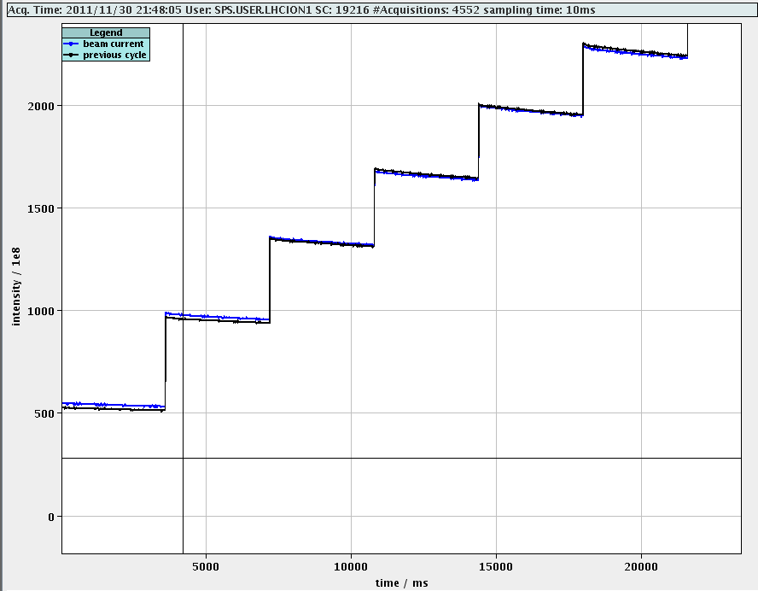
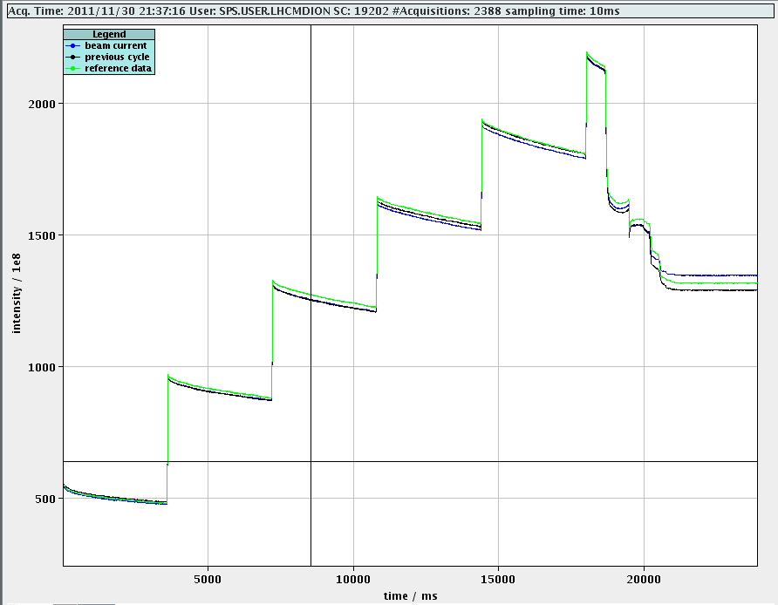
Transmission
Still higher losses along flat bottom in Q20
Need to optimize working point?
Same emittance as in Q26 ...
More studies needed
MD time …
Calculations about IBS …
Q26
Q20

Slide 24
Summary
Implications on optics
Injection Dogleg is creating closed orbit distortion which for now is not corrected – solutions currently under investigation
No problem for beam dump (even with reduced kick strength for MKDV)
Single bunch
High intensities up to 3x10¹¹p/b can be accelerated with total losses smaller than 10% and small emittance blow-up
2.5x10¹¹p/b hard to exceed with Q26 due to losses at injection linked to TMCI even with high chromaticity
25ns
Promising results in MD session: similar transverse emittances in both optics, but more stable in Q20
More time needed for optimizing the settings
50 ns
TMCI might soon become limitation for 50ns beam in SPS as intensity will be increased
Promising results in Q20 optics – better transmission up to now and better stability in longitudinal plane → less or no longitudinal emittance blow-up required for stability
As predicted, similar bunch length at extraction in both optics for same stability in SPS (but smaller long. Emittance in Q20)
Still room for improving the settings for high intensity

Slide 25
Next steps
Pending issues
Transverse damper V2 still not working properly (unexpected behavior for high frequencies, hard to adjust delay)
Prepare correction of dogleg using existing correctors during winter stop
Injection into LHC during MD
Rematching the transfer-lines TI8 and TI2 to the new optics in the SPS → presently ongoing
Study stability of beams with smaller longitudinal emittance in the LHC and acceptable losses due to longer bunches
Future studies: split tunes
Integer tune 20 in horizontal plane for lower transition energy
Keeping the tune in the vertical plane close to 26 for smaller vertical beta function → further increase threshold for vertical instabilities such as TMCI (N_{th}~ηε_{L}/β_{y}), e-cloud, …
Feasibility to be checked (potential conflict with LHC QPS) …

