Slide 1
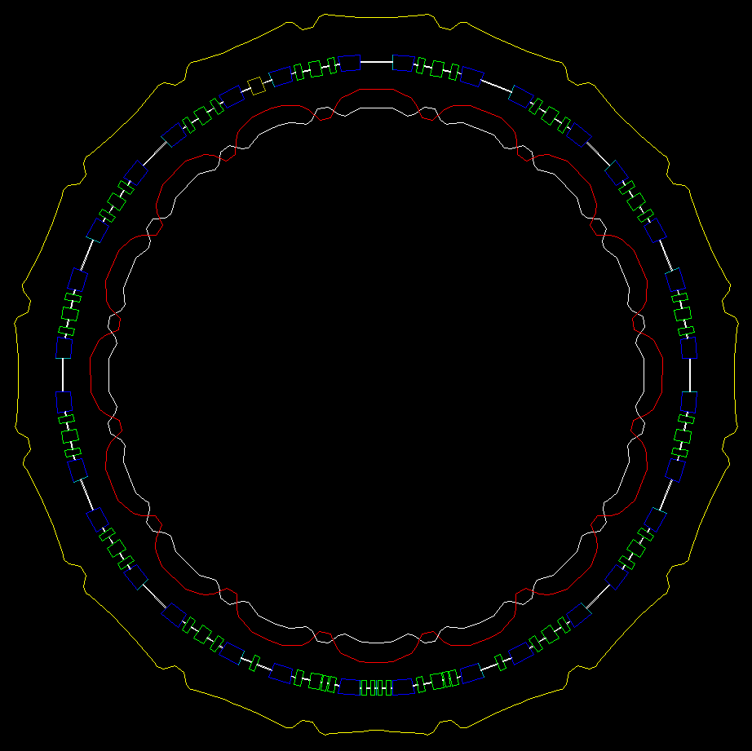
Update on PTC/ORBIT space charge studies in the PSB
LIS meeting 07/05/2012
Vincenzo Forte

Slide 2
Preliminary consideration
This presentation follows the one at LIS meeting on 14-04-2012 (you can find that on my DFS public):
dfs:\\Users\v\vforte\Public\14-04-12_Presentation
Update on PTC/ORBIT space charge studies in the PSB – Vincenzo Forte *
* Follows Preliminary results of the PTC/ORBIT convergence studies in the PSB - Vincenzo Forte – LIS meeting 14-04-12

Slide 3
Aim of the study
Preliminary study for finding the optimal conditions for PTC/ORBIT space-charge simulations in terms of convergence and computational costs
How far do we have to push in simulations settings to obtain reasonable results with less computational costs?
Update on PTC/ORBIT space charge studies in the PSB – Vincenzo Forte *
* Follows Preliminary results of the PTC/ORBIT convergence studies in the PSB - Vincenzo Forte – LIS meeting 14-04-12

Slide 4
Logical path
Lattice setup
Externally created (MadX, …)
Internally modified (tables)
Inject starting 6-D matched distribution
Externally created (Mathematica, …)
PTC ORBIT basic settings
Adding of space charge Orbit routines
PTC-ORBIT
1000 turns tracking
RMS emittance
95-99% emittance
tunes
Results analysis
Plots and tunes footprints
Best settings choose
Update on PTC/ORBIT space charge studies in the PSB – Vincenzo Forte *
* Follows Preliminary results of the PTC/ORBIT convergence studies in the PSB - Vincenzo Forte – LIS meeting 14-04-12

Slide 5
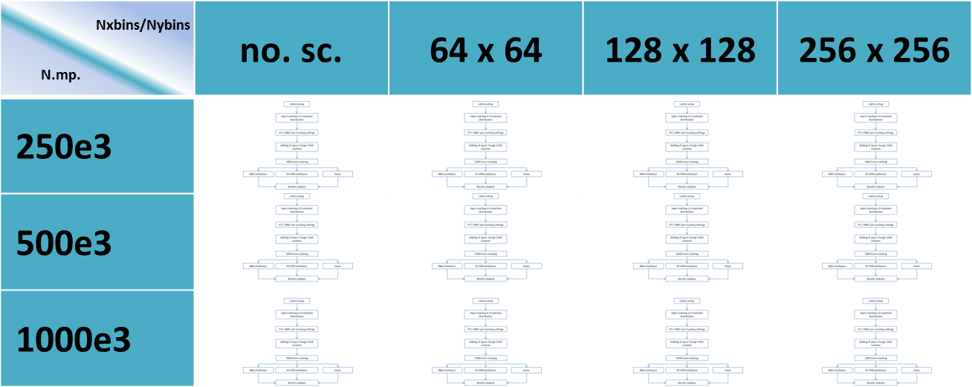
D.O.E.
We wanted to find the best initial parameter settings for transverse space charge studies, with 2 reference models:
“with chamber” -> static mesh grid (with “stable” beams)
“without chamber” -> mesh grid dynamically adapted by the particle extent
We used 2 criteria:
Convergence criterium
Computational costs criterium
Update on PTC/ORBIT space charge studies in the PSB – Vincenzo Forte *
* Follows Preliminary results of the PTC/ORBIT convergence studies in the PSB - Vincenzo Forte – LIS meeting 14-04-12

Slide 6
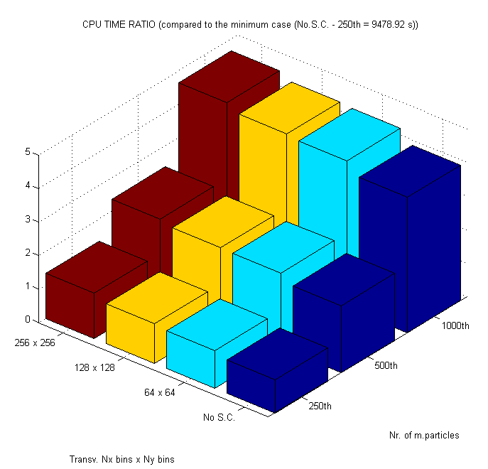
Computational costs criterium – actual engpara situation for 1000 turns…
23h:8min:53s
16h:46m:43s
The space charge mesh doesn’t affect so much the CPU TIME
Clearly, the number of m.particles is the main factor for CPU time and elapsed time increasing
*This is not a proper benchmarking (not all the tests done on the same machines), but just to have a feeling of the situation
Update on PTC/ORBIT space charge studies in the PSB – Vincenzo Forte *
* Follows Preliminary results of the PTC/ORBIT convergence studies in the PSB - Vincenzo Forte – LIS meeting 14-04-12

Slide 7
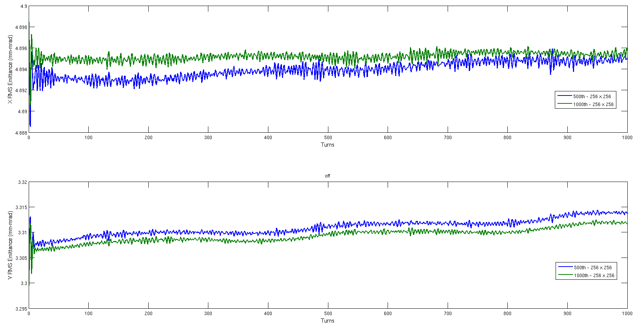
Convergence criterium – best case – with chamber
In the case “with chamber” the “RMS Emittance” best case is Nxbins=256 – Nybins=256 with 1000e3 m.p. …but … even 256x256 with 500e3 m.p. is acceptable (half nr. M.p. -> half CPU TIME !)
Update on PTC/ORBIT space charge studies in the PSB – Vincenzo Forte *
* Follows Preliminary results of the PTC/ORBIT convergence studies in the PSB - Vincenzo Forte – LIS meeting 14-04-12

Slide 8
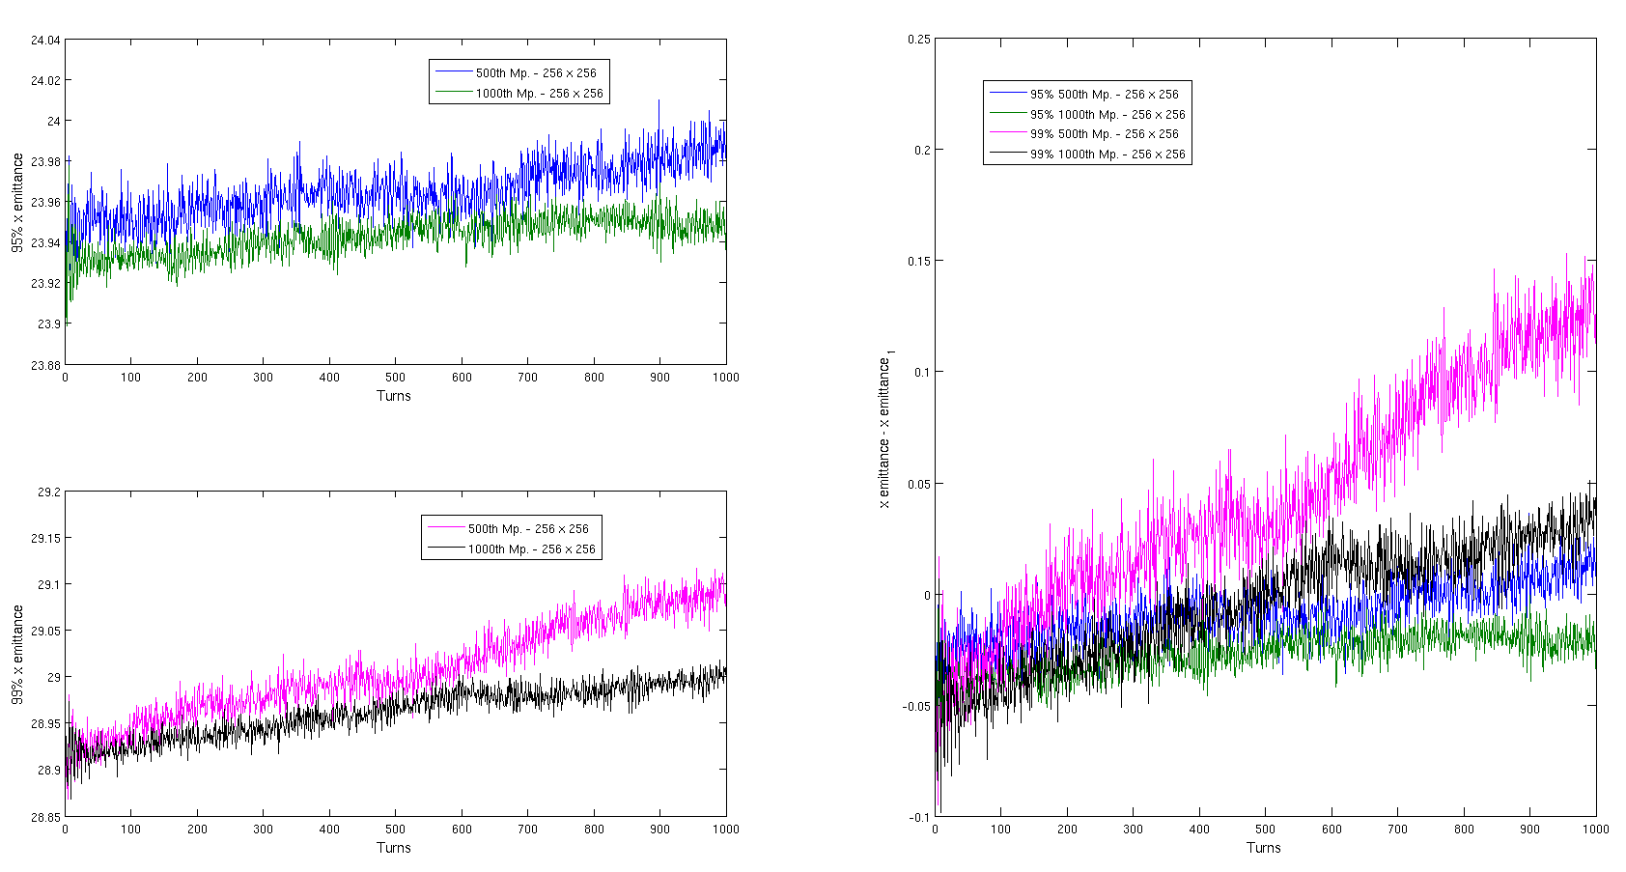
Convergence criterium – best case – with chamber
In horizontal 95% emittance is better for 1000th – 256 x 256
Update on PTC/ORBIT space charge studies in the PSB – Vincenzo Forte *
* Follows Preliminary results of the PTC/ORBIT convergence studies in the PSB - Vincenzo Forte – LIS meeting 14-04-12

Slide 9
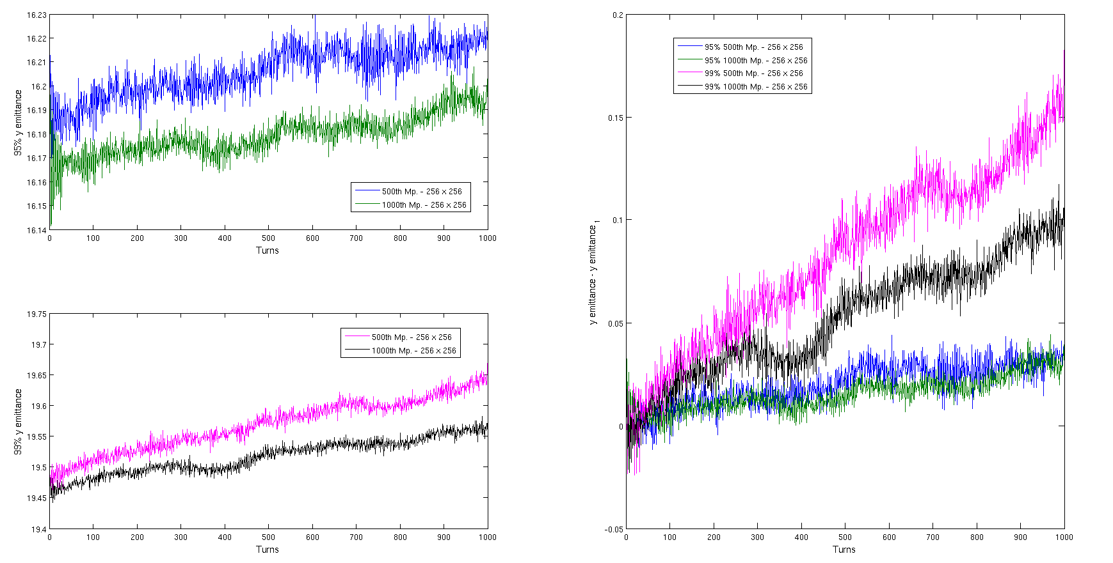
Convergence criterium – best case – with chamber
In vertical 95% emittance is good enough even for 500 th M.p. – 256 x 256
Update on PTC/ORBIT space charge studies in the PSB – Vincenzo Forte *
* Follows Preliminary results of the PTC/ORBIT convergence studies in the PSB - Vincenzo Forte – LIS meeting 14-04-12

Slide 10
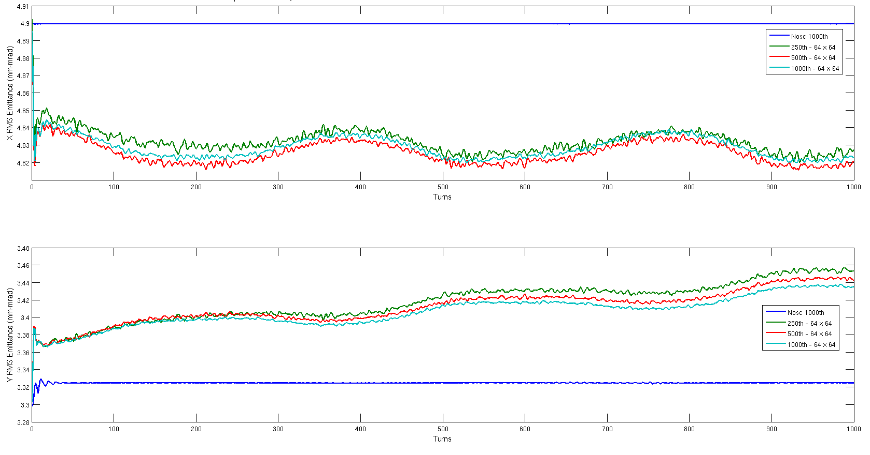
Convergence criterium – worst case – with chamber
In the case “with chamber” the “RMS Emittance” worst case is Nxbins=64 – Nybins=64 with any number of macroparticles… we clearly see a diverging behavior of RMS emittances…
Update on PTC/ORBIT space charge studies in the PSB – Vincenzo Forte *
* Follows Preliminary results of the PTC/ORBIT convergence studies in the PSB - Vincenzo Forte – LIS meeting 14-04-12

Slide 11
Convergence criterium – footprints - with chamber
The 256x256-500e3 shows a footprint far from any structural resonance (in particular Montague resonance)
The mesh definition affects the footprint... The 64x64 case (with chamber) seems to be “under-resolution” (unphysical <-> the mesh size is comparable to 1σ beam size)
Update on PTC/ORBIT space charge studies in the PSB – Vincenzo Forte *
* Follows Preliminary results of the PTC/ORBIT convergence studies in the PSB - Vincenzo Forte – LIS meeting 14-04-12

Slide 12
Convergence criterium – RMS Emittance - without chamber
In the case “without chamber” the 64x64 case – 500e3 m.p. is comparable with the best case “with chamber” (256x256 – 1000e3 m.p.) – in the case with 250e3 m.particles (64 x 64 without chamber) we have slightly different results (error order 10^-3)
Update on PTC/ORBIT space charge studies in the PSB – Vincenzo Forte *
* Follows Preliminary results of the PTC/ORBIT convergence studies in the PSB - Vincenzo Forte – LIS meeting 14-04-12

Slide 13
Convergence criterium – 95-99 x Emittance - without chamber
In the case “without chamber” the 64x64 case – 500e3 m.p. is comparable with the best case “with chamber” (256x256 – 1000e3 m.p.) … The case with 250e3 m.p. has worst results in 99% emittance computation…
Update on PTC/ORBIT space charge studies in the PSB – Vincenzo Forte *
* Follows Preliminary results of the PTC/ORBIT convergence studies in the PSB - Vincenzo Forte – LIS meeting 14-04-12

Slide 14
Convergence criterium – 95-99 y Emittance - without chamber
Also in vertical transverse, the case “without chamber” the 64x64 case – 500e3 m.p. is comparable with the best case “with chamber” (256x256 – 1000e3 m.p.)
Update on PTC/ORBIT space charge studies in the PSB – Vincenzo Forte *
* Follows Preliminary results of the PTC/ORBIT convergence studies in the PSB - Vincenzo Forte – LIS meeting 14-04-12

Slide 15
Convergence criterium – footprints – with/without chamber
 | ΔQx | ΔQy
500e3 – 64x64 (with chamber) | ~-0.27 | ~-0.40
500e3 – 128x128 (with chamber) | ~-0.20 | ~-0.28
500e3 – 256x256 (with chamber) | ~-0.17 | ~-0.24
500e3- 64x64 (without chamber) | ~-0.16 | ~-0.23
Update on PTC/ORBIT space charge studies in the PSB – Vincenzo Forte *
* Follows Preliminary results of the PTC/ORBIT convergence studies in the PSB - Vincenzo Forte – LIS meeting 14-04-12

Slide 16
Convergence criterium – footprints – without chamber - why 64x64 mesh points and not more?
RMS emittance & footprints are very similar in 64x64 and 128x128 cases
Update on PTC/ORBIT space charge studies in the PSB – Vincenzo Forte *
* Follows Preliminary results of the PTC/ORBIT convergence studies in the PSB - Vincenzo Forte – LIS meeting 14-04-12

Slide 17
Convergence criterium – footprints – without chamber - why 64x64 mesh points and not more?
95% & 99% emittances’ behaviors are also very similar…
Update on PTC/ORBIT space charge studies in the PSB – Vincenzo Forte *
* Follows Preliminary results of the PTC/ORBIT convergence studies in the PSB - Vincenzo Forte – LIS meeting 14-04-12

Slide 18
Convergence criterium – footprints – without chamber - why 64x64 mesh points and not more?
95% & 99% emittances’ behaviours are also very similar…
Update on PTC/ORBIT space charge studies in the PSB – Vincenzo Forte *
* Follows Preliminary results of the PTC/ORBIT convergence studies in the PSB - Vincenzo Forte – LIS meeting 14-04-12

Slide 19
A longer tracking (2500 turns) example
 | εx | εy
First 1000 turns | 2.806e-7*turn+4.8944 | 3.5784e-6*turn+3.3065
From 1000th to 2500th turn | 6.9244e-7*turn+4.894 | 3.1936e-6*turn+3.3065
Update on PTC/ORBIT space charge studies in the PSB – Vincenzo Forte *
* Follows Preliminary results of the PTC/ORBIT convergence studies in the PSB - Vincenzo Forte – LIS meeting 14-04-12

Slide 20
Conclusions and future implementations
We had a good indication for parameter settings in space charge studying with PTC-ORBIT, even using a method (2 ½ D) without boundary conditions.
We will keep both ways for further studies (with and without boundaries) for longer turns (starting from 2500 turns as a few synch. periods)
We will use a new set of parameters for the new simulations, which also will include acceleration, bumps …
Parameters | Actual simulations | Future simulations
Intensity | 2.475e12 p.p.bunch | 3.52e12 p.p.bunch*
Norm. emittance | 3/2 mm.mrad | 1.9/1.9 mm.mrad*
Qx-Qy (w. point) | 4.27/4.41 | 4.41/4.46
* Update of achievable beam characteristics at injection in LHC – G. Brennan (slide 6)
Update on PTC/ORBIT space charge studies in the PSB – Vincenzo Forte *
* Follows Preliminary results of the PTC/ORBIT convergence studies in the PSB - Vincenzo Forte – LIS meeting 14-04-12

Slide 21
Alexander Molodozhentsev
CERN PS Booster study:
‘SHORT-dipole’ vz ‘NORMAL’ PSB lattice → emittance growth analysis …
Halo formation at the injection energy … losses in realistic Aperture
Effect of the double-harmonic RF system
LIU: Machine imperfection and Space charge effects
Effects of Basic machine imperfections & resonance correction scheme
Benchmarking with existing results of the emittance measurements at the
injection energy (160MeV)
Acceleration process → ‘time’ scale of the emittance growth …
‘Bare’ working point optimization during injection and acceleration
Multi-turn injection scheme (with FOIL and ‘painting’ process)
→ dynamic variation of the machine properties during the injection process

