Slide 1
Summary of Space-Charge Measurements, 2011
E. Benedetto
LIS meeting 21/5/12
Acknowledgements: M.Martini, S.Gilardoni, PS-OP, H. Damerau,…

Slide 2
The aim
Understand Space-Charge limits @ 2GeV and find best working point
Understand different mechanisms of blow-up and/or losses and find cures (e.g. resonance compensation, chromaticity correction,…)
For LIU beams (high brightness) and BetaBeams (high intensity)

Slide 3
The measurements
Tune scans @ 2 GeV
Dynamic scan
Low-intensity & large emittance (=no space-charge)
To have “good first idea” of where the dangerous lines are
A. Huschauer (OP) continues w. PFW working point…
Measurements with Space-Charge dominated beams
Laslett: ΔQ_{x}=-0.21, ΔQ_{y}=-0.29
Static scan = fix tune and measure over 1s plateau
Measurements of:
Beam intensity (along the cycle)
Longitudinal profiles (Tomoscope, along the cycle)
Transverse profiles (Wire scanners @ beginning & @ end plateau)

Slide 4
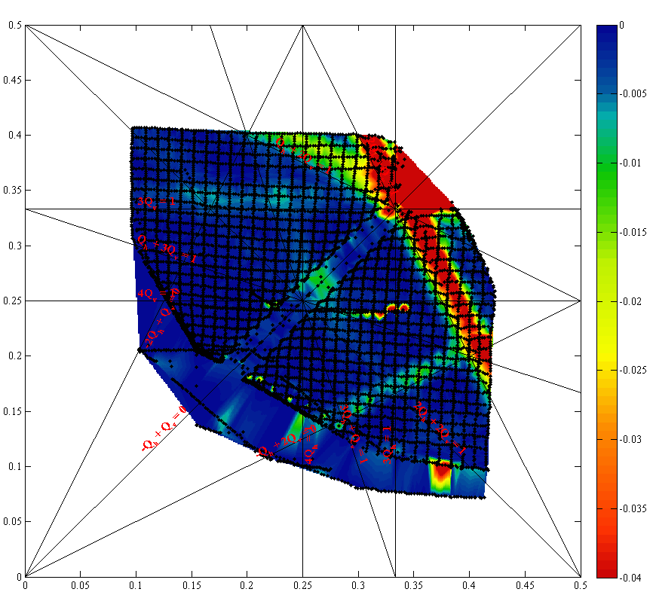
Tune scans: Identify Resonances
Tune scans @ 2 GeV
Dynamic scan
Low-intensity & large emittance (=no space-charge)
To have “good first idea” of where dangerous lines are
Without chromaticity correction: DONE
Chromaticity correction (using PFW): ONGOING, Alex
Qy
0. 5
0.25
0
0
0.25
0. 5
Qx

Slide 5
Measurements, July 2011
Explored few WPs and identified 2 regimes:
No losses & very little emittance blow-up
Losses & bunch shape deformation

Slide 6
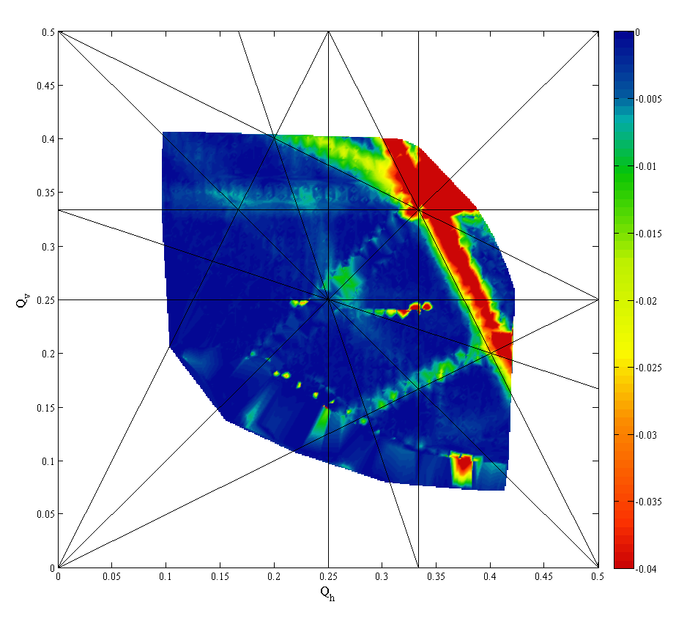
Measurements, Nov. 2011
MAJOR RESULT: Identified region where beam with Laselett ΔQ_{y}=-0.29 survives (= no degradation, no losses) for 1s: Q_{x}~6.20, Q_{y}<6.27 & above diagonal (to cure HT- instability)
Systematic scan (steps of 0.01) over this vertical line:
Qx=0.20; Qy=0.21→ 0.37
Measurements over 1s plateau
Analysis results:
Qv < .27 → No losses, no blow-up
.27 < Qv <.31 → Losses & bunch shortening
Qv > .31 → Vertical tails

Slide 7
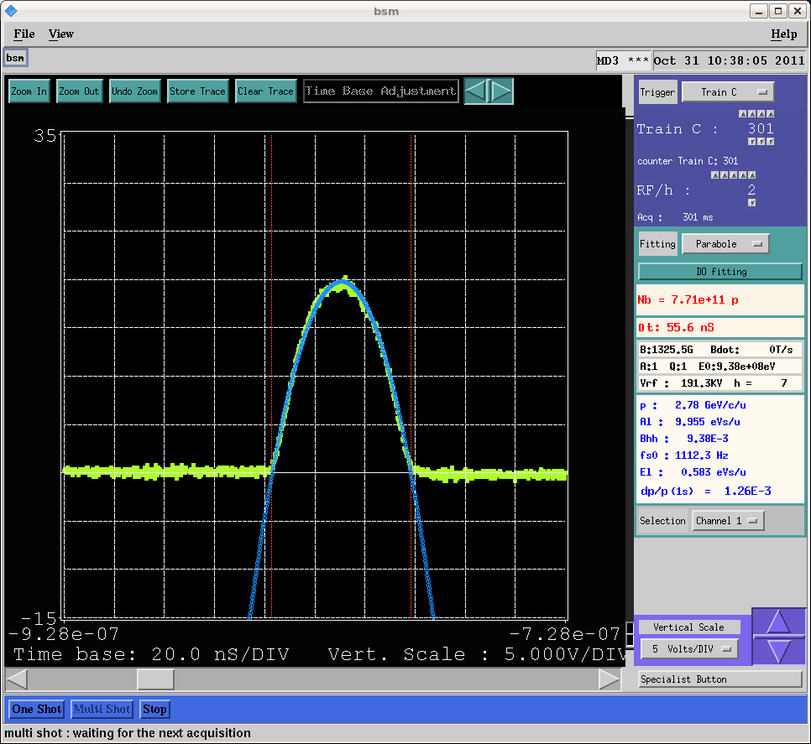
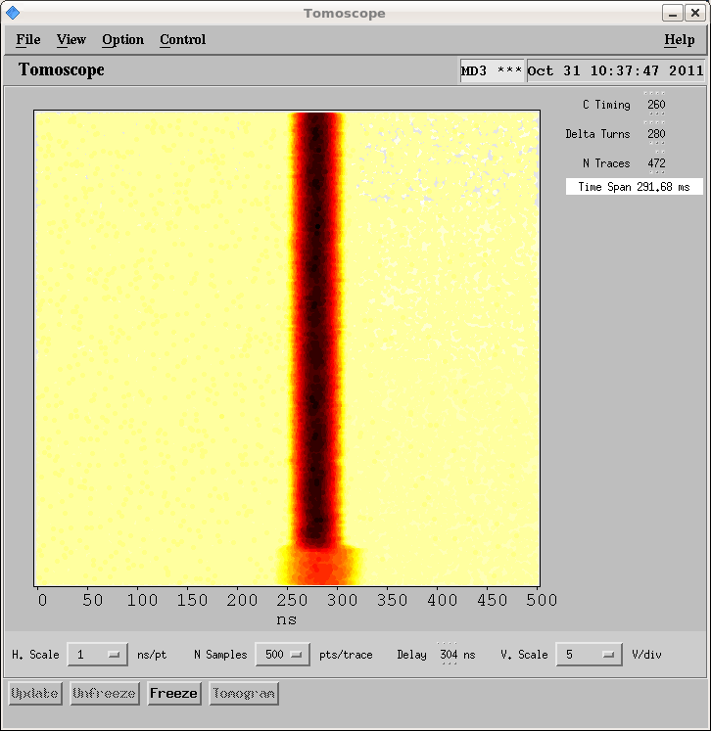
The beam
LIU_V1_SpaceCharge
(LHC_Hi_Bright_rebuket in PSB)
N_{b}~ 70 x 10¹⁰
ε_{x}*~ε_{y}*~2 μm
Bunch compression by increasing RF voltage
Bunch length(4σ)= 55ns , parabolic bunch
dp/p (1σ) ~ 1.21 x 10⁻³
Large chromaticity: ξ_{x}= -0.8, ξ_{v}=-1
Space Charge: ΔQ_{H}=-0.21; ΔQ_{V}=-0.29

Slide 8
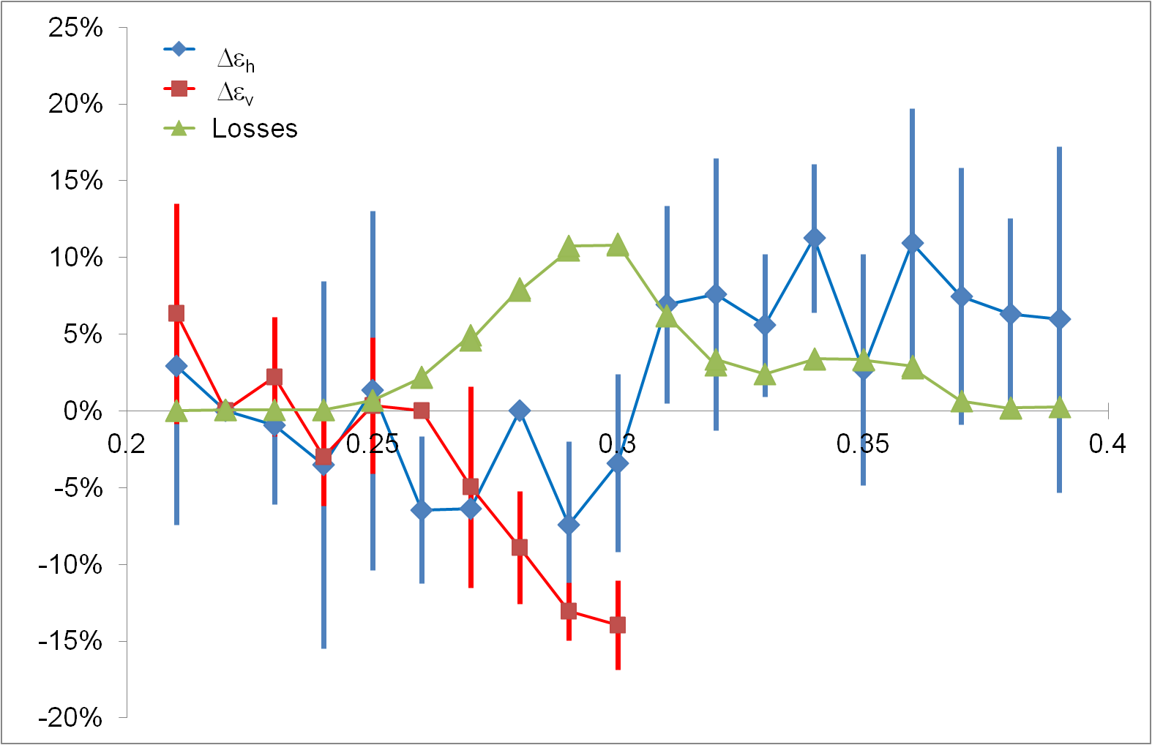
Analysis: PRELIMINARY!!!
DECEMBER 2011
Relative increase over 1s
Qv
Tails in the vertical profiles
for Qv>0.30
Large error-bars in Wire scanners measurements (need to refine analysis)
Important losses @ Qv=0.28-0.29

Slide 9
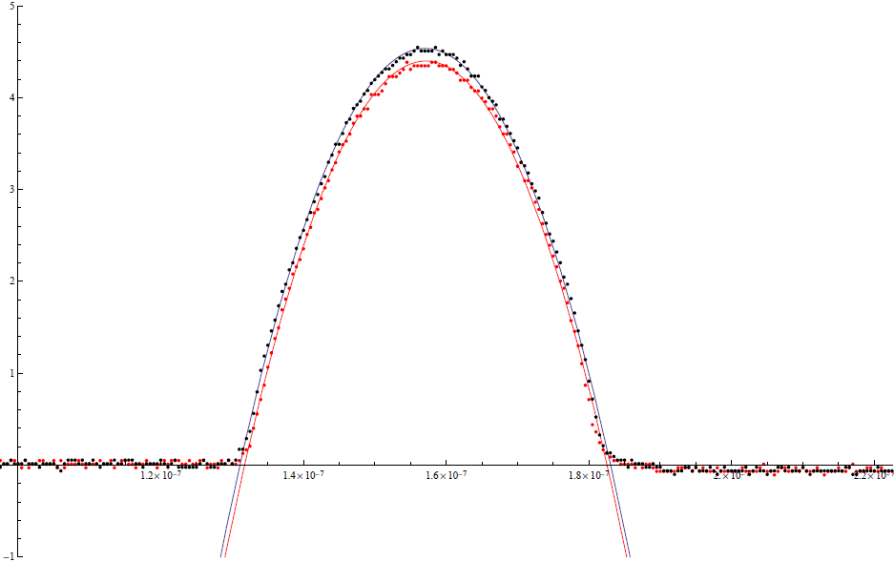
Tomoscope analysis (longitudinal)
Parabolic bunch (profiles @ C320, C1320)
Qh=0.20, Qv=0.27

Slide 10
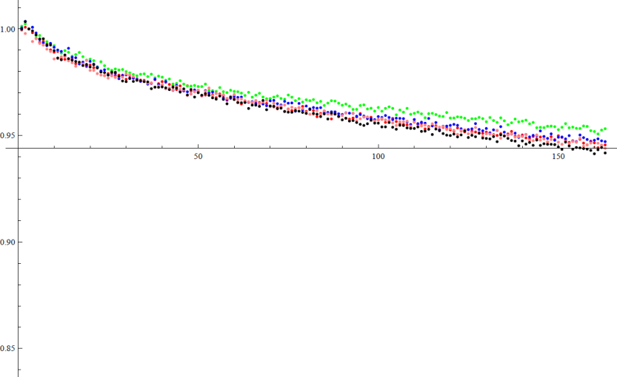
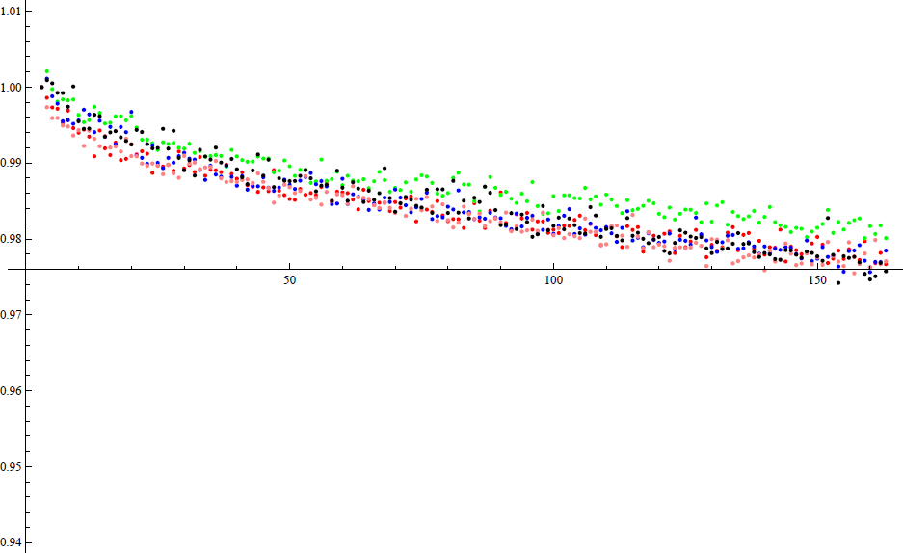
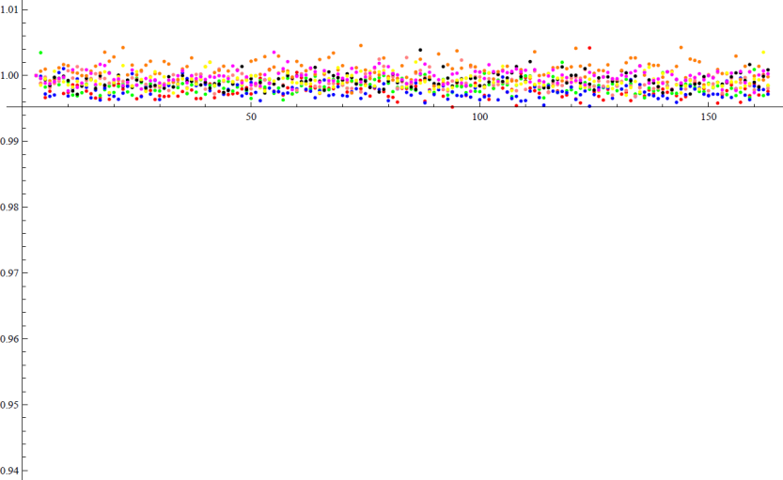
Tomoscope analysis
Qh=0.20, Qv=0.27
Qh=0.20, Qv=0.24
1.00
1.00
0.95
0.95
0.90
0.90
Intensity (Qv=0.27)
Intensity (Qv=0.24)
0.85
0.85
0 s
1 s
0 s
1 s
1.00
1.00
0.98
0.98
0.96
Bunch Length (Qv=0.27)
0.96
Bunch Length (Qv=0.24)
0.94
0.94

Slide 11
Tomoscope analysis
Qv>0.26: Losses + Bunch shortening = Resonance crossing?

Slide 12
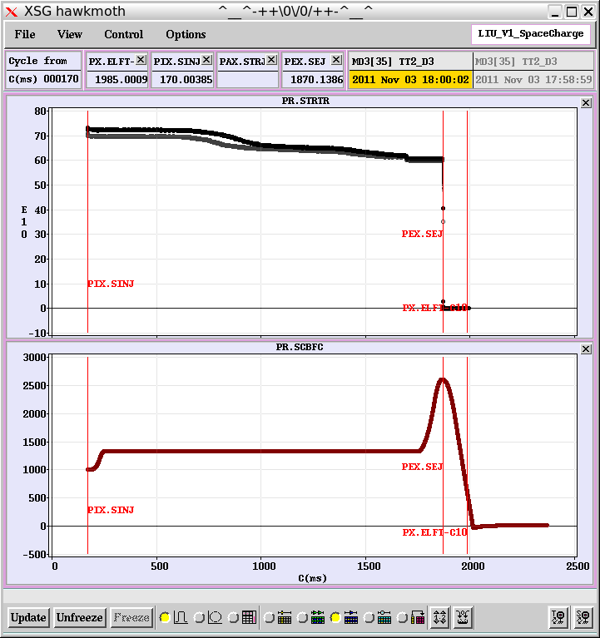
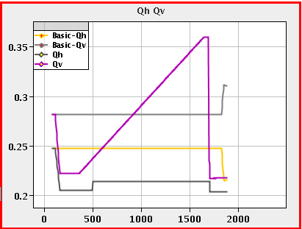
Losses on the 0.25 line
It happens:
between C784-995 --> @ Qy=.268-.29 for short bunch (ΔQy=-0.27)
between C677-816 --> @ Qy=.257-.27 for long bunch (ΔQy=-0.175)
ms
Quick check with low-intensity beam: → small change in loss slope for Qv=0.25
To be further investigated

Slide 13
Wire scanners analysis (vertical)
Qv>32: χ2 gets worse → Tails

Slide 14
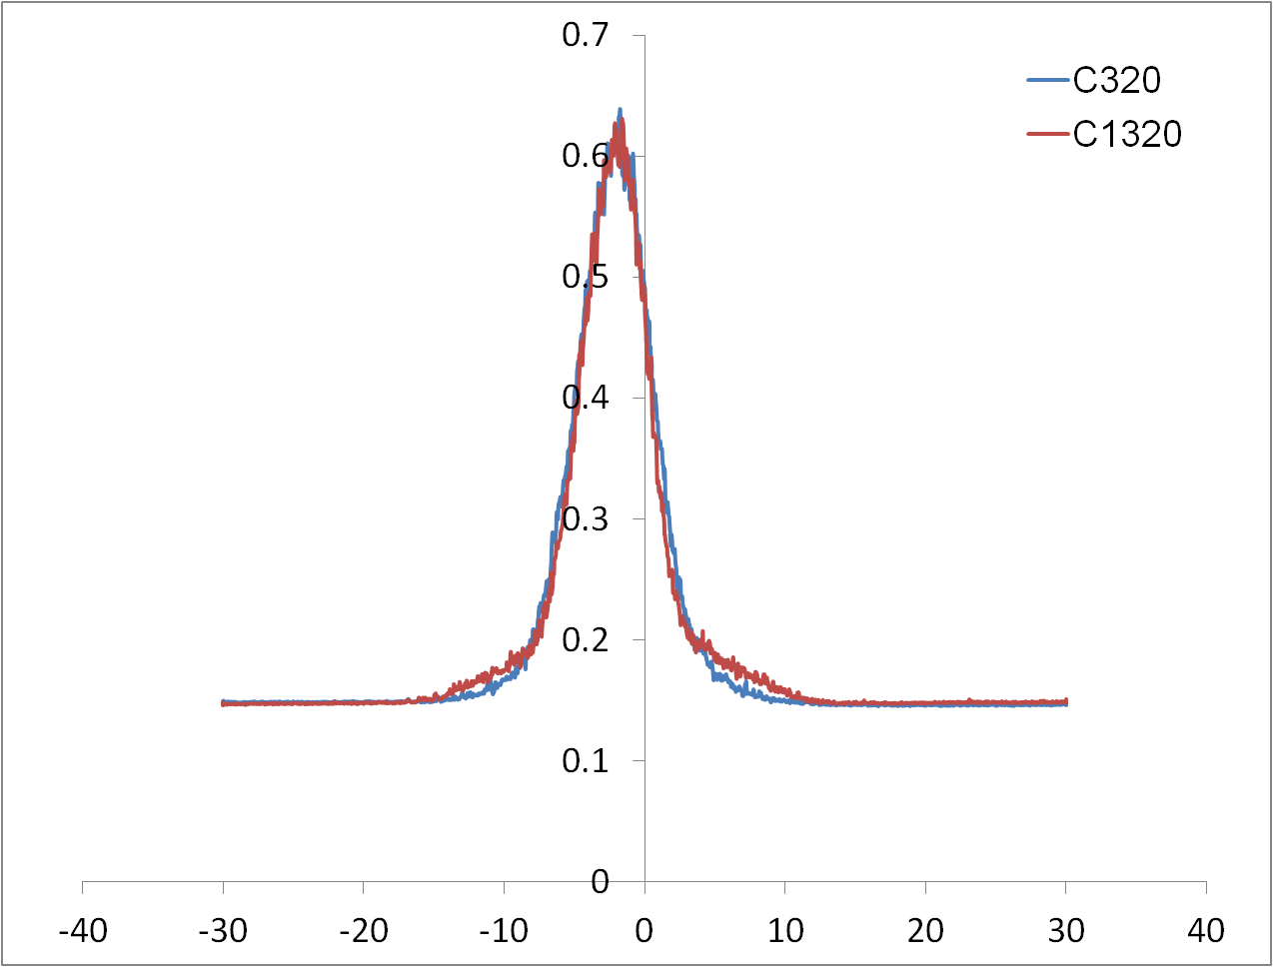
Tails in vertical profile
a.u.
320 ms
1320 ms
Qh=0.20, Qv=0.32
Attempt to fit it with Levy distribution (thanks M. Martini)
Here we may need chromaticity compensation
mm

Slide 15
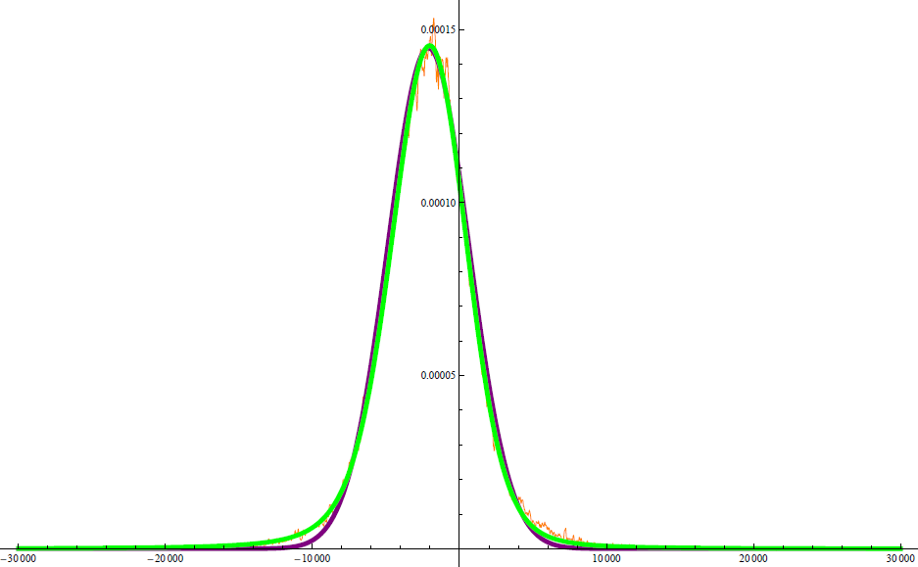
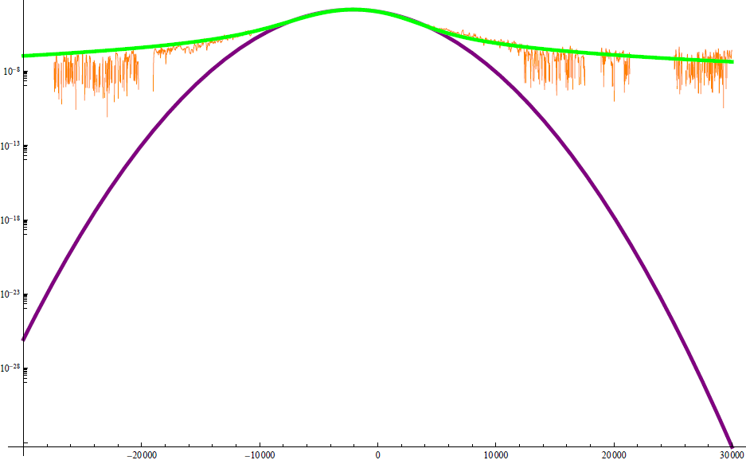
Example of Levy distribution fit
by M. Martini
Qh=0.20, Qv=0.33, @ C1320
TIMBER_DATA __ 20111110163030CET.txt
α=1.7
Gaussian (would be α=2)
α=1.7
Sorry, still analyzing all profiles ‘a la Michel’…

Slide 16
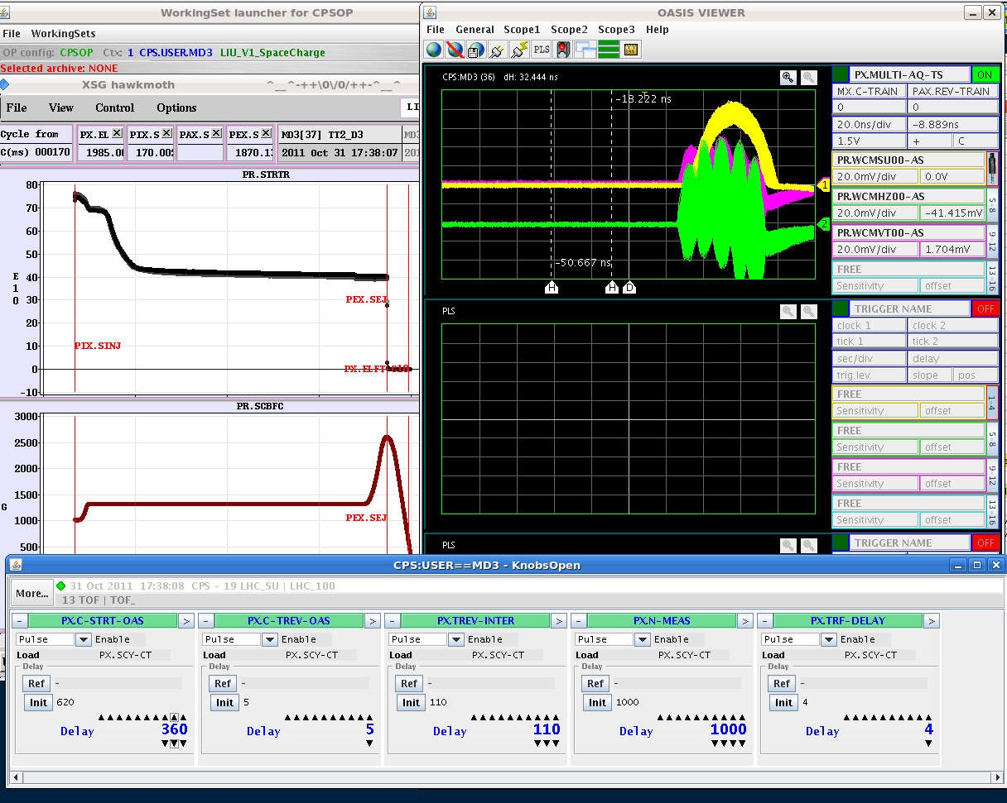
H-T instability ONLY below diagonal
Cannot be cured with coupling
Disappears if WP above diagonal
Need further measurements (to confirm) & simulations
We have some explanation… (Thanks E. Metral & A. Burov!)

Slide 17
Measurements summary & TODO
Large & systematic amount of data taken:
Longitudinal & transverse profiles evolution (over 1s) Vs. working point
Analysis ongoing (Levy distribution fit, using Michel’s routines)
What’s happening close to Qv=0.25 line? (losses)
The line was not seen during dynamic scans w. low intensity (true?)
TODO: Measurements (static) with a not-SC dominated beam
TODO: Losses vs. Qv ↔ correlation with D.A. (M. Giovannozzi help)
TODO: Emittance/bunch profiles evolution Vs. beam intensity
What’s happening close to Qv=0.33 line? (tails in vertical)
Need to disentangle effect of Chromaticity from Space-Charge
TODO: Measurements with not-SC dominated beam, but same (dp/p)
TODO: Measurements with different (dp/p) but same space-charge
TODO: Chromaticity correction (ongoing, Alex)
HeadTail instability only below the diagonal:
To be investigated…
Some of them already ongoing by Simone and others…

Slide 18
Back-up

Slide 19
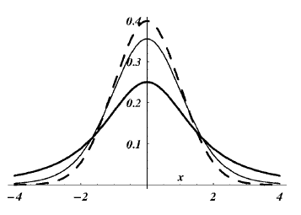
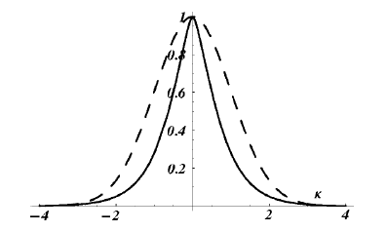
Levy-Student distribution
Thanks M. Martini, S. Gilardoni
Developed for finance, where non-Gaussian tails are important
Parametrization (α=2 → Gaussian, α=1 → Cauchy)
N. Cufaro Petroni, S. De Martino, S. De Siena, F. Illuminati, Lévy-Student distributions for halos in accelerator beams, Phys. Rev. E 72, 066502 (2005)

