Slide 1

Summary Nufact 2012
S. Gilardoni

Slide 2
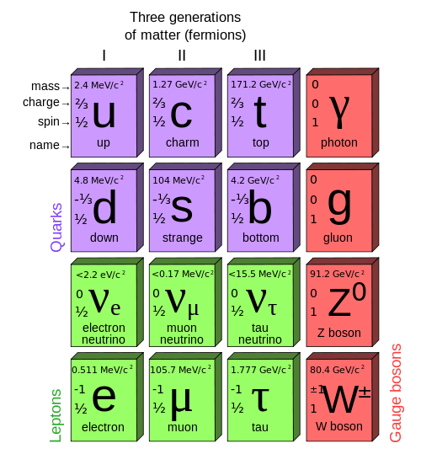
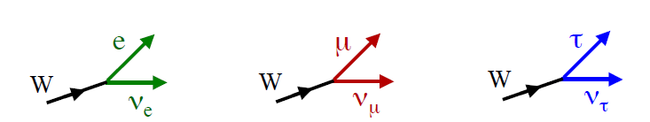
Neutrinos, νe, νµ, ντ
We define the three known flavors of neutrinos,
by W boson decays and the associated lepton
n → p + e– + ν_{e}
π → µ + ν_{µ}
D → τ + ν _{τ}

Slide 3
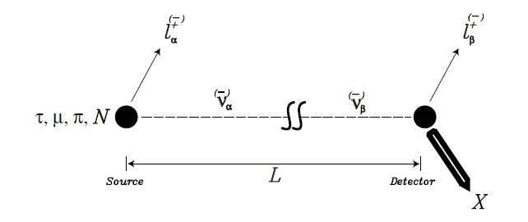
Conceptual neutrino experiment

Slide 4
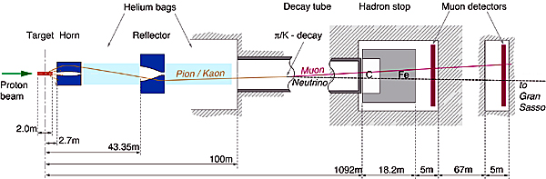
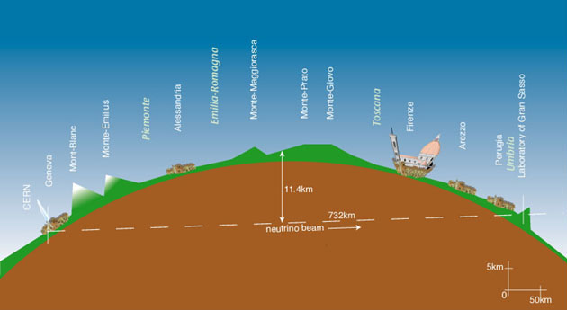
A real neutrino experiment

Slide 5
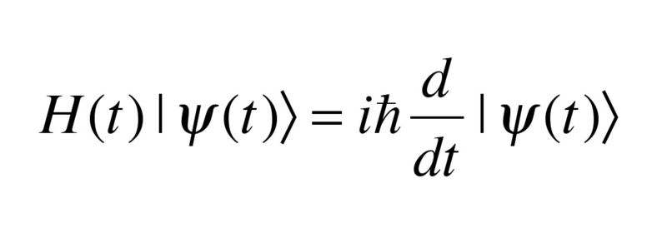

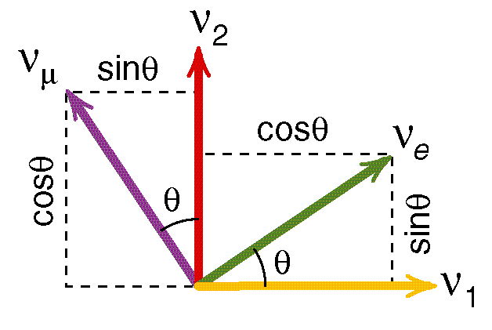
ν oscillations+masses
Propagation in space: Schrodinger equation
Interaction with Gauge Bosons of U(1)xSU(2)_{L}
≠
Mass eigenstates: ν₁, ν₂, ν₃
Flavor eigenstate: νe, νµ, ντ
Two family scheme
ν_{e}, ν_{μ} flavor states; ν₁, ν₂ mass states;

Slide 6
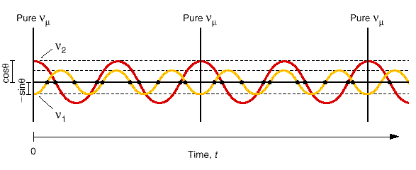
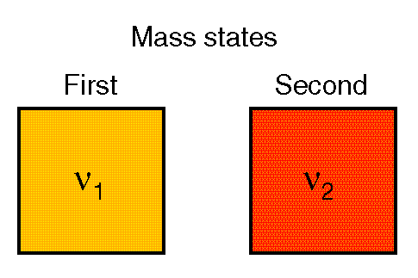
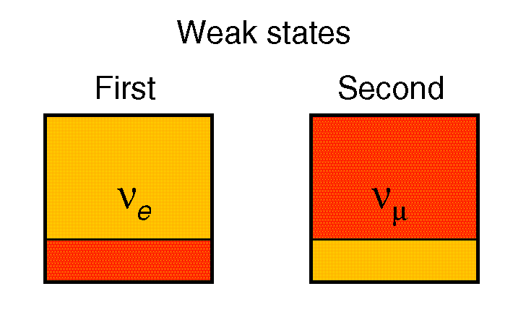
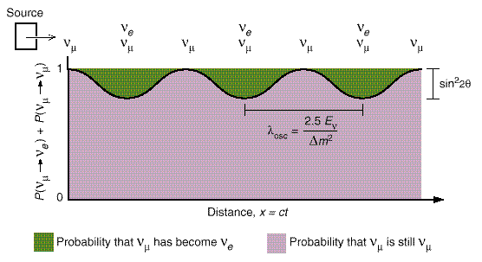
Oscillations
[E]=GeV; [x]=km; [Δm²]=eV²
Source: E
Baseline: l
Nature: sin²2θ
Δm²=m₁² - m₂²

Slide 7
Why neutrino oscillations are important ?
If neutrinos oscillates then they have non-zero mass (Δm²≠0)
If neutrinos have mass, then there must be something more then the Higgs boson, since neutrinos are only left-handed particles (iso-spin singlet of SU(2)_{L}), so one cannot generate in the standard model Lagrangian a Higgs-like mass term.

Slide 8
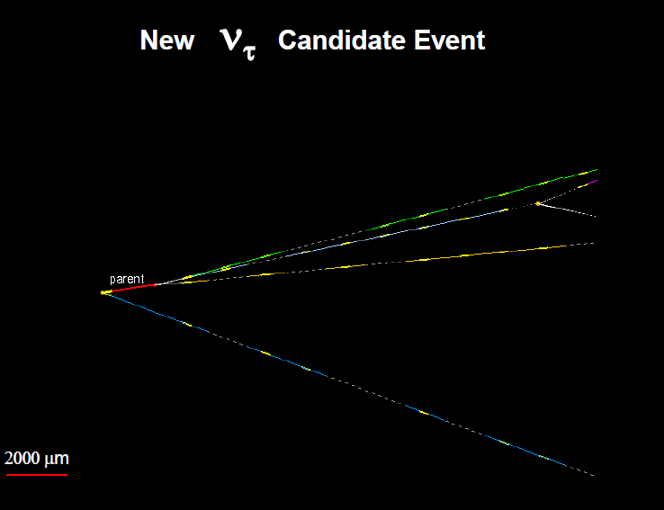
CNGS: ν_{µ} → ν_{τ} example that neutrinos do oscillate

Slide 9
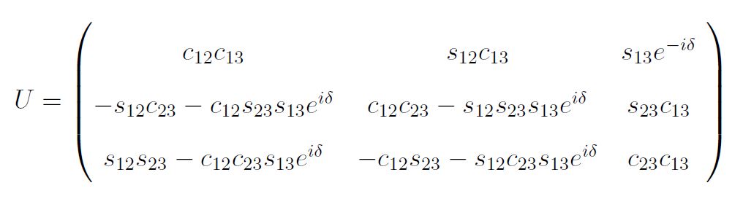
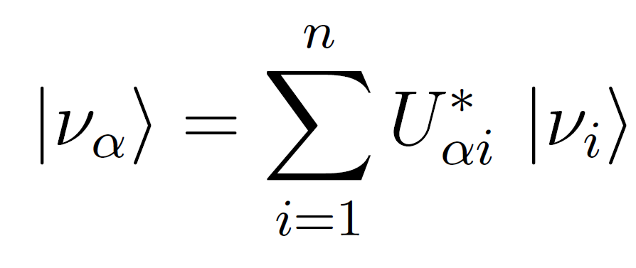

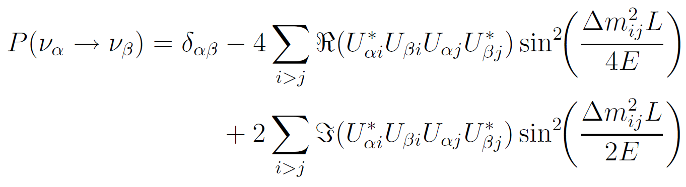

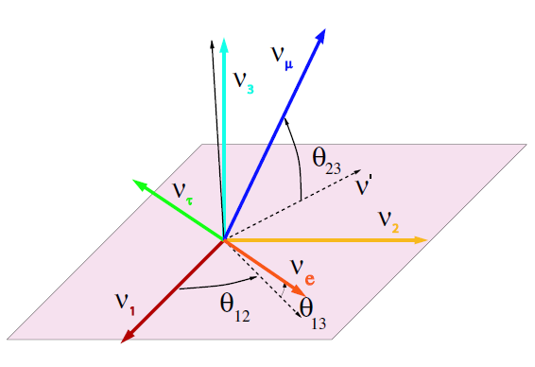
3-Family oscillation
Oscillation described by:
3 mixing angles (θ₁₂ θ₂₃ θ₁₃)
3 mass differences square (Δm₁₂² Δm₂₃² Δm₁₃²)
1 CP violating phase (δ)

Slide 10
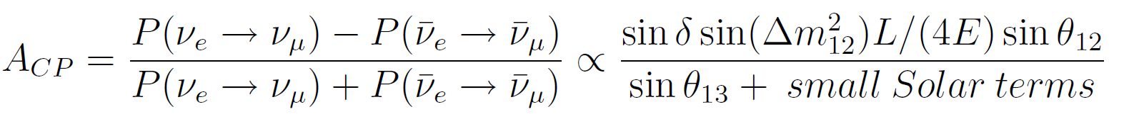
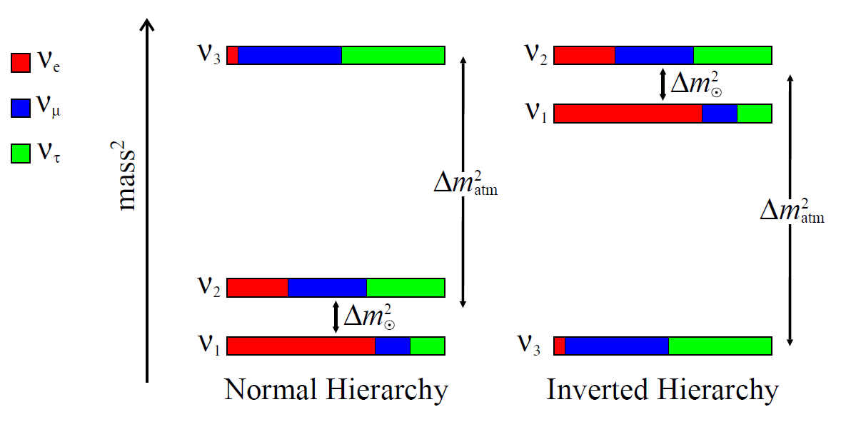
The discovery of the year: θ₁₃ is not zero
θ₁₃ was the last angle not known in the mixing matrix.
Why so important? Because now one can hope to measure CP violation
How? By measuring
What remains to measure
before CP violation ?

Slide 11
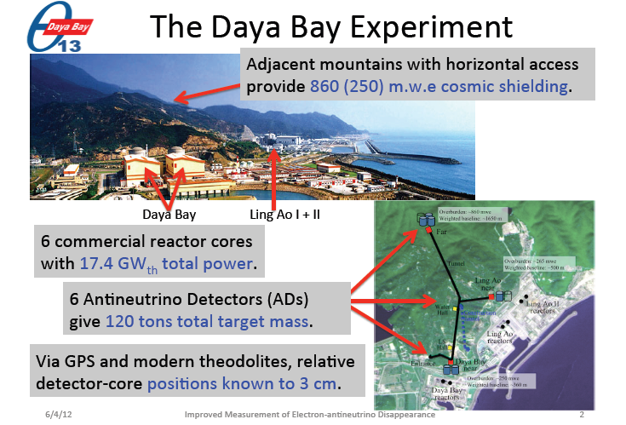
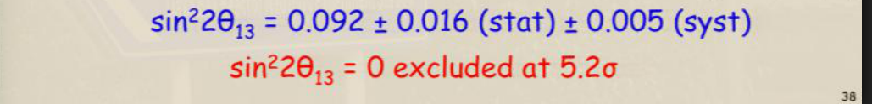

Slide 12
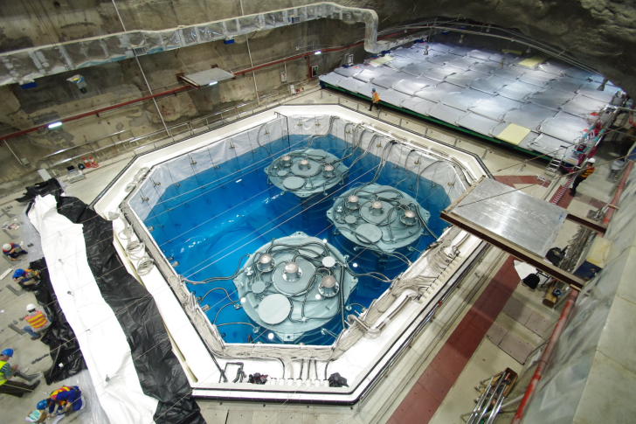
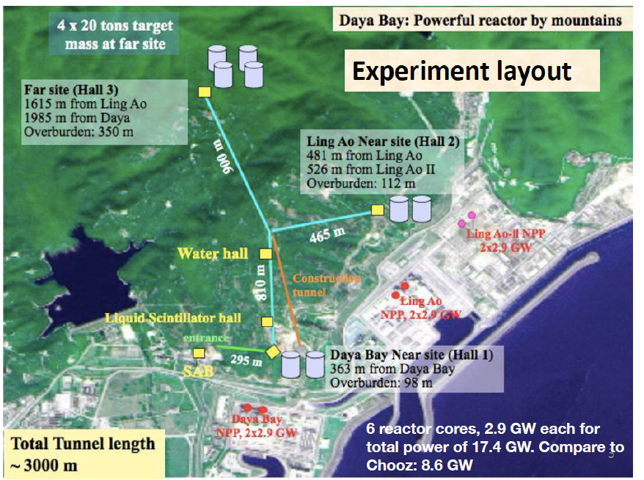
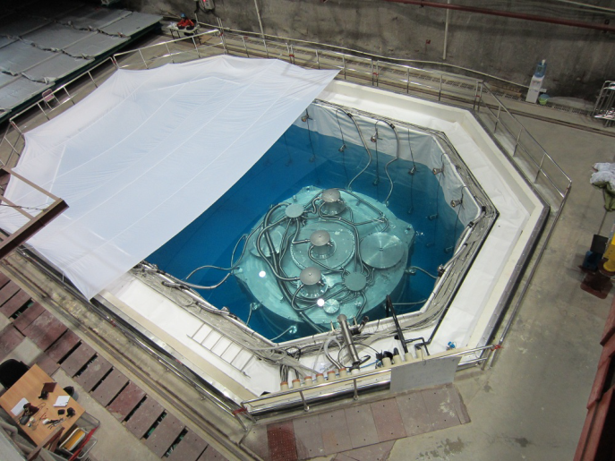
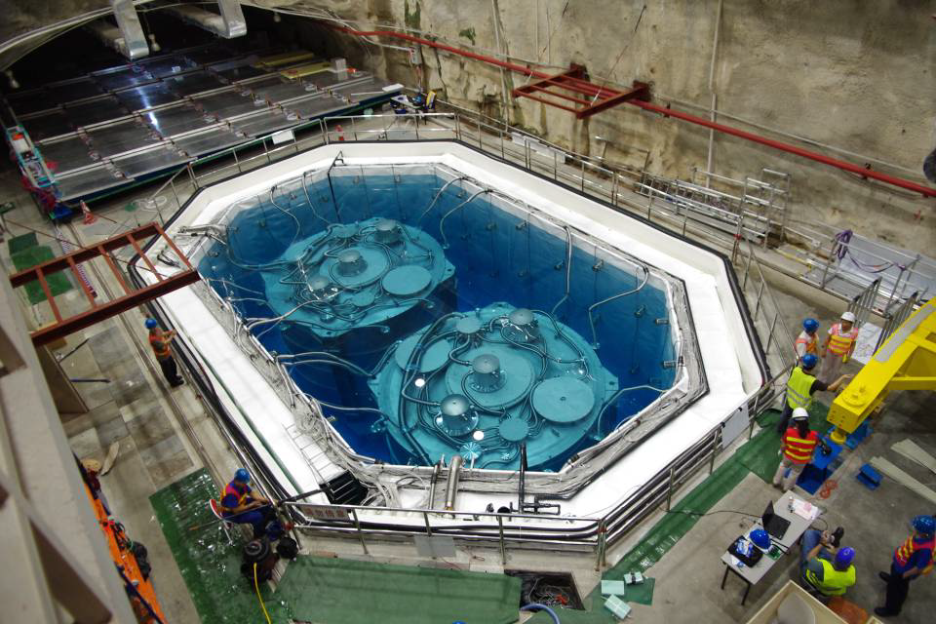

Slide 13
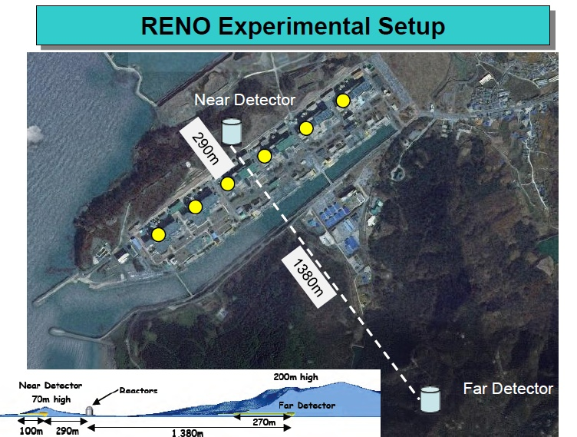
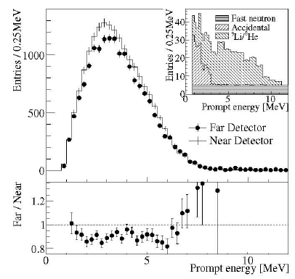

some unexpected behaviour noted

Slide 15
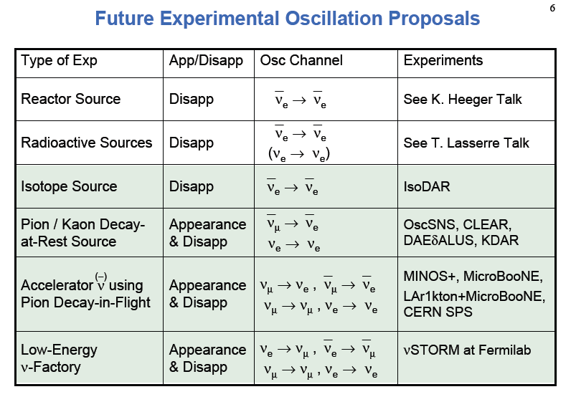
Shaewitz Neutrino 2012

Slide 16
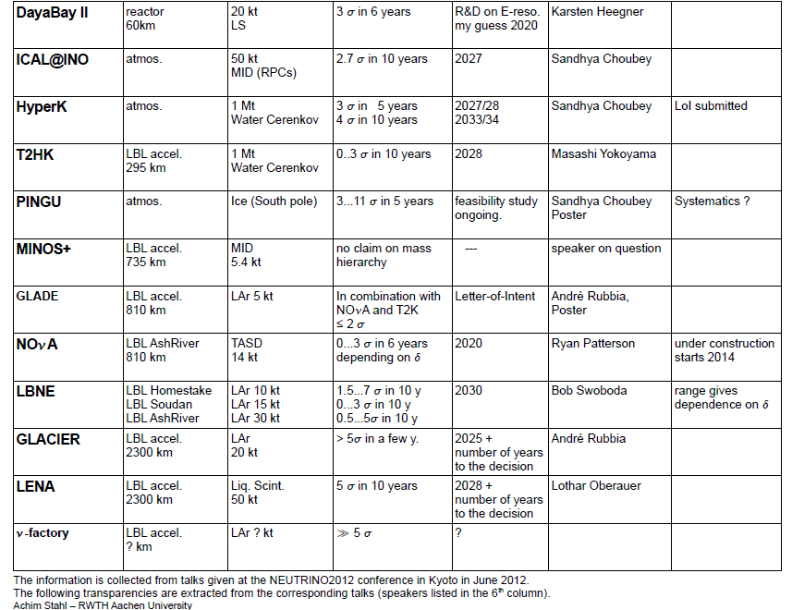
LBNO LArg
LBNO- Lsc
status= ~approved

Slide 17
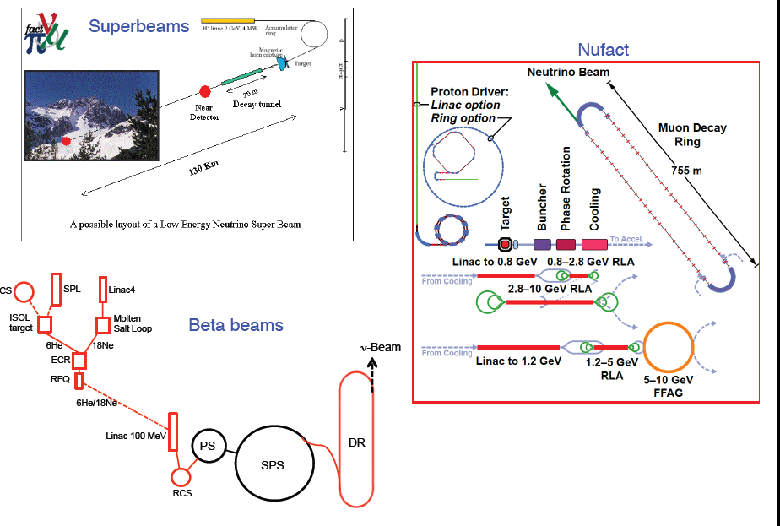
Different type of Man-made neutrino beams

Slide 18
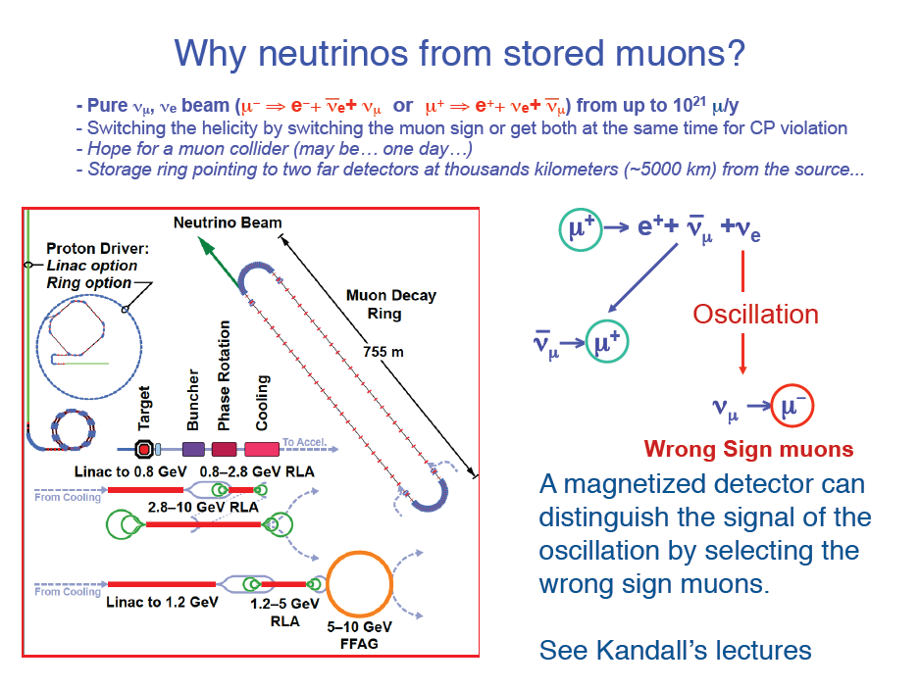

Slide 19
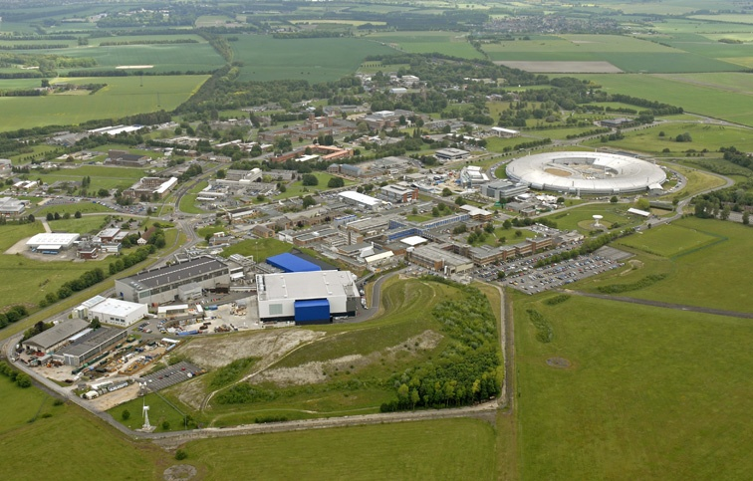

Proton Driver Scenarios at RAL and CERN
John Thomason
Synchrotron Group Leader
ISIS Accelerator Division

Slide 20
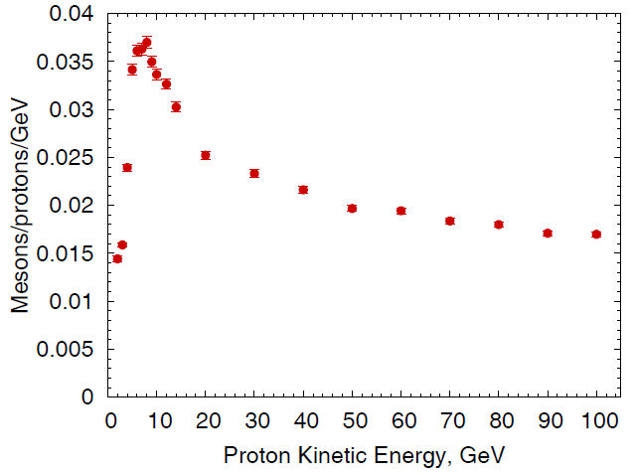
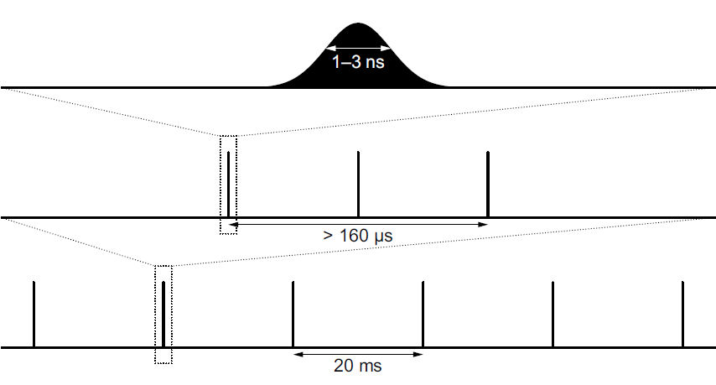
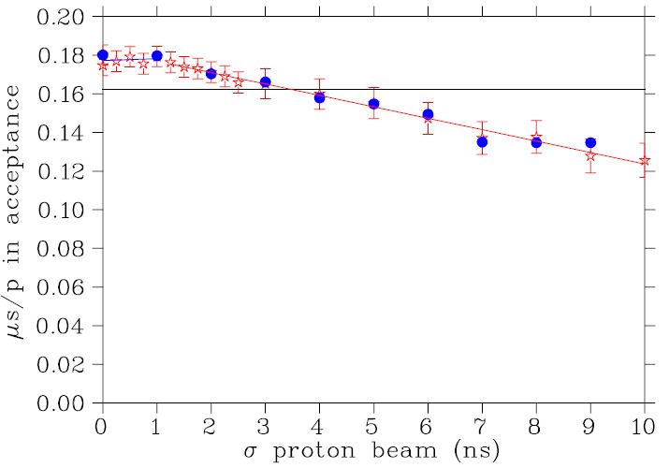
High Power Proton Driver
Supply protons to target to produce pions
Basic specifications:
4 MW proton beam power
Proton kinetic energy 5 – 15 GeV
RMS bunch length 1 – 3 ns
50 Hz repetition rate
Three bunches, extracted > 80 µs apart

Slide 21
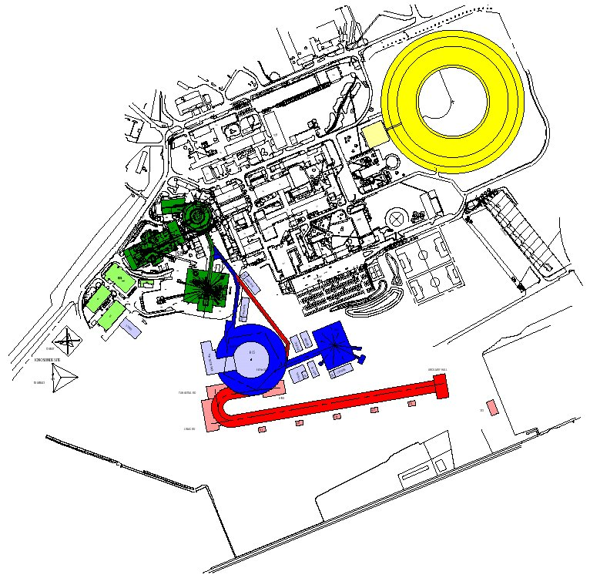
ISIS MW Upgrade Scenarios
1) Replace ISIS linac with
a new ≈ 180 MeV linac
(≈ 0.5MW)
2) Based on a ≈ 3.3 GeV RCS fed by bucket-to-bucket transfer from ISIS 800 MeV synchrotron (1MW, perhaps more)
3) RCS design also accommodates multi-turn charge exchange injection to facilitate a further upgrade path where the RCS is fed directly from an 800 MeV linac (2 – 5 MW)

Slide 22
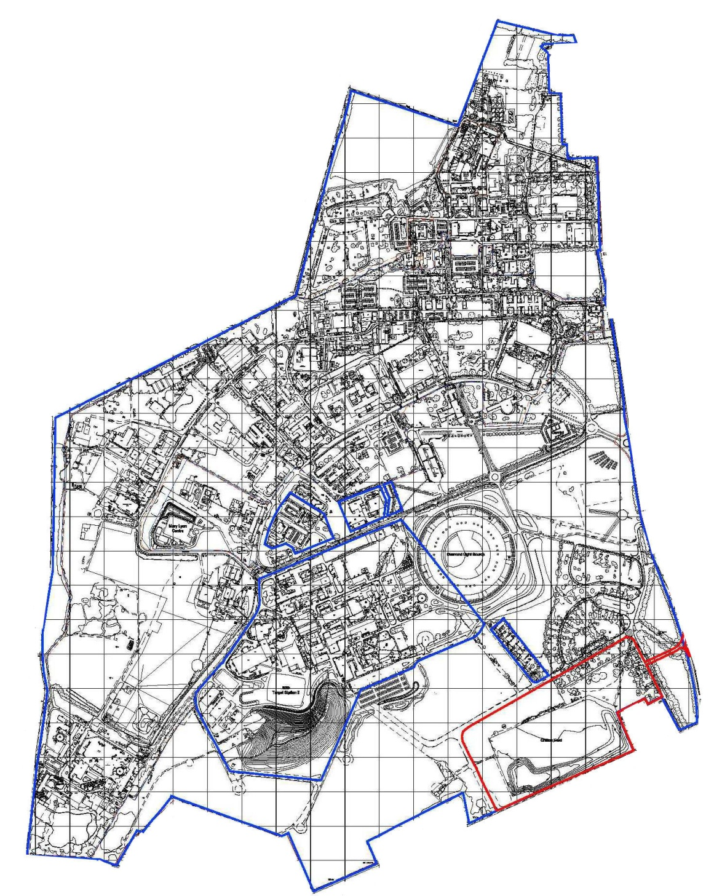

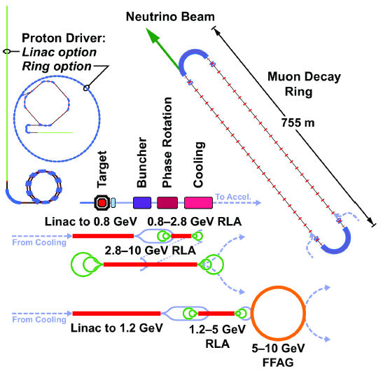
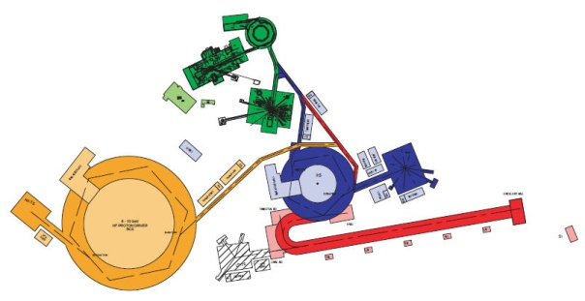
NF on Harwell Oxford Site
decay ring to Norsaq
~10° into ground
RLA 2
RLA 1
muon linac
cooling
phase rotation
bunching

Slide 23
Present
LIU (2019)
Back-up
LP-SPL: Low Power-Superconducting Proton
Linac (4 GeV)
Proton flux / Beam power
HP-SPL: Upgrade of infrastructure (cooling water,
electricity, cryogenics etc.)
Replacement of klystron power supplies
Addition of 5 high b cryomodules to
accelerate up to 5 GeV
50 MeV
Linac2
Linac4
Linac4
160 MeV
1.4 GeV
PSB
LP-SPL
2.0 GeV
PSB
4 GeV
26 GeV
PS
PS
PS2
Main requirements of PS2 on its injector:
50 GeV
Output energy
450 GeV
SPS
Requirement | Parameter | Value
2.2 x ultimate brightness with nominal emittances | Injection energy | 4 GeV
 | Nb. of protons / cycle for LHC (180 bunches) | 6.7 × 10¹³
Single pulse filling of SPS for fixed target physics | Nb. of protons / cycle for SPS fixed target | 1.1 × 10¹⁴
LHC /
sLHC
7 TeV

Slide 24
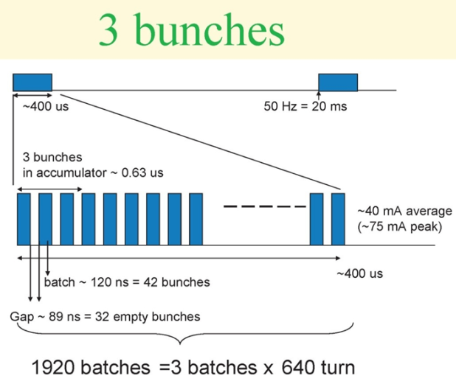
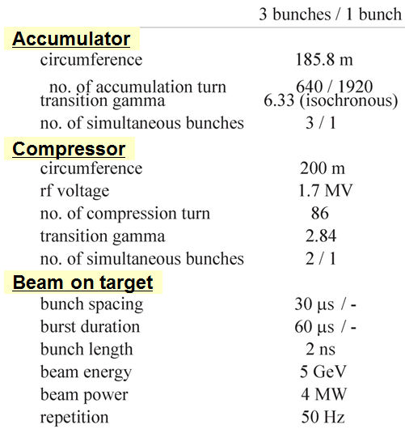
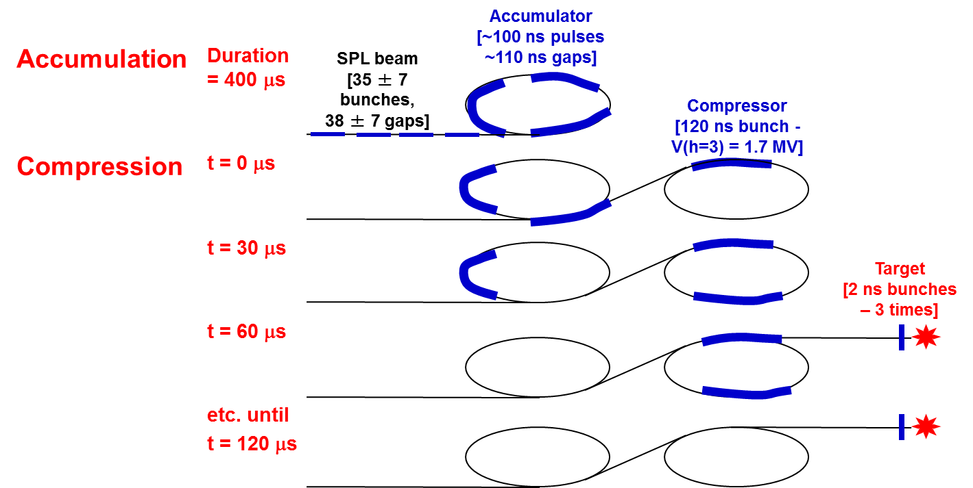
SPL-Based NF Proton Driver: Principle
Accumulation of beam from the High Power SPL in a fixed energy Accumulator (5 GeV, 4MW beam power).
Bunch compression («rotation») in a separate Compressor ring

Slide 25
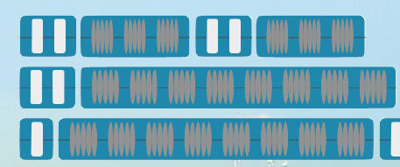
HP-SPL: Block Diagram
0 m
0.16 GeV
110 m
0.73 GeV
291 m
2.5 GeV
500 m
5 GeV
From Linac4
Medium b cryomodule
High b cryomodules
Ejection
High b cryomodules
Debunchers
To HP-PS and/or Accumulator
9 x 6
b=0.65 cavities
11 x 8
b=1 cavities
to
EURISOL
13 x 8
b=1 cavities
Segmented cryogenics / separate cryo-line / room temperature quadrupoles:
Medium b (0.65) – 3 cavities / cryomodule
High b (1) – 8 cavities / cryomodule
Low energy
Intermediate energy
High energy

Slide 26
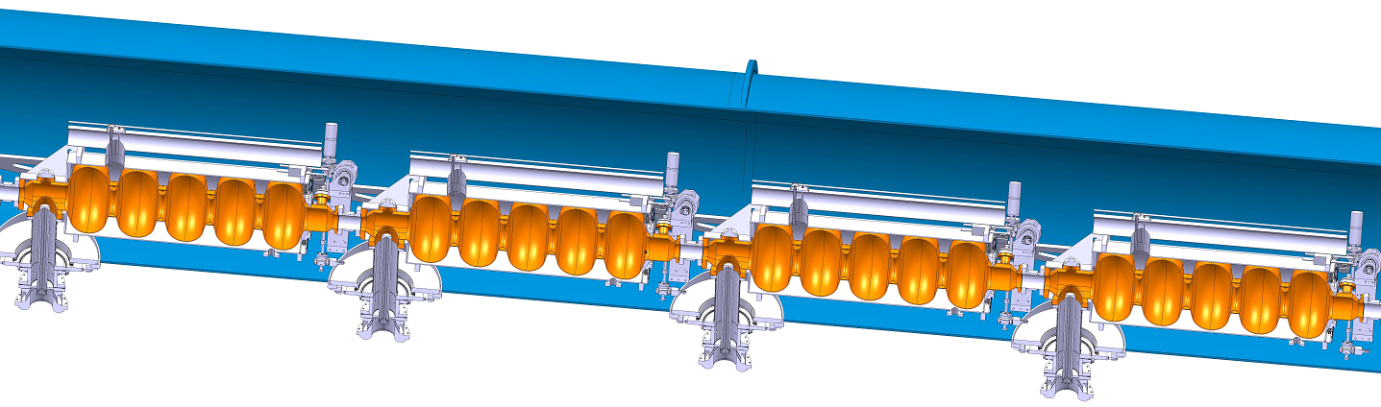
HP-SPL: R&D Objective
Design, construction and test of a string of 4 β=1 cavities equipped with main couplers & tuners inside a “short” prototype cryo-module before the end of 2014 tested in 2014.
Cryomodule
(CERN – CNRS)

Slide 27
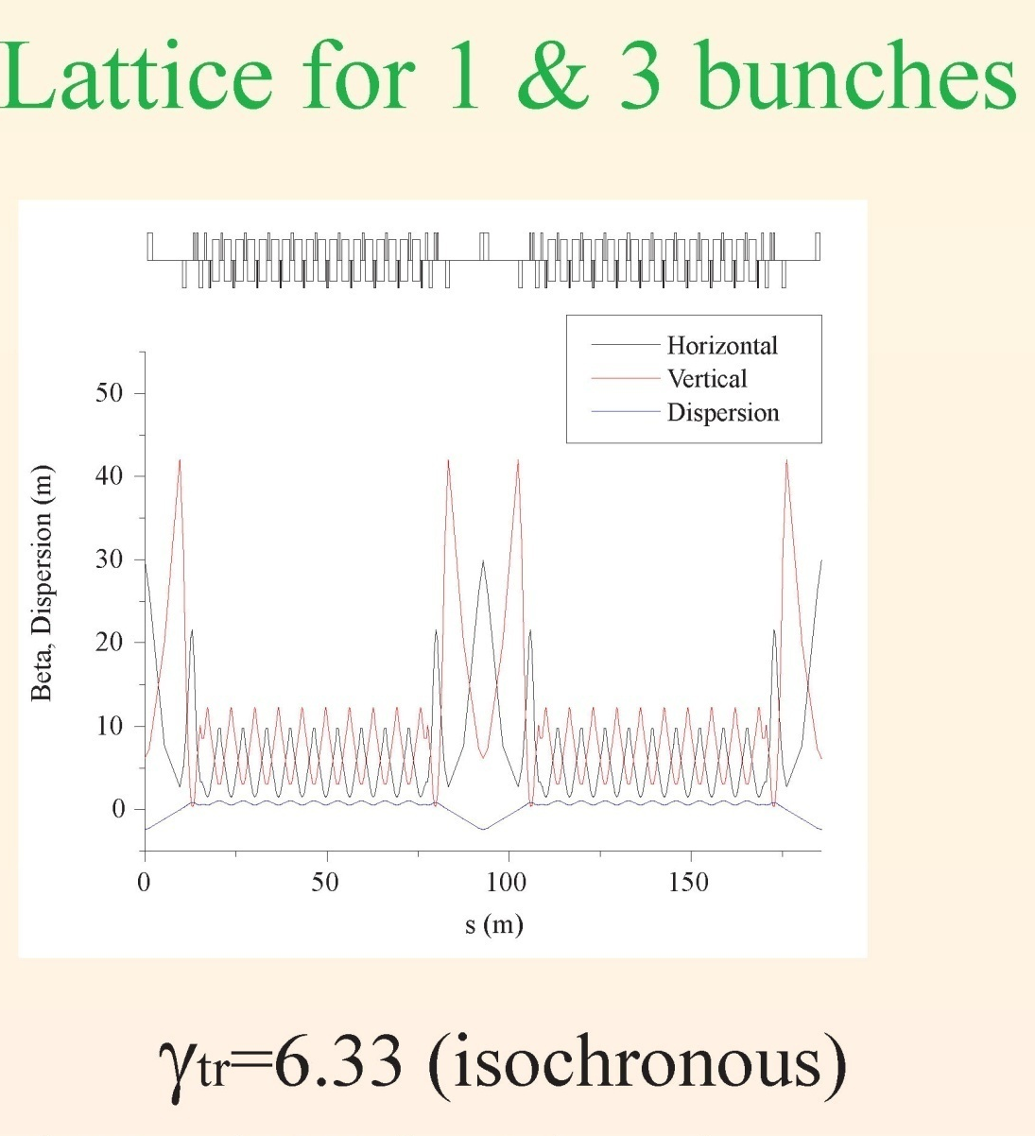
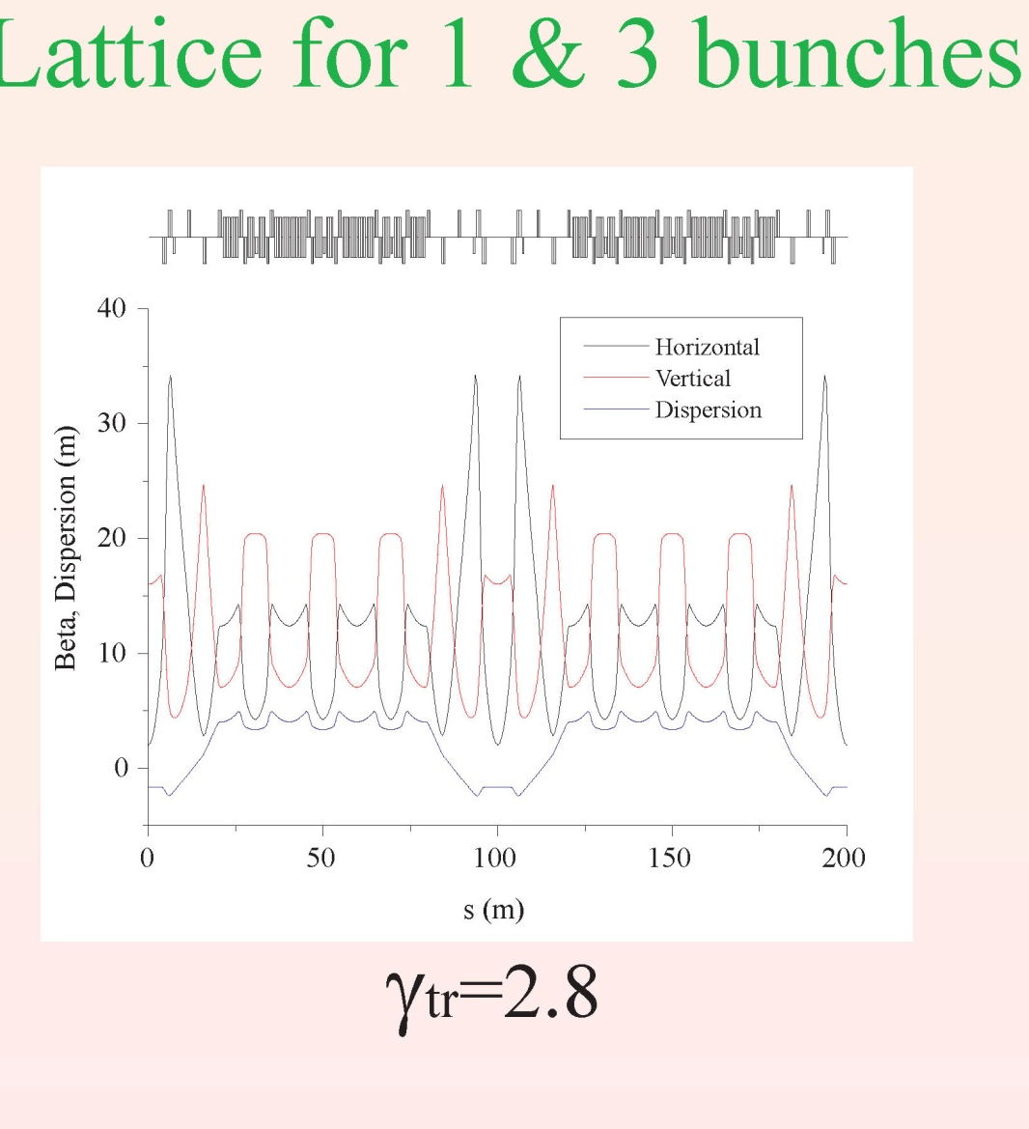
Accumulator/compressor lattices
from M. Aiba
Collective effect related limitations have also been studied

Slide 28
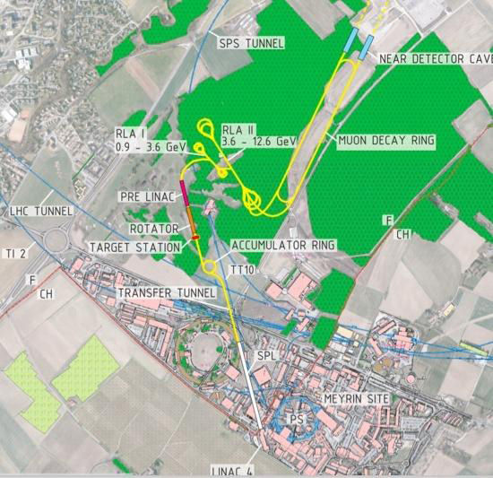
NF on CERN Site
To Pyhäsalmi
Other potential
neutrino physics
sources at CERN
Super-beam:
LAGUNA-LBNO
SPS (750 kW)
Target
0.75 – 2MW
Near
detector
LAGUNA-LBNO
HP-PS (2 MW)
HP-PS
Beta-beam:
EURISOL (200kW)
Transfer line
SPS → Target
To EURISOL

Slide 29
HB2010
Project X as a Driver
for a Neutrino Factory and/or a Muon Collider
Dave Johnson, Fermilab
and
Chuck Ankenbrandt, Muons, Inc.
September, 2010

Slide 30
Major Parameters of Proton Driver… and their Rationale
Beam power: 4 MW
  Needed to reach collider luminosity of ~10**34 at CM energy of 1.5 or 3 TeV
Beam energy: 8 GeV
  Near peak of pion production per unit beam power
  Degree of difficulty and likely cost are near minima.
  A natural choice at Fermilab
One bunch per cycle with rms bunch length: 1-3 nsec
  Enables bunch rotation of muons to reduce momentum spread.
  Natural time spread in collection is a few nsec.
Rep rate: ~15 Hz for collider (and Project X linac); ~60 Hz for neutrino factory
  Luminosity scaling like N**2 favors low rep rates for MC.
  Too low makes bunches too intense.

Slide 31
Recent developments:
Stages and Phases
Project X will be staged, with cost of 1st 3 stages < $1B:
  Stage 1: 1 mA @ 1 GeV from a CW linac
  Stage 2: 1 mA @ 1 GeV + 1 mA @ 3 GeV from a CW linac
  Stage 3: adds a pulsed linac to 8 GeV
  Stage 4: upgrades to a proton driver for MC and/or NF.
LBNE will also be phased.
These are DOE requirements. Also physics at each stage.
Stages and phases will probably be interleaved. Phase 1 of LBNE will likely precede Stage 1 of Project X. (Pier)
The plan is that Stage 4 will not be part of the project. Rather, it will be an upgrade path, and the project will be implemented to maintain the upgradability.

Slide 32
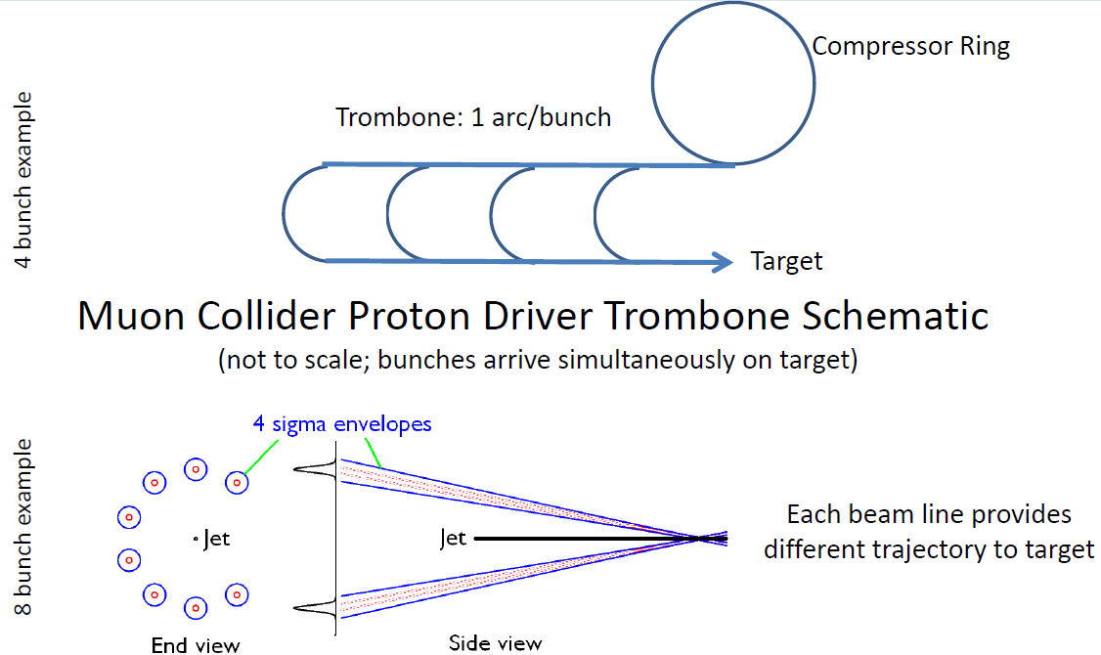
Muon Collider Trombone
From Keith Gollwitzer at MAP Winter Mtg

Slide 33
Summary/conclusions
The baseline plan using Stage 4 of Project X as a Proton Driver would provide superb capabilities. However, recent funding decisions mean that it would be too late.
Fortunately, there’s a high-quality, somewhat faster plan that would provide interesting capabilities.
We need design work on the 3-GeV initial stage.
The bottom line is that we should develop optimal staging scenarios that fit within expected funding constraints.
  Take maximum advantage of existing facilities.
  Build flexible additions that augment capabilities.

Slide 37
Neutrino Factory Front End (IDS)
-capture solenoid to accelerator
David Neuffer
C. Rogers, G. Prior, P. Snopok, C. Yoshikawa, A. Alekou, A. Grant, D. Stratakis, …
April 2012

Slide 38
Outline
Front End for the IDS Neutrino Factory
  Basis for engineering/costs
    Rf, requirements
    Engineering required
  Redesign for cost exercise
Losses – control
    Chicane, proton absorber
    rematching OK
rf gradient/ B concerns
  alternatives
    gas-filled rf/insulated rf/low-B/bucked coil

Slide 39
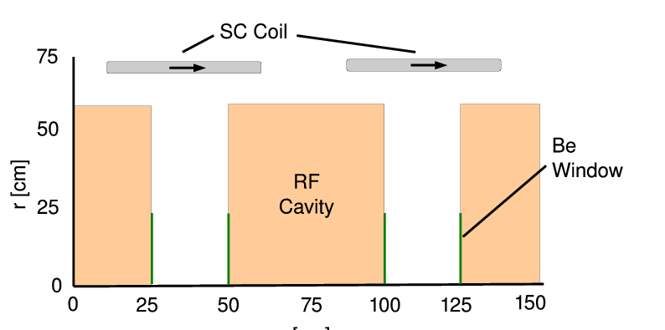
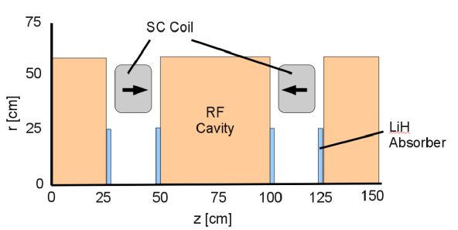
Rf Buncher/Rotator/Cooler requirements
Buncher
  37 cavities (13 frequencies)
  13 power supplies (~1—3MW)
RF Rotator
  56 cavities (15 frequencies)
  12 MV/m, 0.5m
  ~2.5MW (peak power) per cavity
Cooling System – 201.25 MHz
  100 0.5m cavities (75m cooler), 15MV/m
  ~4MW /cavity – most expensive item
Front End section | Length | #rf cavities | frequencies | # of freq. | rf gradient | rf peak power requirements
Buncher | 33m | 37 | 319.6 to 233.6 | 13 | 4 to 7.5 | ~1 to 3.5 MW/freq.
Rotator | 42m | 56 | 230.2 to 202.3 | 15 | 12 | ~2.5MW/cavity
Cooler | 75m | 100 | 201.25MHz | 1 | 15 MV/m | ~4MW/cavity
Total | ~240m | 193 |  | 29 | ~1000MV | ~550MW 400MW from cooling

Slide 40
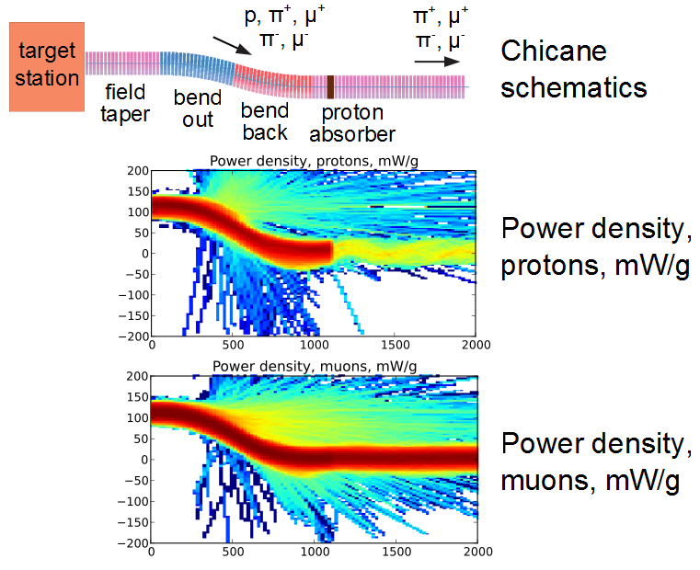


chicane works!
Chicane does not reduce transmission by much:
  0.098 → 0.094 (?) within acceptance
    ~0.107 without chicane/absorber
  Removes unwanted high energy particles
    eliminates prepulse from high-energy muons
  Works for both μ+ and μ⁻
Integrate into Engineering design?
  Optimize chicane/absorber parameters
  coils/shielding in chicane region ??
    normal conducting sector ?
  Cost effects?

Slide 41



Cooling Lattice variations
Gas-filled rf
  With LiH absorbers
    Zisman, et al.
Magnetically shielded
  Small B at rf
  worse than baseline
Magnetically Insulated
  B ǁ rf surface
  ~open-cell cavities
      Stratakis
Bucked Coil
  Reduced B in rf
  Alekou, Pasternak, Rogers

Slide 42


Slide 44


Slide 45


Slide 46


Slide 47


Slide 48


Slide 49


Slide 53
A Muon Collider CDR?
μ
Muons, Inc.
Rolland Johnson, Muons, Inc.
Some Personal History of CDR Experience
Whether a CDR is possible depends on the goals:
The CERN SppbarS had a luminosity goal of 10³⁰ at 540 GeV COM
Discovered W, Z, etc.
John Adams ~”Needed to keep accelerator team together until LEP…”
The Tevatron Collider had a luminosity goal of 10³⁰ at 1600 GeV COM
Discovered Top Quark, etc. Achieved more than 3x10³²
(both projects overestimated the pbar production cross-section by ~2X)
LHC…

Slide 54

Emittance Evolution Plot
Possibly REmEx in a PIC-type channel
PIC is a possible high leverage technique for final 6D Cooling
Muons, Inc.
The figure is courtesy of K. Yonehara

Slide 55

Higgs Factory Enabling Technology
μ
Muons, Inc.
A project is underway (Muons, Inc. and Fermilab) to design a 1-m long Helical Cooling Channel Segment – complete with
A 10 T Superconducting Helical Solenoid magnet,
Twenty 805 MHz RF Cavities, each
- dielectric-loaded
- pressurized with doped hydrogen gas, and powered by a
- phase and frequency locked magnetron power source
This may be the needed proof of principle technology demonstration.

Slide 56



The CERN to Frejus project: from neutrino beams to MEMPHYS
D.Duchesneau,
LAPP, Annecy
On behalf of the MEMPHYS collaboration
Introduction: physics case and motivation
The CERN neutrino beam options
The MEMPHYS detector: new simulation studies
Physics potential
Conclusions
NUFACT 2012
Williamsburg, July 24th, 2012

Slide 57




The CERN to Frejus project
Ingredients:
MEMPHYS: Huge Water Cherenkov detector
Fiducial Mass: 500 kt under the Frejus mountain in the Alps (4800 m.w.e. overburden)
103m
x 2
65 m
2 types of neutrino beams from CERN:
ν_{μ} from a Superbeam
4800 mwe
ν_{e} from a betabeam
Travelling a baseline of 130 km

Slide 58



SuperBeam at CERN (EUROν)
Linac 4, (4.0 GeV, 4 MW, 50 Hz)
p
Energy | 4-5 GeV
Beam Power | 4 MW
Proton per pulse | 1.1 x 10⁺¹⁴
Rep. rate | 50 Hz
Pulse duration | 3.2 μs
Beam shape | Gaussian
Emittances rms | 3π mm mrad**
proton driver (SPL)
Accumulator
ring
HP-SPL proton kinetic energy: ~4 GeV
Magnetic
horn capture
(collector)
p
Target
ν, μ
hadrons
decay tunnel
~300 MeV ν_{μ} beam to far detector
horn off
horn on
Ref: A. Longhin, Eur. Phys. J. C71 (2011) 1745
ν and anti-ν runs by inverting horn polarity
neutrino
anti-neutrino
Cf: details in N. Vassilopoulos’ talk

Slide 59

SuperBeam at CERN (EUROν)

Slide 60

Beta-Beam at CERN
Use of CERN machines and infrastructures, technology
  Use of existing machines: PS and SPS
Relativistic gamma=100 for both ions
  SPS allows maximum of 150 (⁶He) or 250 (¹⁸Ne)
  Gamma choice optimized for physics reach
Assumed rates for estimations
  2.9*10¹⁸ anti-neutrinos/year from ⁶He
  1.1 10¹⁸ neutrinos/year from ¹⁸Ne
Aim ⁶He and ¹⁸Ne: 2 10¹³/s
Low Q
Isotope | ⁶He | ¹⁸Ne
A/Z | 3 | 1.8
decay | β ⁻ | β ⁺
τ_{1/2} [s] | 0.81 | 1.67
Q [MeV] | 3.51 | 3.0
R&D on Beta Beams:
Isotope Production (β – and β ⁺)
Cross section measurements
Collection of isotopes
Ionizing isotopes
Accelerate optimally a stable ion beam
Optimize the acceleration and cycling
Radioprotection
Alternative high Q isotope pair not considered for Frejus
Isotope | ⁸Li | ⁸B
A/Z | 2.7 | 1.6
decay | β ⁻ | β ⁺
τ_{1/2} [s] | 0.83 | 0.77
Q [MeV] | 12.96 | 13.92
See also T. Mendonca’s talk on 25/07

Slide 63



Beta-Beam at CERN
The Low-Q option ⁶He/¹⁸Ne (CERN-Fréjus) is the baseline
CERN Specific,
Beta Beam favored by θ ₁₃ results
Decay Ring: Bρ ~ 500 Tm, B = ~7 T, C = ~6900 m, L_{ss}= ~2500 m, γ = 100, all ions

Slide 64
Combination of Super Beam with Beta-Beam
similar ν spectrum
Beta Beam (γ~100)
Super Beam
ν_{e} → ν_{μ} (β+) | (T) | ν_{μ} → ν_{e} (π⁺)
(CP) | (CPT) | (CP)
ν_{e} → ν_{μ} (β-) | (T) | ν_{μ} → ν_{e} (π⁻)
combination of CP and T violation tests
Bonus: the unoscillated neutrinos of one facility can be used to well study the efficiencies of the other one
2 beams
1 detector

Slide 65






The Frejus site
Favoured location : extension of LSM lab
  overburden 4800 m.w.e.
  distance from CERN 130 km
Laboratoire Souterrain de Modane
Lombardi

Slide 66






Horn studies for the
CERN to Fréjus neutrino Super Beam
Nikolas Vassilopoulos (on behalf of EUROnu WP2), IPHC/CNRS

Slide 67



Packed-bed target
He Temperature
He Velocity
transversal cooling
stresses levels manageable

Slide 68


Slide 69


Slide 70


Slide 72


Slide 73


Slide 74


Slide 75


Slide 76


Plans for future neutrino oscillation beams in Europe
Marcos DRACOS
IPHC-IN2P3/CNRS Strasbourg

Slide 77

MODULAr
ν_{μ} → ν_{e}
LAr-TPC Imaging underground detector made of several identical units 5 kt fid. mass each, 20 kt LAr-TPC detector as a first step.
New experimental area LNGS-B, 10 km Off-Axis the main lab.
~1200 mwe depth for p-decay and cosmic ν searches
Neutrino beam derived from the existing CNGS facility with an increased intensity.
Nearly optimal ν_{μ} beam in few GeV energy range.
Very massive modular Liquid Argon Imaging Chamber to detect low energy off-axis neutrinos from the CNGS beam

Slide 78





All sites and detection techniques under consideration by LAGUNA and possible neutrino beams from CERN
LAGUNA
LAGUNA-LBNO
LENA 50 ktons
MEMPHYS 450 Ktons
GLACIER 100 ktons

Slide 79

Possible CERN strategy for neutrino beams
I. Efthymiopoulos

Slide 80




Far detectors for CN2PY
Layout of the LAGUNA-LBNO observatory at Pyhäsalmi (-1400m)
Necessary space for 2x50 kton LAr + 50 kton LSc
879’000 m3 excavation
Design to be finalized within LAGUNA-LBNO by ≈2014
In 1st phase: 20 kton double phase LAr LEM TPC
35 kton magnetized Muon Detector (MIND)
Liquid scintillator

Slide 81

Possible CERN strategy for neutrino beams
Timescales driven by LHC long shutdowns as known today
Projects beyond 2013 would depend on the outcome of the CERN - European Strategy decisions
Sterile neutrinos
experiment in NA
I. Efthymiopoulos

Slide 82



Neutrino Super Beam from SPL
(4 MW, a real Super Beam)
SPL proton kinetic energy: ~4 GeV
Neutrino energy: ~300 MeV
Δm²_{sun}=7.7x10⁻⁵ eV²
Δm²_{atm}=2.4x10⁻³ eV²
θ₂₃=45°
θ₁₃=10°
δ_{CP}=0
p(ν_{μ}→ν_{e})
LAGUNA DS
distance (km)
~130 km
Fréjus tunnel

Slide 83

The MEMPHYS Project
(within FP7 LAGUNA DS)
Mainly to study:
Proton Decay (GUT)
  up to ~10³⁵ years lifetime
Neutrino properties and Astrophysics
  Supernovae (burst + "relics")
  Solar neutrinos
  Atmospheric neutrinos
  Geoneutrinos
  neutrinos from accelerators (Super Beam, Beta Beam)
Water Cerenkov Detector with total fiducial mass: 500 kt:
2 Cylindrical modules 100x65 m
Readout: 22.2k 8” PMTs, 30% geom. cover.
(arXiv: hep-ex/0607026)

Slide 84



European Spallation Source
(Lund)

Slide 85


Possible Detector Locations
Many mines (active or not) are available in Sweden
What is the optimal position for CPV
How this project could help for MH?
Δm²_{sun}=7.6x10⁻⁵ eV²
Δm²_{atm}=2.5x10⁻³ eV²
θ₂₃=44.4°
θ₁₂=34.4°
θ₁₃=9.3°
δ_{CP}=0
E~290 MeV
p(ν_{μ}→ν_{e})
CN2PY
distance (km)

Slide 86
Conclusions
CNGS will probably stop at the end of this year. Very difficult to be used for future projects.
Federation of many European neutrino physicists around a long base line from CERN to Pyhasalmi.
  very good mass hierarchy performance
  very limited CPV performance
  for CPV, the Neutrino Factory is needed (using the same base line)
The SPL SB project under study in FP7 EUROnu:
  Conventional technology
  Cost effective
  Many synergies with other projects (Beta Beam, Neutrino Factory)
  Very competitive CPV sensitivity
  Fréjus (130 km): 60% (35%) CP coverage at 3σ (5σ).
    Canfranc (650 km):
      77% (65%) CP coverage at 3σ (5σ),
      Mass Hierarchy at 5σ.
Excellent opportunity of neutrino Super Beam using the 5 MW ESS proton beam (ready before 2020) with very good CPV sensitivity.

Slide 87

Physics reach for different facilities
Given sin² 2θ₁₃≈ 0.1,
the optimal energy
and distance for the
neutrino factory are
2200km, 10 GeV muons
Pyhasalmi (2300km) OKOK

Slide 88

Neutrinos from Stored Muons νSTORM
An entry-level NF?
Williamsburg’s Ripley’s Believe it or Not Museum & 4-D Theatre

Slide 89
Motivation
The idea of using a muon storage ring to produce neutrino beams for experiments is not new
  50 GeV beam – Koshkarev @ CERN in 1974
  1 GeV – Neuffer in 1980
The facility/program I will describe here can:
  Address the large Δm² oscillation regime and make a major contribution to the study of sterile neutrinos
    Either allow for precision study, if they exist in this regime
    Or greatly expand the dis-allowed region
  Make precision ν_{e} and ν_{e}-bar cross-section measurements
    And add, in general, to our understanding of ν interactions
  Provide a technology test demonstration ( μ decay ring) and μ beam diagnostics test bed
  Provide a precisely understood ν beam for detector studies

Slide 90

Baseline(s)
100 kW Target Station
  Assume 60 GeV proton
    Fermilab PIP era
  Ta target
    Optimization on-going
  Horn collection after target
    Li lens has also been explored
Collection/transport channel
  Two options
    Stochastic injection of π
    Kicker with π → μ decay channel
    At present NOT considering simultaneous collection of both signs
Decay ring
  Large aperture FODO
  Racetrack FFAG
  Instrumentation
    BCTs, mag-Spec in arc, polarimeter
3.8 GeV/c
stored μ
150 m

Slide 91
The First Muon Collider (?)
125.5 GeV Higgs
David Neuffer
July 2012

Slide 92

Outline
Introduction
  Motivation
Scenario Outline and Features
  Parameters -cooling
  Proton Driver, Front End, Accelerator, Collider
    Features-spin precession
Upgrade Path(s)
  to High-Energy High Luminosity Muon Collider

Slide 93

Higgs MC Parameters
Parameter | Symbol | Value
Proton Beam Power | P_{p} | 4 MW
Bunch frequency | F_{p} | 60 Hz
Protons per bunch | N_{p} | 5×10¹³
Proton beam energy | E_{p} | 8 GeV
Number of μ bunches | n_{B} | 1
μ^{+/-}/ bunch | N_{μ} | 2×10¹²
Transverse emittance | ε_{t,N} | 0.001m
Energy spread | δE | 2MeV
Collision β* | β* | 0.1 m
Collision β_{max} | β* | 500m
Beam size at collision | σ_{x,y} | 0.04cm
Beam size (arcs) | σ_{x,y} | 1.0cm
Beam size IR quad | σ_{max} | 5.4cm
Collision Beam Energy | E_{μ+},E_{μ_} | 62.5GeV (125GeV total)
Storage turns | N_{t} | 1000
Luminosity | L₀ | 10³¹
π→μ Source
Hg target
μ Cooling
Linac
RLAs
Accelerator
to 63 GeV
Collider Ring

