Slide 1
PTC-Orbit issues for PSB, with a filled RF bucket
Vincenzo Forte, Elena Benedetto, Michel Martini
LIS meeting, 03-06-2013

Slide 2
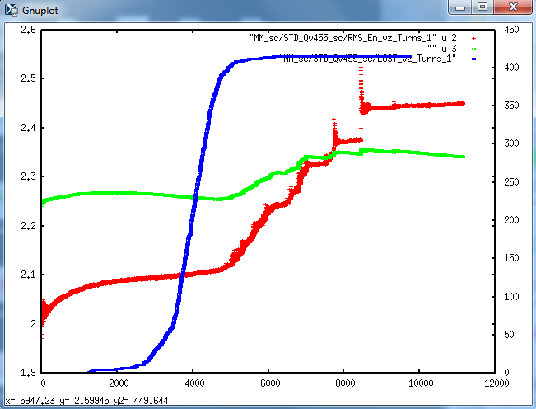
What is the problem?
Double harmonics
Acceleration Brhodot=10 Tm/s
MT injection
Losses of uncaptured particles on WBS or madxaperture

Slide 3
The beam
Nb=35e11 (~twice the actual LHC25 type beam)
Ex,Ey=2, 2.3 um (...normalized are E*=1.20, 1.38um!!!)
Bf=0.56, V1=8kV, V2=6kV, Brhodot=10 Tm/s
The long simulations start after a 20 turns injection process
…without space charge…
…or with space charge.

Slide 4
The beam: tune footprint
Huge!!!! ..to be an LIU or HL-LHC beam!!!
→ more reasonable param under consideration (see Giovanni’s tables)
ΔQ~0.5
ΔQ~0.4

Slide 5
The Orbit RMS emittance behavior (80% bucket)
*starting from turn 5022

Slide 6
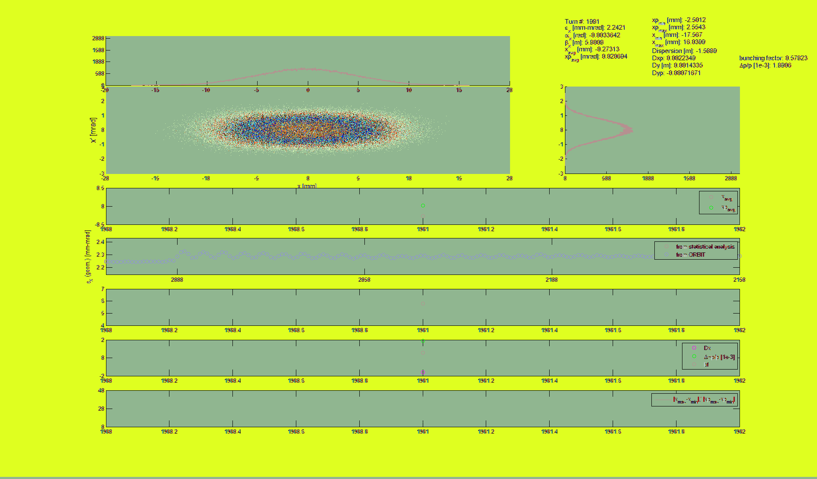
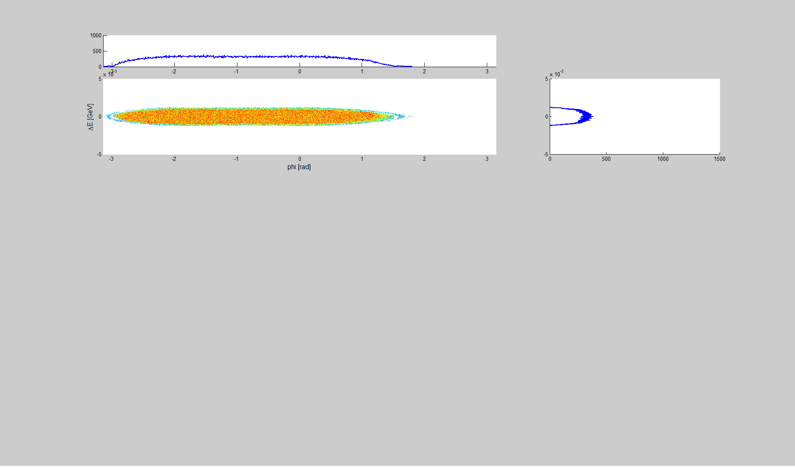
The horiz. and long. plane

Slide 7
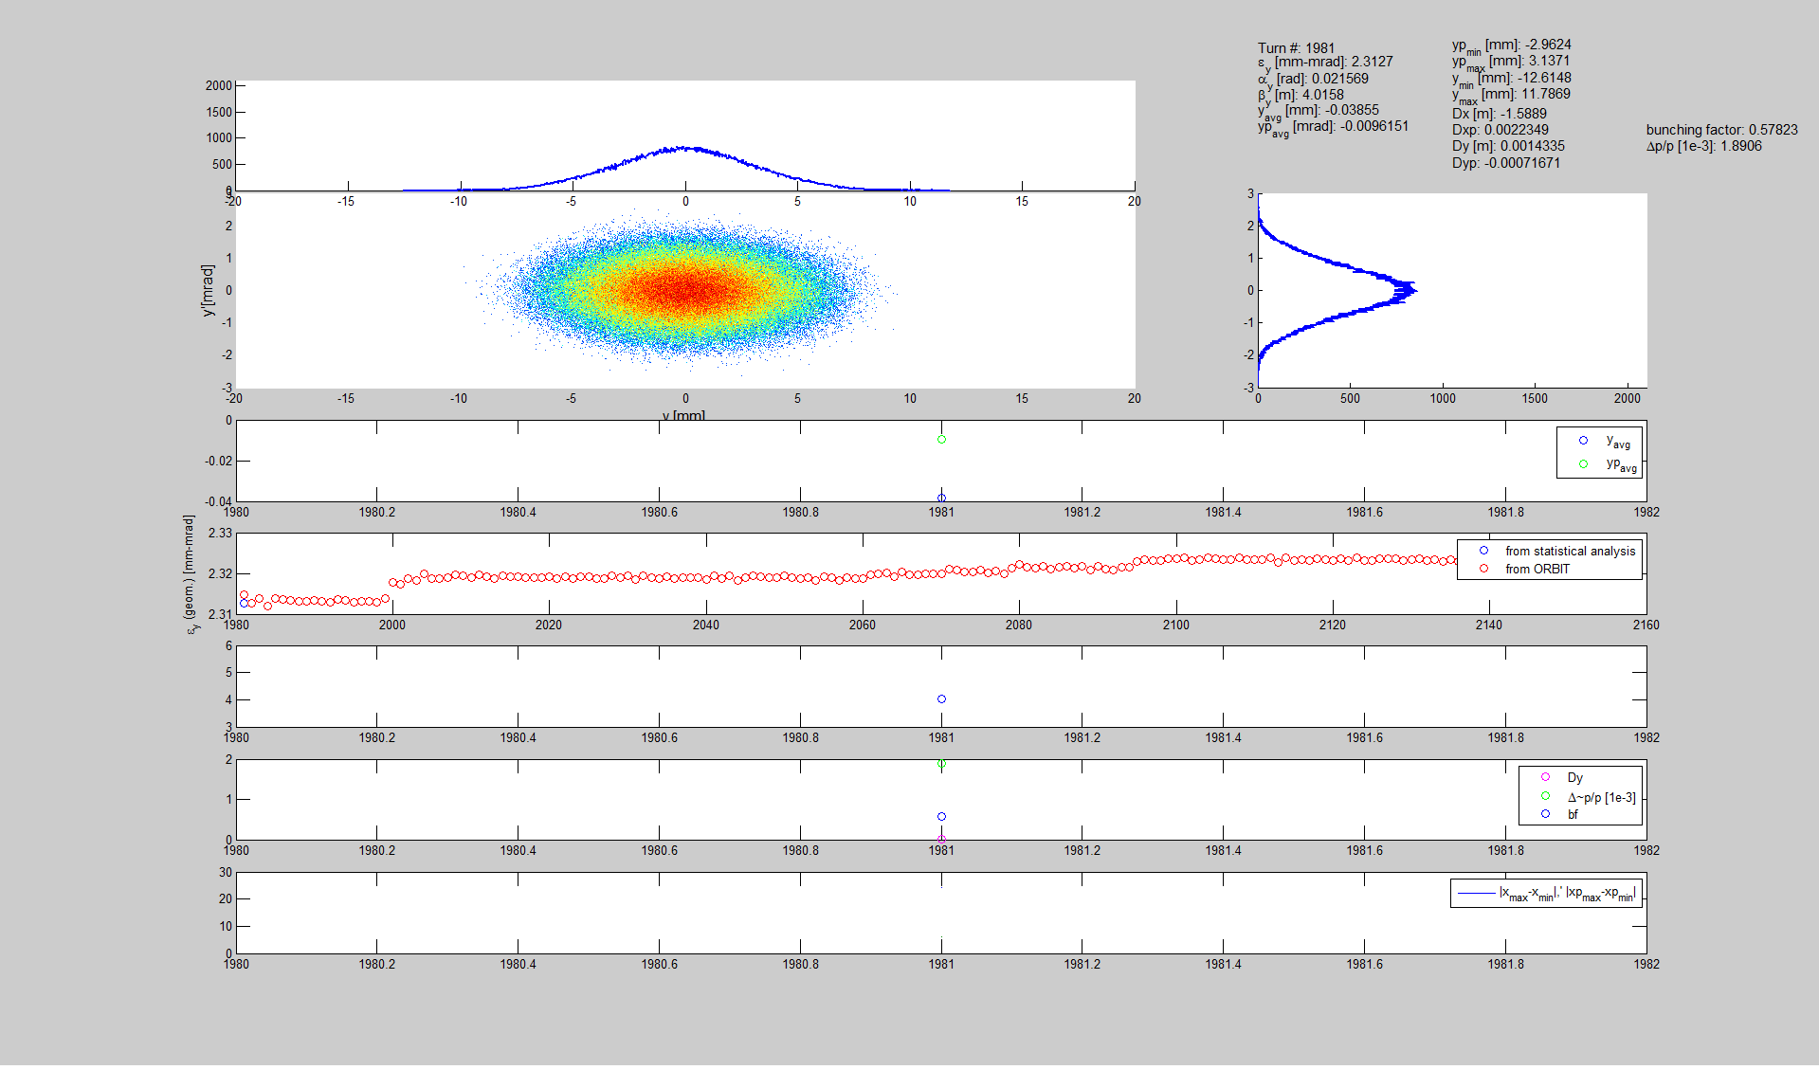
The vertical plane

Slide 8
Going towards a more detailed analysis...
Original complete distribution
(un-normalized phase space)
6D stat. analysis (Twiss, dispersion, Δp/p, emittances...)
Normalized complete distribution
Select only the m.particles inside a certain emittance
Back to the un-normalized phase space
6D stat. analysis (Twiss, dispersion, Δp/p, emittances...)

Slide 9
Going towards a detailed analysis...

Slide 10
Emittances vs. Turns for different transv. cuts

Slide 11
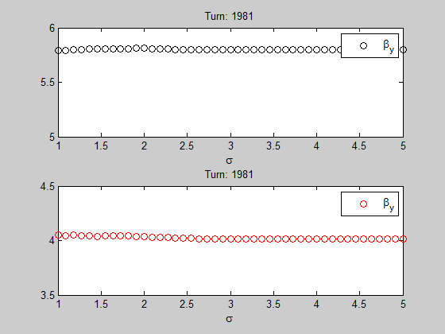
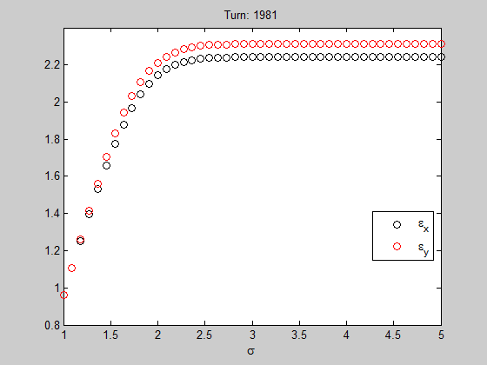
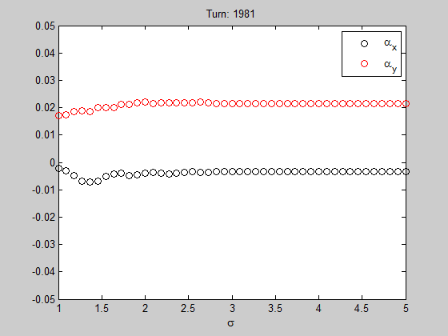
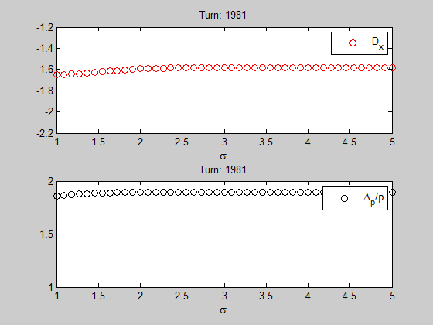
Going towards a detailed analysis...

Slide 12
Cutting more in longitudinal for the analysis...

Slide 13
Cutting more in longitudinal...

Slide 14
Another future possible analysis: crowns...
Depopulation
Between 1.7 and 1.8 sigma

Slide 15
Tests done
No aperture → NO jumps
No longitud SC → Jumps
Reduce # bins 128 → 64 → Jumps
Double # macrop → Jumps
Transverse SC
  No binning → 2D → Jumps
  SC method? w boundaries? → huge growth...smtg wrong
  Vertical tune 4.45 or 4.55 → Jumps
Cut according to bucket shape (95% acceptance)→ NO jumps, EB & MM
Half the intensity → Jumps
Tests to do:
No acceleration
Change Qx and Qy
MT injection with smaller acceptance
Uniform distribution (Vs. MT inj)
Single particles observation (suggestion from last SC meeting)
Driving terms

Slide 16
Backup slides

Slide 17
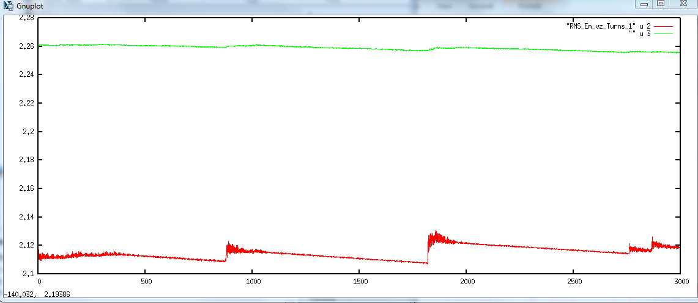
Half the intensity: RMS emittances

Slide 18
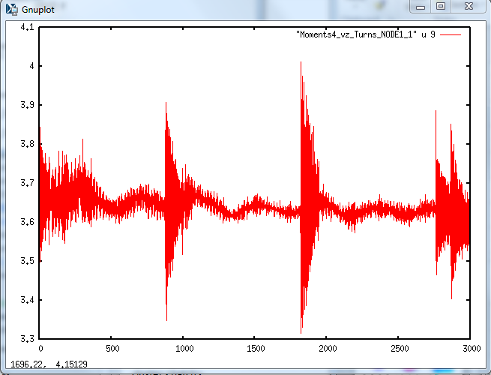
Half the intensity: Sigma_x

Slide 19
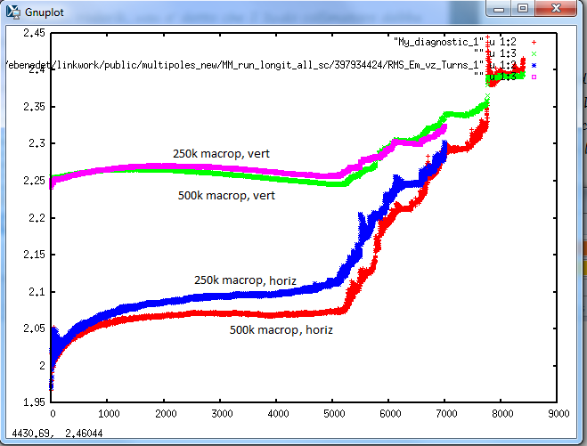
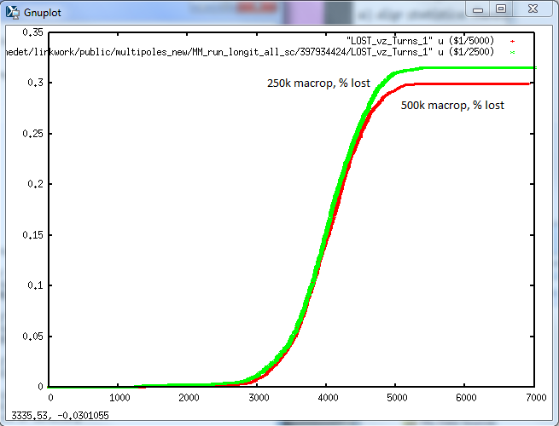
# of macroparticles

Slide 20
Intensity= 3.5e12 p.
Before long. cutting
After long. cutting

