Slide 1
Linear and non-linear PS optics: MAD8, MADX, PTC and pole-face angles
R. De Maria, A. Franchi, S. Gilardoni, M. Giovannozzi,
T. Risselada & F. Schmidt
LIS meeting 11 February 2008

Slide 2
Context
1. Simulations of the Multi-turn Extraction have been so far done with a single-particle 2D MAD8 PS model (optics, bump settings) and a multi-particle 4D simplified model -Henon map- (optimize capture)
2. Need of 4D multi-particle simulations with the realistic PS lattice to describe consistently both the island capture and the extraction (slow and fast bumps)
3. A MAD8-based script was written.
Why MAD8 and not MADX? To keep the same lattice model used during the design + compatibility with other scripts.

Slide 3
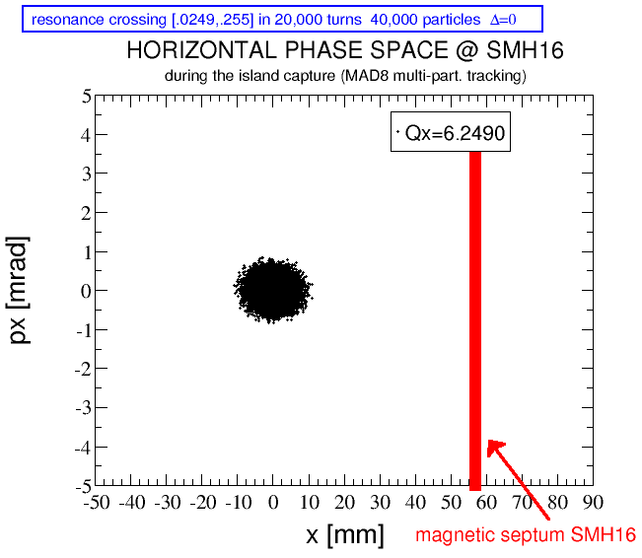
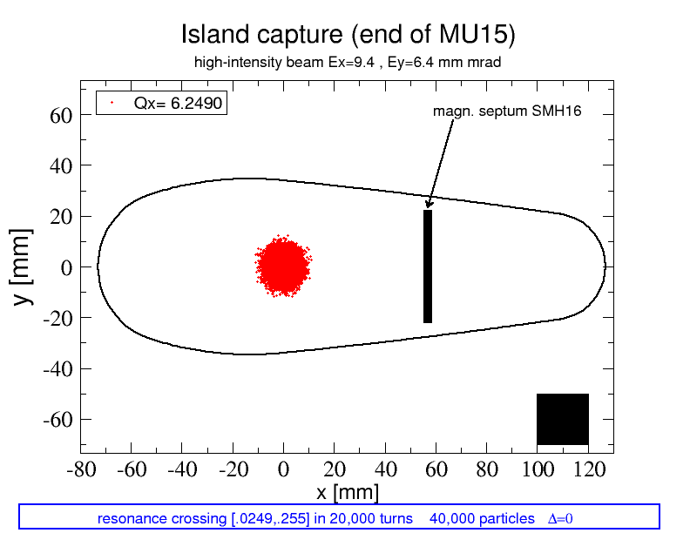
Context
1. Simulations of the Multi-turn Extraction have been so far done with a single-particle 2D MAD8 PS model (optics, bump settings) and a multi-particle 4D simplified model -Henon map- (optimize capture)
2. Need of 4D multi-particle simulations with the realistic PS lattice to optimize both the capture and the extraction (slow and fast bumps)
3. A MAD8-based script was written.
Why MAD8 and not MADX? To keep the same lattice model used during the design. design + compatibility with other scripts.

Slide 4
Context
Problem: MAD8 tracking predicts an unexpected vertical emittance blow up (~ linear with time).

Slide 5
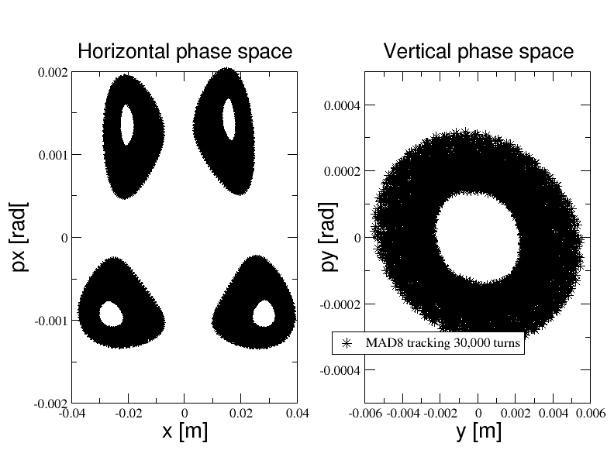
Context
Problem: MAD8 tracking predicts an unexpected vertical emittance blow up: single-particle tracking

Slide 6
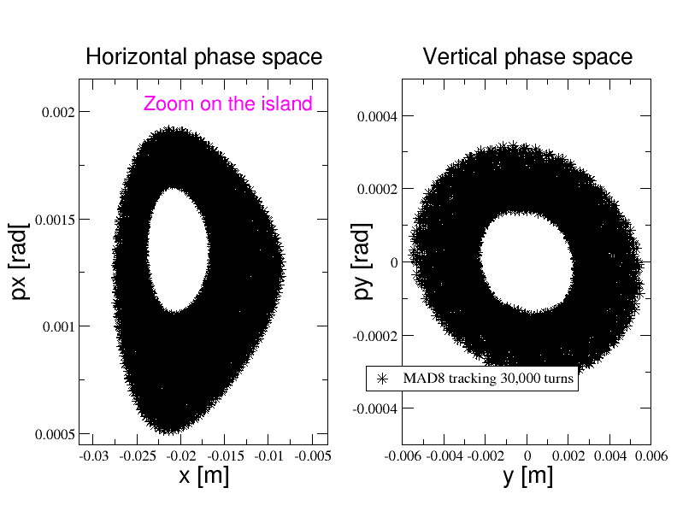
Context
Problem: MAD8 tracking predicts an unexpected vertical emittance blow up: single-particle tracking

Slide 7
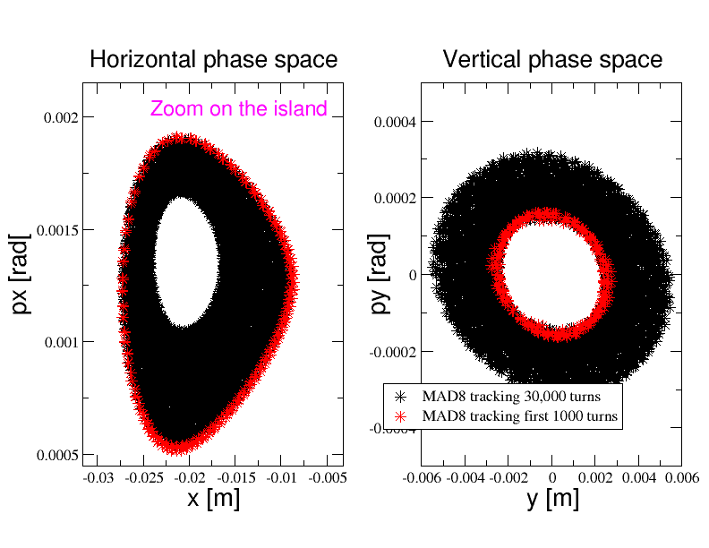
Context
Problem: MAD8 tracking predicts an unexpected vertical emittance blow up: single-particle tracking

Slide 8
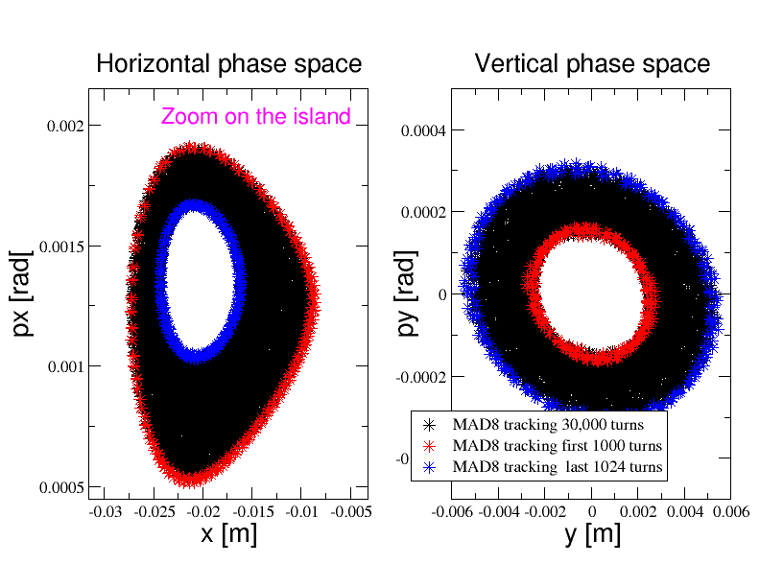
Context
Problem: MAD8 tracking predicts an unexpected vertical emittance blow up: single-particle tracking

Slide 9
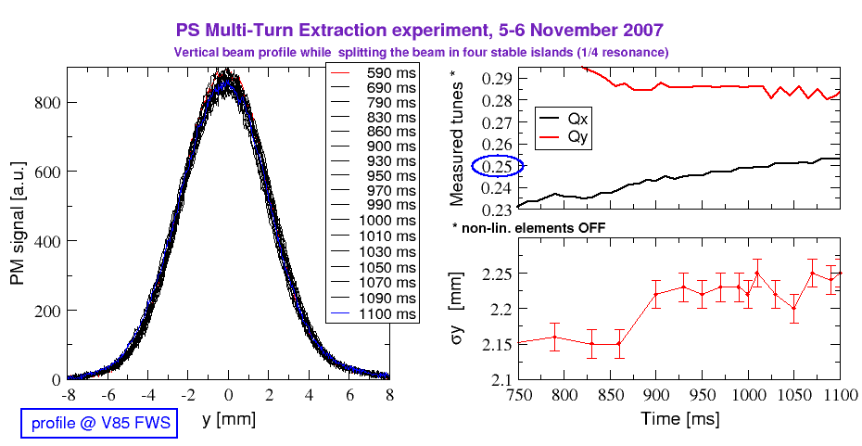
Context
Problem: MAD8 tracking predicts a vertical emittance blow up, measurements don’t show any !!
Vert. beam size increases of 5% only. Emittance: 5.8 -> ~ 6.2 mm mrad

Slide 10
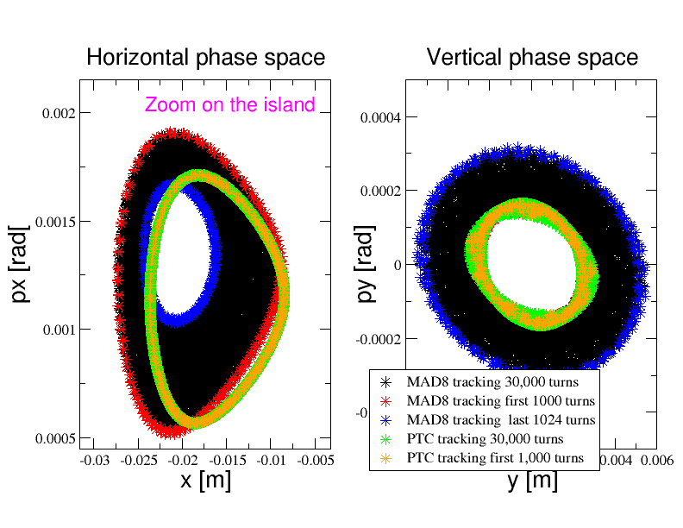
Context
MAD8 tracking predicts a vertical emittance blow up, PTC does not !!

Slide 11
Context
Seen that:
No vertical emittance blow up has been observed in the PS during and after the capture
No theoretical ground for the MAD8 predictions
PTC tracking is more robust than MAD8
Decision:
Migrate to MADX-PTC multi-particle tracking
Consequence:
A new PS non-linear lattice MADX-PTC model has to be computed (pole-face windings gradients from chromaticity measurement)

Slide 12
Comparing MADX TWISS, PTC TWISS and PTC tracking
First attempt using the pole-face-windings gradients of MAD8
MADX TWISS PTC TWISS PTC TRACK+FFT+FIT
tunex_t = 6.2445 6.2445 6.2445
chromx1 = 1.3141 0.4646 0.4650
chromx2 =-229.9 -235.3 - 150.8
chromx3 = N.A. 18272.2 2623.0
tuney_t = 6.29 6.29 6.29
chromy1 = 6.97 7.07 7.04
chromy2 = 156.38 155.33 135.12
chromy3 = N.A. 6357.8 6744.4

Slide 13
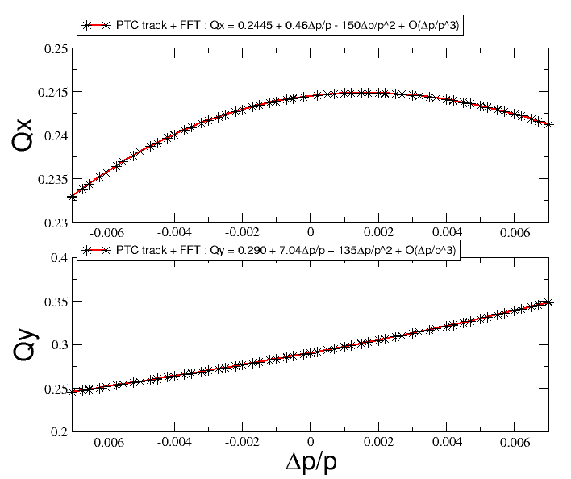
Comparing MADX TWISS, PTC TWISS and PTC tracking
First attempt using the pole-face-windings gradients of MAD8
MADX TWISS PTC TWISS PTC TRACK+FFT+FIT
tunex_t = 6.2445 6.2445 6.2445
chromx1 = 1.3141 0.4646 0.4650
chromx2 =-229.9 -235.3 - 150.8
chromx3 = N.A. 18272.2 2623.0
tuney_t = 6.29 6.29 6.29
chromy1 = 6.97 7.07 7.04
chromy2 = 156.38 155.33 135.12
chromy3 = N.A. 6357.8 6744.4

Slide 14
Comparing MADX TWISS, PTC TWISS and PTC tracking
We learned that:
1.Chromaticity from MADX TWISS is not Chromaticity
Q’=Q’(madx twiss)*β (β=0.998 @ 14 GeV/c)
Q’’=Q’’ (madx twiss)*β² … similar for dispersion
2. Correct PTC tracking:
ptc_create_universe;
ptc_create_layout,time=false,model=2,method=6,nst=3,exact;
ptc_start,X= 1.0E-6,PX= 0.0E-3,Y= 1.0E-6,PY= 0.0E-3,T=0.0,PT=0.0;
ptc_track,icase=5,closed_orbit,deltap=-7.0e-3,turns=256;
Ptc_track_end;
3. MADX does not model properly the pole-face angles

Slide 15
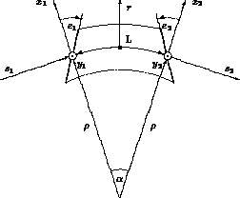
Comparing MADX TWISS, PTC TWISS and PTC tracking
MADX does not model properly the pole-face angles
In the PS E1=E2=0, but stray fields have been modelled by introducing them.
“Effective” E1,E2 depend on the magnet geometry and on energy and have been computed and fitted from magnetic measurement
!-----------------------------------------------------------------------!
! F half-units !
!-----------------------------------------------------------------------!
LF = +2.12600; ! iron length
DLF = +0.07024; ! correction bending length
EF = +0.16180; ! end pole face angle
!-----------------------------------------------------------------------!
! D half-units !
!-----------------------------------------------------------------------!
LD = +2.13400; ! iron length
DLD = +0.07080; ! correction bending length
ED = -0.15700; ! end pole face angle

Slide 16
Comparing MADX TWISS, PTC TWISS and PTC tracking
After setting E1=E2=0 and properly run PTC _track
MADX TWISS PTC TWISS PTC TRACK+FFT+FIT*
tunex_t = 6.2445 6.2445 6.2445
chromx1 = 0.4646 0.4646 0.4646
chromx2 = -47.0654 -45.829 -45.866
chromx3 = N.A. -2544.4 -2911.0 *
tuney_t = 6.3000 6.3000 6.3000
chromy1 = 7.0710 7.0711 7.0711
chromy2 = 19.7345 20.3195 20.380
chromy3 = N.A. 8293.96 8310.0
* Quality depends on fit and range of Dp/p

Slide 17
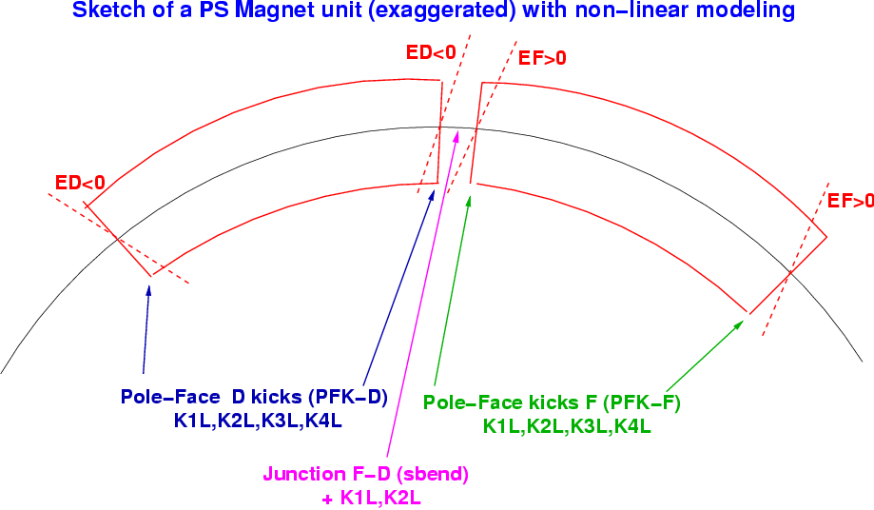
Modeling the PS
!-----------------------------------------------------------------------!
! F half-units !
!-----------------------------------------------------------------------!
LF = +2.12600; ! iron length
DLF = +0.07024; ! correction bending length
EF = +0.16180; ! end pole face angle
!-----------------------------------------------------------------------!
! D half-units !
!-----------------------------------------------------------------------!
LD = +2.13400; ! iron length
DLD = +0.07080; ! correction bending length
ED = -0.15700; ! end pole face angle

Slide 18
Modeling the PS
* EF,ED & Junction from magnetic measurement @ different energies + fit (from ‘80s)
* PFK-F & PFK-D from non-lin. Chromaticity measurement
!-----------------------------------------------------------------------!
! F half-units !
!-----------------------------------------------------------------------!
LF = +2.12600; ! iron length
DLF = +0.07024; ! correction bending length
EF = +0.16180; ! end pole face angle
!-----------------------------------------------------------------------!
! D half-units !
!-----------------------------------------------------------------------!
LD = +2.13400; ! iron length
DLD = +0.07080; ! correction bending length
ED = -0.15700; ! end pole face angle

Slide 19
Modeling the PS
* Shall ED,EF & junction be used for the new 5-current PFW mode?

Slide 20
Modeling the PS
* Shall ED,EF & junction be used for the new 5-current PFW mode?
* Possible choices for the official lattice model:
Keep the “effective” EF,ED (and junction) as they are: MADX TWISS shall not be used with dp/p≠0, PTC only

Slide 21
Modeling the PS
* Shall ED,EF & junction be used for the new 5-current PFW mode?
* Possible choices for the official lattice model:
Keep the “effective” EF,ED (and junction) as they are: MADX TWISS shall not be used with dp/p≠0, PTC only
Set again EF & ED to zero (maybe remove also the junction) and rematch for linear and non-linear optics by using PFK-F & PFK-D kicks: both MADX TWISS and PTC are ok. (Thys agrees, already successfully tested)

Slide 22
Modeling the PS
* Shall ED,EF & junction be used for the new 5-current PFW mode?
* Possible choices for the official lattice model:
Keep the “effective” EF,ED (and junction) as they are: MADX TWISS shall not be used with dp/p≠0, PTC only
Set again EF & ED to zero (maybe remove also the junction) and rematch for linear and non-linear optics by using PFK-F & PFK-D kicks: both MADX TWISS and PTC are ok. (Thys agrees, already successfully tested)
Any other idea?

