Slide 1
Beam stability - impedance in the ps
S. Aumon, H. Bartosik, P. Freyermuth, O. Hans
S. Gilardoni, E. Metral, G. Rumolo, B. Salvant

Slide 2
Contents
Motivations
Coherent tune shift at injection energy
Effective imaginary impedance at injection
Coherent tune shift at extraction
Effective imaginary impedance at LHC extraction energy
Estimation of the coherent tune shift due to the space charge at injection in the vertical plane
Fast transverse instability at transition
Estimation of the real part of the impedance
Conclusions - Remarks

Slide 3
Motivations
What is the transverse impedance of the PS now ?
High intensity and High brightness LHC beams remained unstable at injection due to head-tail (m=5,6,7).
Important issue PS 2 GeV upgrade
Fast instability measurements at transition crossing in the PS gave an estimation of Real(Zt) broadband
Estimate the low frequency imaginary part of the broad-band impedance.
Estimation of the tune shift due to the space charge.

Slide 4
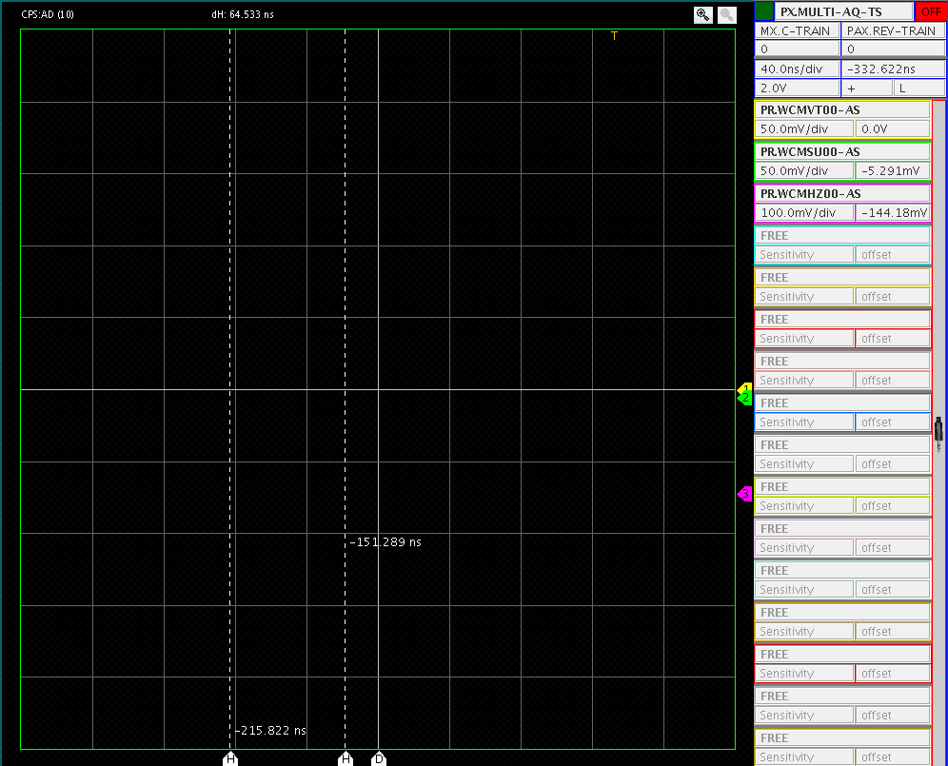
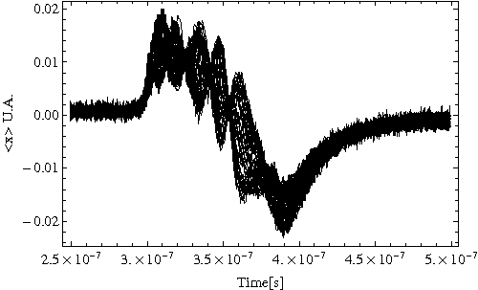
Motivations - Examples
HI-LHC beam at injection
(2010)
AD beam in the PS at injection (2010)

Slide 5
Why is important ?
ToF
Single bunch
Since 2010, accelerated intensity 850e10 protons !

Slide 6
Broad band impedance model
Real Tune shift measurements
Estimation of this part
Im(Zt)
Re(Zt)
Instability rise time measurements
Estimation of this part
wr
Courtesy R. Cappi, “Impedance Measurements”

Slide 7
Broad band impedance model
Broad band (BB) impedance model assumed at a resonator Rs (shunt impedance), fr (resonator freq. ) pipe cutt-off freq. and the quality factor Q.
For Elias (2001), R. Cappi, M. Martini et al (1989) Rs= 3 Mohm/m, fr=1GHz, Q~1.
Last measurements in 2001, since then new MTE kickers, removal RF cavities …
Real Tune shift measurements -> Estimation of the Imaginary part of the BB impedance

Slide 8
Injection beam parameters
Tune shift measurements done with the BBQ.

Slide 9
Coherent tune shift at injection
Fractional part of the tune as a function of the Nb particles

Slide 10
Effective impedance at PS injection
From Sacherer formula (CERN/PS/BR 76-21):
with

Slide 11
Effective impedance at PS injection
m | 0
Bunch length | ~ 180 ns
βrel | 0.91
γ rel | 2.47
ω0 | 2728 e3 rad.s-1
Machine radius | 100 m
Horizontal:
Zeff=3.5 MOhm/m
Vertical:
Zeff=12 MOhm/m

Slide 12
Beam parameters at LHC extraction energy

Slide 13
Coherent tune shift at extraction
Horizontal tune decrease as a function of time (also in vertical).
Independent of the energy, visible on long plateau (B. Vandorpe)
Phenomena not understood.

Slide 14
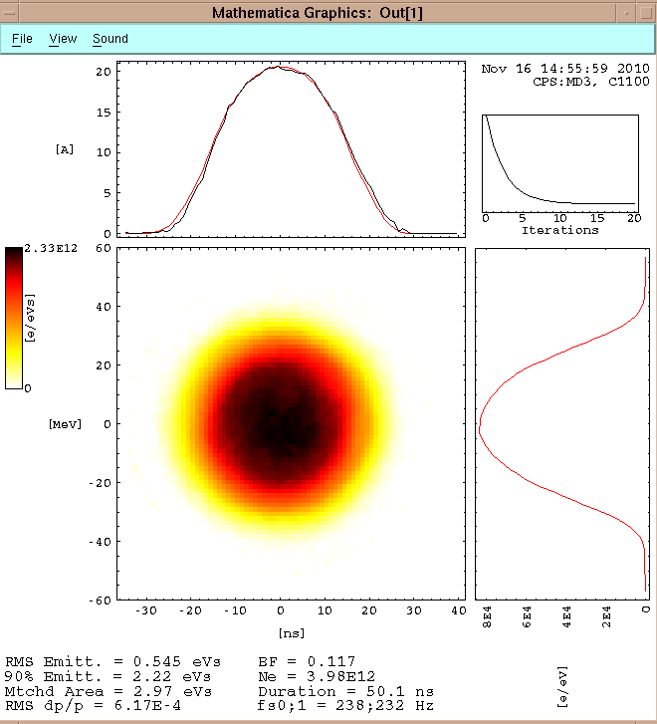
Effective impedance at extraction
m | 0
Bunch length | ~ 50 ns
βrel | 0.9993
γ rel | 27.729
ω0 | 2996 e3 rad.s-1
Machine radius | 100 m
Horizontal:
Zeff~1 MOhm/m
Vertical:
Zeff=6.8 MOhm/m

Slide 15
Comments
No tune shift in horizontal plane @ extraction energy: ΔQcoh(x) ~ 0 ΔQcoh(x) ~ ΔQdipolar+ ΔQquadrupolar
Results for a flat chamber, with infinite plate.
Courtesy, E. Metral

Slide 16
Effective impedance
From Sacherer formula (CERN/PS/BR 76-21):
with
Dipolar part only! The quadrupolar part is not taken into account

Slide 17
Comments
By using the Sacherer formula, only the dipolar part is taken into account
For the PS type vacuum chamber ΔQdipolar ~ ΔQquadrupolar (A. Burov et al. PRSTAB)
In the vertical plane: Im(Zeff)=i 6.8MOhm/m would means Im(Zeff)dip~Im(Zeff)quad~i 3.4MOhm/m

Slide 18
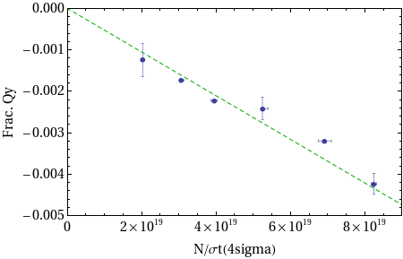
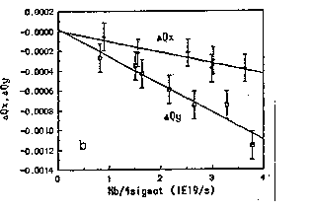
Comments
Comparison with measurements done in 1989 (R. Cappi, M. Martini et al)
@26GeV/c
Caution: not the same beam condition (not the same bunch length etc …)

Slide 19
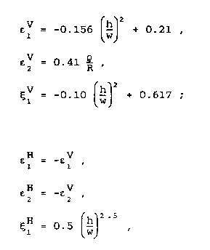
Estimation of the coherent tune shift due to the space charge at injection and extraction
Rough estimation of the space charge contribution in the impedance at injection.
Reference to “Tune shift and stop bands at injection in the CERN PS”, Y. Baconnier CERN/PS 87-89.
“Non penetrating field”
Laslett coefficients for elliptical chamber a centered beam in the vacuum chamber valid for h/w < 0.7 (B. Zotter CERN ISR-TH/72-8)

Slide 20
Estimation of the coherent tune shift due to the space charge at injection in the vertical plane
26 GeV/c
1.4 GeV/c
Estimated tune shift due to Space charge with analytical formulas
Total vertical tune shift
Estimation!
ΔQ-Space charge ~ ¼ Total measured ΔQ at injection

Slide 21
Conclusions - Remarks
Vertical : Zeff=12 Mohm/m @ 1.4 GeV/c and 6.8 MOhm/m @ 26 GeV/c
Horizontal: Zeff=3.5 Mohm/m and ~1MOhm/m
Measurements done in the past (1989) by R.Cappi et al and by Elias (2001) Zt(Vert)~3 MOhm/m and Zt(Hor)~1 MOhm/m
Analytical formulas estimates ¼ the coherent tune shift due to space charge in the vertical plane.
MTE kickers (2006) ? The studies planed an 10% increase of the transverse impedance.

Slide 22
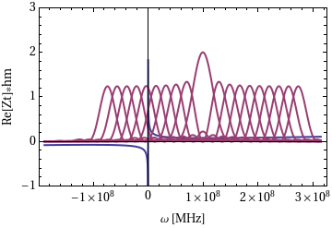
High order headtail modes
Observed on most of high intensity beams (AD, m~5,6), on the HI-LHC beam on the flat bottom at 1.4GeV (m~5,6)
Observed also on the MD beam (h=8, full σl=180ns, xiH~-0.8, xiV~-1) with m=6,7
m=0
Mode> = 5 instable
*
m=9,8,7,6,5
m=1
ωξ
“High order headtail modes in the CERN PS”
R. Cappi

Slide 23
High order headtail modes
Planned MD with the impedance team to stabilize the beam with the linear coupling.
Rise time headtail instability (fit of the Re(ZtBB impedance)+Re(ZtResistive wall)
With headtail simulation , I am still missing 2 nodes (m=3) (some simulation were done in the past by Elias and Benoit in 2007 PAC07)

Slide 24
Horizontal emittance blow up
25%
Blow up

Slide 25
Broad band impedance model
Real Tune shift measurements
Estimation of this part
Im(Zt)
Re(Zt)
Instability rise time measurements
Estimation of this part
wr
Courtesy R. Cappi, “Impedance Measurements”

Slide 26
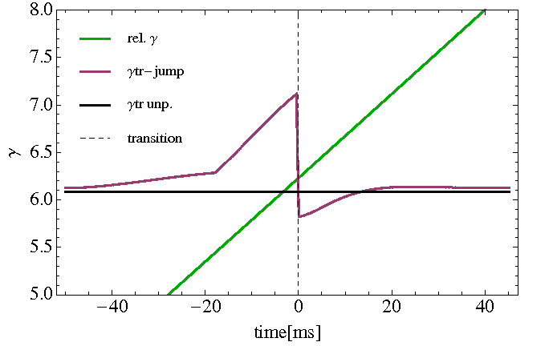
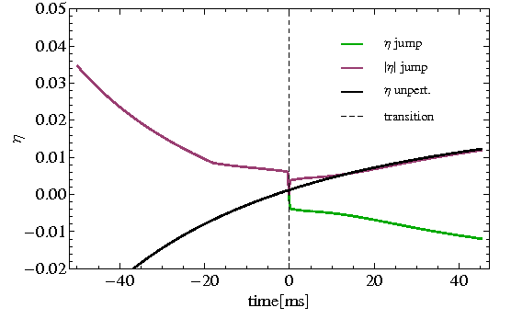
Crossing Transition in the CERN PS
Asymmetrical gamma jump
In the past, avoid 'negative mass instability' and longitudinal space charge effect on bunch length.
Doublets and triplets (combined doublets) quadrupoles in non zero dispersion locations.
Designed for a Qx,y=6.25 with no tune shift.
Δγt=-1.24 in 500μs
RF stable phase jump at transition to keep the longitudinal focusing after transition energy

Slide 27
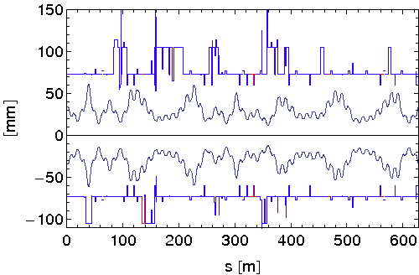
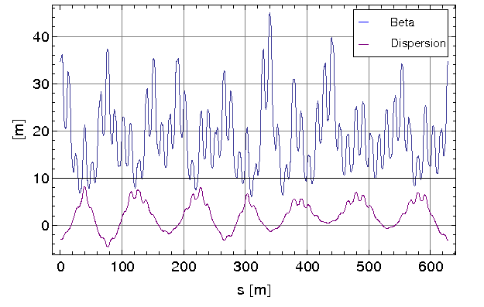
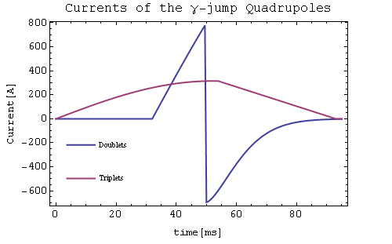
Crossing Transition in the CERN PS
Hor. beam envelop Hor. Emittance (1sigma) 5mm.mrad norm
However …
Increase the Hor. beam size
Localized beam losses
High intensity beams fill the aperture

Slide 28
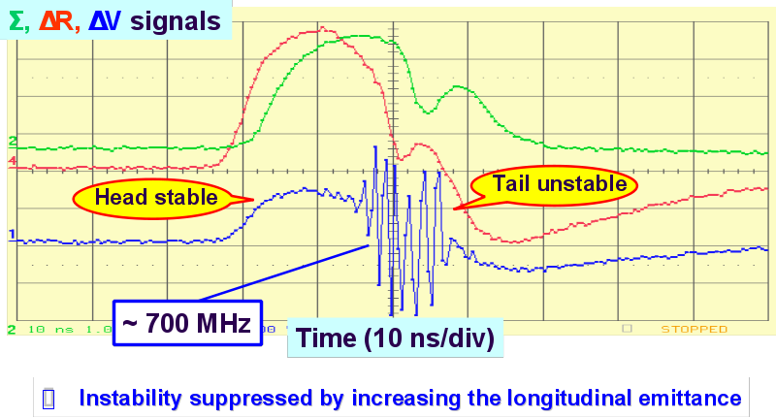
Motivations
Understand the dynamics of the fast instability at transition (no synchrotron motion) with/without gamma jump
Improve stability of high intensity beams with gamma jump without compromising the longitudinal density.
Predict also transverse stability of the ultimate LHC beam in the PS at transition crossing
> 2.1 eVs are needed for 7e12 p/b
Single bunch
E. Metral, S. Hankock
(PS/RF Note 2002-198)
Courtesy E. Metral

Slide 29
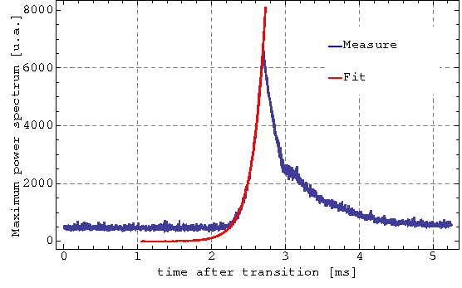
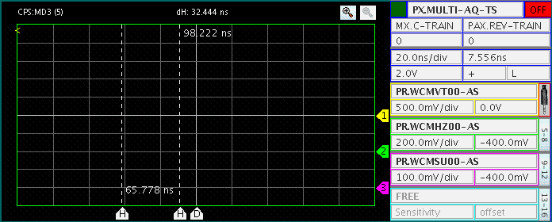
For OUR analysis:
time growth = Max of the instability frequency in the FFT, while a filter is implementing in the analysis.
Vertical instability appears 2 ms after transition in the measurements, whereas depends of the absolute value of |η|

Slide 30
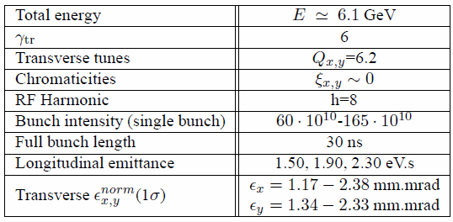
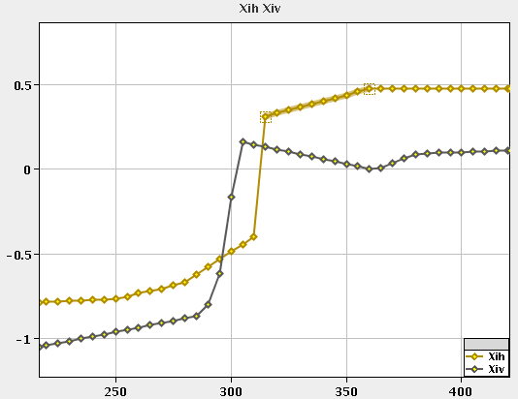
Instability measurements without gamma jump: beam setting-up
No gamma jump
Tuning the transition timing
Almost zero vertical chromaticity 'plateau' , create ideal condition for the fast vertical instability
PS magnets = combined function magnets
Working point controlled by Pole Face Winding
No vertical chromaticity measurements around transition energy over 15ms.
ΔQ/Q=ξ Δp/p

Slide 31
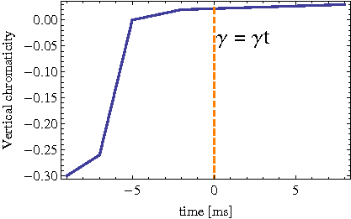
Instability measurements without gamma jump: expected vertical chromaticity
Vertical chromaticity slightly positive at transition

Slide 32
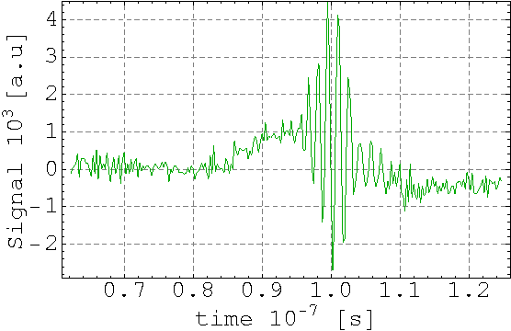
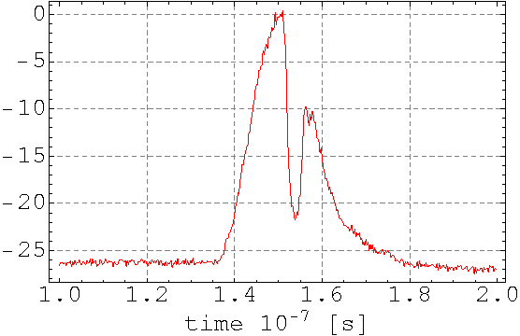
Instability measurements without gamma jump: beam setting-up
Instrumentation: wide band pickup, band width 2.5MHz-1GHz (See the “A 1.5 GHz wide-band beam position and intensity monitor for the electron-positron accumulator (EPA)”)
No measurements of the vertical position of the bunch centroid, but of the transverse profile.
The pickup is acted as filter, to compute the bunch centroid position: <y> = Δ/Σ where Δ is the difference signal (transverse) and Σ the sum signal (longitudinal)

Slide 33
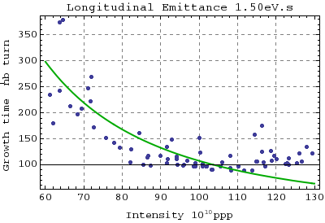
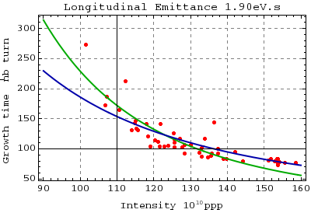
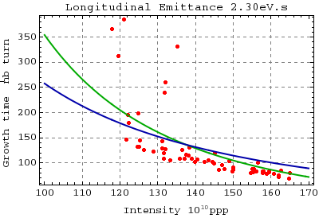
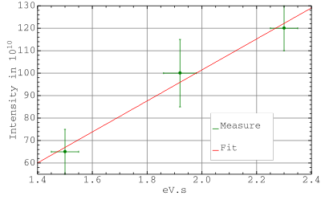
Time growth of the instability
Notes:
3333

Slide 34
Measurements without gamma jump: summary
Vertical fast instability
Travelling wave with high frequency oscillation pattern ~700MHz: head of the bunch stays stable, while the instability starts in the middle of the bunch, the tail becomes unstable
Without gamma jump, the vertical instability start up to 2ms after transition energy.
Fast instability , take few turns to develop, much less than one synchrotron period.
TMCI characteristics.

Slide 35
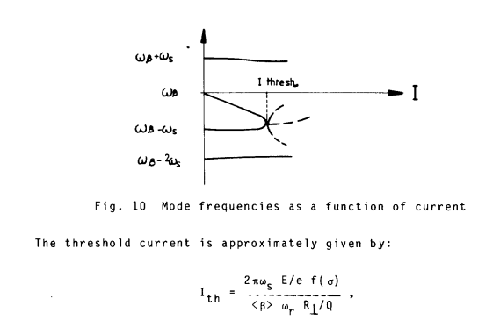
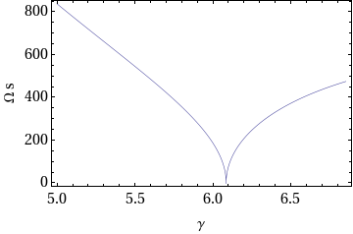
Measurements without gamma jump: summary
We did not check yet the tune shift
* B. Zotter, CAS, 1984

Slide 36
Instability simulations
Parameters | PS - nToF
R [m] | 100
ρ [m] | 70
Bdot [T/s] | 2.2
Vrf [kV] | 145
harmonic | 8
el [eVs] | 1.50 - 2.3
Nb [e10 p/b] | 50 - 150
Є [1σ norm] μm | 1- 2.8
Betax=betay[m] | 16
Pipe [cmxcm] | 7x3.5
Qt | 6.25
Hor. & Vert. ξ | 0/0-varying
Gamma transition | 6.08
Acceleration | 46 GeV/c/s
HEADTAIL code
Broad band impedance model: in the past (1989) frequency resonator=1GHz quality factor Q=1 Transverse shunt impedance Rs=3MΩ/m
Flat chamber
No longitudinal and transverse space charge
Acceleration
No higher orders in momentum compaction.
Chromaticity as in measurements

Slide 37
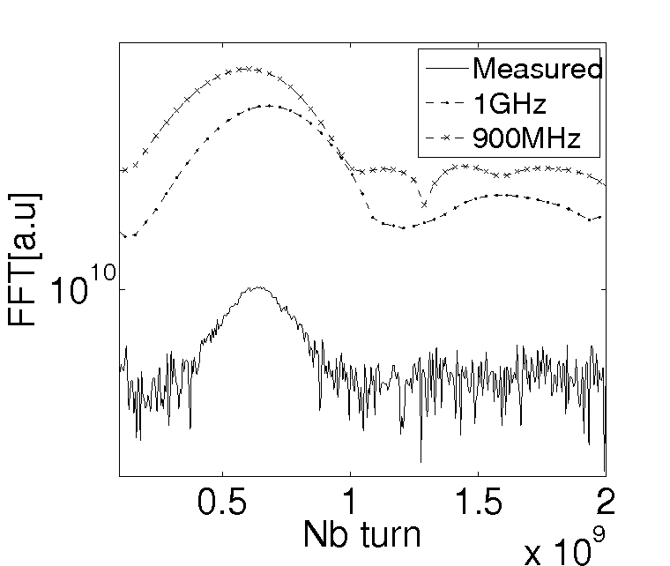
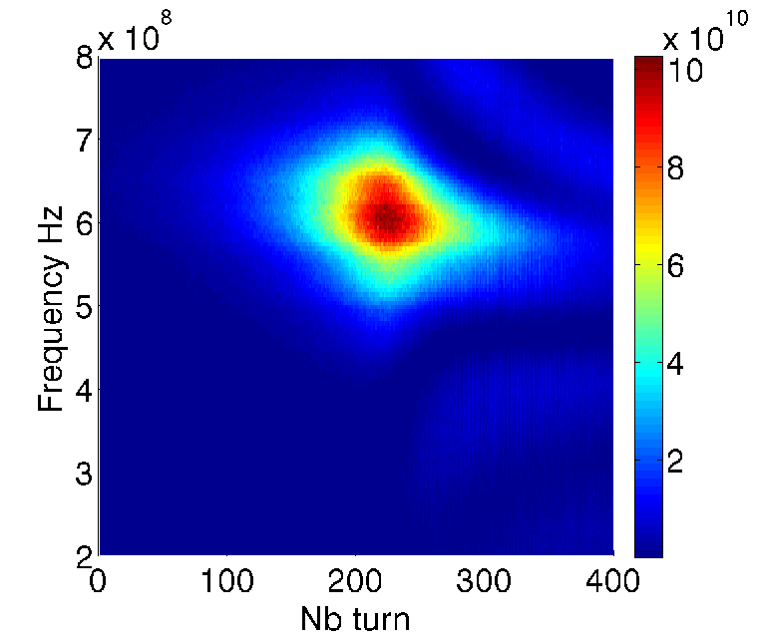
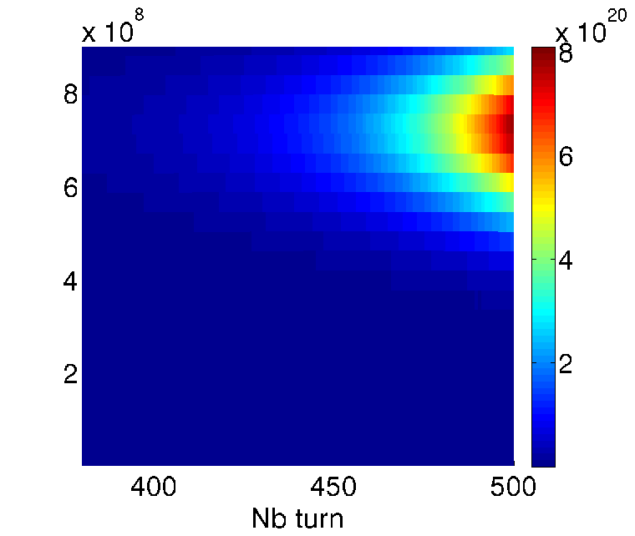
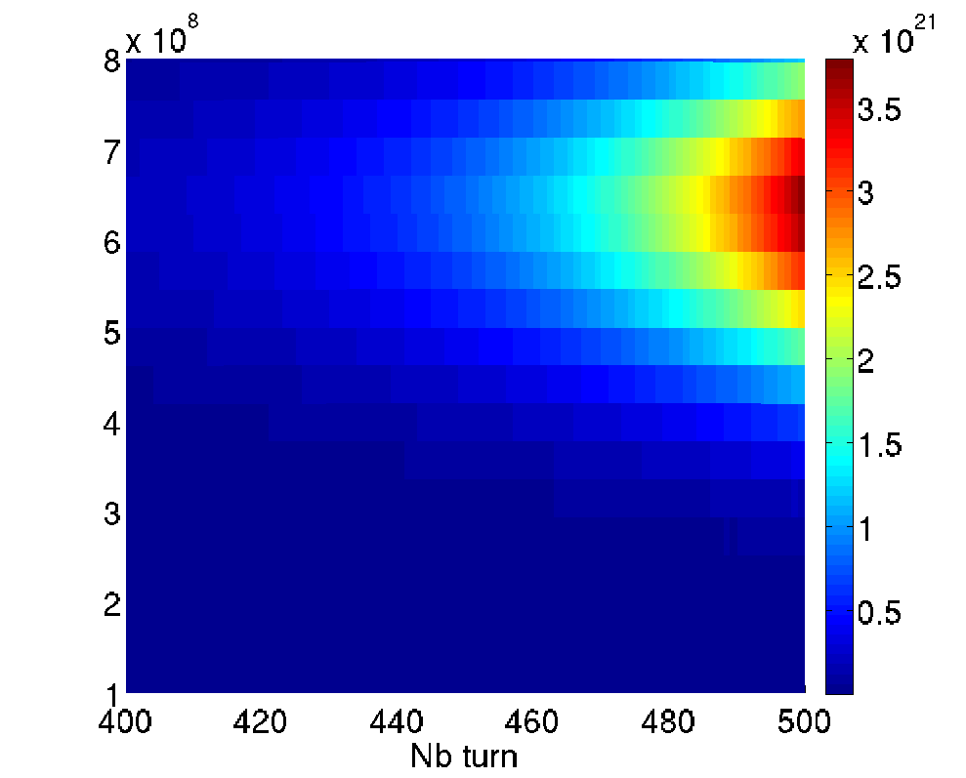
Measurements
Simulated resonator frequency=1GHz
Simulated resonator frequency=900MHz

Slide 38
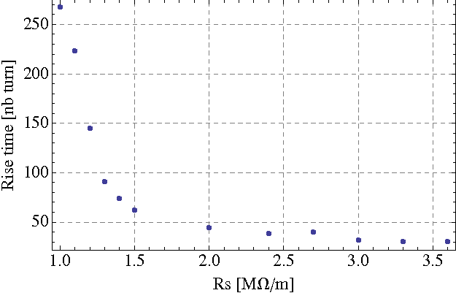
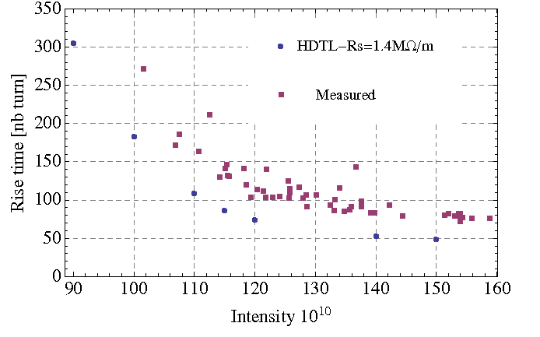
Transverse shunt impedance Rs
Intensity 120e10 protons single bunch
long. emittance(1 sigma)=1.9eVs
Time growth in measurements=120 turns (one PS turn=2.2microsecond)
Resonator frequency=1GHz, Q=1.
Offset of 25 turns in measurements with respect to HEADTAIL simulations

Slide 39
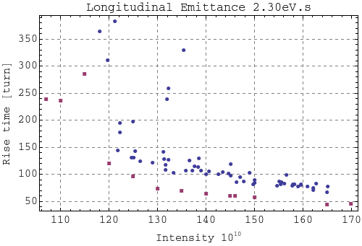
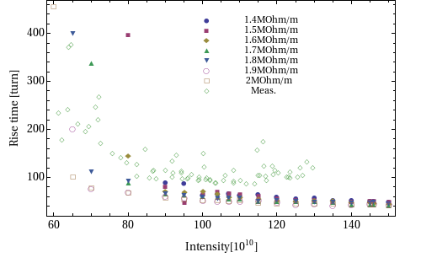
Transverse shunt impedance Rs
Rs=1.4 MOhm/m
Rs=2 MOhm/m
Longitudinal emittance 1.5eVs
Offset of 25 turns in measurements with respect to HEADTAIL simulations

Slide 40
TMCI threshold
The 1.5eVs does not fit for Rs=1.4MOhm/m
Rs =2MOhm/m is a better fit probably because the longitudinal emittance is slighlty varying by 20% with the intensity.

Slide 41
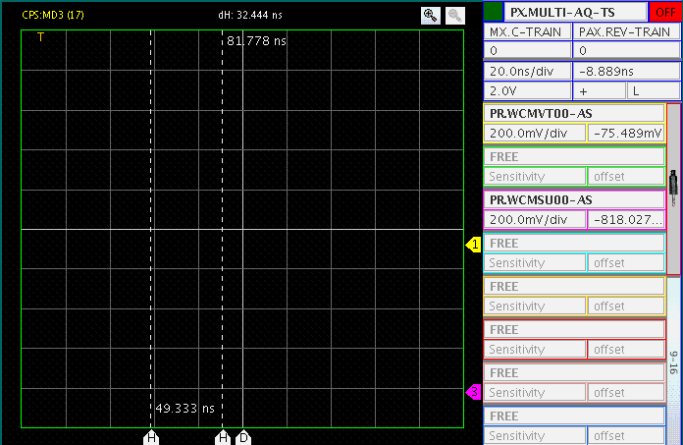
Instability measurements with gamma jump

Slide 42
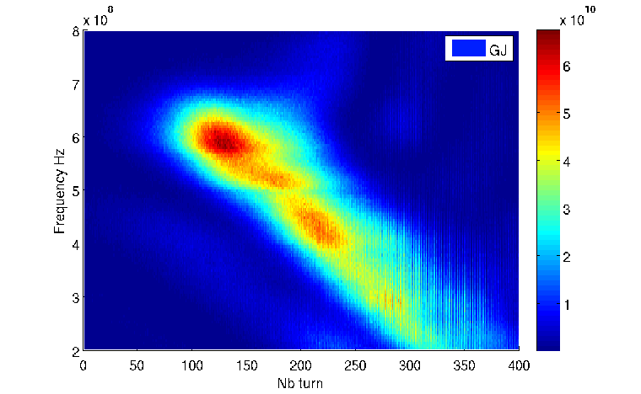
Measurements with gamma jump: setting up still on going
Trying to keep the vertical chromaticity plateau
Transition time changed by several milliseconds ~6ms with gamma jump
Issues to set the beam since losses occur due to the optics distortion.

Slide 43
Gammajump in Headtail

Slide 44
Benchmark with HEADTAIL: Summary
Broadband impedance model Rs~1.4 Mohm/m, fr=1GHz, Q=1 → Rough model
Coherent tune shift measurements at injection done in 1989 Rs=3MOhm/m: global impedance measurements (Dipolar and quadrupolar part of the impedance)
A. Burov, V. Danilov, Phys.Rev. Lett., Vol.82, Nb.11
In HEADTAIL, rise time calculation, mostly dipolar part fitting.
Strong need of a better PS impedance model like in the SPS
Most of the high intensity beams are unstable (injection, transition …)

Slide 45
Conclusions - Outlooks
Fast vertical instability believed to be a Transverse Mode Coupling
Estimation of the vertical dipolar part of the broadband impedance.
Strong need of a better impedance model for the PS
- Questions about transverse space charge? (G. Rumolo, MOA2IS02, ICAP06)
- Implement gamma jump in HEADTAIL
- Find an alternative cure for the transverse instability instead of compromising the longitudinal emittance (via chromaticity, new gamma jump scheme etc..)

Slide 46
Thank you for your attention !
Thanks to B. Salvant, E. Benedetto, E. Metral, G. Rumolo, R. Steerenberg

