Slide 1
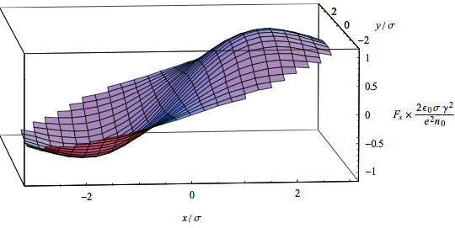
PS Space-Charge Studies
Raymond WASEF
Space-Charge Force (E.Métral, LIS meeting, 02/04/2007)
Acknowledgements : Simone Gilardoni, Alexander Molodozhentsev, Heiko Damerau, Cedric Hernalsteens

Slide 2
PTC-ORBIT
Optimizing Space Charge Parameters
Checking the relative CPU time
Optimizing the simulated beam

Slide 3
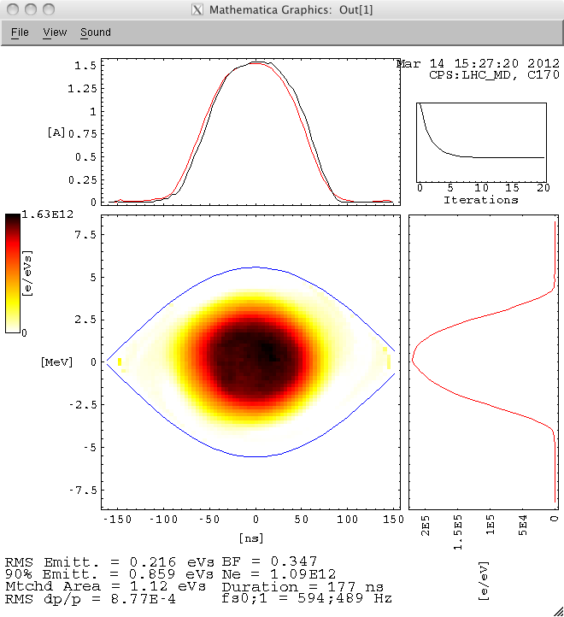
Measured beam
Length = 180ns

Slide 4
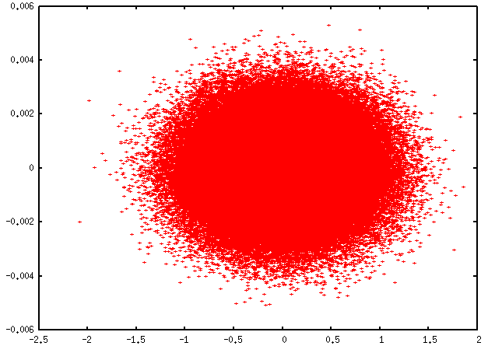
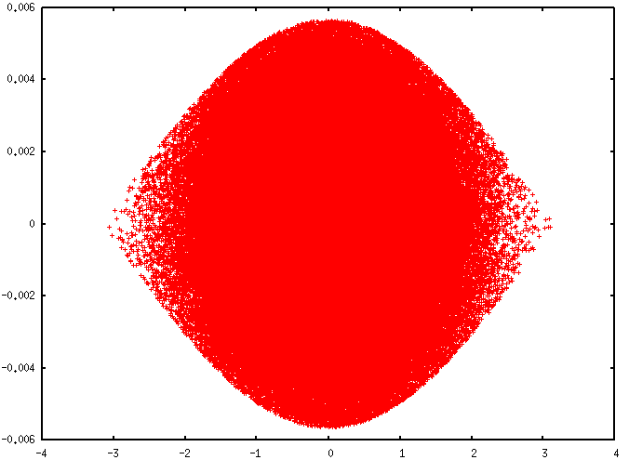
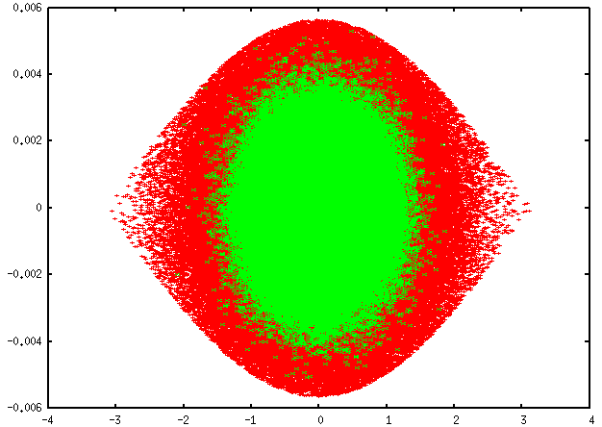
Gaussian Beams
Length ~ 90ns
Length ~ 180ns
∆E (Gev)
∆E (Gev)
Φ (rad)
Φ (rad)
∆E (Gev)
Φ (rad)
For convergence studies, I used the short beam

Slide 5
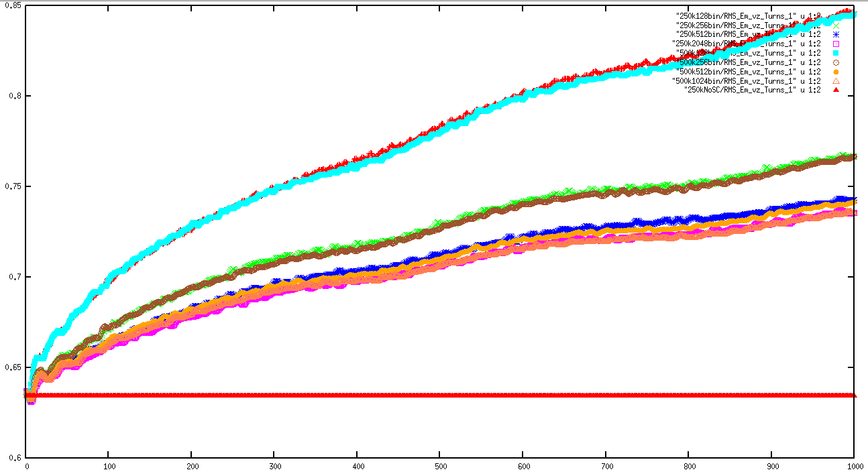
Transverse mesh points
Working Point: Qx=6.21 Qy=6.23
εRMS (π.mm.mrad)
horizontal
250k 128bin
256bin
500k 128bin
512bin
1024bin & 2048bin
250k No Space Charge
turns
➔ There is no difference between 250k and 500k macro-particles

Slide 6
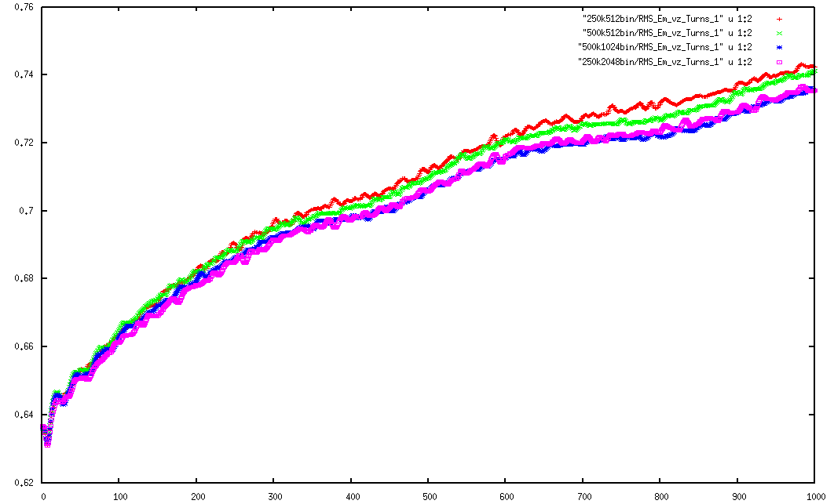
Transverse mesh points
εRMS (π.mm.mrad)
horizontal
250k 512bin
500k 512bin
~1%
500k 1024bin
250k 2048bin
turns
➔ Optimum guess: 1024 mesh points

Slide 7
CPU time
For 250k macro-particles on 1 machine of LXBST with 8 processors
Number of mesh points | CPU-Time
128 | 55.91
256 | 56.37
512 | 63.1
1024 | 74.87
2048 | 133.85
~0.8%
~11%
~19%
~80%
➔ Confirmation of optimum: 1024 mesh points

Slide 8
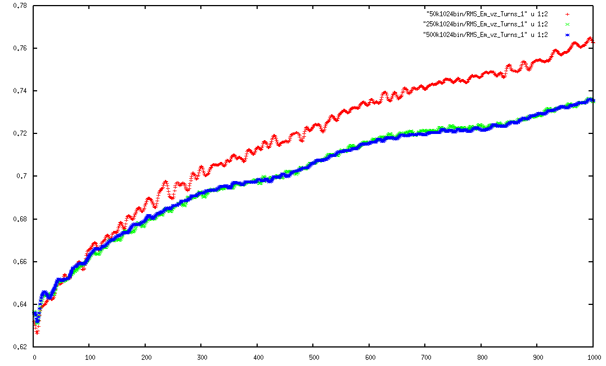
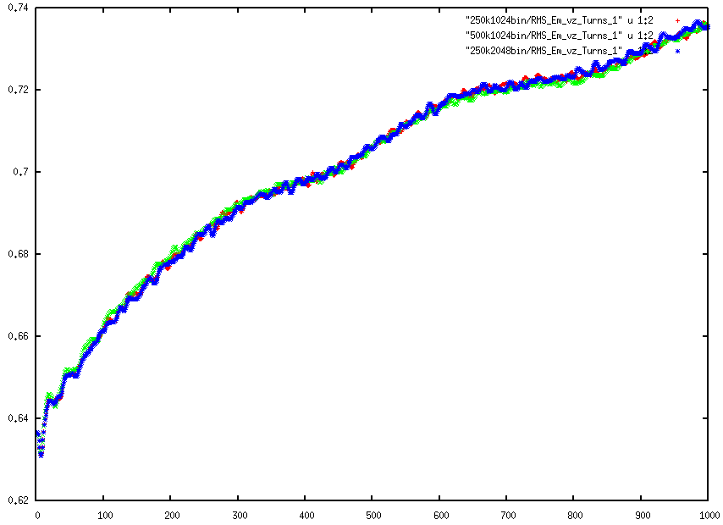
Transverse mesh points
εRMS (π.mm.mrad)
horizontal
50k 1024bin
500k 1024bin
250k 1024bin
250k1024bin 500k1024bin 250k2048bin
turns
For the moment 250k macro-particles seems to be the best. ➔Less particles to be tested (150k & 100k)

Slide 9
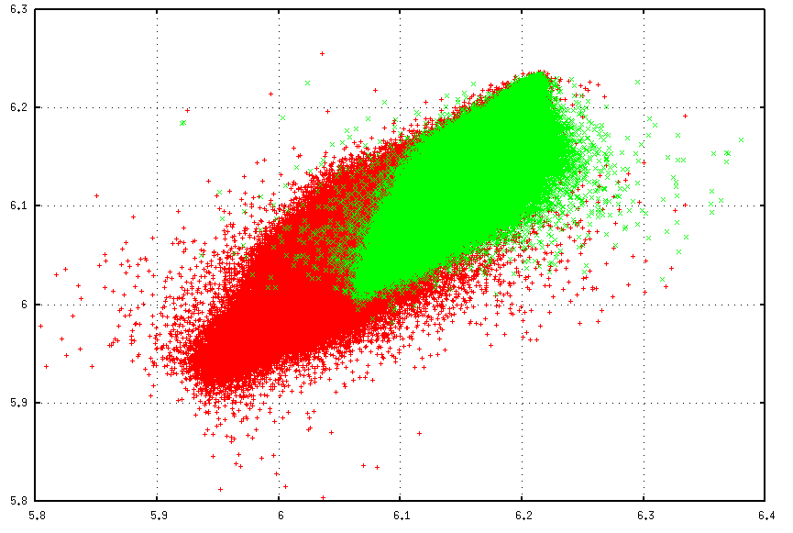
Tune footprint
Working Point: Qx=6.21 Qy=6.23
Qy
Lb~180ns
Lb~180ns
∆Q~0.23
∆Q~0.17
Qx

Slide 10
Tune footprint
Qy
Integer Resonance!!!
Qx
➔ Which could explain the emittance growth

Slide 11
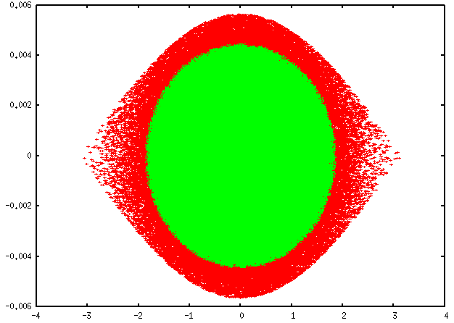
Parabolic Beam
∆E (Gev)
Φ (rad)
Both beams have a Length ~ 180ns

Slide 12
TO DO
Check 150k1024bin and the longitudinal parameters
Change working point to see the influence of the integer resonance and compare to measurements
Introduce Aperture and Injection bump
Make a tune scan

Slide 13
Thank you for your attention!

