Slide 1
Impact of short dipoles on PSB performance (status)
E. Benedetto
LIS meeting, 07/5/12
Acknowledgements: C. Carli, V. Forte, A. Molodozhentsev, LIU-PSB team, …

Slide 2
Outline
Motivation: Shorter main dipoles in injection region (BHZ11 and BHZ162) to accommodate the H- injection hardware

Slide 3
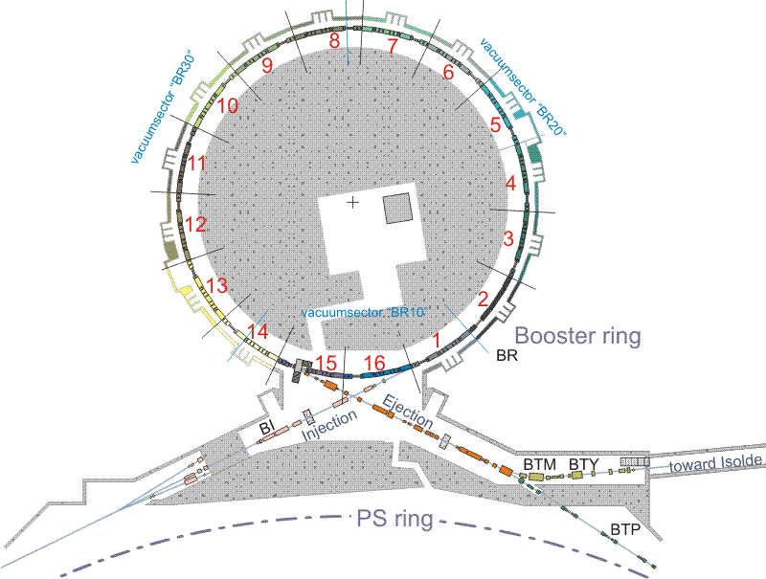
http://psb-machine.web.cern.ch/psb-machine/layout.htm

Slide 4
B.Goddard

Slide 5
B.Goddard

Slide 6
H- injection baseline
Injected beam
Injected beam
W. Weterings

Slide 7
Outline
Motivation: Shorter main dipoles in injection region (BHZ11 and BHZ162) to accommodate the H- injection hardware
Single particle dynamics:
Vertical β−beating (w.r.t. existing perturbations)
3 options studied
Changes in geometry
Multi-particle (space-charge):
To do
Just started (Thanks Vincenzo for precious help in PTC-Orbit run set-up!)

Slide 8
Vertical β−beating if Shorter Dipoles
Qv close to half-integer:
any quadrupolar perturbation in the vertical…
Different edge focusing:
kl = tan(ψ/2)/ρ vertical focusing @ BHZ edges
ρ = (L-ΔL) /ψ bending radius
ψ = 2π /32 bending angle
Displacement of the edges
focusing occurs at a different phase
may be cancellation effects

Slide 9
New layouts considered
Injection hardware
Old BHZ162
(1.677m)
Old BHZ11
(1.677m)
50 cm
50 cm
Case 0
Short BHZ162
Short BHZ11
25 cm
25 cm
25 cm
25 cm
Case 1
Short BHZ162
Short BHZ11
25 cm
25 cm
Case 2
Short BHZ162
Short BHZ11

Slide 10
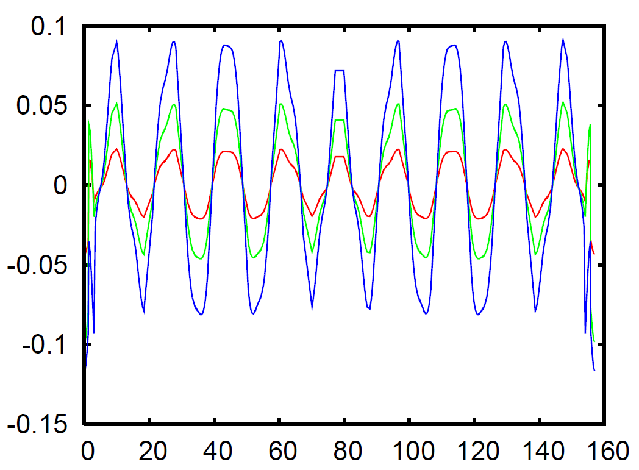
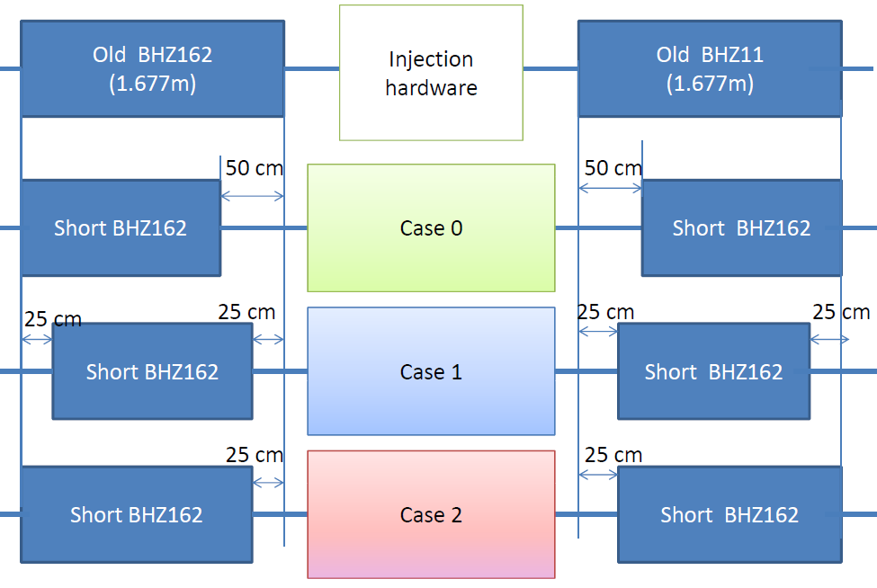
BetaBeating for the different options
Δβ/β
The best is
case 2:
ΔL=0.25m
center is displaced
s (m)

Slide 11
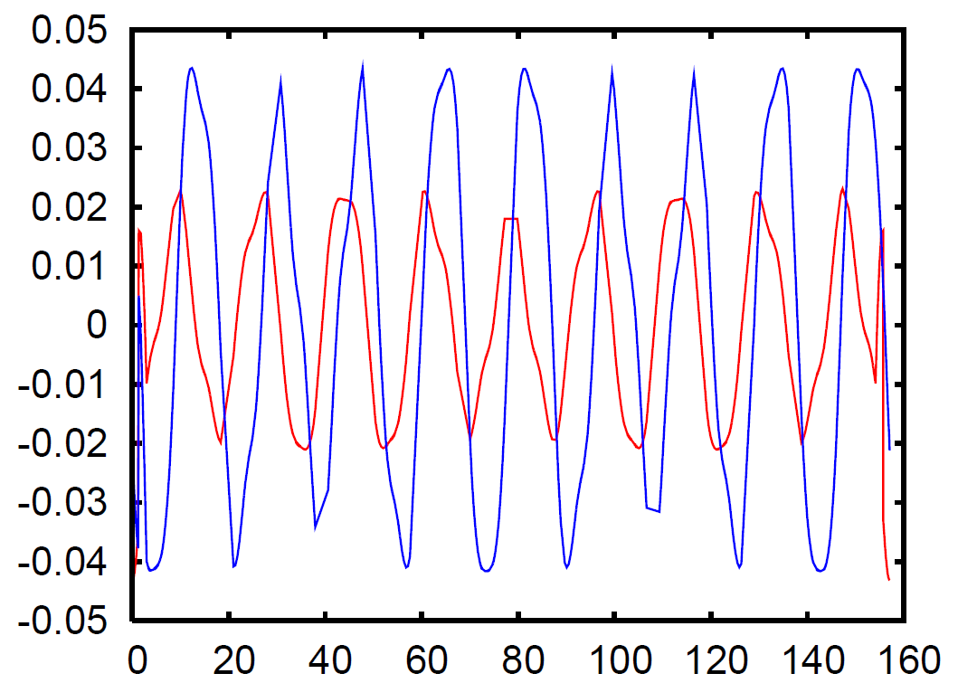
What if only BHZ11 is shorter?
BHZ11+BHZ16
only BHZ11
Δβ/β
if both:
partial cancellation
case 2:
ΔL=0.25m
center is displaced
s (m)

Slide 12
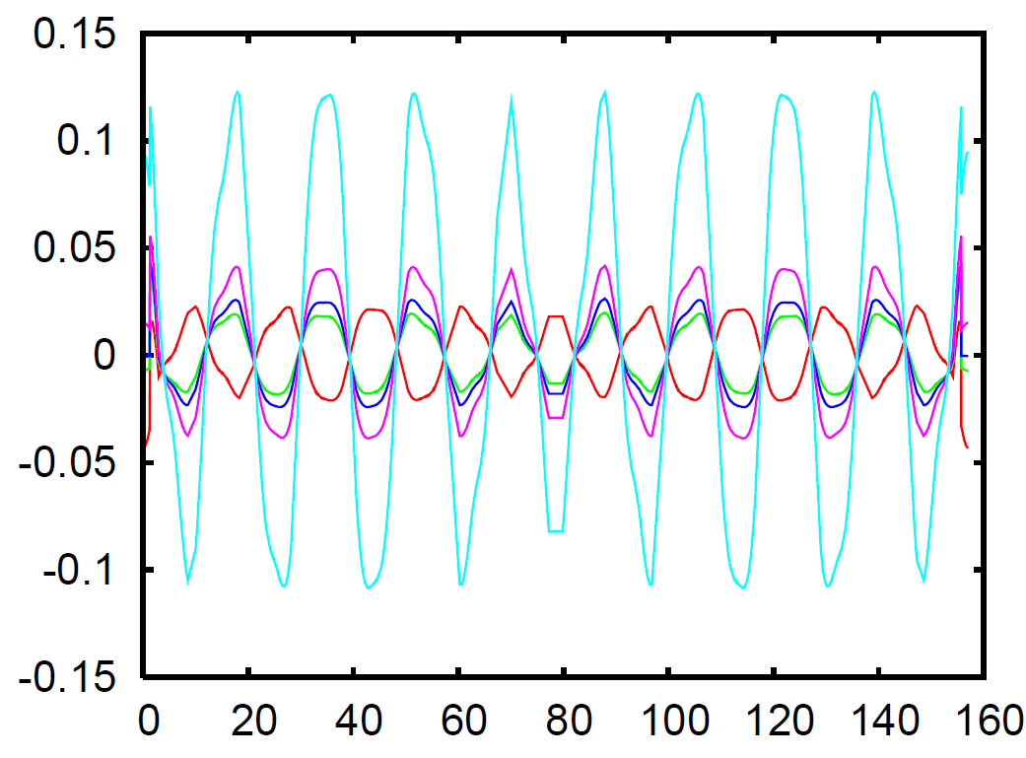
Change of Qv
Qv=4.55
Qv=4.43
Qv=4.55
Qv=4.47
Qv=4.49
Δβ/β
s (m)

Slide 13
Compare with chicane perturbation
Tried to compensate 2Qv=9 excitation w. QDE3 & QDE14
Used same MADX matching script as Christian’s for the chicane
SHORTER DIPOLES:
kf = 0.7566 ;
kd = -0.7732 ;
dkd3 = -0.0006;
CHICANE:
kf = 0.7563 ;
kd = -0.7718 ;
dkd3 = -0.00691 ;
Vs.
Conclusion: Factor 10 lower than chicane perturbation

Slide 14
Compare with existing errors
Compare beta-beating with what we have now in the machine
i.e. that we correct with QNO correctors
I QNO412L3 = -0.94 A;
I QNO816L3 = -1.77 A;
(klqno412L3 = 1.0/Brho(@50MeV)*0.05/85.0*Iqno412L3)
klqno412l3 = -0.00029 = klqno4= -klqn12
klqno816l3 = -0.00055 = klqno8= -klqn16
Conclusions: same ~order of existing errors in the machine (see next slide)

Slide 15
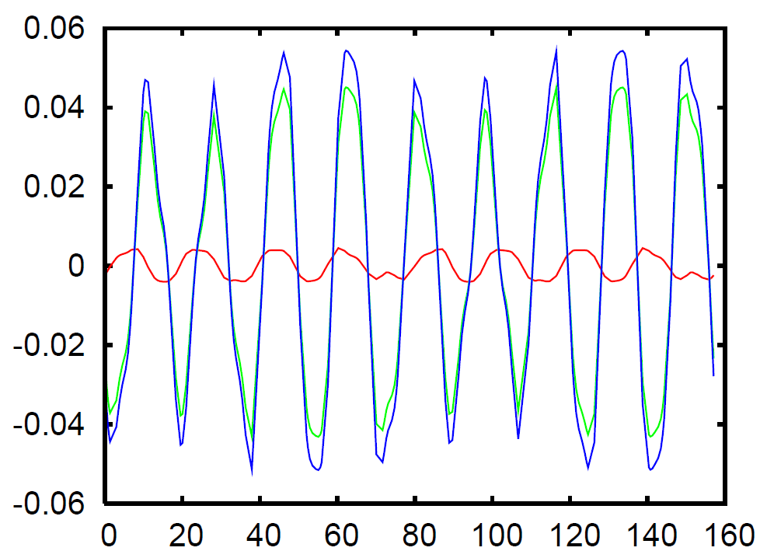
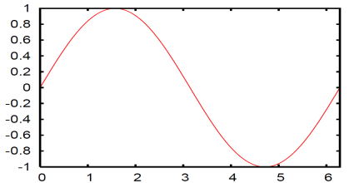
Existing errors: cured w. QNOs
Same polarity (wrong)
Opposite polarity, ok
1.2 times the currents
The 2 pairs are orthogonal, so they add-up
The different polarity assure that the correction is not canceled-out, as phase advance between the two is almost 2.25 pi

Slide 16
Change in geometry
ΔL
δ
Δx= ΔL sin(δ) = 24.5mm
ρ₁
Trajectory @ exit of short BHZ16 will be Δx= -24.5mm offset
Add Δx= -10mm offset w.r.t. Linac2
Δx_{tot} = -34.5mm
ρ₀
δ=ψ/2
ψ
OTHERS:
Change of Twiss param & Disp. in inj. region:
- should be taken into account
Change in circumference length:
to be estimated for completeness
should be ~negligible w.r.t. extraction bump

Slide 17
Summary & Outlook
(presented @LIU-PSB meeting 29/3/2012)
Shorter dipoles option looks feasible for single particle dynamics:
Perturbation (vert. βbeating) ~same order as existing errors
(partial cancellation of additional focusing)
Preferred option:
ΔL=25 cm shorter + displaced (case 2), both BHZ11 & BHZ162
Change in geometry:
Δx=~25 (+10) mm offset inward w.r.t. Linac2 injection
Geometry of injection line & region to be revised
Space charge & break of 16-fold periodicity:
All resonances become systematic
May reduce space-charge limit (but perturbation is “small”…)
Thorough simulations not feasible on short time scale

Slide 18
Space-Charge simulation plan
(as discussed w. AM, CC, VF, NM, GA)
Break of 16-fold periodicity:
All resonances become systematic
May reduce space-charge limit (but perturbation is “small”…)
Plan:
0. Have simulations running DONE, thanks VF for help!
Without Space-Charge
“best case from Vincenzo’s studies
Same parameters as his, to compare optics (Qx=4.27, Qy=4.41)
Nb= 2.475e12, no acceleration, Ex=4.9e-6, Ey=3.30e-6 (geometric)
Emittance growth / Losses w. shorter dipoles STARTED
Preliminary: very small increase of vertical emittance (Ey=3.315e-6 after 365 turns)
Emittance growth / Losses w. correction implemented TODO
Increase complexity simulations (for both config!) TODO
Acceleration
Working point above half integer
Errors , …
Another issue: influence of chicane magnet on main dipoles!

Slide 19
Back-up slides

Slide 20
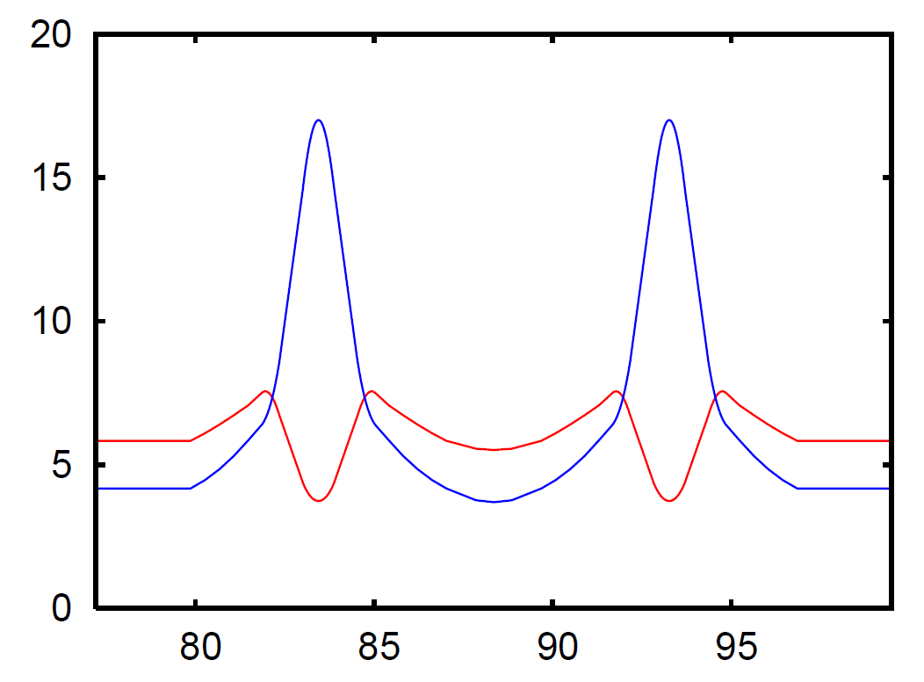
Betx
Bety

