Slide 1
PSB H- chicane magnets: Inconel vacuum chamber option & consequences on beam dynamics - Status-
E. Benedetto,
V. Forte, M. Martini, B. Bahlan
Thanks: C. Carli, R. De Maria, L. Deniau, A. Molodozhentsev, D. Schoerling…

Slide 2
Outline
Extraction of multipolar components
Comparison with dipole edge effects
Compensation of
Vertical beta-beating: (ok)
Horiz detuning, bump closure (could be done but…)
Implementation in MADX-PTC / PTC-Orbit
Preliminary results
Excitation 3rd order resonance

Slide 3
Introduction
ϕ
ϕ
BSW1
-ϕ
-ϕ
BSW2
BSW3
BSW4
Chicane magnets for H- injection
46mm (ϕ=66mrad), falls linearly to 0mm in 5ms
Proposed corrugated Inconel vacuum chamber new baseline
Influence on beam dynamics of induced Eddy currents:
Delay of ~50us (compensated by power supplies)
Higher order field components (sextupolar) varying w. time
Quadrupolar feed-down
Excitation 3rd order resonance

Slide 4
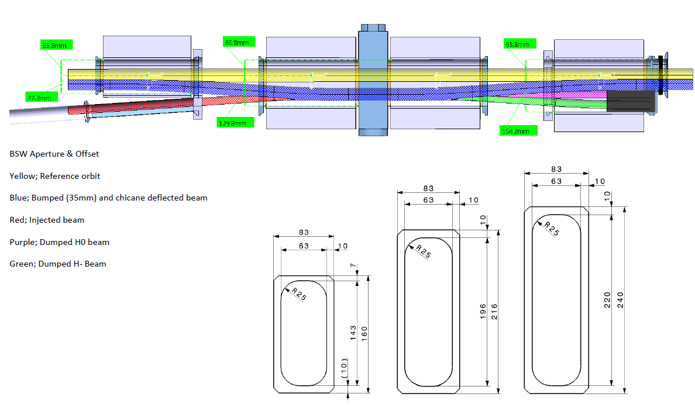
Drawings from W.Weterings, 09/01/’13

Slide 5
Drawings from W.Weterings, 09/01/’13
5.5 mm
32 mm
44 mm
66 mm
Bump height = 46 mm MAX

Slide 6
Order of magnitude perturbation
Edge effect (rectangular magnet):
k1L~ ϕ²/2L~6e-3
Feed-down from sextupole:
Int(Bdl)~c0+c1 x+c2 x² +…
x0=-50mm
→ k1L~3.4e-3

Slide 7
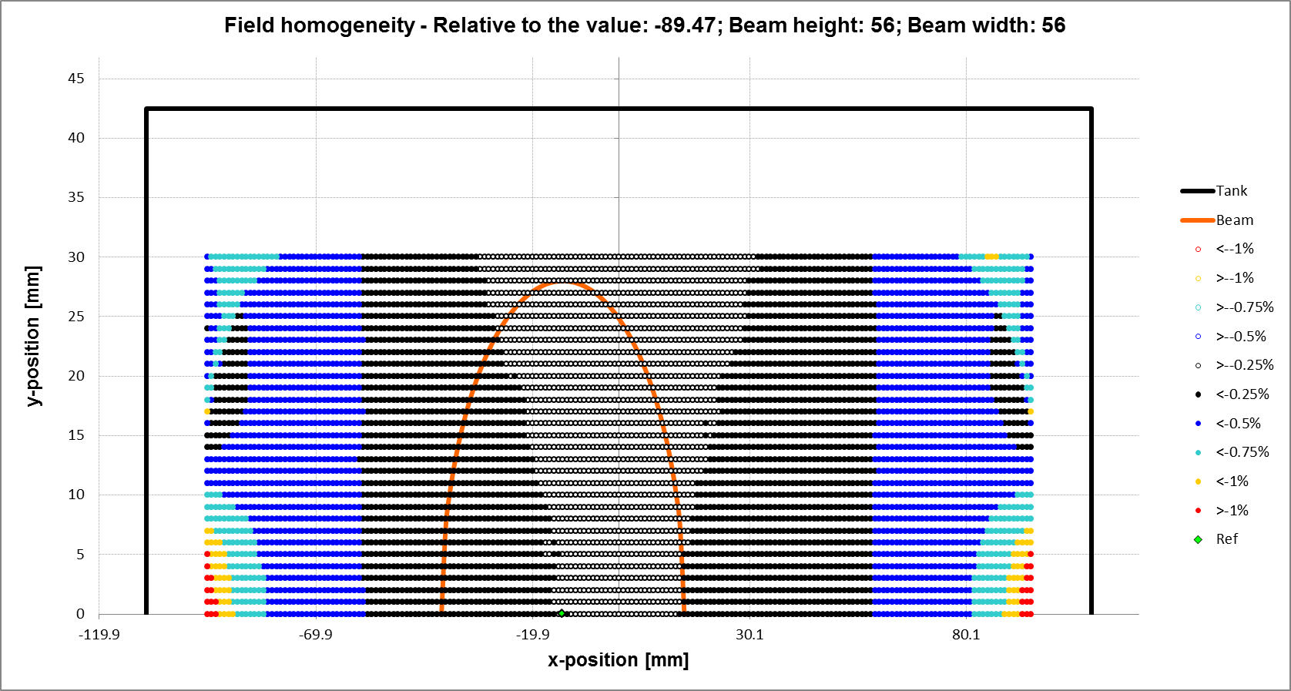
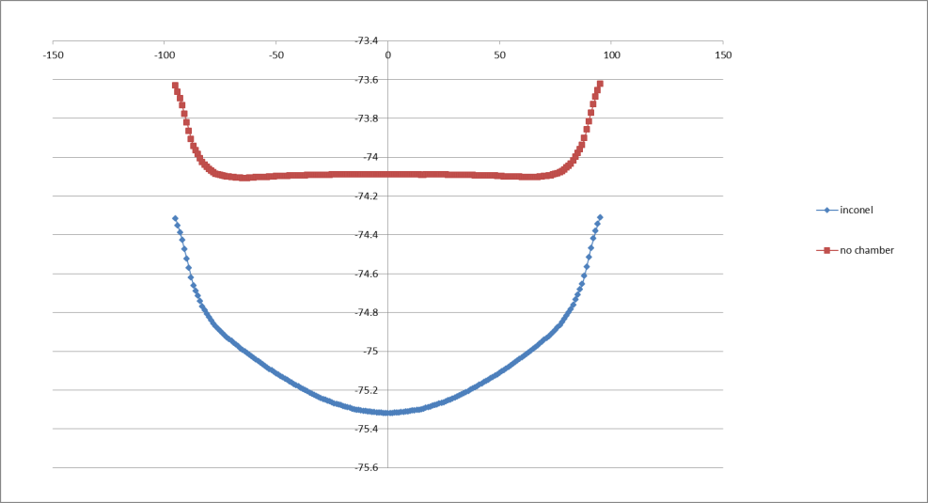
Extraction BSW varying multipoles
BSW2-3 @ 2.5ms

Slide 8
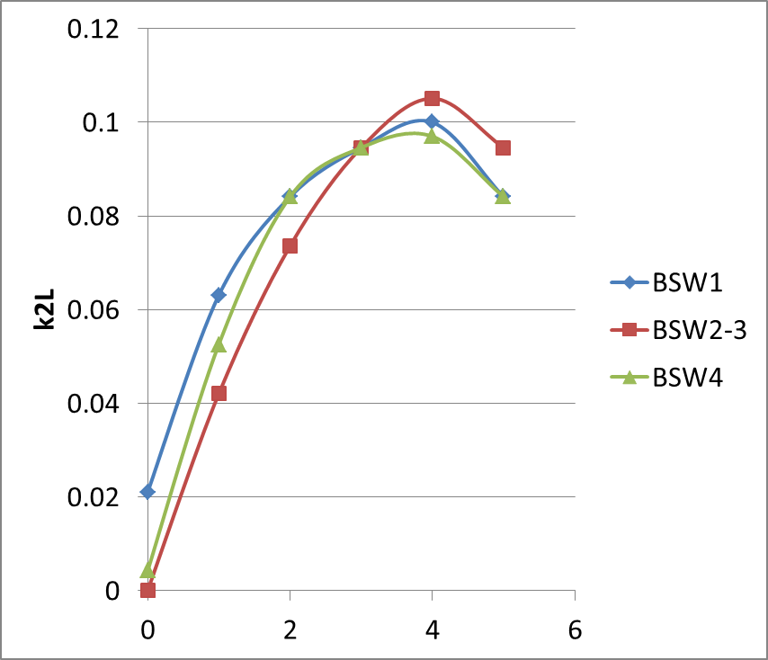
Extraction BSW varying multipoles

Slide 9
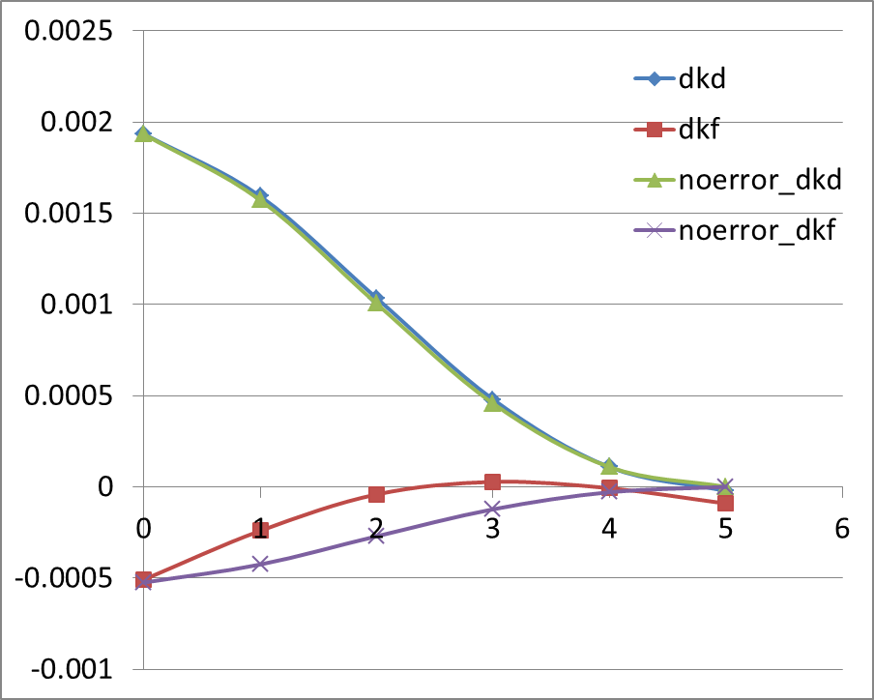
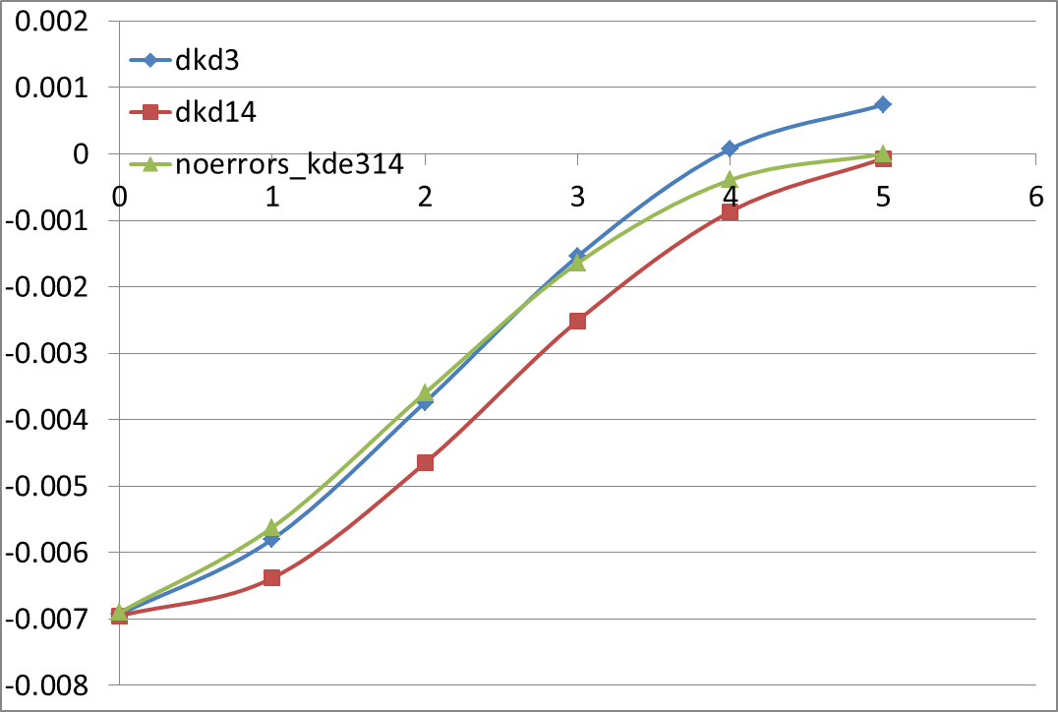
Extraction BSW varying multipoles

Slide 10
Implementation MADX-PTC/PTC-Orbit:
Misalignments
Time-varying errors
Shifted apertures

Slide 11
“Static” simulations
Ramp @ 2ms (out of 5ms)
Assumed:
trajectory bump
edge effects
multipoles
Correction for the vertical BetaBeating with QDE3, QDE14

Slide 12
Horiz emittance vs. time

Slide 13
Vertical emittance vs time

Slide 14
To do
Time varying fields (5ms):
With compensation vertical b-beating
Find compensation horizontal (needed?)

Slide 15
Back-up slides

Slide 16
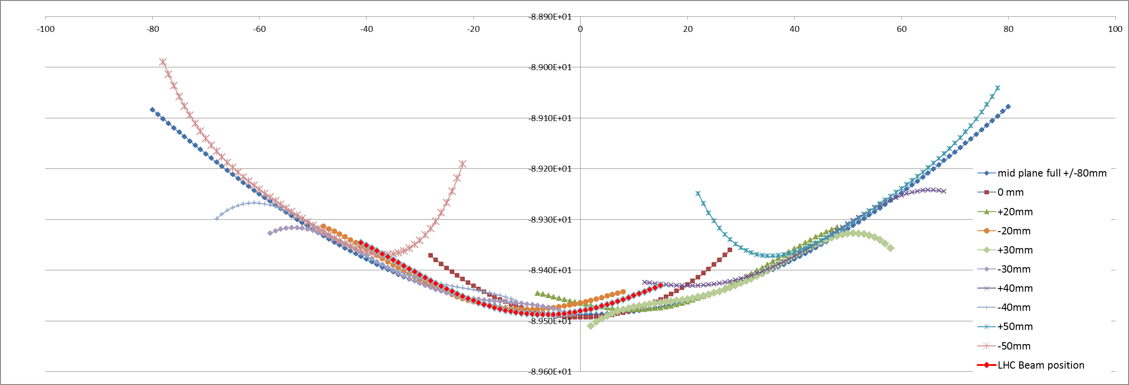

Slide 17
