Slide 1
LEIR Tune measurement
Michael Bodendorfer
March 25th, 2013
Thanks to:
D. Manglunki, C. Carli, M.E. Angoletta, S. Pasinelli, J. Findlay, S. Hancock, S. Jackson, SPS operators

Slide 2
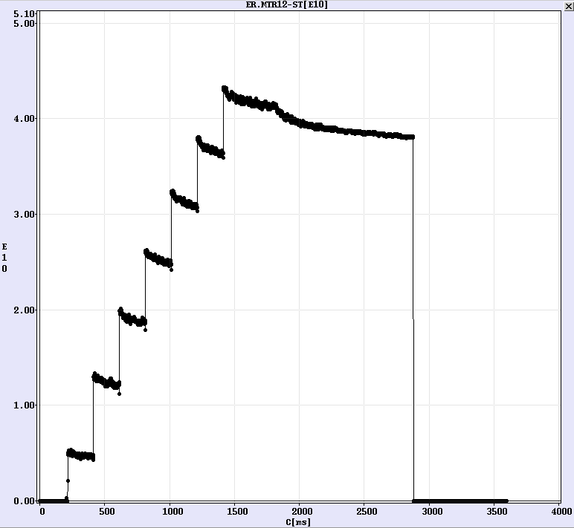
A LEIR NOMINAL cycle (Q_{h}=1.82; Q_{v}=2.72)
Continuous Electron cooling
RF capture @ 1780ms
Extraction
@ 2880ms
Master timer
Magnetic Ramp @ 1823ms
7 injections. First at 215ms, then spaced by 200ms. Each 200μs long.

Slide 3
Measurement of
We are looking for:
From YASP, beam position monitors
From BBQ tune measurement
How it is done:
Find ridge of peaks in FFT from BBQ (as a function of cycle time)
Program radial beam offset into RF radial loop
➔ RF system increases/decreases momentum to meet demanded radial offset
➔ Measure rad. offset and find Δp/p
Compute

Slide 4
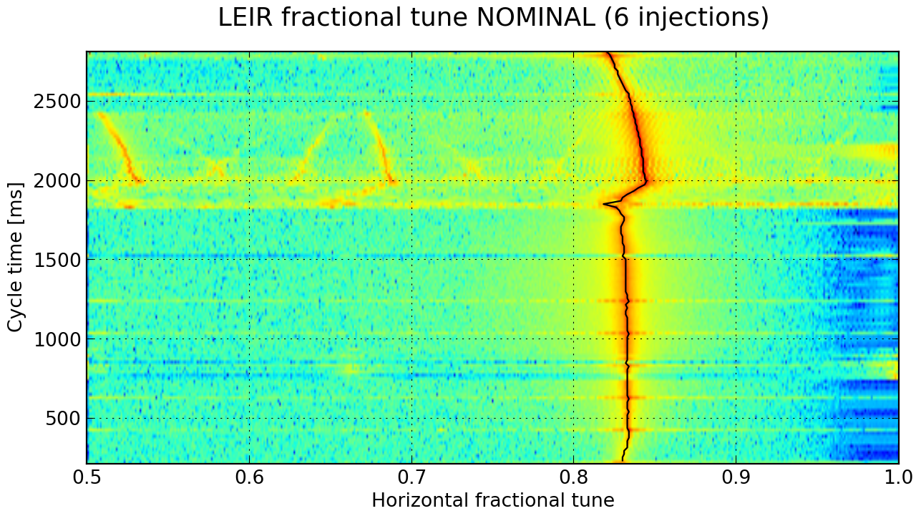
Horizontal tune behavior (Shown from first injection @215ms to extraction @2880ms)
RF capture
(1780ms)
6 Injections

Slide 5
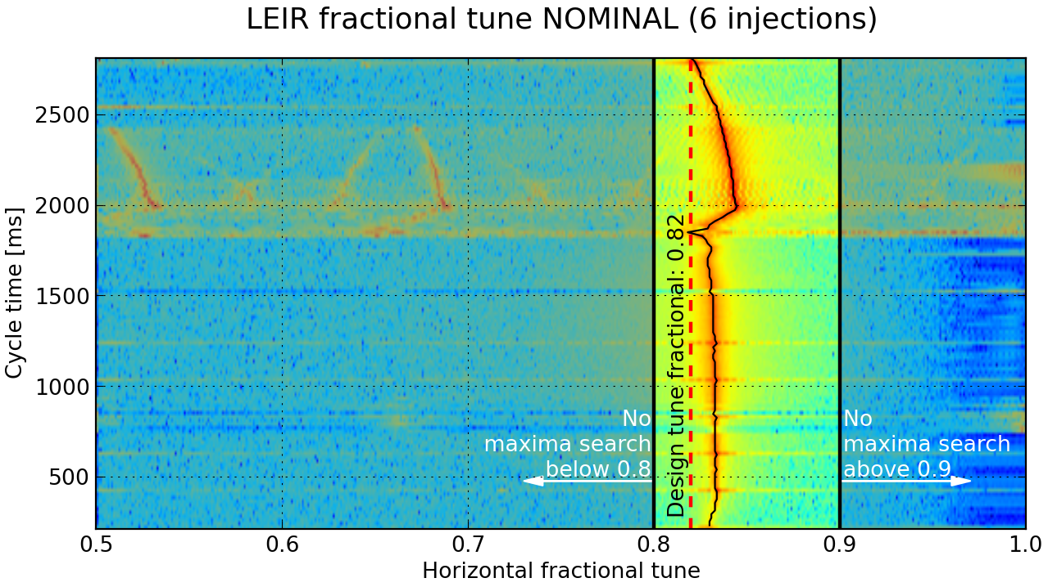
Restricted maxima search

Slide 6
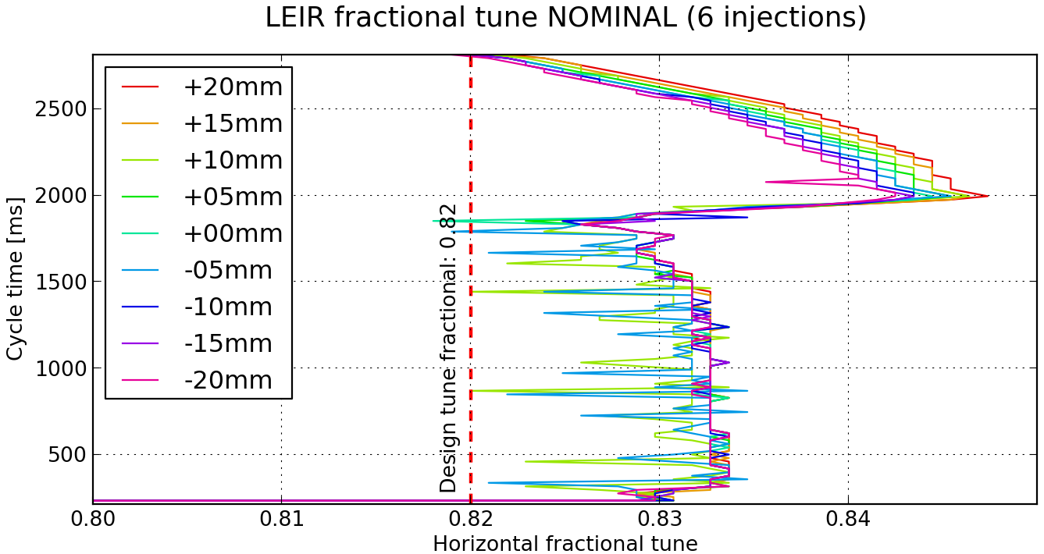
Q for different radial offsets and, hence, momenta

Slide 7
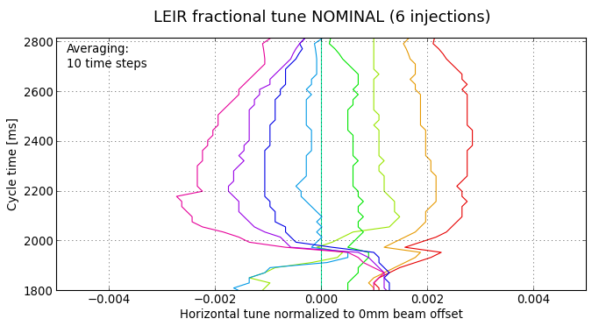
ΔQ for programmed radial offset from -20mm to +20mm
1 time step: 20ms
-15mm
-5mm
10mm
20mm
-20mm
-10mm
5mm
15mm

Slide 8
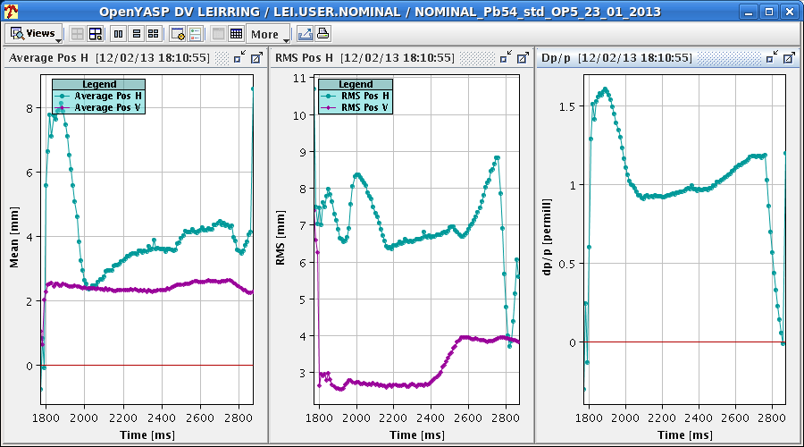
YASP output

Slide 9
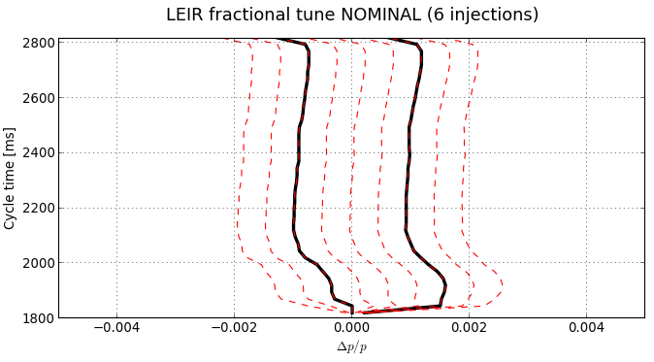
Linear extrapolation of Δp/p
Measurement from +10mm programmed radial offset
Linear extrapolation from:
-20mm to +20mm
radial offset
Measurement from -10mm programmed radial offset

Slide 10
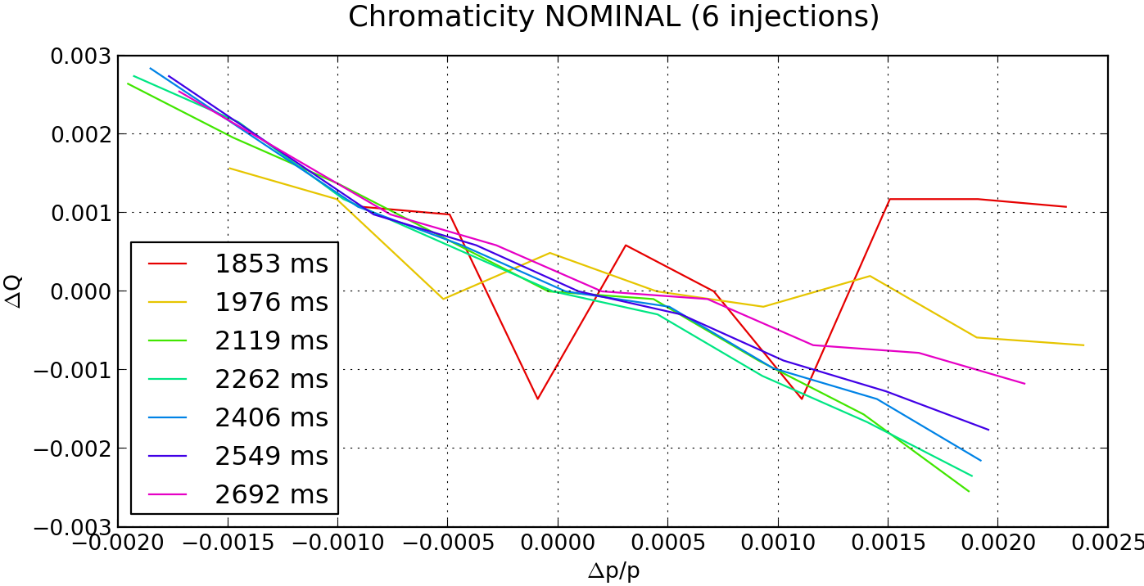
Producing:

Slide 11
changes during the cycle

Slide 12
changes during the cycle

Slide 13
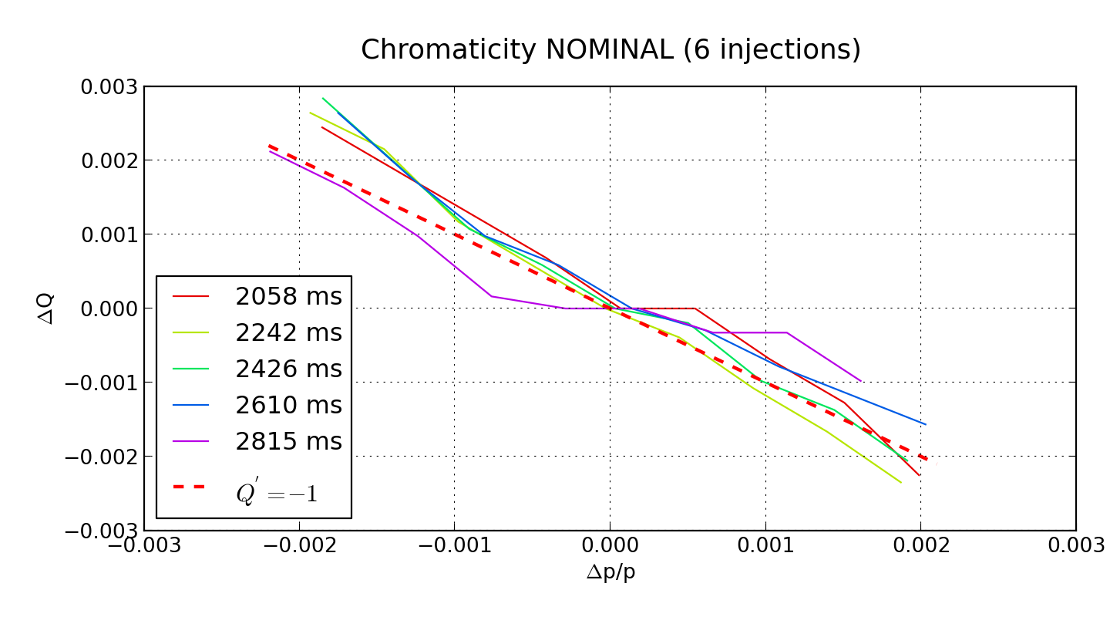
when is stable

