Slide 1
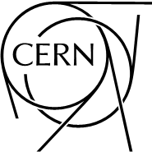
Optics Measurements in the PSB
Meghan McAteer
1 July 2013

Slide 2
Contents
Part I: Linear optics from orbit response
Measurement method
Fit results with no constraints on parameters
Fit results with constraints
Part II: Nonlinear optics from turn-by-turn trajectories
Results of initial measurements
Preparation for measurement campaign after LS1

Slide 3
Part I:
Linear optics from orbit response

Slide 4
Linear Optics from Closed Orbits (LOCO)
Orbit response to dipole perturbations:
LOCO method of lattice calibration
Measure orbit response to each of j corrector dipoles at each of i BPMs
Define variable model parameters (quad tilts and strengths, BPM and dipole tilts and gains)
Fit for values of parameters that minimize difference between model and measured response

Slide 5
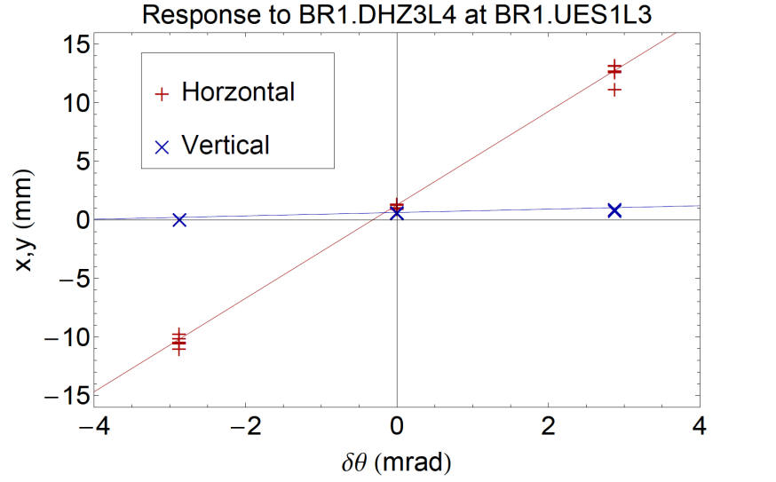
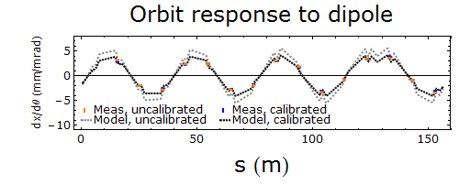
Application of LOCO in the PSB
Each ring has 13 corrector dipoles in each plane, 16 BPMs in each plane
Orbit response to all dipoles and dispersion were measured in all rings
Measurements were made from ~160 MeV to 1.4 GeV; analysis done only at 160 MeV so far
Example of measured orbit response at one BPM
Example of measured and model orbit response to one dipole

Slide 6
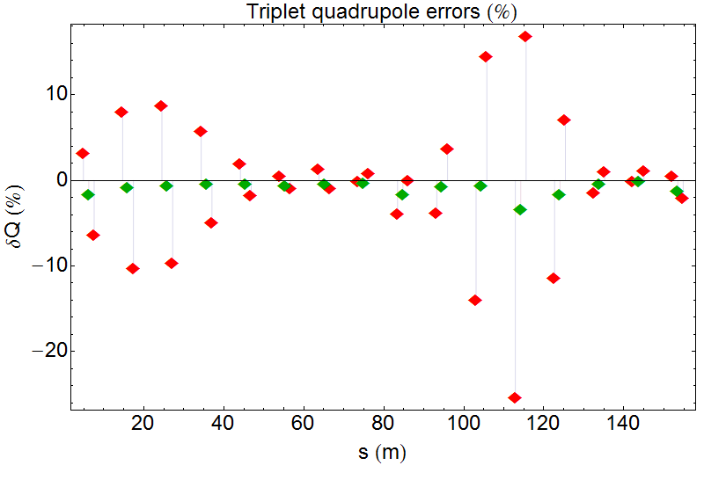
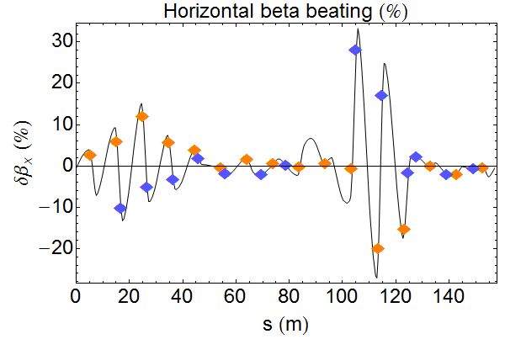
Fit #1:
LOCO results without parameter constraints
Simple least-squares fit finds solution with unreasonably large parameter deviations
Fit must be constrained in order to get realistic solution
Quadrupole errors from unconstrained fit;
errors are much too large to be realistic
Model beta beating with large quadrupole errors from unconstrained fit

Slide 7
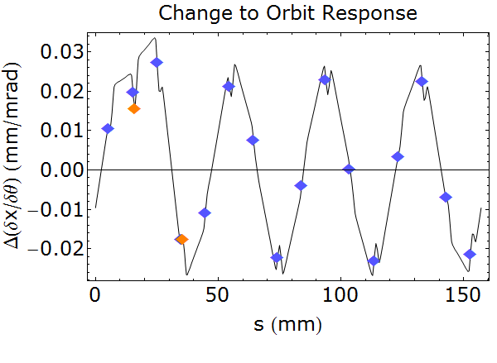
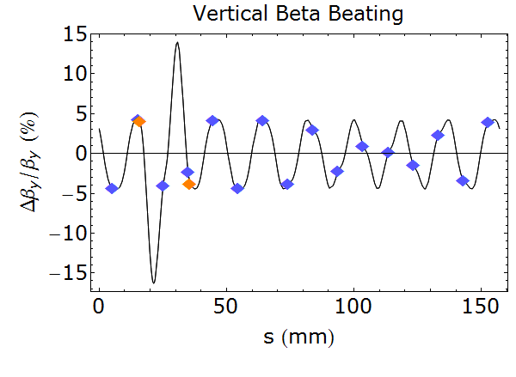
Why does LOCO fitting in the PSB require constraints on parameters?
Phase advance between periods is ≈ 90⁰ in both planes
Orbit response propagates at betatron frequency, beta beating at two times betatron frequency
MADX simulation shows how changing two quadrupole magnets can leave orbit response virtually unchanged (measurement resolution is ~0.02 mm/mrad) while causing large beta distortion
ΔK1L(QDE2)≈ +13%
ΔK1L(QDE2)≈ +13%
ΔK1L(QDE4)≈ -11%
ΔK1L(QDE4)≈ -11%

Slide 8
Constraints on least squares fit
An extra term in the penalty function limits excursion of parameters on each iteration
Combined effects of highly correlated parameters such as adjacent quadrupoles can also be constrained in this way
Change to q^{th} fit parameter
Penalty for q^{th} fit parameter

Slide 9
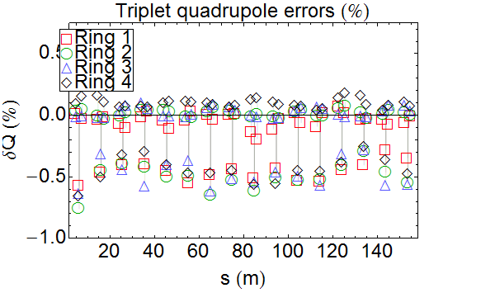
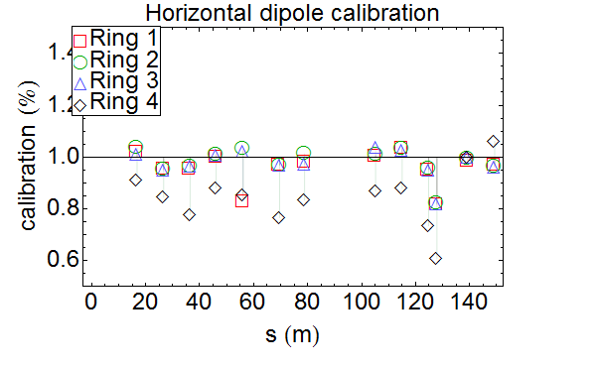
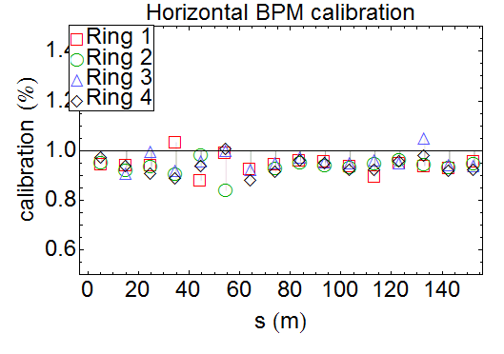
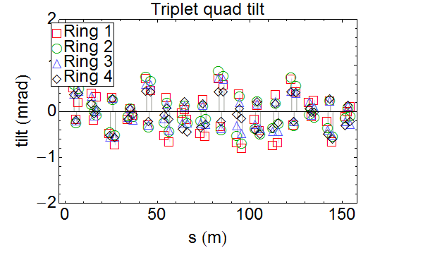
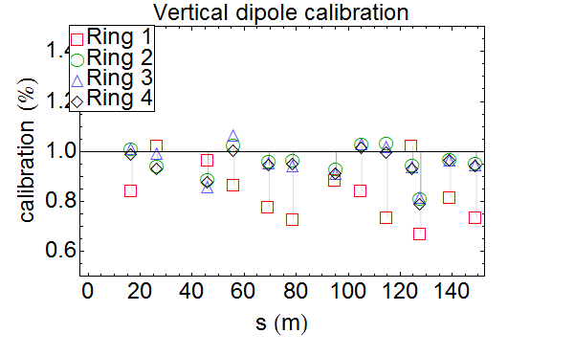
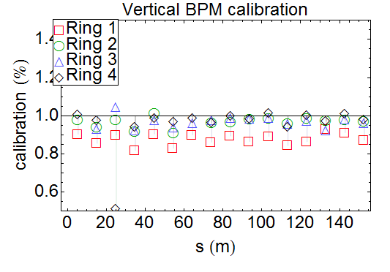
Fit #2:
LOCO results with constraints on individual parameters
Quad strength and tilt, and dipole and BPM calibration, for all four rings

Slide 10
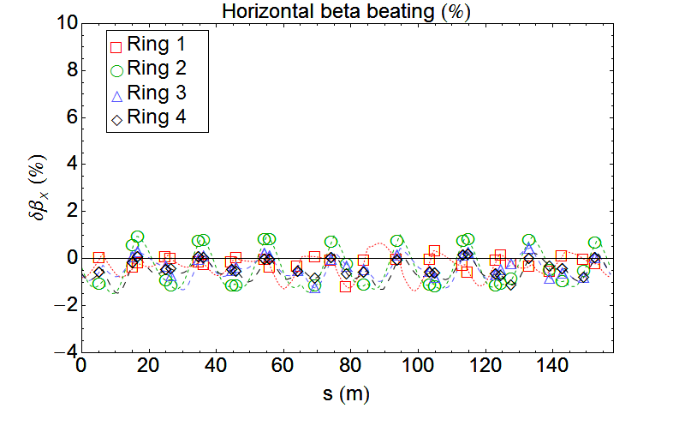
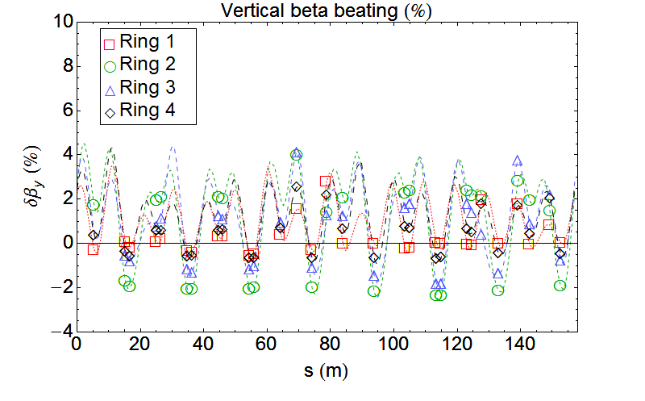
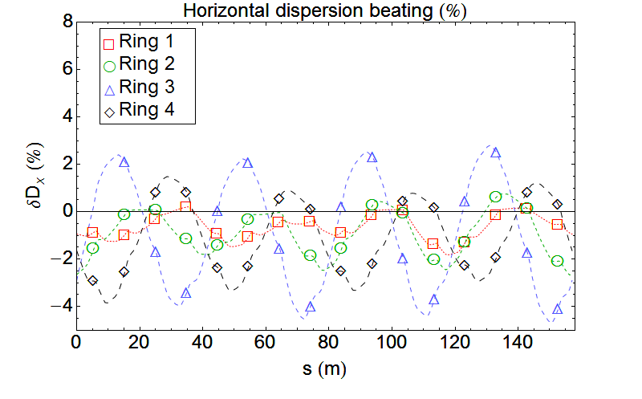
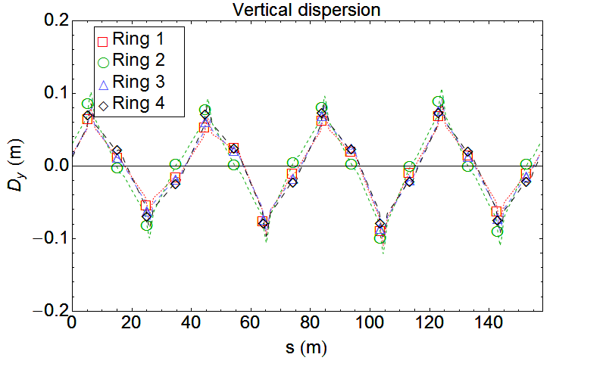
Fit #2:
LOCO results with constraints on individual parameters
Optics from calibrated MADX model for all four rings

Slide 11
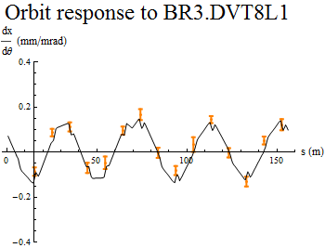
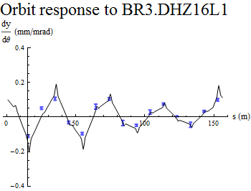
Fit #3:
Constrained fit with survey alignment
New survey results for quads, bends, BPMs recently became available
MADX model with alignment errors reproduces off-diagonal measurements quite well
Signs of alignment offsets and tilt, lattice skew elements used in this model still need to be verified
Variable parameters for new LOCO fit:
Quad K1 error
Bending magnet K1 component
Dipole corrector gain and tilt (no dipole tilt survey data available)
BPM gain
New fit includes constraints to limit the difference between adjacent parameter changes
Measured and calibrated model
x response to vertical dipole
Measured and calibrated model
y response to horizontal dipole

Slide 12
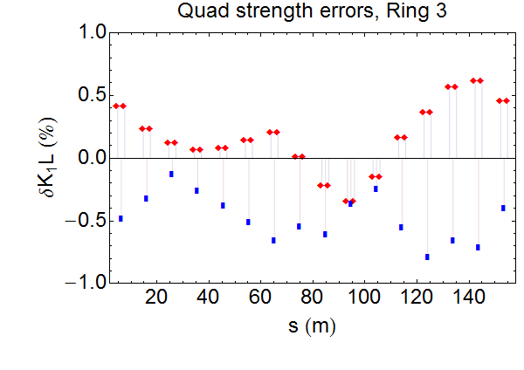
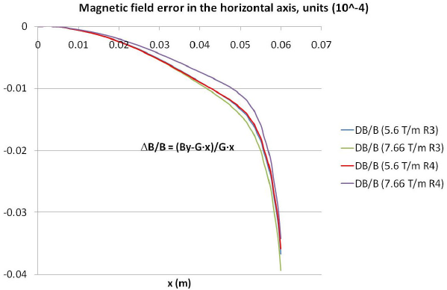
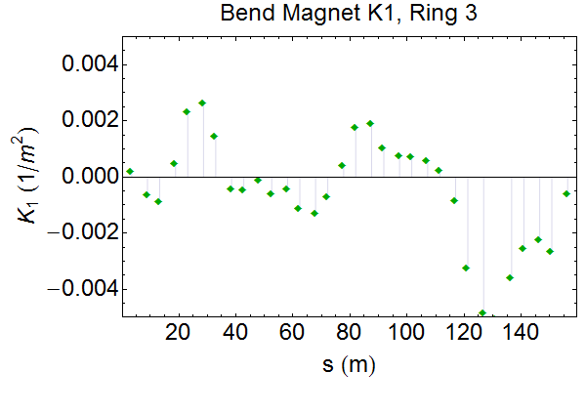
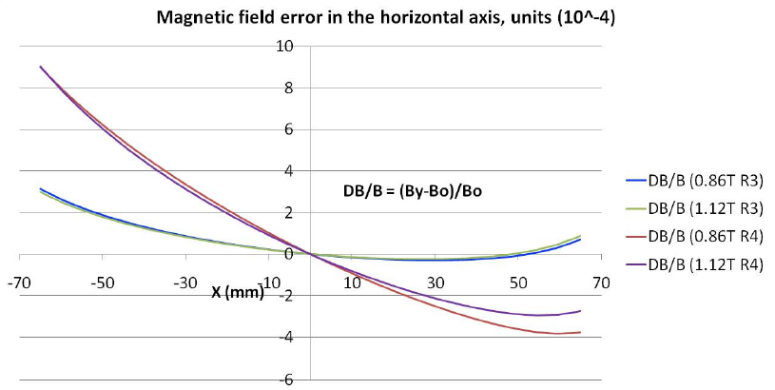
Fit #3:
Focusing errors from constrained fit with survey alignment
Bend K1 component is close to the range expected from orbit deviation through magnets
Quad K1 errors are larger than expected to be caused by orbit deviation
Quadrupole magnet field
(images from M. Giovannozzi, 2010 Chamonix workshop)
Bend magnet field

Slide 13
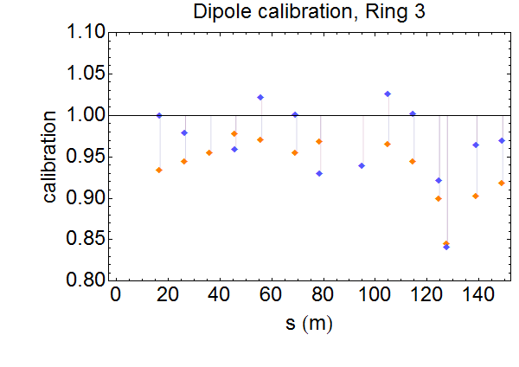
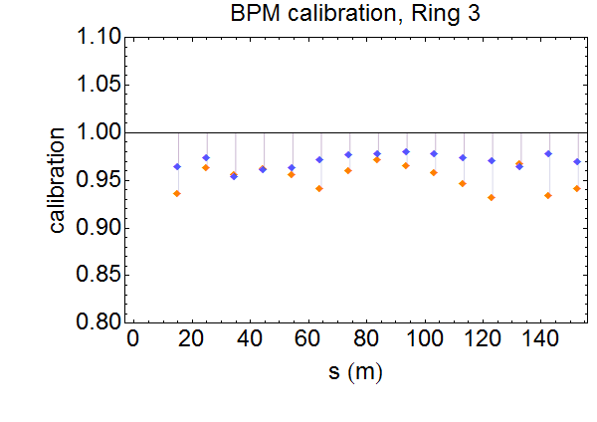
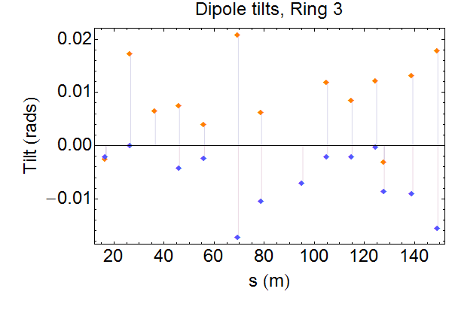
Fit #3:
Dipole and BPM errors from constrained fit with survey alignment
BPM calibrations are ~93% to 98%
Corrector dipole calibrations are ~90% to 103%
Corrector dipole tilts are ~ -20 to +20 mrads

Slide 14
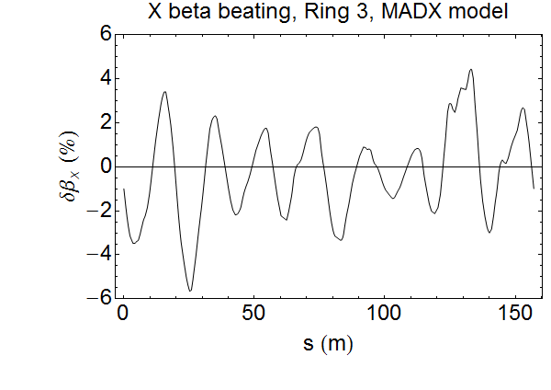
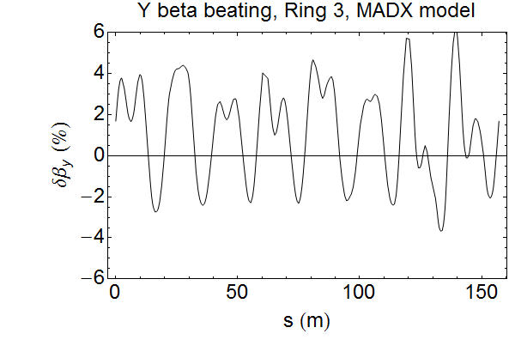
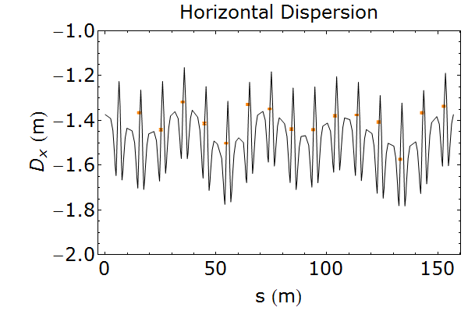
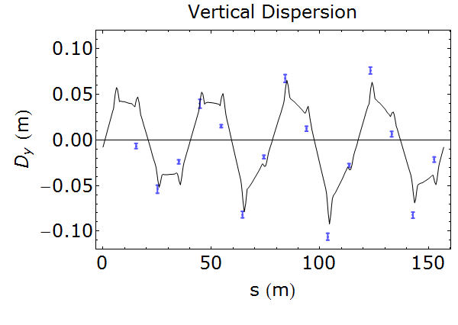
Fit #3:
Calibrated model optics from fit with survey alignment
Beta beating ~10% peak-to-peak in both planes
Good agreement between measured and model dispersion despite no coupling parameters in fit

Slide 15
Part II:
Nonlinear optics from turn-by-turn trajectories

Slide 16
Nonlinear optics from turn-by-turn measurements
Beam trajectory measurements will be used to determine higher-order resonance driving terms
Tests were performed before LS1, and full measurement campaign will be carried out after LS1
Trials of turn-by-turn acquisition were done on high-intensity H=1 cycles, using three available BPMs
Tune kicker and AC dipole were investigated for exciting large transverse oscillations

Slide 17
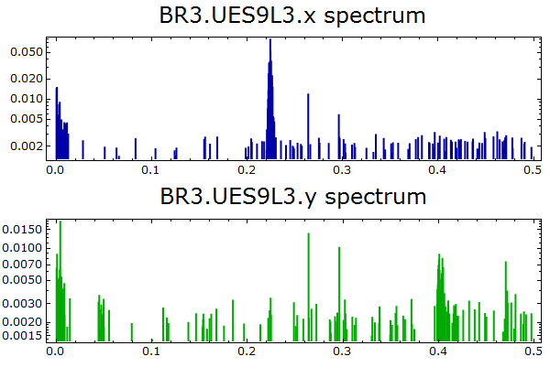
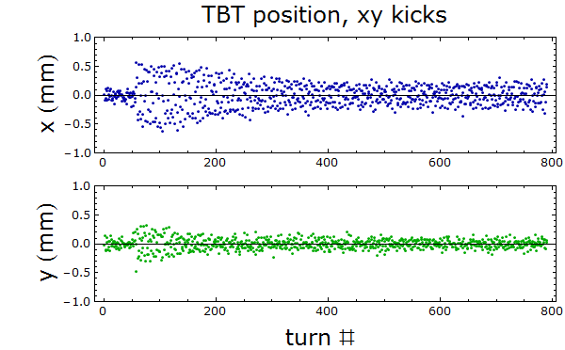
Turn-by-turn measurements:
Free oscillations with tune kicker
Tune kicker set to 2 kV (using max of 5kV risks causing equipment failure)
Chromaticity was corrected in one plane at a time
Position resolution ~0.1 mm
Oscillation amplitude 1 mm peak-to-peak

Slide 18
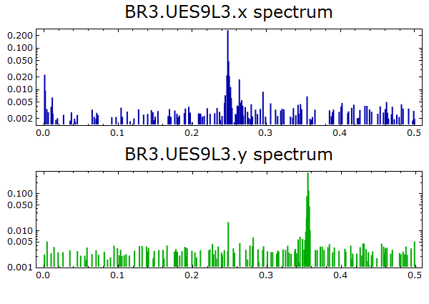
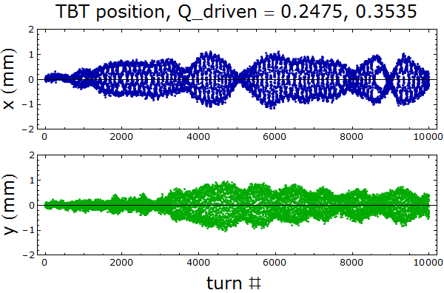
Turn-by-turn measurements:
Driving with AC dipole
Transverse damper configured to drive beam at a fixed frequency
0.6 volts used on plates; signal saturated at higher voltage
Q_{x}=4.2481, Q_{y}=4.3542; driven Q_{x}=.2475, Q_{y}=.3535
Maximum oscillation amplitude ~2mm peak-to-peak

Slide 19
Preparation for turn-by-turn measurement campaign after LS1
Questions to be addressed via simulations:
What size kick is required to see higher-order resonance lines (from both tune kicker and AC dipole)?
What causes irregular envelope shape of driven oscillations? (Kick too small? Tune varying slightly?)
Other questions:
Can we use a different working point (away from 90⁰ phase advance between BPMs) for improved measurement precision?
How can we produce a large enough angular kick from tune kicker and from AC dipole?

Slide 20
Thank you for your attention!
Acknowledgements:
Jeroen Belleman
Christian Carli
Alan Findlay
Bettina Mikulec
Rogelio Tomás
This research project has been supported by a Marie Curie Early Initial Training Network Fellowship of the European Community’s Seventh Framework Programme under contract number (PITN-GA-2011-289485-OPAC).

